Slide 1
Software Design Patterns
by Zachary Handel, Lucas Hasting, and Braden Harris

Slide 2
What is a Software Design Pattern?
We (as programmers) face recurring problems
What happens if we do not know Software Design Patterns?
Example of Organizing Tasks
“Each software design pattern describes a problem which occurs over and over again in our environment, and then describes the core of the solution to that problem, in such a way that you can use this solution a million times over, without doing it the same way twice.”
- Gamma, Helm, Johnson, Vlissides

Slide 3
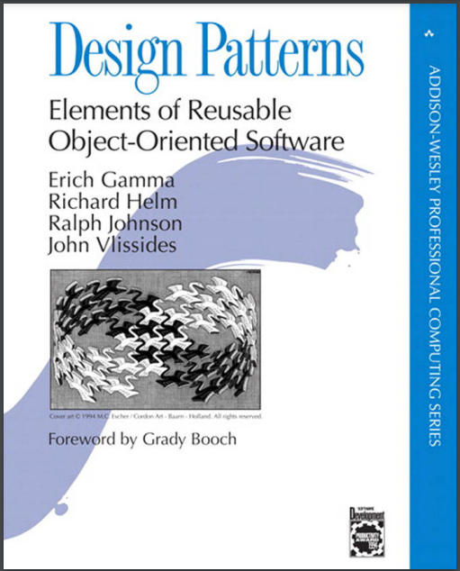

Slide 4
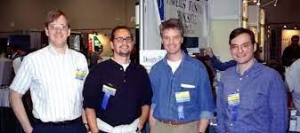
The “Gang of Four”
Erich Gamma, John Vlissides, Ralph Johnson, Richard Helm
Their Inspiration
Wrote Design Patterns: Elements of Reusable Object-Oriented Software

Slide 5
Why Use Design Patterns?
Many go without knowing any (although we passively use them all the time)
They are tools of a toolkit
Strengthens knowledge of object oriented programming
Sets a common language amongst teammates for communication
“Oh, just use X design pattern.”

Slide 6
Types of design patterns
Creational - Design patterns that provide various object creation mechanisms, which increase flexibility and reuse of existing code.
Structural - Design patterns that explain how to assemble objects and classes into larger structures, while keeping these structures flexible and efficient.
Behavioral - Design patterns that are concerned with algorithms and the assignment of responsibilities between objects.

Slide 7
Concept Review - UML Class Diagrams
Terminology
Inheritance - A child class inherits properties from a parent class
Permissions:
+ public
- private
# protected

Slide 8
Concept Review - UML Class Diagrams
Terminology
Dependency - A class depends on another class
Association - Two classes are used by each other
Directed Association - A class is used by another class
Aggregation - A child class is independent of a parent class
Composition - A child class is dependent of a parent class
Abstract Class - Can not be used to make an object, they have abstract methods

Slide 9
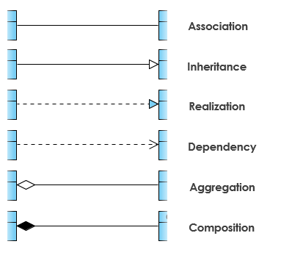
Concept Review - UML Class Diagrams
Terminology
Interface - A blueprint for a class, has abstract methods and variables
Concrete Class - A class that is complete (no abstract anything)
Realization - implements the abstract elements of a class

Slide 10
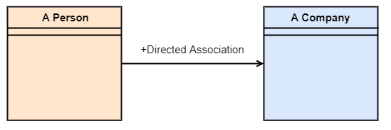
Concept Review - UML Class Diagrams

Slide 11
Creational Pattern - Abstract Factory
Definition - Design pattern that lets you produce families of related objects without specifying their concrete classes.
Declare interfaces for each distinct product of the product family.
Make all variants of products follow those interfaces.
Requires an Abstract Factory Interface - an interface with a list of creation methods for all products that are part of the product family.
A concrete factory implements a “version” of the abstract factory
Why use it - It influences reuse of code when creating multiple objects with similar functions
Real World Example - Creating a GUI (Graphical User Interface) for Windows and MAC

Slide 12
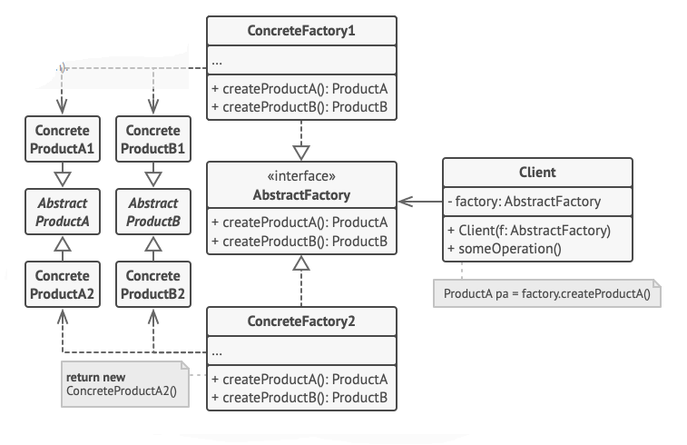
Abstract Factory - Structure

Slide 13
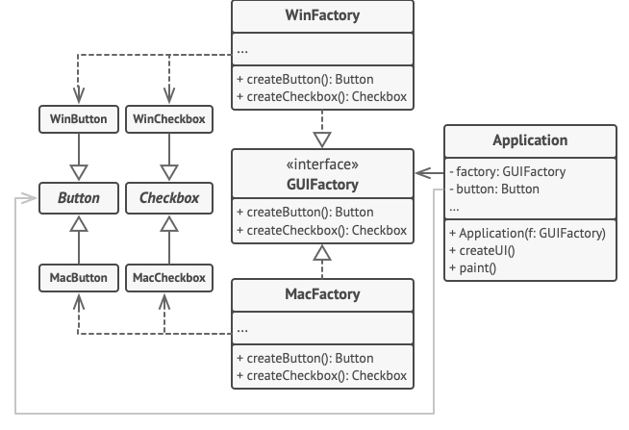
Abstract Factory - Example

Slide 14
Creational Pattern - Builder
Definition - Design pattern that lets you construct complex objects step by step.
The pattern allows you to produce different types and representations of an object using the same construction code.
Extract the object construction code out of its own class and move it to separate objects called builders.
You can extract a series of calls to the builder steps you use to construct a product into a separate class called director.
The director class defines the order in which to execute the building steps, while the builder provides the implementation for those steps.
Why use it - When many objects have similar parts to them.
Real World Example - Online software to build the car of your dreams.

Slide 15
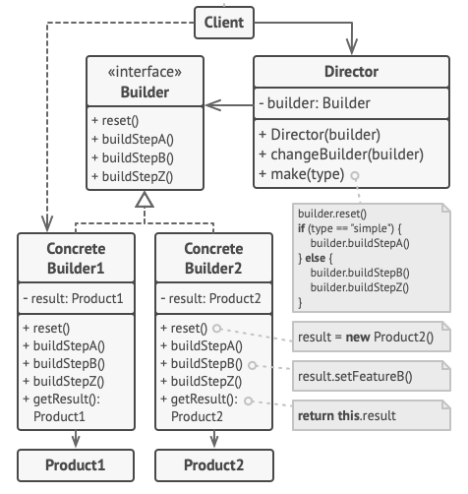
Builder - Structure

Slide 16
Creational Pattern - Factory Method
Definition - Design pattern that provides an interface for creating objects in a superclass.
Allows subclasses to alter the type of objects that will be created.
Subclasses may return different types of products only if these products have a common base class or interface.
A factory method is used to create the object (returns a new object).
Why use it - To add objects to your main code without having to change it to adapt to the new object.
Real World Example - Adding support for boats on an application meant to sell different types of products.

Slide 17
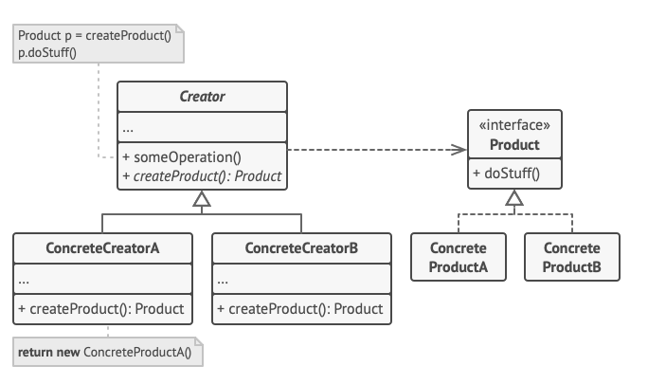
Factory Method - Structure

Slide 18
Creational Pattern - Prototype
Definition - Design pattern that lets you copy existing objects without making your code dependent on their classes.
Delegates the cloning process to the actual objects that are being cloned.
The pattern declares a common interface for all objects that support cloning.
Lets you clone an object without coupling your code to the class of that object.
An interface contains just a single clone method.
The cloning method creates an object of the current class and carries over all of the field values of the old object into the new one.
Why use it - To make copies of a particular object.
Real World Example - Saving an order from a cart on an online application.

Slide 19
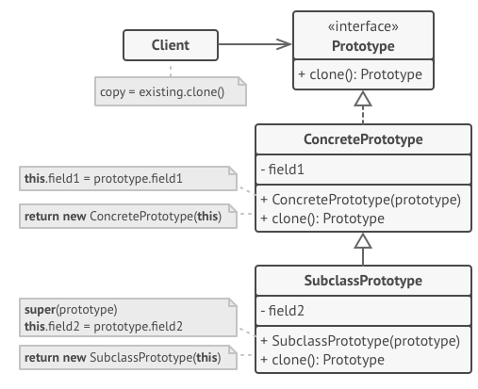
Prototype - Structure

Slide 20
Creational Pattern - Singleton
Definition - Design pattern that ensures that a class has only one instance, while providing a global access point to this instance.
Step 1: Make the default constructor private, to prevent other objects from using the new operator with the Singleton class.
Step 2: Create a static creation method that acts as a constructor. Under the hood, this method calls the private constructor to create an object and saves it in a static field. All following calls to this method return the cached object.
Why is it used - To control access to some shared resource.
Real World Example - An object that connects to a database.

Slide 21
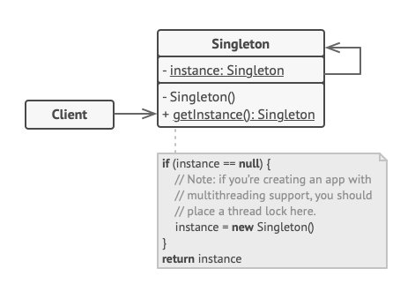
Singleton - Structure

Slide 22
Structural Pattern - Adaptor
Definition - Design pattern that allows objects with incompatible interfaces to collaborate.
An adapter wraps one of the objects to hide the complexity of conversion happening behind the scenes.
The wrapped object isn’t even aware of the adapter.
Process
The adapter gets an interface, compatible with one of the existing objects.
Using this interface, the existing object can safely call the adapter’s methods.
Upon receiving a call, the adapter passes the request to the second object, but in a format and order that the second object expects.
Why is it used - To translate incompatible formats to a compatible format without the need to change the main program
Real World Example - Using JSON formatted data for a product that uses XML formatted data

Slide 23
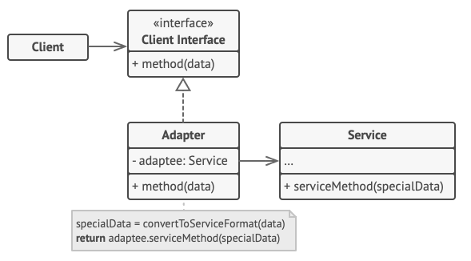
Adaptor - Structure

Slide 24
Structural Pattern - Bridge
Definition - Design pattern that lets you split a large class or a set of closely related classes into two separate hierarchies (abstraction and implementation)
can be developed independently of each other.
Abstraction - A high-level control layer for some entity, delegates the work to implementation.
Implementation - Methods for implementation, can be an API (Application Programmable Interface).
Uses composition instead of inheritance to add functionality.
Why use it - It makes the produce easier to read and less complicated to execute.
Real World Example - Remotes that controls a television.

Slide 25
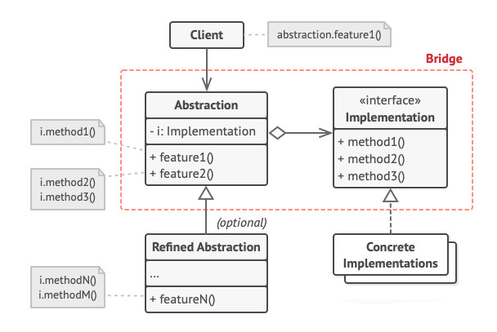
Bridge - Structure

Slide 26
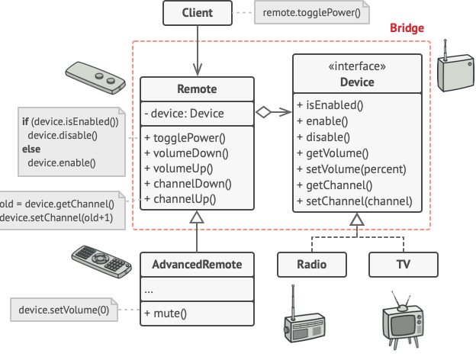
Bridge - Example

Slide 27
Structural Pattern - Composite
Definition - Design pattern that lets you compose objects into tree structures and then work with these structures as if they were individual objects.
Can use classifications (components) to build a tree.
It uses a component interface to retrieve an item from a container and it uses a leaf class to execute the item.
Why use it - To simplify items that can go together (example: a product can go to a box, so a product would be the child of a box).
Real World Example - The cost of a delivery.

Slide 28
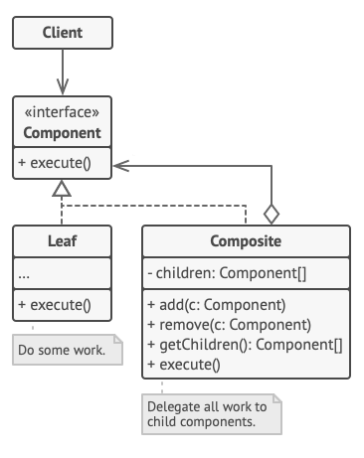
Composite - Structure

Slide 29
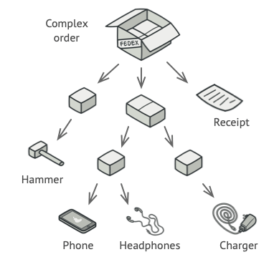
Composite - Example

Slide 30
Structural Pattern - Decorator
Definition - Design pattern that lets you attach new behaviors to objects by placing these objects inside special wrapper objects that contain the behaviors.
A wrapper is an object that can be linked with some target object.
Uses aggression or composition instead of inheritance.
The wrapper contains the same set of methods as the target and delegates to it all requests it receives.
Why use it - To handle future additions to the product.
Real World Example - Sending notifications through multiple platforms and adding those platforms as they are needed.

Slide 31
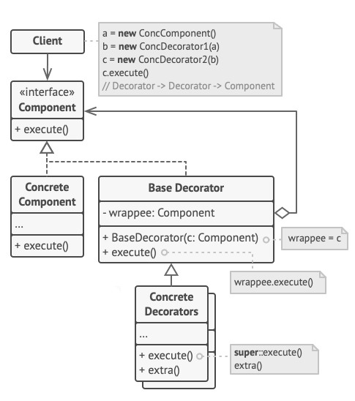
Decorator - Structure

Slide 32
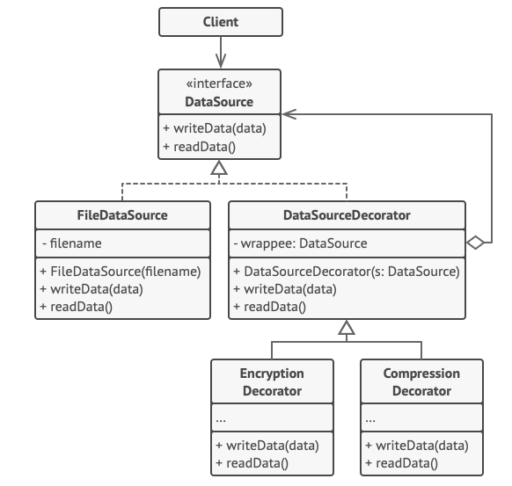
Decorator - Example

Slide 33
Structural Pattern - Facade
Definition - Design pattern that provides a simplified interface to a library, a framework, or any other complex set of classes.
Provides a simple interface to a complex subsystem which contains lots of moving parts.
Has limited functionality in comparison to working with the subsystem directly.
It includes only those features that clients really care about.
An Additional Facade class can be created to prevent polluting a single facade with unrelated features
Why use it - To simplify any third-party classes/frameworks used in a program.
Real World Example - A video converter using many conversion classes from a framework.

Slide 34
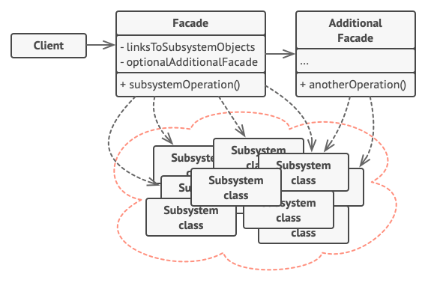
Facade - Structure

Slide 35
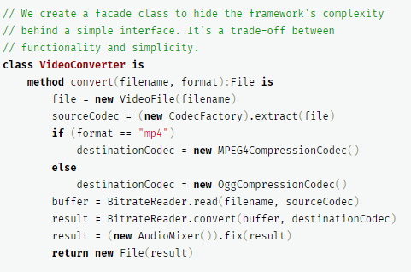
Facade - Example

Slide 36
Structural Pattern - Flyweight
Definition - Design pattern that lets you fit more objects into the available amount of RAM by sharing common parts of state between multiple objects instead of keeping all of the data in each object.
Works similar to a cache
Shares data between objects to prevent duplicate use of data
Data may be in a class and accessed via a cache like array
Why use it - To reduce the size of the product.
Real World Example - Color palettes in a video game/tree objects on a canvas.

Slide 37
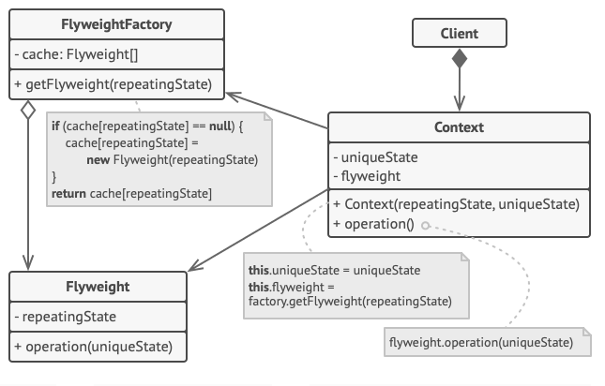
Flyweight - Structure

Slide 38
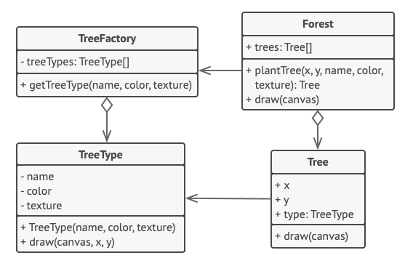
Flyweight - Example

Slide 39
Structural Pattern - Proxy
Definition - Design pattern that lets you provide a substitute or placeholder for another object.
A proxy controls access to the original object, allowing you to perform something either before or after the request gets through to the original object.
Why use it - To process information before making a request or to add to the service before using it.
Real World Example - Adding a cache functionality to downloading videos from a third-party youtube library

Slide 40
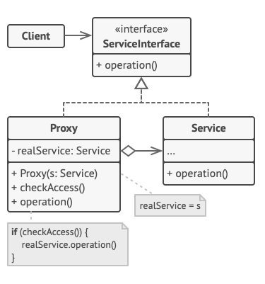
Proxy - Structure

Slide 41
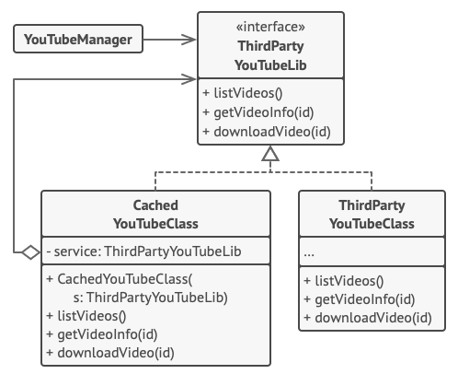
Proxy - Example

Slide 42
Behavioral Pattern- Chain of Responsibility
Definition- a behavioral design pattern that lets you pass requests along a chain of handlers. After receiving the request each handler decides either to process the request or pass it to the next handler.
Avoids coupling the sender of request to its receiver by giving more than one object a chance to handle the request.
Why use it- This pattern is recommended when multiple objects can handle a request and the handler doesn’t have to be a specific object.
Real World Example - Calling customer service.

Slide 43
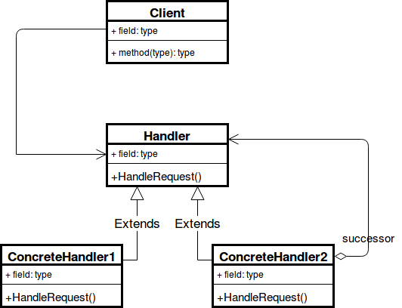
Chain of Responsibility - Structure

Slide 44
Behavioral Pattern- Command
Definition- encapsulates a request as an object, thereby letting us parameterize other objects with different requests, queue or log requests, and support undoable operations.
The request itself is an object.
The command interface declares just a single method for executing the command.
Why use it- New commands can be added without changing existing code.
Real World Example- Ordering from a restaurant.

Slide 45
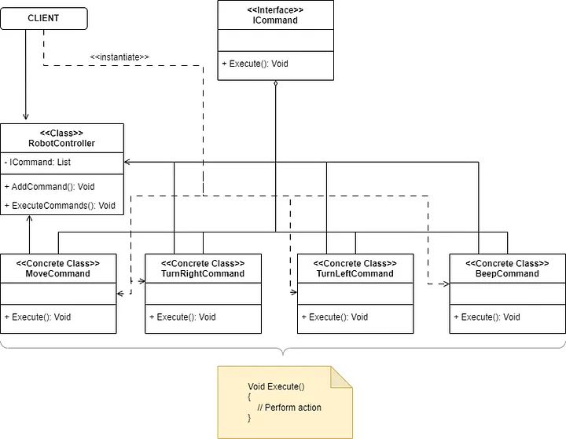
Command - Structure

Slide 46
Behavioral Pattern - Interpreter
Interpreter pattern defines a language or grammar, and provides a way to interpret sentences or expressions in that language.
Once the language grammar is established, the pattern facilitates the interpretation of sentences or expressions in that language.
Organized into the structure of the Composite pattern
Why use it- Because the pattern uses classes to represent grammar rules, you can use inheritance to change or extend the grammar.
Real World Example- Solving an arithmetic expression

Slide 47
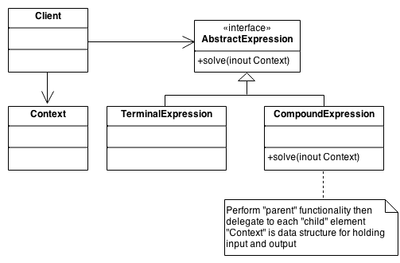
Interpreter - Structure

Slide 48
Behavioral Pattern - Iterator
Definition- a behavioral design pattern that lets you traverse elements of a collection without exposing its underlying representation.
The key idea is to take the responsibility for access and traversal out of the aggregate object and put it into an Iterator object that defines a standard traversal protocol.
Why use it - Iterators can be used when the collection has a complex data structure, but its complexity needs to be hidden from the client.
Real World Example - Searching for a radio channel

Slide 49
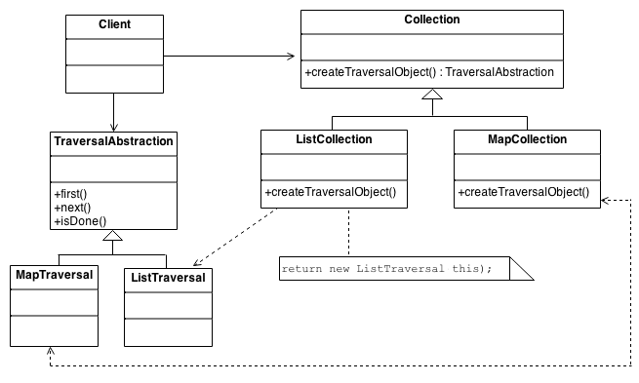
Iterator - Structure

Slide 50
Behavioral Pattern - Mediator
Definition- a pattern that restricts the direct communications between the objects and forces them to collaborate only via the mediator object.
Instead of every component directly communicating, each component calls a mediator object that redirects the call to the appropriate component.
The components depend only on a single mediator class instead of being coupled to dozens of their colleagues.
Why use it - A mediator localizes behavior that otherwise would be distributed among several objects.
Real World Example - Air traffic control

Slide 51
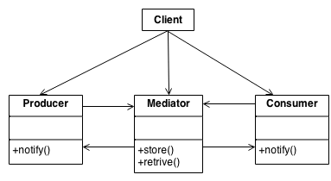
Mediator - Structure

Slide 52
Behavioral Pattern - Memento
Definition- a design pattern that lets you save and restore the previous state of an object without revealing the details of its implementation.
The memento design pattern defines three distinct roles:
Originator - Can produce snapshots of its own state, as well as restore from snapshots
Caretaker - Knows when and why to capture the originators state, and when it should be restored
Memento - Acts as a snapshot of the originator’s state
Why use it - It should be used when we need the option to revert, rollback, or undo.
Real World Example - Making changes in Microsoft Word.

Slide 53
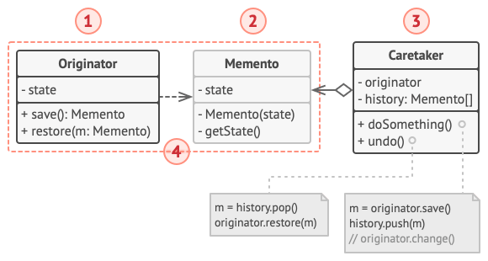
Memento - Structure

Slide 54
Behavioral Pattern - Observer (Publish/Subscribe)
Definition- a pattern that lets you define a subscription mechanism to notify multiple objects about any events that happen to the object they’re observing.
The Observer Pattern defines a one to many dependency between objects so that if one object changes state, all of its dependents are notified and updated automatically.
Why use it - When multiple objects are dependent on the state of one object
Real World Example - GUI toolkits and event listener.

Slide 55
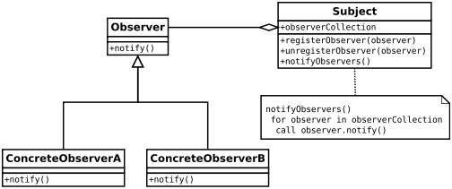
Observer - Structure

Slide 56
Behavioral Pattern - State
Definition- a pattern that lets an object alter its behavior when its internal state changes. It appears as if the object changed its class.
Instead of implementing all behaviors on its own, the original object stores a reference to one of the state objects that represents its current state, and delegates all the state-related work to that object.
Why use it - In large projects with many complicated conditional statements it is better to replace them with the State Pattern.
Real World Example- Phone notification states ringtone, vibrate, or silent.

Slide 57
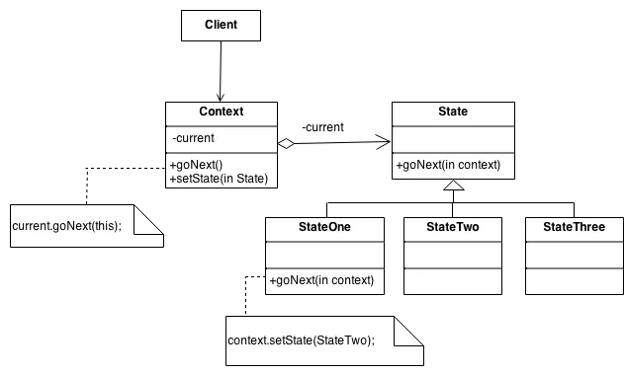
State - Structure

Slide 58
Behavioral Pattern - Strategy
Definition- a pattern that lets you define a family of algorithms, put each of them into a separate class, and make their objects interchangeable.
The Strategy pattern takes a class that does something specific in many different ways, and extracts all of these algorithms into separate classes called strategies.
Why use it- allows the behavior of an object to be selected at runtime.
Real World Example- Google Maps

Slide 59
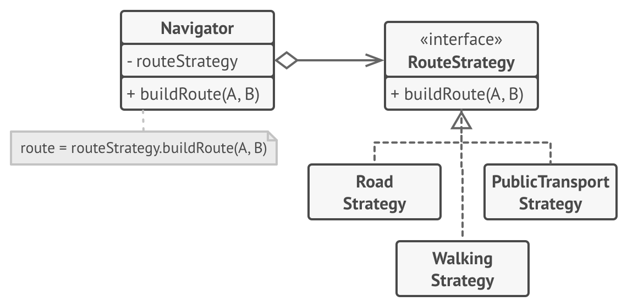
Strategy Structure

Slide 60
Behavioral Pattern - Template Method
Definition- a pattern that defines the skeleton of an algorithm in the superclass but lets subclasses override specific steps of the algorithm without changing its structure.
An algorithm is broken down into a series of steps, then the steps are turned into methods, and then put into a series of calls to these methods inside a single template method.
Why use it- when there are several classes that contain almost identical algorithms with minor differences. REUSABLE
Real World Example- Different character types in a video game.

Slide 61
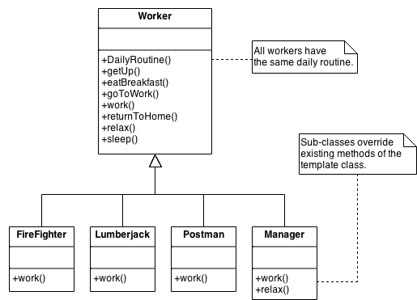
Template Method - Structure

Slide 62
Behavioral Pattern - Visitor
Definition- a pattern that lets you separate algorithms from the objects on which they operate.
When adding a new behavior instead of integrating it into an existing class, it is placed into its own separate visitor class.
Why use it- Adding a new item to the system is easy, it will require change only in visitor interface and implementation. Existing classes will not be affected.
Real World Example- Insurance salesman selling different types of insurance based on the buyer.

Slide 63
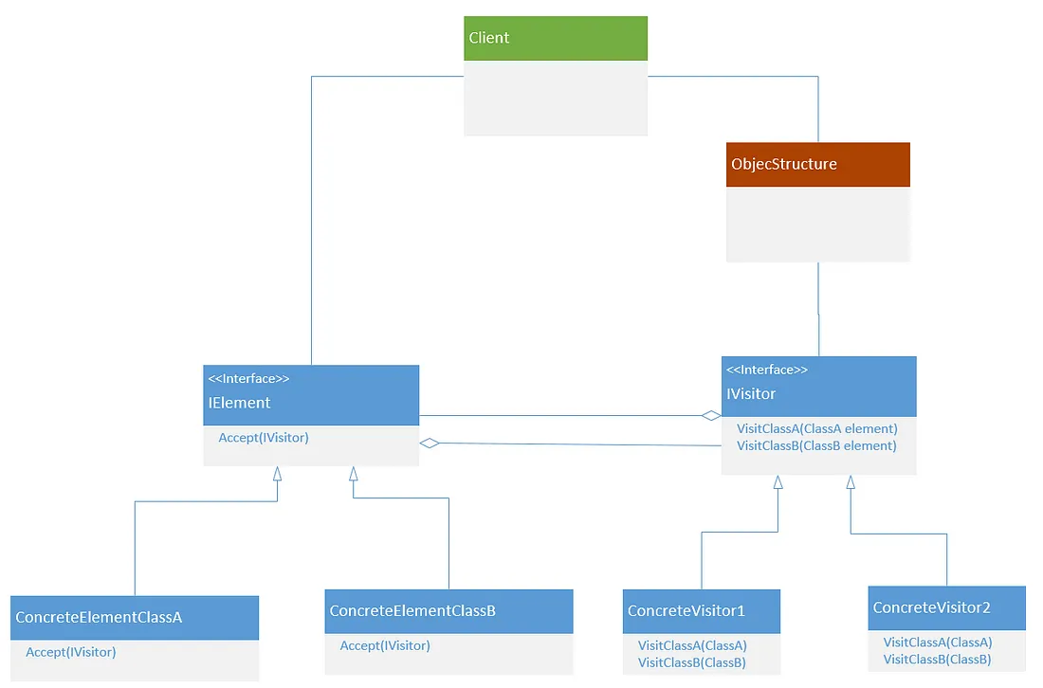
Visitor - Structure

Slide 64
Concurrency Patterns
Definition- design patterns that help manage the complexity of multithreaded or parallel programming.
Concurrency is the ability of a system to execute multiple tasks simultaneously.
Addresses issues with synchronization, thread safety, and resource sharing.
Common Example: Thread Pool, Leader/Followers, and Active Object

Slide 65
Null Object Pattern
Definition- Encapsulate null behavior into a type expected by the client code.
The NullObject class can be used as a dependency by the client. It contains no functionality, but implements all of the members defined by the abstract class.
Why use it- Instead of checking for null with if-else statements, execution can be skipped or a default action can be performed.

Slide 66
Module Pattern
Definition- a pattern used to create objects that have private variables and methods, which cannot be accessed from outside the object.
Modular programming separates code into functions, each of which deals with a single aspect of overall functionality.
Why use it- makes software development easier by breaking larger programs into smaller more manageable parts

Slide 67
RAII Pattern
Definition- “Resource Acquisition Is Initialization” - an object’s creation and destruction are tied to a resource being acquired and released.
When you acquire resources in a constructor and release them in the corresponding destructor.
Why use it- memory allocation and deallocation should be coupled to object lifetime.

Slide 68
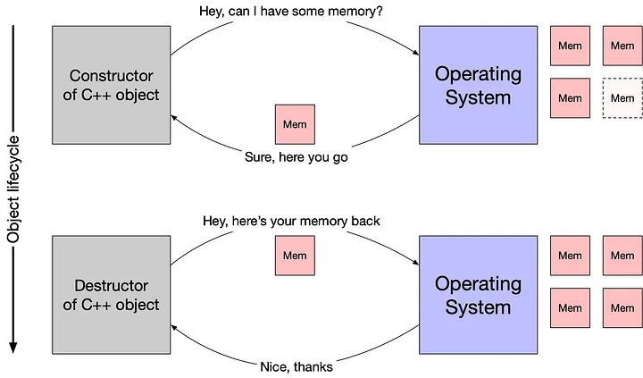
RAII - cont

Slide 69
Lazy Initialization Pattern
Definition- is a design pattern in which an object is created only when it is needed.
The object is created when a method or property that requires the object is accessed for the first time.
The value of the class field is checked when it’s being used, if the value equals null then that field is then loaded and returned.
Why use it- This can be useful when an object is expensive to create or is not used frequently

Slide 70
What is an Architectural Pattern in Software?
More broad, abstract view of a problem that can consist of multiple design patterns
Structure over implementation
Are also reusable
Reusing elements of software

Slide 71
Why Use Architectural Patterns?
Reusable
Scalable
Maintainable
Adaptable
Increase time efficiency
No architectural pattern can lead to a “big ball of mud”

Slide 72
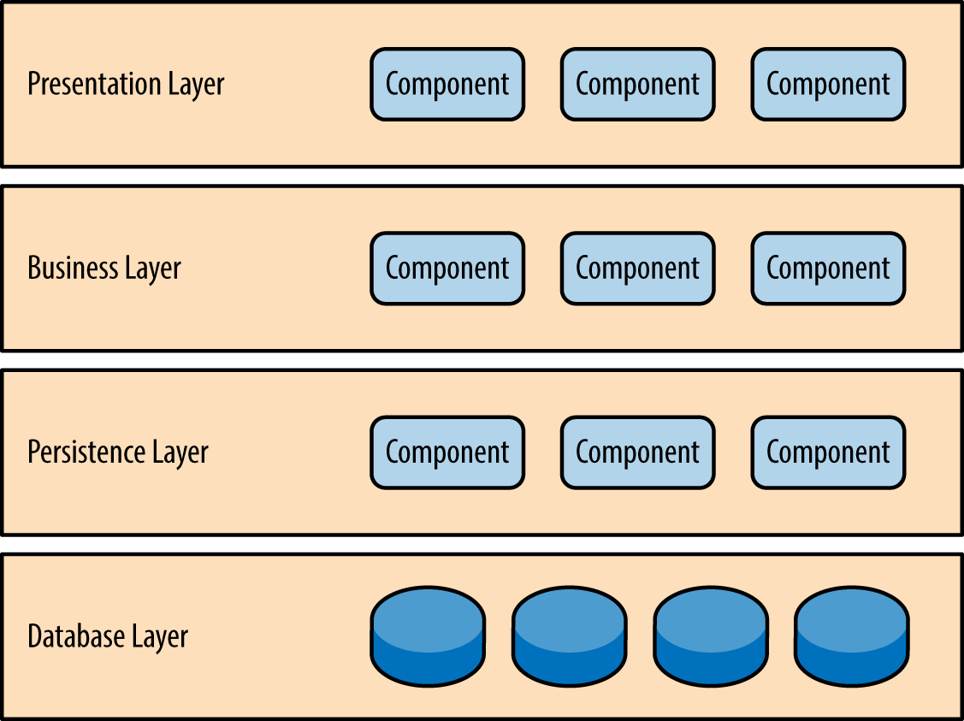
Layered
Components organized into layers
Layers have subtasks and services
Unidirectional
Very common in web applications
Why use it?
Very easy to develop with and understand
Data transfer is consistent
Consolidated objects
Drawbacks:
Complexity and cost if you want to add more layers
Difficulty in change in dependencies between layers
Example (Presentation, Business, Persistence, Database)

Slide 73
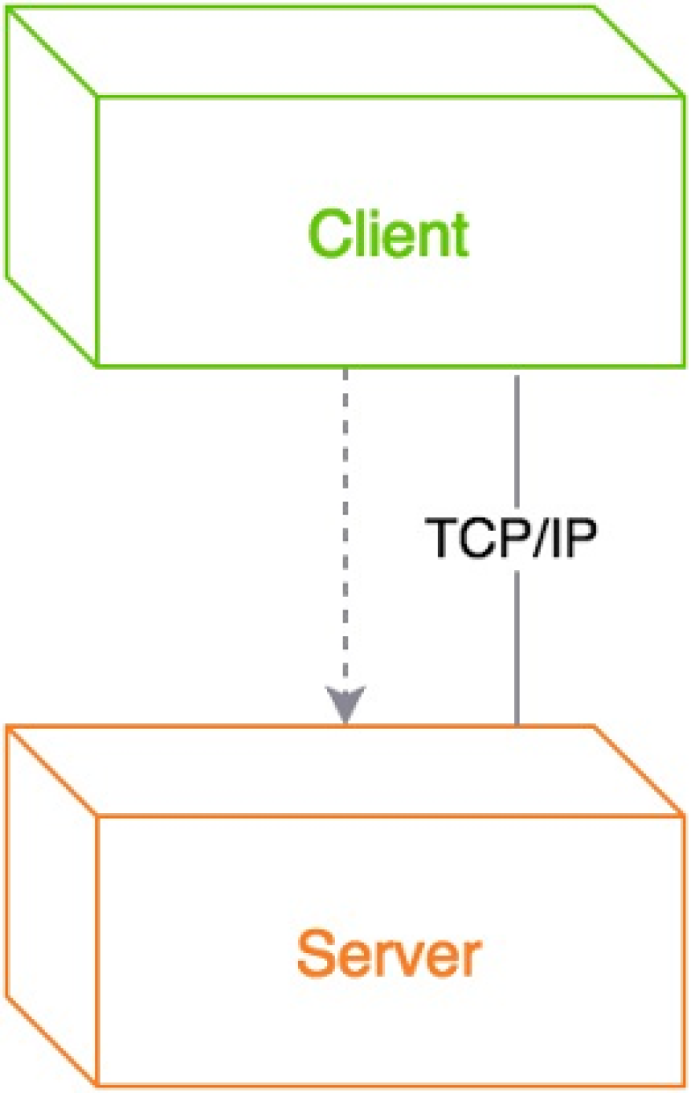
Client-Server
Two major components
Client (requester)
Server (provider)
Usually through a network on separate hardware
Communication initiated by client
Linked through request/reply connector messages
Used in WWW, file sharing, and email
Why use it?
Central computing of data
Drawbacks:
Servers are expensive and difficult

Slide 74
MVC
Used for applications and divides it into 3 components
Model
Central component that holds app data/core functionality
Controls data logic
View
Displays app data and interactions to the user
Can access data but does not understand it
Controller
Takes input from user and mediates between model and view
Communicate with callbacks/events/notifications
Why use it?
Allows for congruent programming on all components
Rapid development through using multiple views from same model
Drawbacks:
It is a complex framework through several layers of abstraction

Slide 75
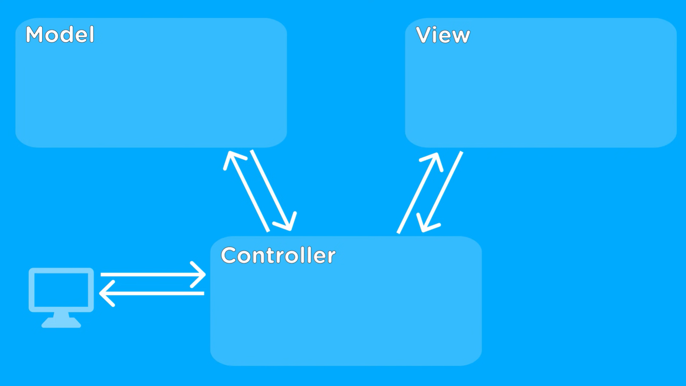
MVC Cont.

Slide 76
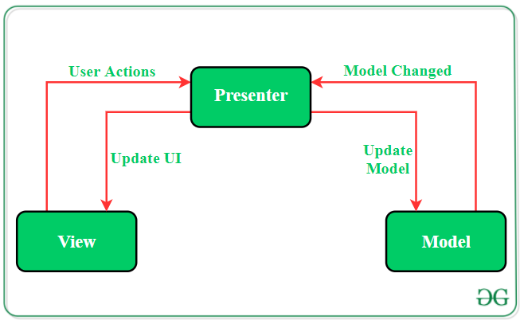
MVP
Derived from MVC
Logic is split up differently to take load off of controller
Model
Stores app data and handles domain business logic
Deals with database retrieval
View
UI Layer
Provides visualization of data
Keeps track of user actions to notify presenter
Presenter
Middle man between view and model
Gets data from model and manipulates it for view
Reacts to user’s interaction with the view

Slide 77
MVVM
Another way to divide UI, Data Source, and Business Logic
Model
Data source with repository that collects data in a single source
View
Visible part of app
All UI elements and gets events from ViewModel
Logic for manipulating views
ViewModel
Business logic
Direct communication with model
Why use it?
Easy to make changes to model code with no risk
Unit tests can be used for the viewmodel and model
Dynamic view redesign
Concurrent development
Drawbacks:
Overkill for simple UI because of databinding
Databinding is hard to debug

Slide 78
MVVM Cont.

Slide 79
Microservices
Multiple applications that can work interdependently
Separate deployment of units
Allows for delivery pipeline
Distributed architecture
Can be accessed through remote access protocols like REST
Why use it?
Highly scalable
Easy to deploy new features (and individual deployment)
Easy maintenance
Drawbacks:
Network layer can get complex with remote protocols
Decoupling services for independent services takes architectural expertise

Slide 80
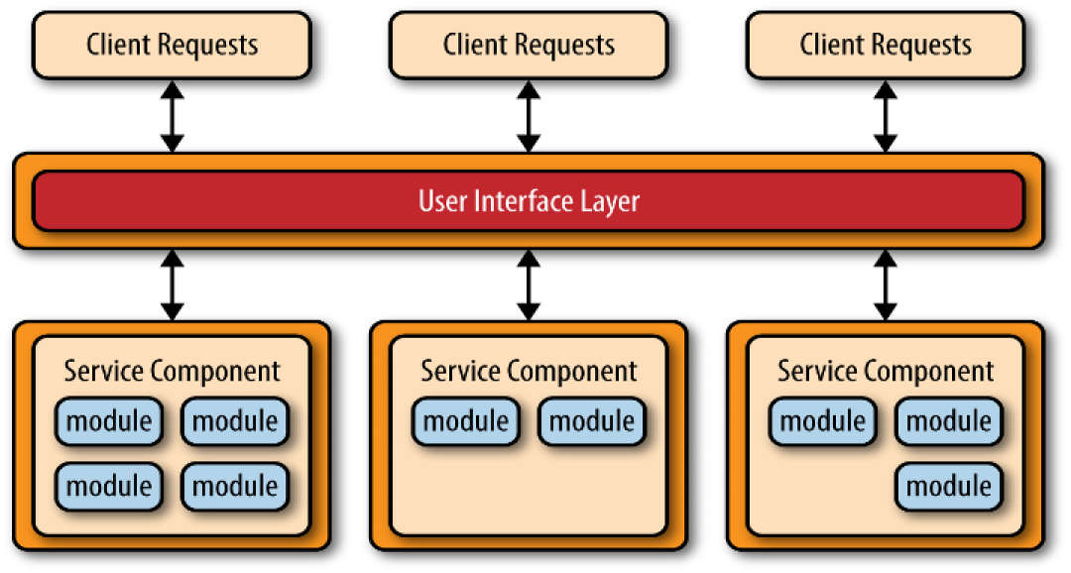

Slide 81
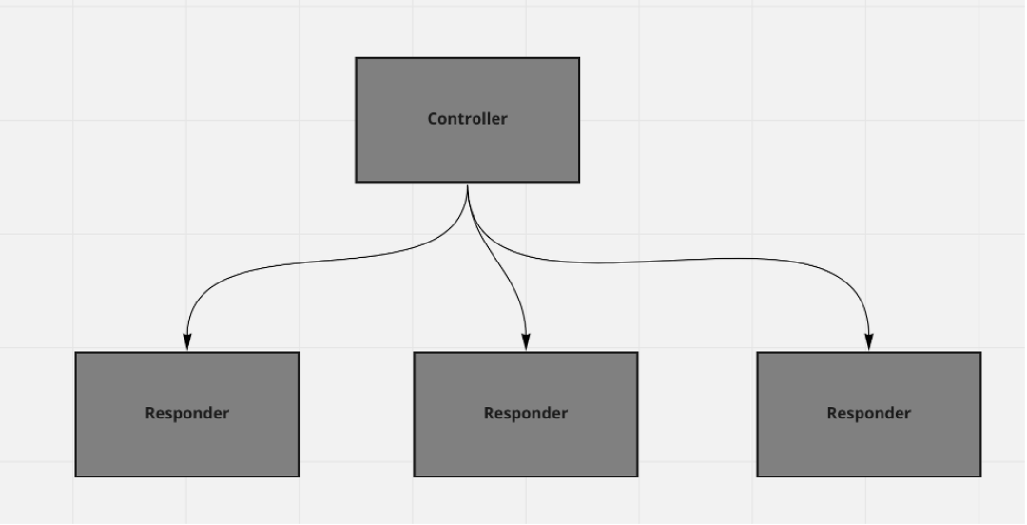
Controller-Responder
Previously known as master/slave but IEEE adopted the new name
Used in database management/backup and application performance
2 components:
Controller and responder
Controller:
Distributes the data among identical responders
Consists of complete data collection in a master database
Responder:
Holds divided section of master database
Why use it?
Reliable and improves performance
Drawbacks:
Slower retrieval of data

Slide 82
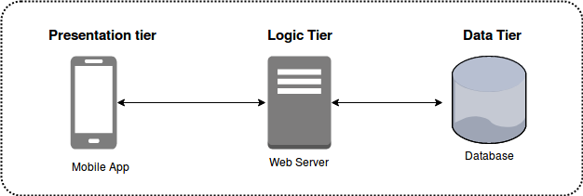
Multi-Tier
Tier vs. Layer
A layer is a functional division of software (a division of code)
A tier is a functional division of software that runs on a separate infrastructure from tiers (where the code runs)
Tiers have more benefits
A logical “tier” is just a layer
1 tier, 2 tier, 3 tier
Why use it?
Performance
Scalability
Fault tolerance
Security
Drawbacks:
The more boundaries you have, the slower the application
The more tiers, the more complexity

Slide 83
Representational State Transfer
A.k.a REST
Stateless architecture
Provides standards between systems on the web for communication
Client and server separation
Only need to know the format of each other
Improves flexibility of UI and scalability of the server
Independent evolution
Allows for clients to have a standard when hitting endpoints allowing for universal response between client and server
RESTful API
Why use it?
Reliability, performance, scalability, and easy maintenance
Drawbacks
Limited request operations (GET, POST, PUT, DELETE)
No documentation standard
Security concerns

Slide 84
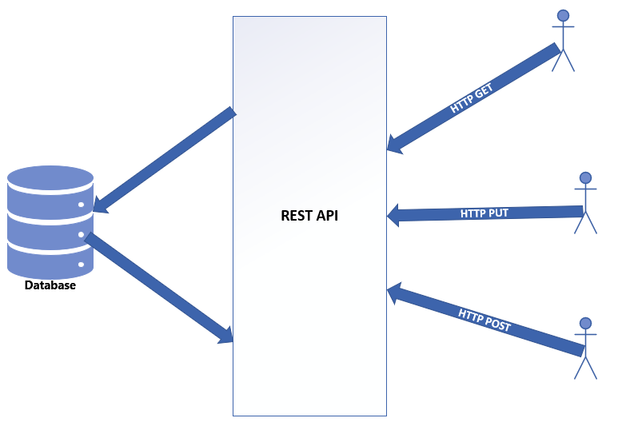

Slide 85
Map Reduce
Programming architecture used for parallel processing
Created by Google
Allows for processing on giant data sets (computing cluster)
Map phase:
Separated nodes of data clusters (key-value pairs)
Reduce phase:
Takes map phase and reduce to a single value which is sent to requester

Slide 86
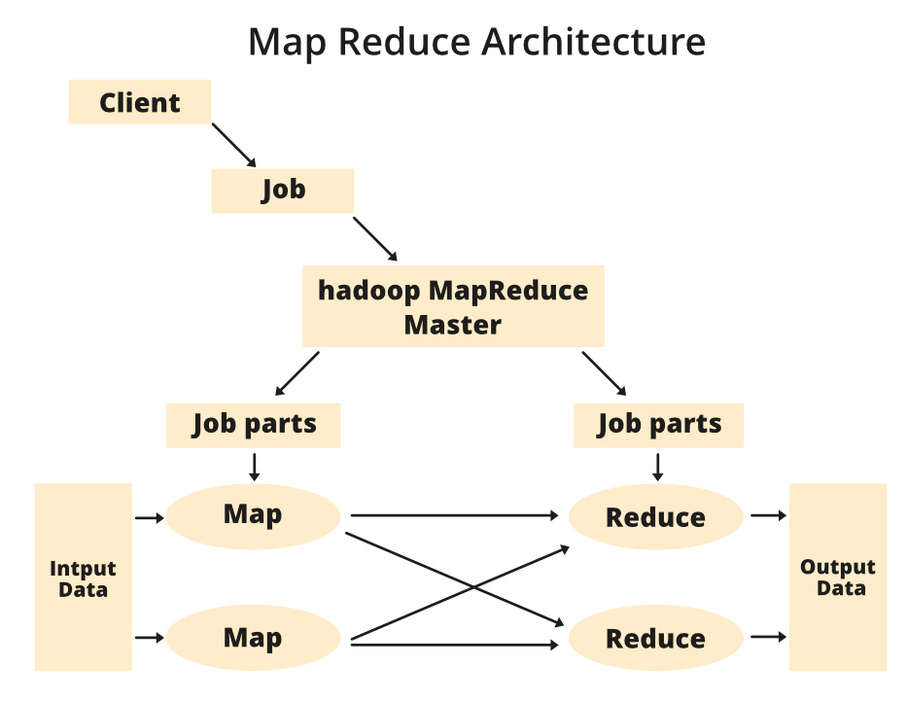

Slide 87
Sources
https://refactoring.guru/design-patterns
https://sourcemaking.com/design_patterns
https://www.visual-paradigm.com/guide/uml-unified-modeling-language/uml-class-diagram-tutorial/
https://www.scaler.com/topics/concrete-class-in-java/
https://www.w3schools.com/java/java_abstract.asp
https://www.visual-paradigm.com/guide/uml-unified-modeling-language/uml-aggregation-vs-composition/#:~:text=Aggregation%20implies%20a%20relationship%20where,exist%20independent%20of%20the%20parent.

Slide 88
Sources
https://medium.com/@aydinserbest34/understanding-dependencies-in-object-oriented-programming-and-testing-7e9059f54561
https://www.analyticsvidhya.com/blog/2020/10/inheritance-object-oriented-programming/#:~:text=In%20object%2Doriented%20programming%20(OOP,and%20establishes%20relationships%20between%20classes.
https://www.redhat.com/architect/14-software-architecture-patterns#:~:text=There%20are%20numerous%20advantages%20to,patterns%20you%20can%20tap%20into.
https://www.redhat.com/architect/14-software-architecture-patterns#:~:text=There%20are%20numerous%20advantages%20to,patterns%20you%20can%20tap%20into.
https://www.javier8a.com/itc/bd1/articulo.pdf
https://www.codecademy.com/article/what-is-rest
https://web.archive.org/web/20200802111420/http://www.lhotka.net:80/weblog/ShouldAllAppsBeNtier.aspx

