Slide 1
STL and Boost
Ethan Nix, Ramneek Singh Matharu, Diksha Chottani, Chayton Morris

Slide 2
What is the STL?
Standard Template Library
A set of C++ template classes designed to provide common data structures and functions.
Designed to work with multiple data types.
Everything is parameterized, making it more flexible.

Slide 3
Why STL?
Efficiency:
Optimized algorithms and data structures
Pre-built components = faster execution
Reusability:
Generic code that can be used for multiple data types
Reusable programming = reduced development time
Standardization and Many Tools:
Ensures consistency across many compilers and platforms
Extensive collection of iterators, algorithms, and containers

Slide 4
Iterators
What is an iterator?
Object that allows the traversal of elements in a container.
Does not expose the details of the container’s implementation.
Iterators act as a layer of abstraction by providing a consistent interface for accessing elements.
Iterators are essential in the STL and enable operations like reading, writing, and modifying sequences of elements.
Multiple types of iterators:
Input
Output
Forward
Bidirectional
Random Access

Slide 5
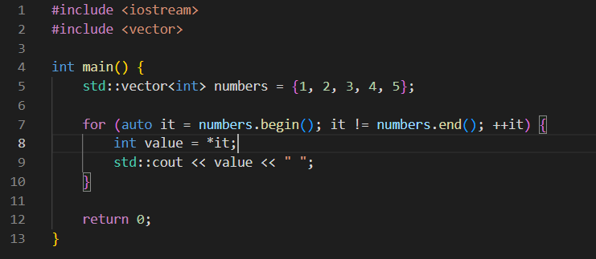
Input Iterator
Allows sequential reading of elements from a data structure
One-pass traversal
Does not typically support modifying elements.

Slide 6
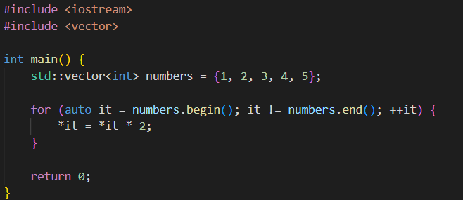
Output Iterator
Allows sequential writing of values to a data structure
Used for inserting or modifying values
Typically one-way traversal

Slide 7
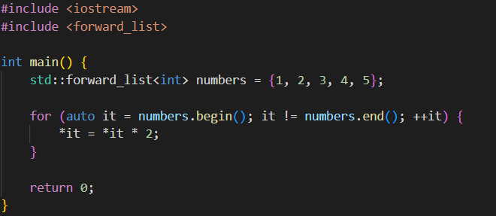
Forward Iterator
Iterator that only allows movement in the forward direction.
Allow multiple passes over the same sequence
Can be used for both reading and modifying elements.

Slide 8
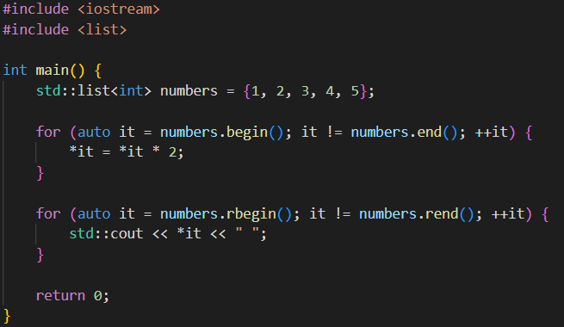
Bidirectional Iterator
Allows movement in both the forward and backward directions
Same benefits of forward iterators while allowing the ability to move backward(decrement)

Slide 9
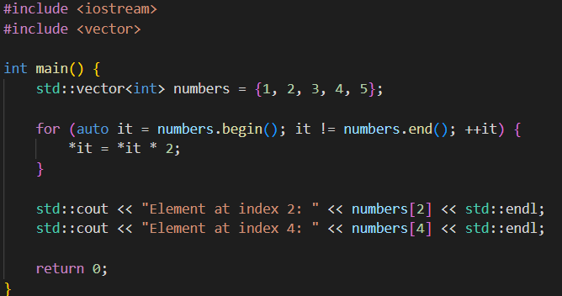
Random Access Iterators
Most powerful iterator
Constant-time access
Supports arithmetic operations and direct movement to distant elements
Uses index notation to access any element in constant time.

Slide 10
Algorithms
STL contains 84 algorithms and can all be
accessed by “ #include <algorithm> “
Why Use STL Algorithms?
Code Readability
Reusability
Performance
Safety and Correctness
Reference to view all algorithms provided by STL: https://www.geeksforgeeks.org/algorithms-library-c-stl/
Swap
Sort
Accumulate
Merge
Make_Heap
Search
Equal
Find
For_Each
All_Of
Notes:
Provided by STL, these algorithms are used to manipulate data stored in containers.

Slide 11
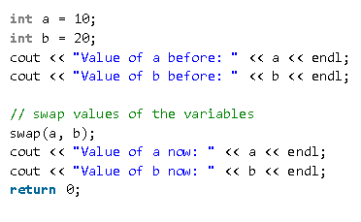
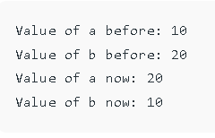
Swap
Swaps the value of 2 variables
Syntax: swap(var1, var2)

Slide 12
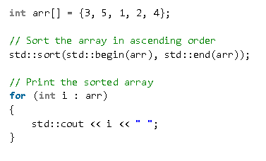
Sort
Arranges the data in a container into ascending order.
Syntax: sort(startAddress, endAddress)

Slide 13
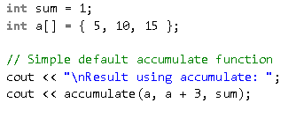
Accumulate
Returns the sum of all values in lying within a range
Syntax: accumulate(firstAddress, lastAddress, sum)

Slide 14
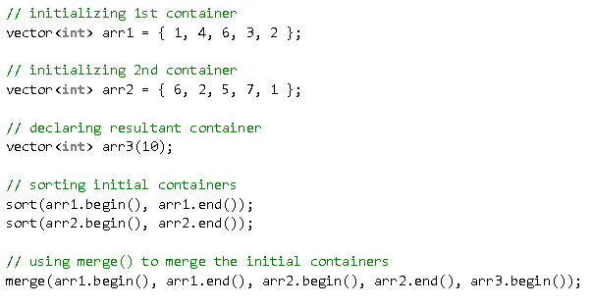
Merge
Used to merge sort 2 containers into a single container
Syntax: merge(begAddress1, endAddress1, begAddress2, endAddress2, resultContainer)

Slide 15
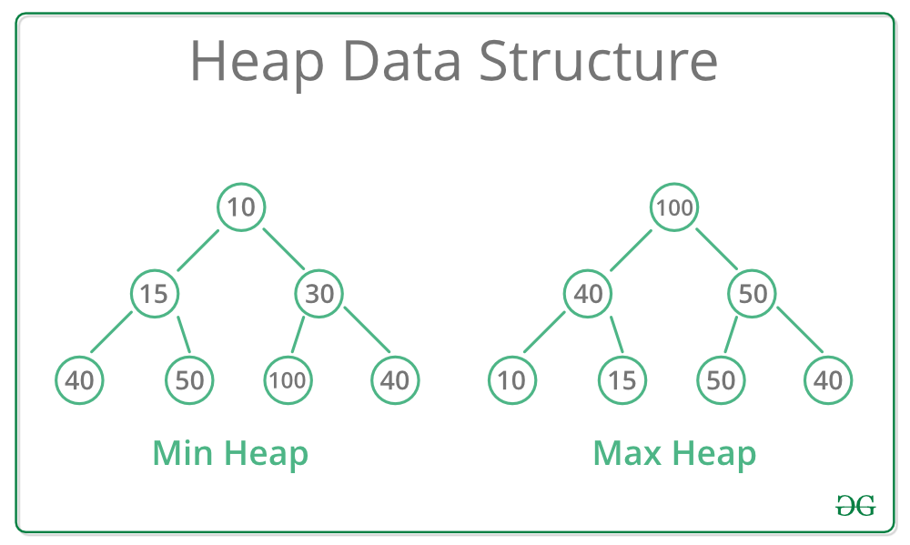
Make_Heap
Used to transform a sequence into a heap.
What is a heap?
- Tree based data structure.
Max Heap
For every node “i” other than the root, the value at “i” is less than value stored at its parent node.
Min Heap
For every node “i” other than the root, the value at “i” is greater than value stored at its parent node.

Slide 16
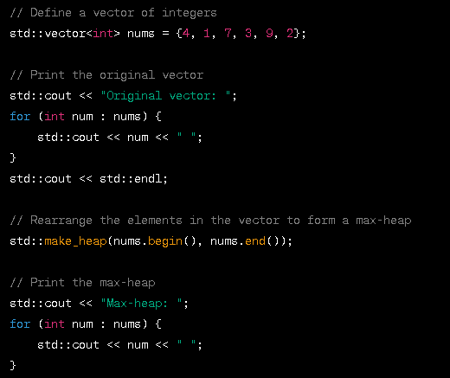
Make_Heap
Syntax: make_heap(firstAddress, lastAddress)

Slide 17
Search
Used to to find the presence of a subsequence within a given range of elements. Returns an iterator to the first element of the subsequence if pattern is found. If subsequence is not a found an iterator to the last element is returned.
Syntax: (begAddress container1, endAddress container1, begAddress container2, endAddress container2)

Slide 18
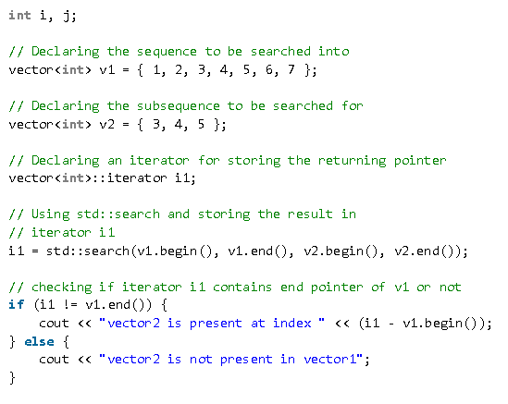
Search

Slide 19
Equal
Determines whether the elements in two sequences are equal. After comparing, if all elements are equal, the algorithm will return true.
Syntax: bool equal(begAddress Container1, endAddress Container1, begAddress Container2)

Slide 20
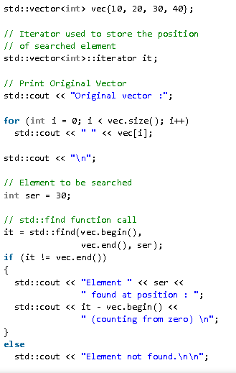
Find
Finds an element within a given range. Returns an iterator to the first occurrence of the specified element. If element is not found, iterator to the end of the specified range is returned.
Syntax:
find(begAddress, endAddress, constT& value)

Slide 21
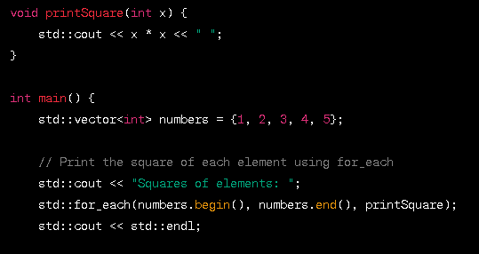
For_Each
A more expressive and concise alternative to a traditional “for” loop. Helpful when performing an operation on each element within a container.
Syntax: for_each(begAddress, endAddress, function)

Slide 22
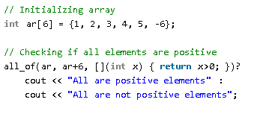
All_Of
Operates on a range of elements, checks for a given property on every element and returns true if the elements within the range satisfy the given property and false if they do not.
Syntax: (begAddress, endAddress, pred)

Slide 23
Containers
A container is a holder object that stores a collection of other objects of a specific type and its elements.
They are implemented as class templates.
The container manages the storage space for its elements and provides member function to access them. (That can be either directly or through iterators)

Slide 24
Types of Containers
Sequence Containers: implement data structures that can be accessed sequentially.
Container adaptors: provides a different interface for sequential containers.
Associative Containers: implement sorted data structures that can be quickly searched. O(log n)
Unordered associative Containers: implement unsorted data structures that can quickly searched.

Slide 25
Vector
Vector is an dynamic array container provided by STL .
Key Features:
Can dynamically resize according to the number of elements stored
Constant-time complexity for accessing elements
Stored contiguously in memory, which allows efficient traversal and manipulation
Allocation and deallocation of memory is managed automatically, which ensures efficient use of resources and avoid memory leaks.,
Notes:
In comparison to the traditional array, vectors consume more memory in exchange for the ability to manage storage and grow dynamically in an efficient way.

Slide 26
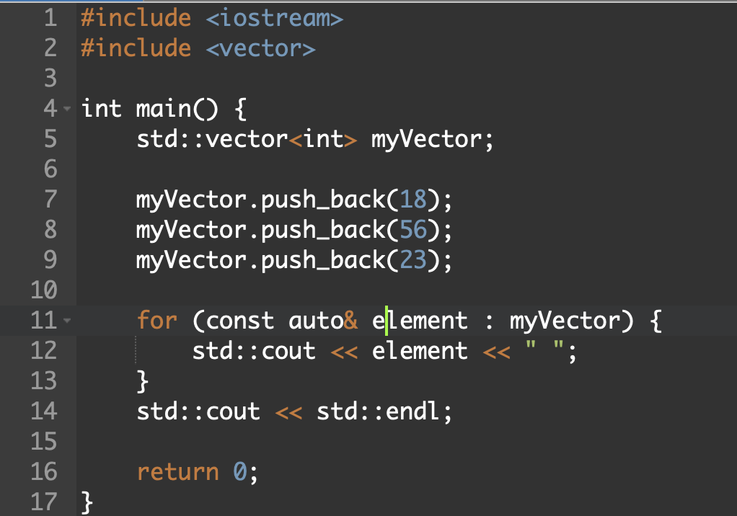
Vector - Example

Slide 27
List
List is the doubly linked list container provided by STL
Key Feature:
Allows insertion and removal of elements anywhere in the list while maintaining the order.
Constant complexity of O(1)
No random access, needs traversal to access elements
Supports bidirectional iterators, allowing traversal in both forward and backward direction efficiently
Notes:
Storage - Use a sequence of individually allocated fixed-size arrays : with additional bookkeeping
Comparison with deque:
Which means indexed access to deque must perform two pointer dereferences, compared to vector’s indexed access which performs only one
Expansion of deque is cheaper than the expansion of a vector: because it does not involve copying of the existing elements to new memory location

Slide 28
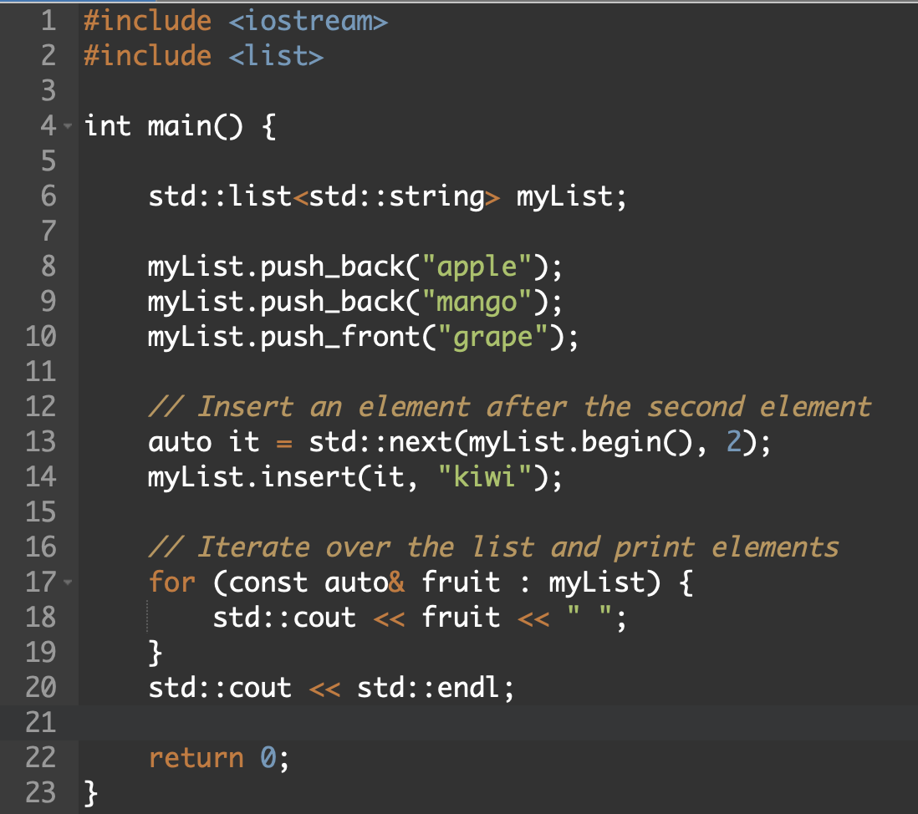
List - Example

Slide 29
Forward List
Forward List is a singly linked list container provided by STL. It represents a sequence of elements where each element is linked to the next element in sequence.
Key Feature:
Allows insertion and deletion operations at the beginning and middle of the list
Constant complexity of O(1)
Supports only forward iterations
Consumes less memory compared to list due to its singly-linked nature
Notes:
Storage - Use a sequence of individually allocated fixed-size arrays : with additional bookkeeping
Comparison with deque:
Which means indexed access to deque must perform two pointer dereferences, compared to vector’s indexed access which performs only one
Expansion of deque is cheaper than the expansion of a vector: because it does not involve copying of the existing elements to new memory location

Slide 30
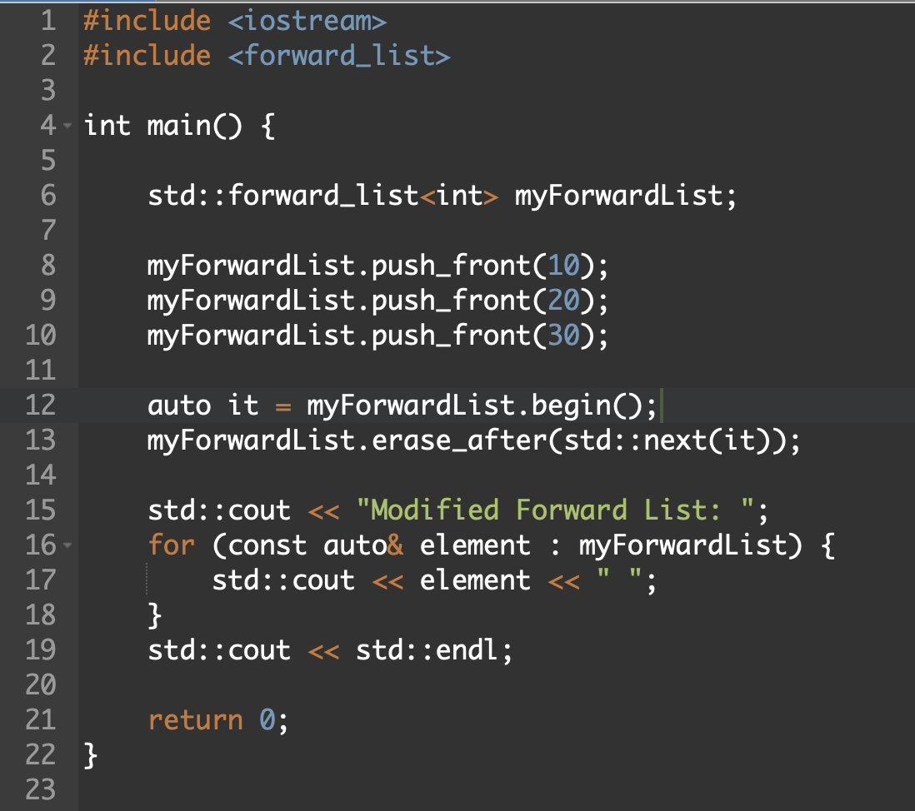
Forward List - Example

Slide 31
Deque
Deque - short for double-ended queue, an adaptable array like structure that supports dynamic insertion and deletion of elements at both ends
Key Features:
Can dynamically resize to accommodate elements as needed
Allows index-based access
Constant time complexity for insertion and deletion at both ends
Implemented as collection of fixed-size arrays that are dynamically allocated
Notes:
Storage - Use a sequence of individually allocated fixed-size arrays : with additional bookkeeping
Unlike vectors, which provide efficient random access but slower insertion/removal at the front, std::deque offers efficient insertion and removal operations at both the beginning and end of the container.

Slide 32
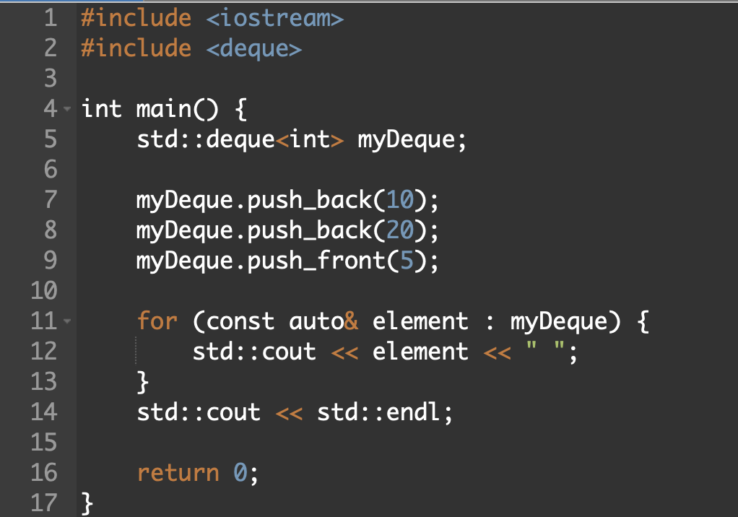
Deque - Example

Slide 33
Stack
Stack class is a container adaptor that gives the programmer the functionality of a stack.
Key Features:
Follows LIFO (Last in, First out) principle
Acts as wrapper to the underlying container - only a specific set of functions are provided
Restricted operations, available operations are the essential stack operations
Efficient constant-time complexity
Notes:
Storage - Use a sequence of individually allocated fixed-size arrays : with additional bookkeeping
Comparison with deque:
Which means indexed access to deque must perform two pointer dereferences, compared to vector’s indexed access which performs only one
Expansion of deque is cheaper than the expansion of a vector: because it does not involve copying of the existing elements to new memory location

Slide 34
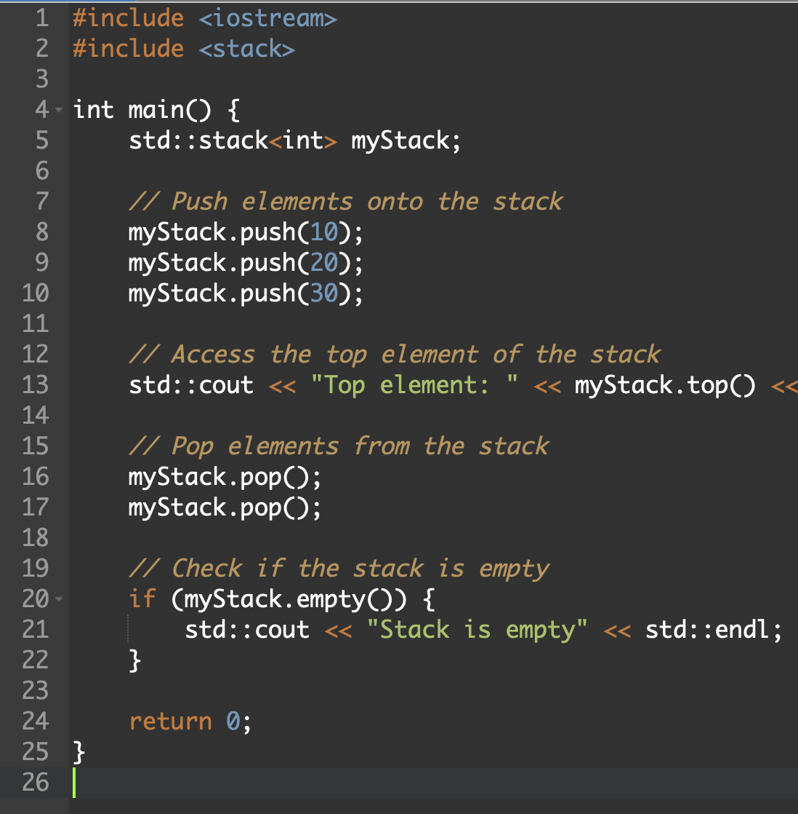
Stack - Example

Slide 35
Queue
Queue is a container adaptor in STL which gives functionality of a queue
Key Features:
Follows FIFO (First in, First out) principle
Acts like a wrapper to the underlying sequence container
Ensures efficient enqueue and dequeue operations
Does not support random access of elements
Notes:
Storage - Use a sequence of individually allocated fixed-size arrays : with additional bookkeeping
Comparison with deque:
Which means indexed access to deque must perform two pointer dereferences, compared to vector’s indexed access which performs only one
Expansion of deque is cheaper than the expansion of a vector: because it does not involve copying of the existing elements to new memory location

Slide 36
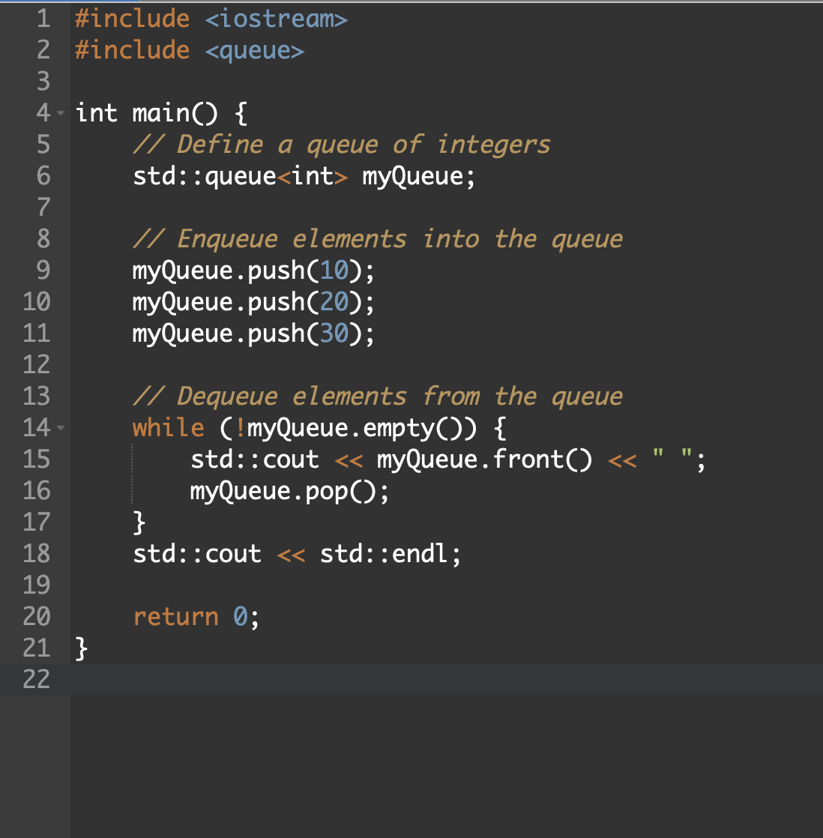
Queue - Example

Slide 37
priority_queue
Priority queues are a type of container adaptors, specifically designed such that its first element is always the greatest of all the elements it contains
Key Features:
Orders elements based on their priority value
Typically ordered using a comparison function(provided during the construction)
Supports efficient insertion of element and removal of the highest priority element
Notes:
Storage - Use a sequence of individually allocated fixed-size arrays : with additional bookkeeping
Comparison with deque:
Which means indexed access to deque must perform two pointer dereferences, compared to vector’s indexed access which performs only one
Expansion of deque is cheaper than the expansion of a vector: because it does not involve copying of the existing elements to new memory location

Slide 38
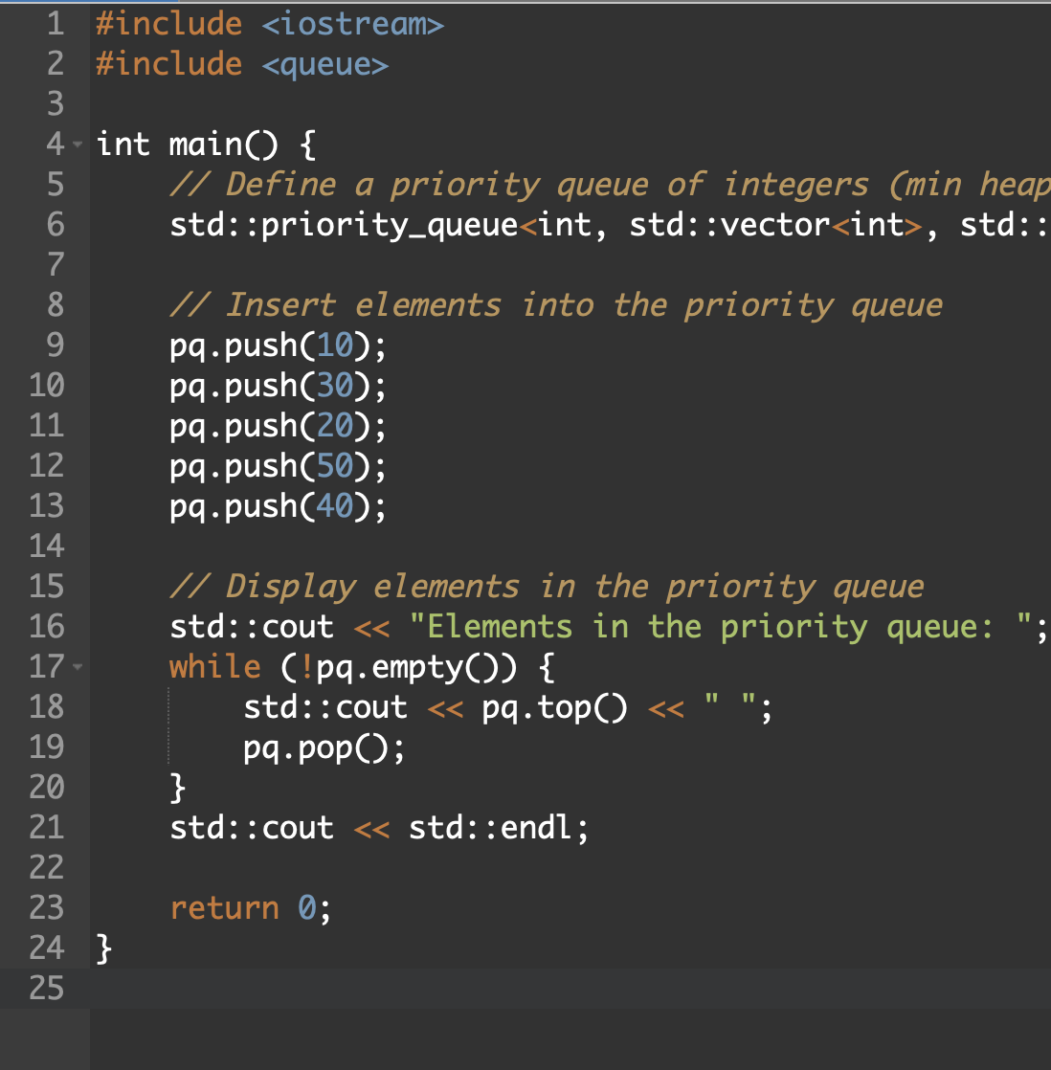
priority_queue - Example

Slide 39
set
It is an associative container provided by STL which is implemented as balanced binary search tree
Key Features:
It ensures each element is stored only once
Elements are stored in a sorted order (ascending order)
Insertion, deletion and searching operations works efficiently and effortlessly
Logarithmic time complexity
Notes:
Storage - Use a sequence of individually allocated fixed-size arrays : with additional bookkeeping
Comparison with deque:
Which means indexed access to deque must perform two pointer dereferences, compared to vector’s indexed access which performs only one
Expansion of deque is cheaper than the expansion of a vector: because it does not involve copying of the existing elements to new memory location

Slide 40
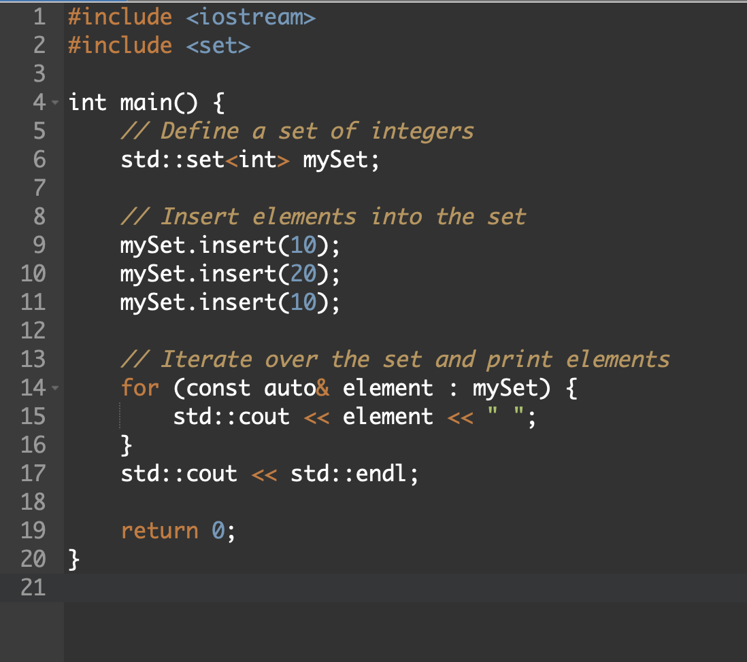
Set - Example

Slide 41
unorderd_set
It is an unordered associative container provided by STL which is implemented as a hash table based data structure
Key Features:
Elements are unique, duplicates are not allowed
No particular order is imposed
Elements are organized based on their hashed values
Hash function can be modified according to specific requirements
Notes:
Storage - Use a sequence of individually allocated fixed-size arrays : with additional bookkeeping
Comparison with deque:
Which means indexed access to deque must perform two pointer dereferences, compared to vector’s indexed access which performs only one
Expansion of deque is cheaper than the expansion of a vector: because it does not involve copying of the existing elements to new memory location

Slide 42
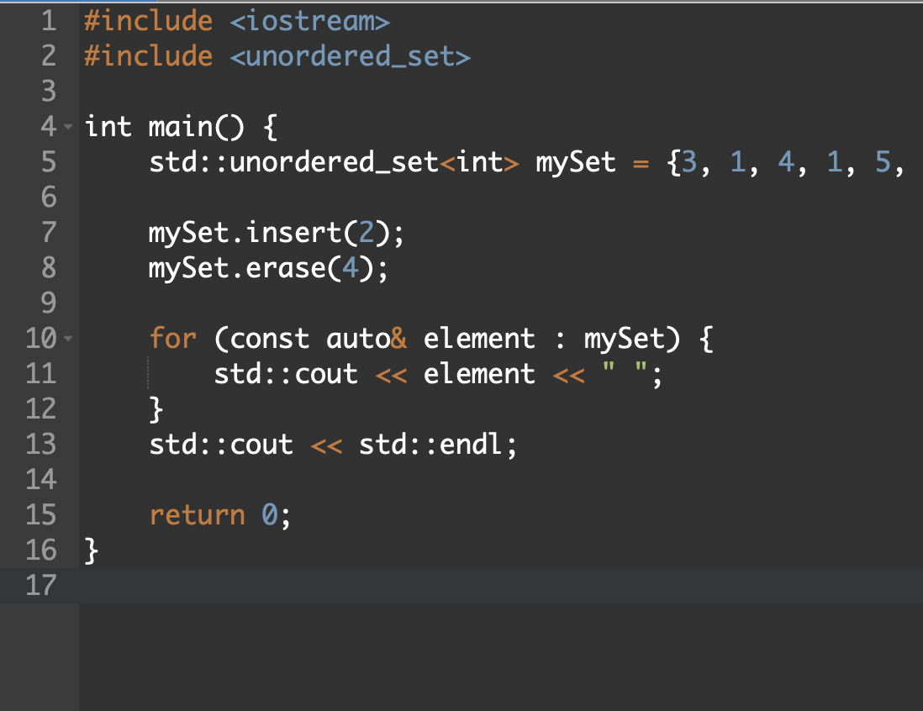
unorderd_set - Example

Slide 43
multiset
This associative container is a sorted collection of key-value pairs where keys are sorted in a specific order.
Key Features:
Effective searching, insertion and removal operations (sorted order)
Typically implemented using balanced binary search tree
Multiple keys with equivalent values are allowed
Two objects are considered equivalent if neither compares less that other
Notes:
Storage - Use a sequence of individually allocated fixed-size arrays : with additional bookkeeping
Comparison with deque:
Which means indexed access to deque must perform two pointer dereferences, compared to vector’s indexed access which performs only one
Expansion of deque is cheaper than the expansion of a vector: because it does not involve copying of the existing elements to new memory location

Slide 44
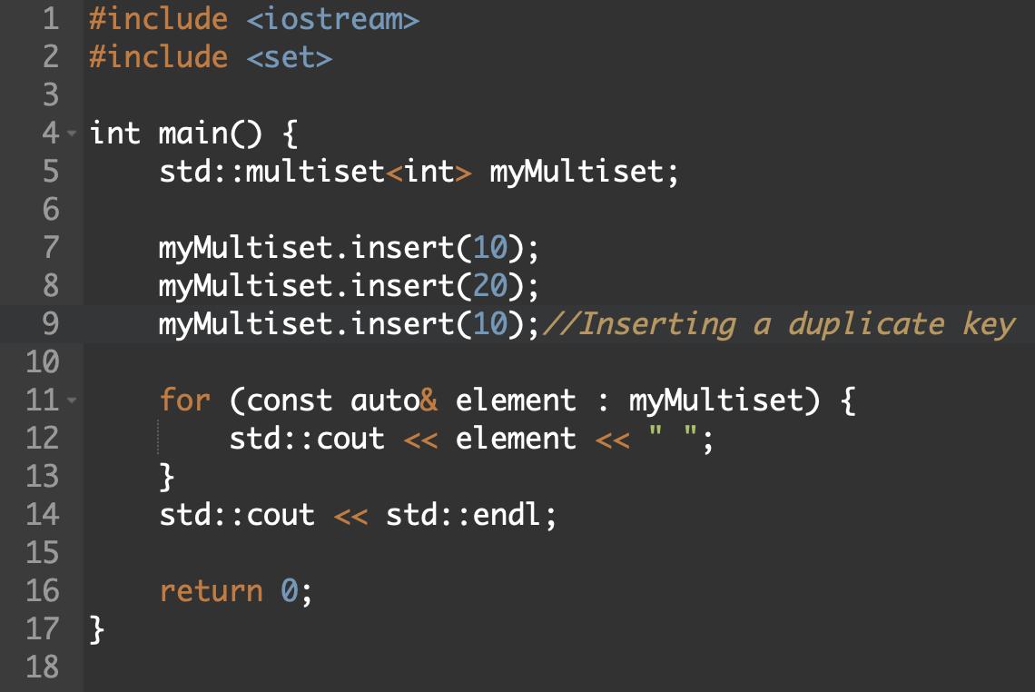
multiset - Example

Slide 45
unordered_multiset
It is an unordered associative container that contains set of possibly non-unique objects of type key.
Key Features:
Duplicates elements can be stored
Elements are not sorted any any specific order
Elements are stored on the basis of their hash values
It can dynamically resize to accommodate variable number of elements which ensures efficient memory usage and performance
Notes:
Storage - Use a sequence of individually allocated fixed-size arrays : with additional bookkeeping
Comparison with deque:
Which means indexed access to deque must perform two pointer dereferences, compared to vector’s indexed access which performs only one
Expansion of deque is cheaper than the expansion of a vector: because it does not involve copying of the existing elements to new memory location

Slide 46
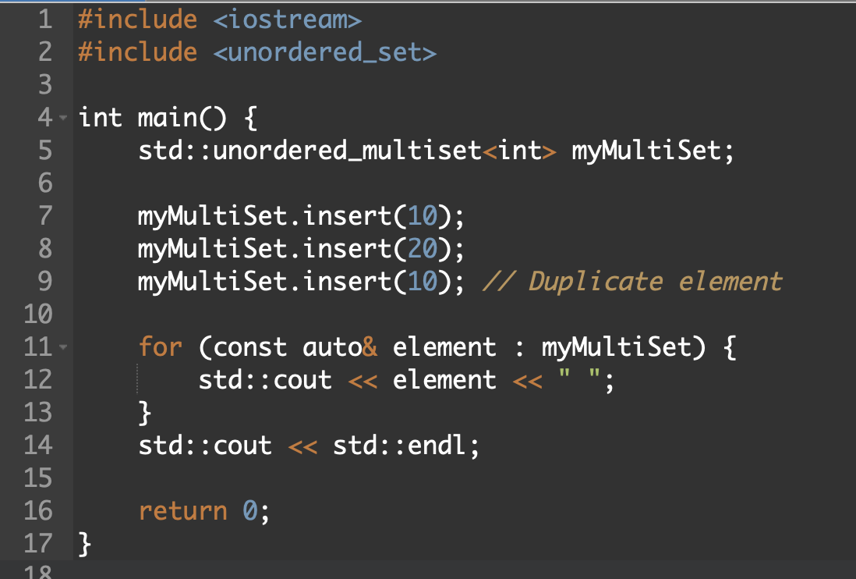
unordered_multiset - Example

Slide 47
map
Associative container which is a sorted collection of key-value pairs, where each key is unique and associated with a corresponding value.
Key Features:
Elements are sorted based on the keys
Allows efficient binary search algorithms
Elements can be accessed based on their keys
Map iterate in ascending order of keys
Notes:
Storage - Use a sequence of individually allocated fixed-size arrays : with additional bookkeeping
Comparison with deque:
Which means indexed access to deque must perform two pointer dereferences, compared to vector’s indexed access which performs only one
Expansion of deque is cheaper than the expansion of a vector: because it does not involve copying of the existing elements to new memory location

Slide 48
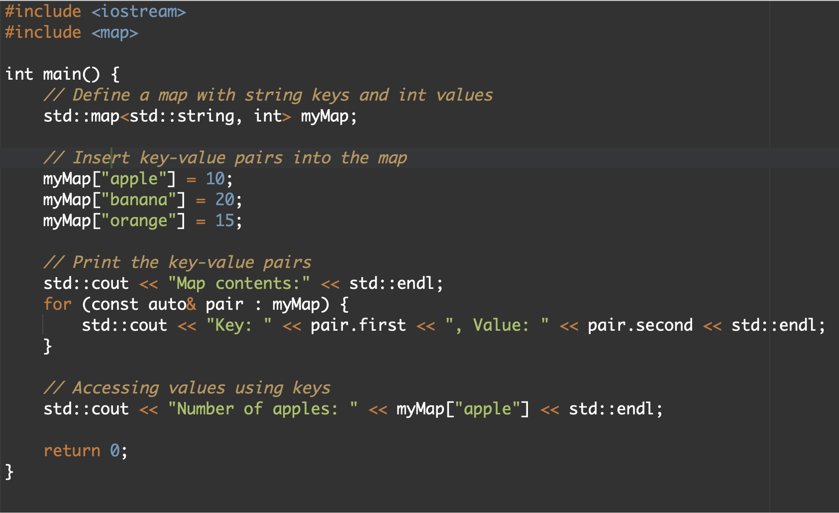
map - Example

Slide 49
unordered_map
It is an associative container which is basically an implementation of hash table
Key Features:
Hash tables are used to store key-value
Effective storage and retrieval of elements based on their keys
Elements are stored based on keys, which doesn’t impose any specific order on the elements itself
Since, hash function is used hash collisions are common.
Notes:
Storage - Use a sequence of individually allocated fixed-size arrays : with additional bookkeeping
Comparison with deque:
Which means indexed access to deque must perform two pointer dereferences, compared to vector’s indexed access which performs only one
Expansion of deque is cheaper than the expansion of a vector: because it does not involve copying of the existing elements to new memory location

Slide 50
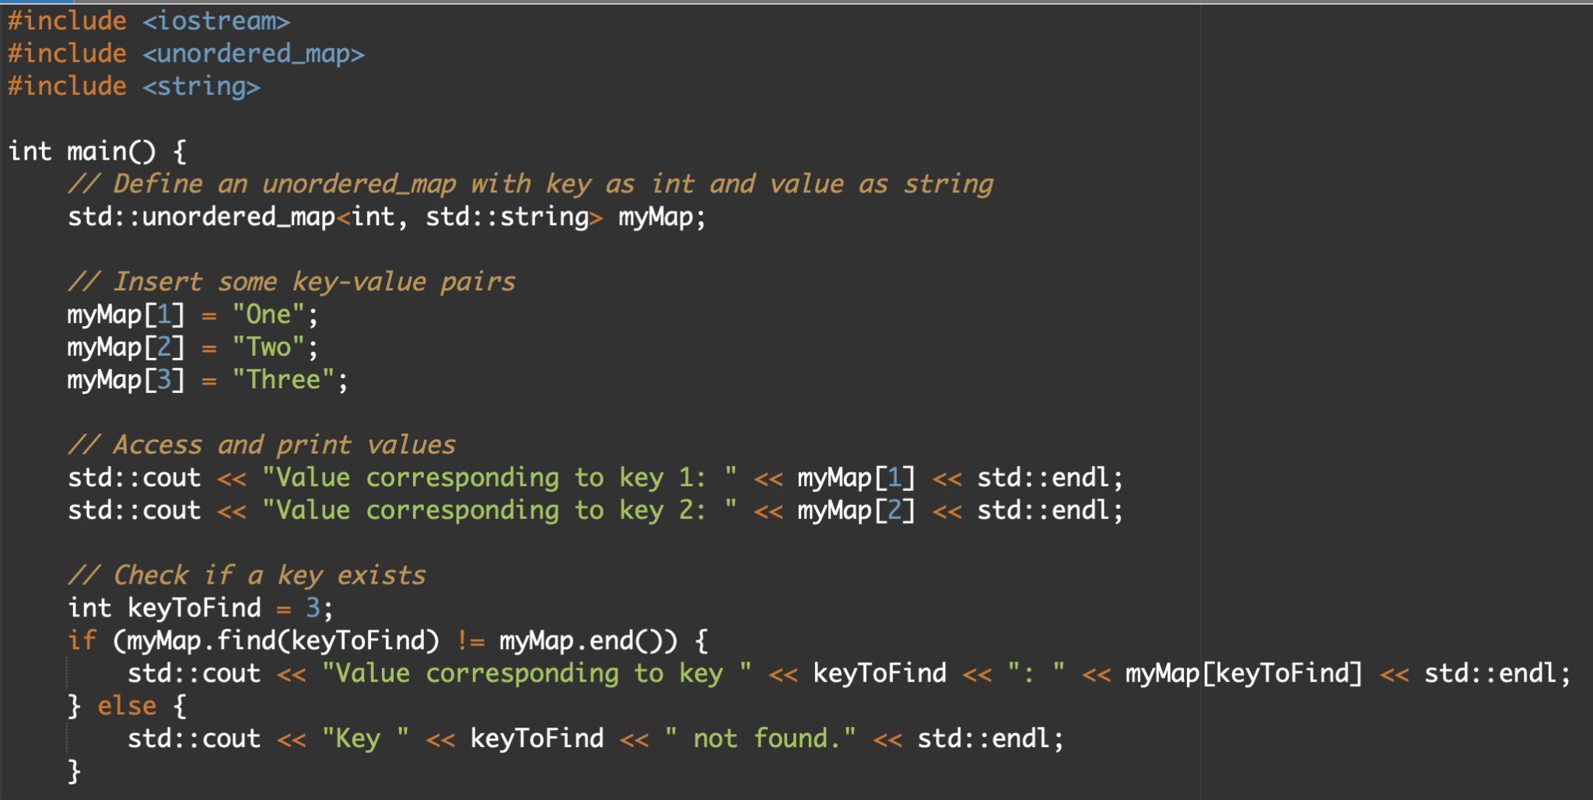
unordered_map - Example

Slide 51
Functors
An object or class that acts like a function.
Typically used as an instance of a class that can be used in resemblance to a function call.
More flexible and functional compared to ordinary function pointers.
Essentially encapsulates operations or algorithms within an object.

Slide 52
Functors VS. Functions
Functors:
Created by defining the function call operator (operator())
Can restore state and data between function calls
Can be customized to perform various tasks
Slower to execute
Can have different types of arguments and return values
Functions:
Created by declaring a function with a name and syntax.
Cannot restore state and data between function calls
Must have a fixed signature
Faster to execute
Have fixed type of arguments and return values

Slide 53
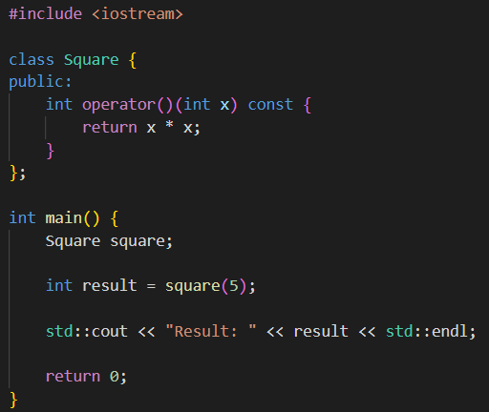
Unary functor
Functor that takes a single argument
Typically used in algorithms that apply operations to each element(transform())

Slide 54
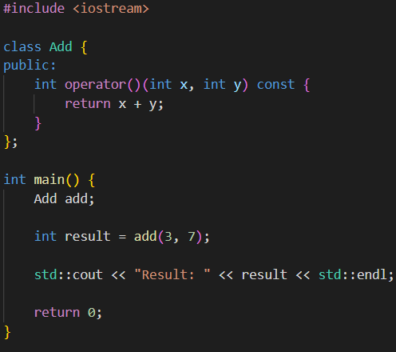
Binary Functor
Functor that takes two arguments
Often used in algorithms that involve operations between two elements.

Slide 55
Boost
Boost is a set of libraries for the C++ programming language that provides support for tasks and structures commonly used in C++ development. It aims to extend the functionality of the C++ standard library and address various aspects of modern C++ programming, including but not limited to smart pointers, concurrency, regular expressions, data structures, mathematical algorithms, and more.
Boost libraries are designed to be high-quality, portable, and conformant to C++ standards. They undergo rigorous review and testing processes by the C++ community, ensuring reliability and robustness. Boost has a significant impact on the C++ ecosystem, with many features and concepts originating in Boost eventually being adopted into the C++ standard itself.

Slide 56
More about Boost
Boost is open source and freely available for use, and it has a large and active community of developers who contribute to its development, provide support, and share knowledge. Boost libraries are often used in a wide range of applications, from desktop software and games to large-scale distributed systems and scientific computing.
Overall, Boost serves as a valuable resource for C++ developers, providing them with a rich collection of libraries to enhance productivity, improve code quality, and tackle various programming challenges.

Slide 57
Why we use boost library?
High-Quality Libraries: Boost libraries are known for their high quality, having undergone extensive review and testing by the C++ community.
Portability: Boost libraries are designed to be highly portable across different platforms and compilers, making them suitable for cross-platform development.
Feature Enhancement: Boost provides a wide range of libraries that extend the functionality of the C++ standard library, covering areas such as smart pointers, multithreading, regular expressions, and more.
Community Support: Boost has a large and active community of developers who contribute to the libraries, provide support, and share best practices.

Slide 58
Standardization Influence: Many features originally introduced in Boost libraries eventually make their way into the C++ standard, indicating Boost's influence on the evolution of the language.
Simplicity and Efficiency: Boost libraries are designed to be both simple to use and efficient in terms of performance, allowing developers to achieve their goals with minimal overhead.
Cross-Domain Usage: Boost provides libraries that cater to various domains such as mathematics, networking, file system operations, and more, making it versatile for a wide range of applications.
Experimental Features: Boost often serves as a testing ground for new features and concepts that may later be adopted into the C++ standard, allowing developers to experiment with cutting-edge technologies.

Slide 59
Any
Description: The Boost.Any library provides a container that can hold instances of any type. It allows you to store and retrieve values of different types without knowing their exact types at compile time.

Slide 60
Contract
Description: Boost.Contract provides support for programming by contract in C++. It allows you to specify preconditions, postconditions, and class invariants for functions and classes, enhancing code clarity and reliability.
Example Code: Boost Contract is typically used in larger projects where contracts between components need to be explicitly specified. Contracts are often expressed using macros such as BOOST_CONTRACT_FUNCTION.

Slide 61
Functional/Factory
Description: The Boost.Functional/Factory library provides utilities for creating functions, function objects, and factories. It includes function wrappers, function adaptors, and a factory template.

Slide 62
JSON
Description: Boost.JSON provides tools for parsing and manipulating JSON (JavaScript Object Notation) data in C++. It offers functionalities for reading, writing, and manipulating JSON data structures.

Slide 63
Locale
Description: The Boost.Locale library provides facilities for internationalization and localization in C++. It supports formatting, collation, date/time manipulation, and message translation in different languages and locales.

Slide 64
MPI
Description: The Boost.MPI library provides C++ bindings for the Message Passing Interface (MPI) standard, commonly used in parallel and distributed computing. It facilitates communication and coordination among processes in a parallel application.

Slide 65
Property Tree
Description: The Boost.PropertyTree library provides a tree data structure for storing hierarchical data such as configuration settings or data read from files. It supports various file formats like XML, JSON, INI, and more. The library allows you to access, modify, and manipulate the data stored in the tree structure easily.

Slide 66
Thread
Description: The Boost.Thread library provides support for multithreading in C++. It offers a high-level abstraction for creating and managing threads, synchronization primitives like mutexes and condition variables, and utilities for thread-safe data sharing. Boost.Thread aims to make concurrent programming in C++ easier and more portable.

Slide 67
REFERENCES
https://stackoverflow.com/questions/125580/what-are-the-advantages-of-using-the-c-boost-libraries
https://en.wikipedia.org/wiki/Boost_(C%2B%2B_libraries)
https://theboostcpplibraries.com/boost.any
https://chat.openai.com/c/de21309a-c540-4671-9274-b35b9abcd9c5
https://www.boost.org/doc/libs/1_80_0/doc/html/mpi/tutorial.html#mpi.tutorial.point_to_point
https://cplusplus.com/reference/stl/
https://stackoverflow.com/questions/31691700/c-standard-container-and-stl-container-in-c
https://www.geeksforgeeks.org/algorithms-library-c-stl/

