Slide 1
HCI / UX
Jagger Thurman, Chase Gilmer, Khant Khine

Slide 2
HCI/UX
Needs
Design
Evaluation
Agile
Responsive

Slide 3
Introduction
What is HCI?
What is UX?
Why HCI/UX?

Slide 4
What is HCI?
HCI is a field of study that refers to communication between the human user and a computer system.
HCI is also known as Computer Human Interface (CHI) or Man Machine Interaction (MMI)
Main Concerns: Design, Evaluation, and Implementation (these will be discussed later in the presentation)
Goal of HCI: design systems in such a way that make them efficient, stable, usable, attainable

Slide 5
What is HCI?

Slide 6
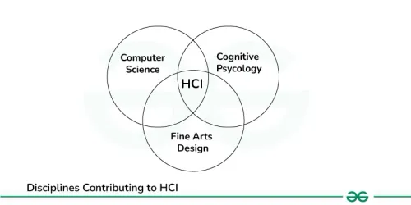
HCI Composition
HCI can be considered a combination of three major disciplines: Computer Science, Cognitive Psychology, and Fine Arts Design
Computer Science: Plays a crucial role in the development of HCI
Cognitive Psychology: Field of HCI that identifies how humans interact with systems
Fine Arts Design: Involves the graphical side of HCI

Slide 7
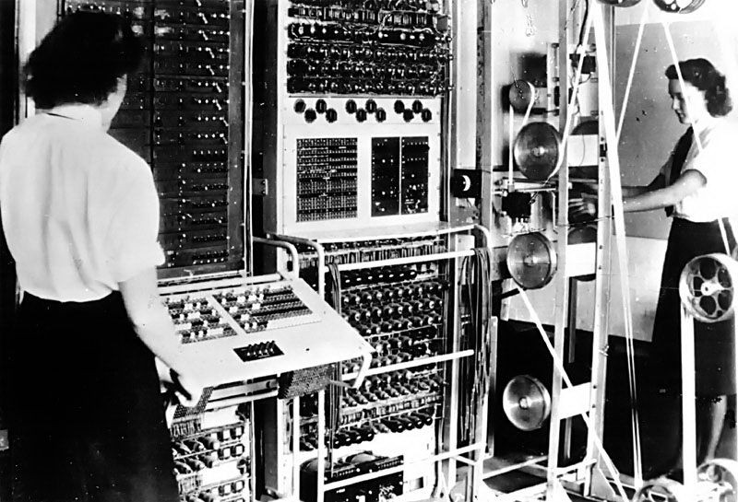
Brief History of HCI
The first computers were large, expensive, and difficult to use
Mid 1960's: Command Line Interface
1980's: GUI's begin to emerge
1990's: Email communication and World Wide Web
2000's: Mobile Devices: Smartphones, tablets, laptops, video-games

Slide 8
Styles of HCI
Command line: One of the oldest interaction styles and is still present today
Graphical User Interface (GUI): Popular interaction style today
Natural Language: Voice Assistants
Q/A: Chatbots

Slide 9
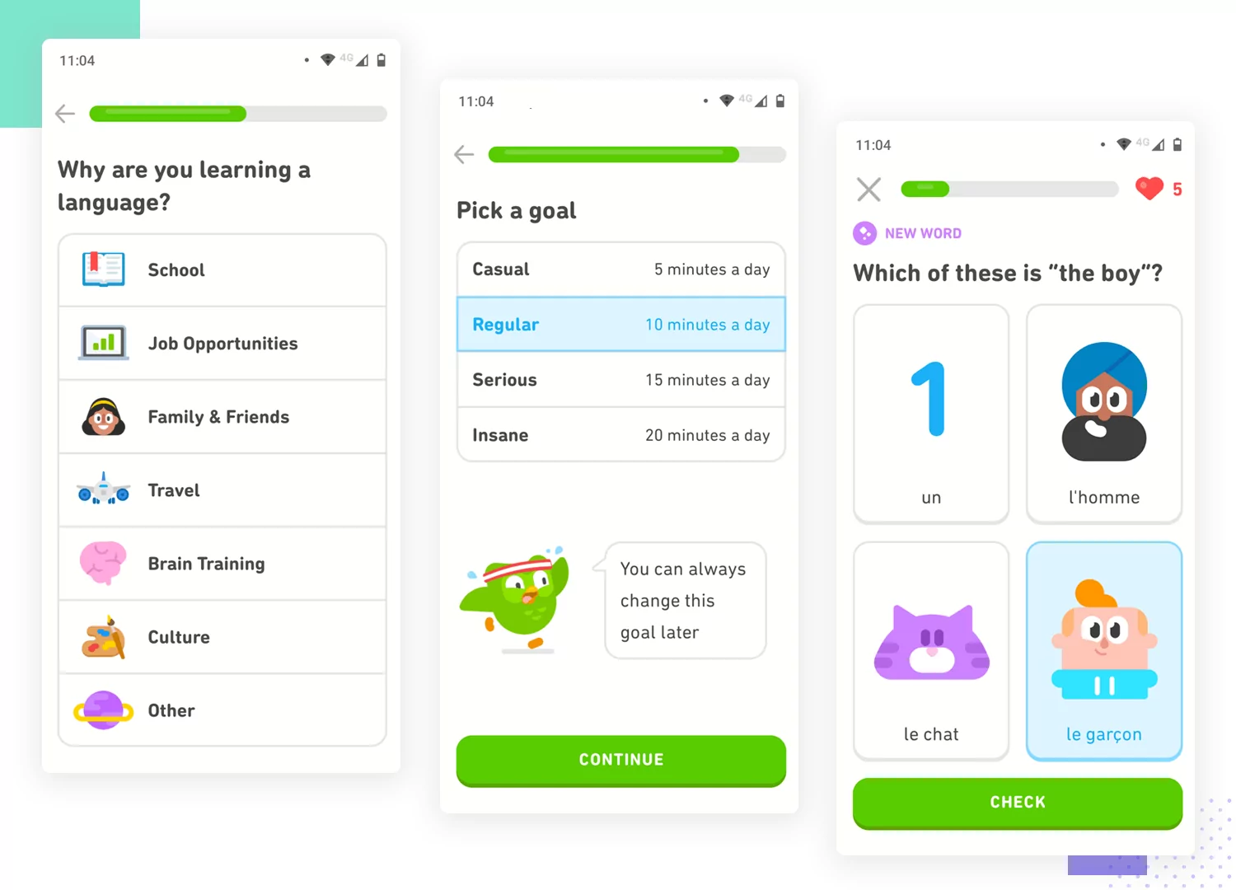
What is UX?
User Experience (UX) refers to the way a user interacts with and experiences a product, system, or service.

Slide 10
Key Aspects of UX
Total User Experience: Refers to the broad experience of a user, encompassing every touchpoint along the way
User Interface: Focuses on the visual and interactive aspects of the product
User Journey: UX design aims to create a seamless and meaningful experience throughout interaction with the product

Slide 11
Questions that guide UX design
Is the product logical, self-explanatory, and easy to use?
Does the product solve an existing user problem?
Is the product accessible to different categories of users?
Does the product create a positive user experience that the user would happily repeat?

Slide 12
What is the difference between HCI and UX?
HCI is a broader field of research that encompasses all aspects of interaction between humans and computers, while UX is focused on design and creating appealing and effective interfaces
HCI is more academically focused, involving research and empirical understanding of users, while UX is industry focused, involving working on products and services
HCI aims to improve the user experience with technology, while UX aims to create an overall positive experience for the user
UX can be considered a sub-field of HCI. UX pulls from HCI research to support the design process.

Slide 13
Why do we need HCI/UX?
HCI/UX is present in every field or industry that uses some form of technology.
Even outside of work and business, billions of individuals use technology on a daily or weekly basis.
By integrating HCI/UX principles into technological development, we can create systems that are more humane, effective, and beneficial for both individuals and society.
More specifically, HCI/UX improves usability, enhances the customer experience, boosts business efficiency, and contributes to academic advancements and research

Slide 14
HCI/UX
Needs
Design
Evaluation
Agile
Responsive

Slide 15
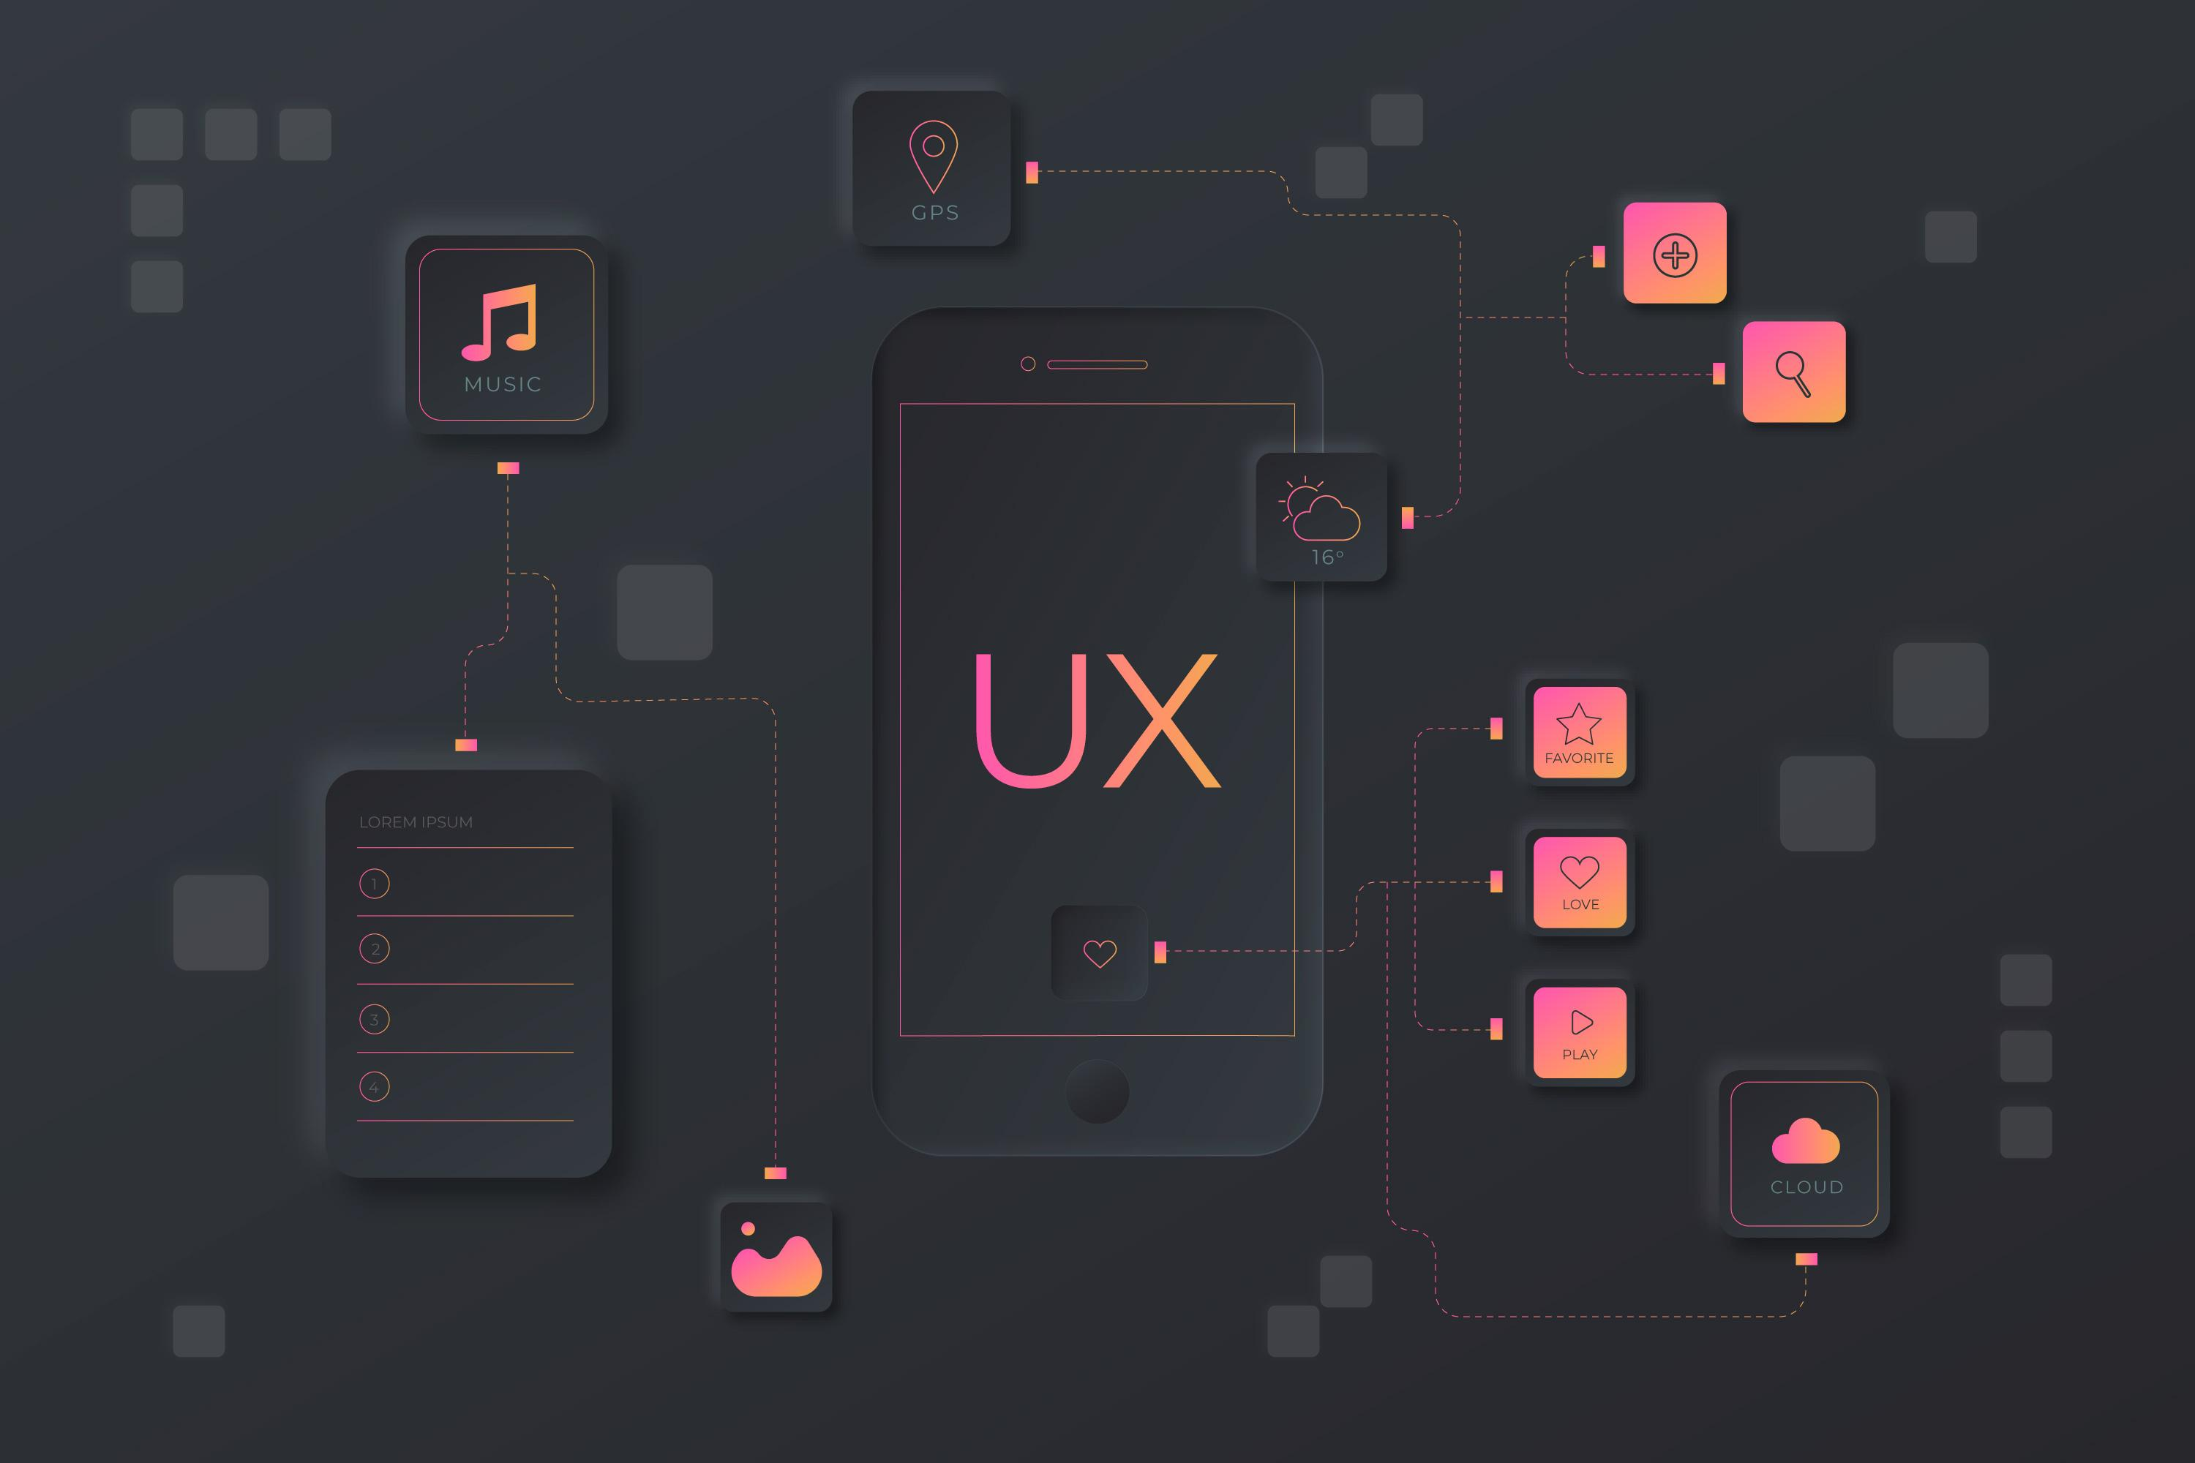
User Stories and Requirements
Understanding Needs
Research Data

Slide 16
What is research data?
It is the process of understanding how users discover, interact, and use products to better a designer. This data is crucial for gaining insight and bettering design and development for products and services that are centered around a user. This can be done through several methods that are both qualitative and quantitative
Qualitative methods
These methods are about gathering rich and in-depth insights about what a user thinks, feels and does. These insights are invaluable for improving the user experience to meet their needs and wants.

Slide 17
User Interviews
What is it: User Interviews are deep conversations about their experiences, needs and frustrations. This gives a deep insight into the individual and how they feel about the software.
Drawbacks: Users can have biases that influence their feelings, they could have bad memory, or the interviewer could ask bad questions. This is also a time intensive process.
Focus Groups
What is it: User review sessions where a small group discusses the product openly with a moderator. This can find the collective view and diverse opinions
Drawbacks: Groupthink can lead to only the dominant views coming through. The moderator could also influence the discussion with biases. Additionally, this method is not as deep as an interview.

Slide 18
Usability testing
What is it: Watching users use the product to find issues and understand user-friendly elements
Drawbacks: Limits scope due to focus on certain features. The artificial environment of it also does not represent the real-world usage the product would normally have. The user would also be influenced by the fact they are being observed and that would affect their behavior.
Concept testing
What is it: Presenting early prototypes, wireframes and high-level sketches of a product or feature.
Drawbacks: Early stages come with bias from people only wanting things they already know. Additionally, the vague nature of a prototype could lead to confusion

Slide 19
Card Sorting
What is it: Users are given cards containing topics and ideas and are told to group them based on their personal interpretation. Of this there are two kinds, Open and closed card. Open cards have them categorize the topics into groups they create. In closed they put them into groups that are predetermined.
Drawbacks: May not reflect how the users feel about the topics in the real world. Also has a limited scope due to the limit of categorization and hierarchy
Journey mapping / Diary Studies
What is it: user directed form of documentation where their experiences, interaction and thoughts about a product over time
Drawbacks: Very time consuming and has bias in self reporting data. Participants may also forget to journal.

Slide 20
Quantitative Research Methods
Involves collecting and analyzing numerical data to focus on aspects like behavior, task completion times, click through rates and error frequencies. This makes it easy to find trends, patterns and behavior of users.
User Surveys
What is it: structured questionnaires that are made to collect specific information from a broad base of users. These can include multiple types of questions such as multiple choice, open ended, and ratings.
Drawbacks: Multiple choice surveys can limit the depth of the responses. Not clear questions can lead to confusion and answers that don’t reflect their true feelings

Slide 21
A/B Testing
What is it: It is a method in which two versions of a web page or feature are compared to which performs better. This can test various designs, content, or functionality changes.
Drawbacks: Limited scope since only one thing can change at a time. Users may also get confused by the changes in the program that they were not aware of. Also, could lead to only short-term gains with it hurting the long-term user satisfaction overall.
Web Analytics
What is it: This is about understanding how users interact with websites and tracks their actions about behavior. This data is invaluable for getting users habits, traffic patterns and performance overall.
Drawbacks: Privacy concerns can be made over this technique since you are looking at everything a user is doing. Additionally, you would need a way to hold all the data you would be getting from the users.

Slide 22
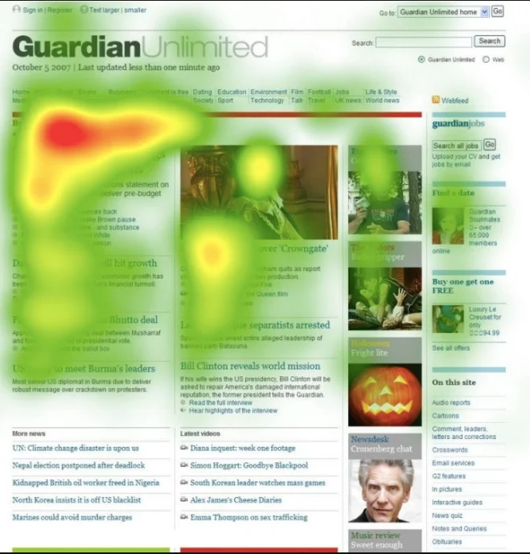
Usability Metrics
What is it: Turns the user experience into numbers to measure how easy and efficient a product is. They focus on collecting hard data over opinions and analyzing user performance.
Drawbacks: Focusing only on usability can lead to missing out on the broader user experience. Also, the data is missing context of the interactions, leaving it incomplete
Heatmaps
What is it: They are visual tools that graphically show where users click or scroll on a webpage. Color codes highlight which parts of a webpage draw the most attention and interaction
Drawbacks: These lack context for why users are clicking in certain spots, must be inferred. Heatmaps are also from a certain point in time and don’t show how that evolves.

Slide 23
User Stories
A user story is a short plain language description of how the software should work from the end user’s perspective. It is about what they want and hope to achieve with the product. It is not a product feature but is the end goal the user wants from the product.
Benefits:
Provide a clear and concise way to capture requirements that makes it easy for the dev team to know what to implement
Prioritizes features and functionalities based on what the user wants.
Minimizes scope creep by focusing only on what is needed and wanted
Better for startups and small teams.

Slide 24
Requirements
Requirements are the blueprint for the dev team. This involves analyzing the needs and expectations of the stakeholders, users, and clients involved in the project. The functional and non-functional requirements outline the aspects of the software that need to be developed. The written software requirements serve as the foundation for the project, including design, development, testing, and deployment.
Benefits:
Gives a clear understanding of what needs to be done or implemented
Well defined requirements streamline the dev process, making it very efficient and with less risks
Requirements serve as valuable documentation for future updates and maintenance

Slide 25
HCI/UX
Needs
Design
Evaluation
Agile
Responsive

Slide 26
Design Approaches for Displays
Wickens’ 13 Principles
Prototyping Techniques

Slide 27
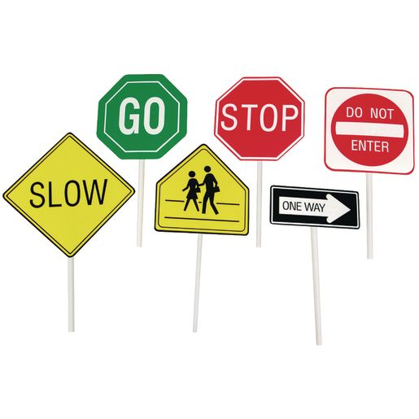
Wickens’ Thirteen Principles
Developed in 2013 by Christopher Wickens in his book, “An Introduction to Human Factors Engineering”
These principles can be divided into four different sections:
Perceptual Principles (5)
Mental Model Principles (2)
Principles based on Attention (3)
Memory principles (3)
Perceptual Principles
Display is defined as a human-made artifact “designed to support the perception of relevant system variables and facilitate the further processing of that information.”
The perceptual principles deal with the way a user initially perceives the material presented. The information needs to be presented in a clear and unambiguous manner to avoid confusion by the user.

Slide 28
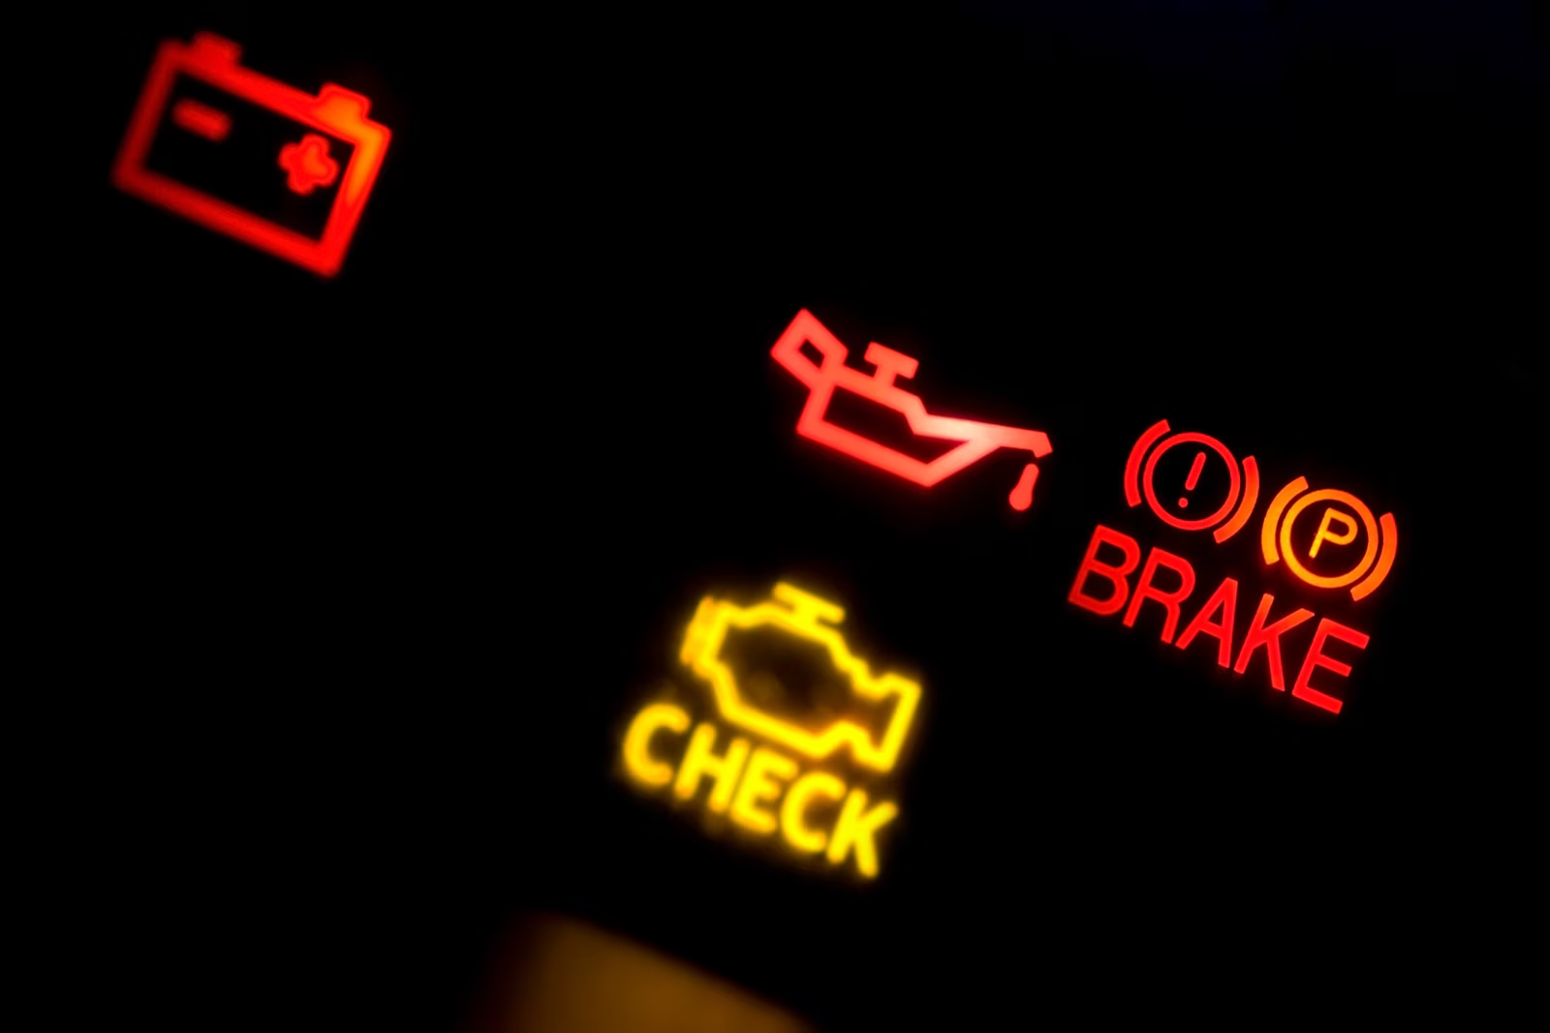
Make display legible or audible
The most important principle of display design. Every display must be legible (or audible, if needed) to allow the user to interact with it successfully.
The correct combination of colors, contrasts, and sounds should be used to ensure that the user gets the necessary information from the display
Avoid Judgement Limits
Do not require the operator to judge the level of a represented variable based on a single sensory variable (e.g., color, size, loudness) which contains more than five to seven possible levels
It is important to use multiple different variables so that the operator can tell what is happening in a short amount of time.

Slide 29
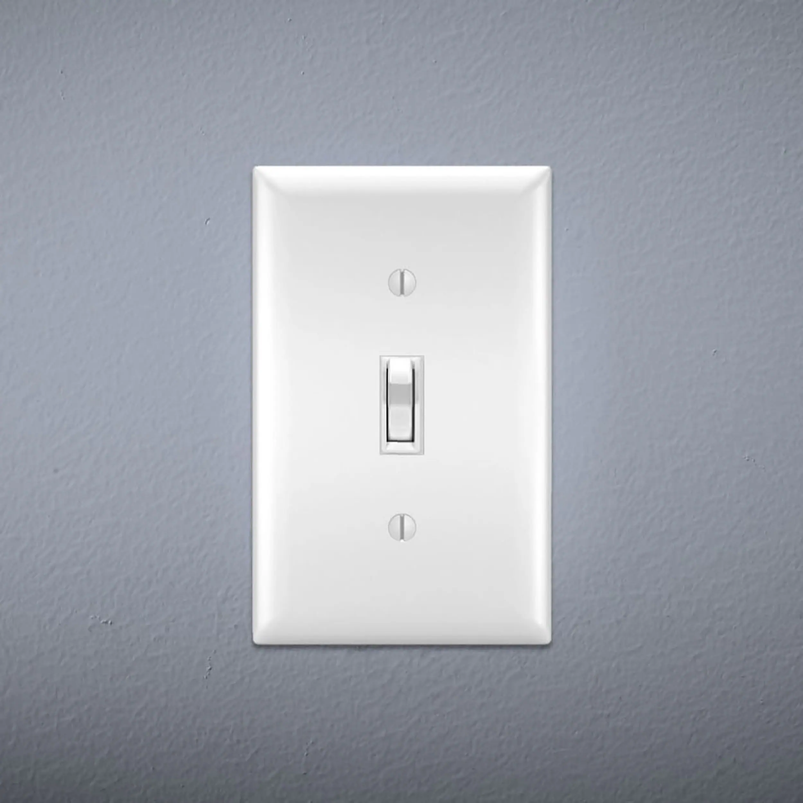
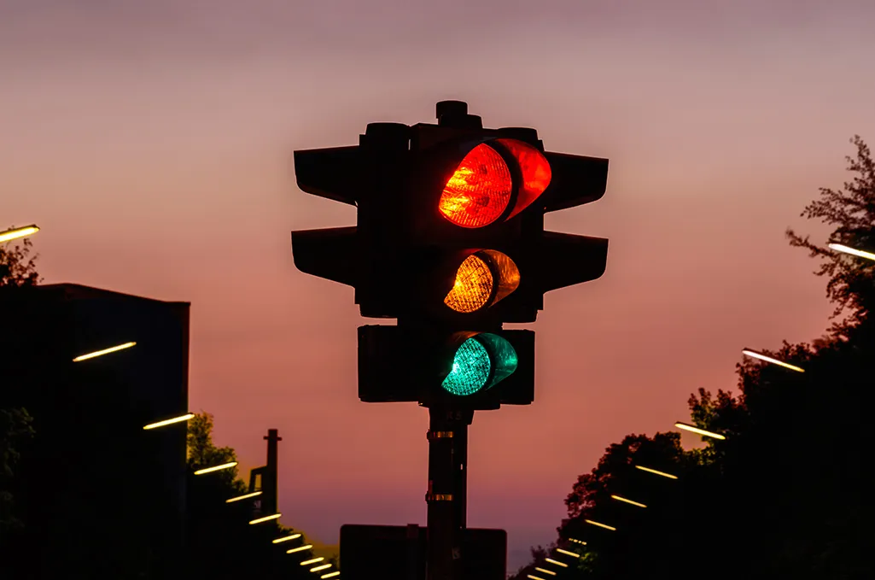
Top-Down Processing
If a signal is presented that is contrary to expectations, then more evidence will be needed to better represent that. Design signals that go along with people’s expectations.
Ex. Is this light switch on or off?
Make use of redundancy gain
Presenting multiple redundant stimuli can lead to faster and more accurate responses than presenting a single stimulus
Ex. Traffic light, position and hue are redundant because they can both tell you the same thing. Top light is stop and bottom is go, and red is stop and green is go. Having both makes it easier to tell at a glance what to do.

Slide 30
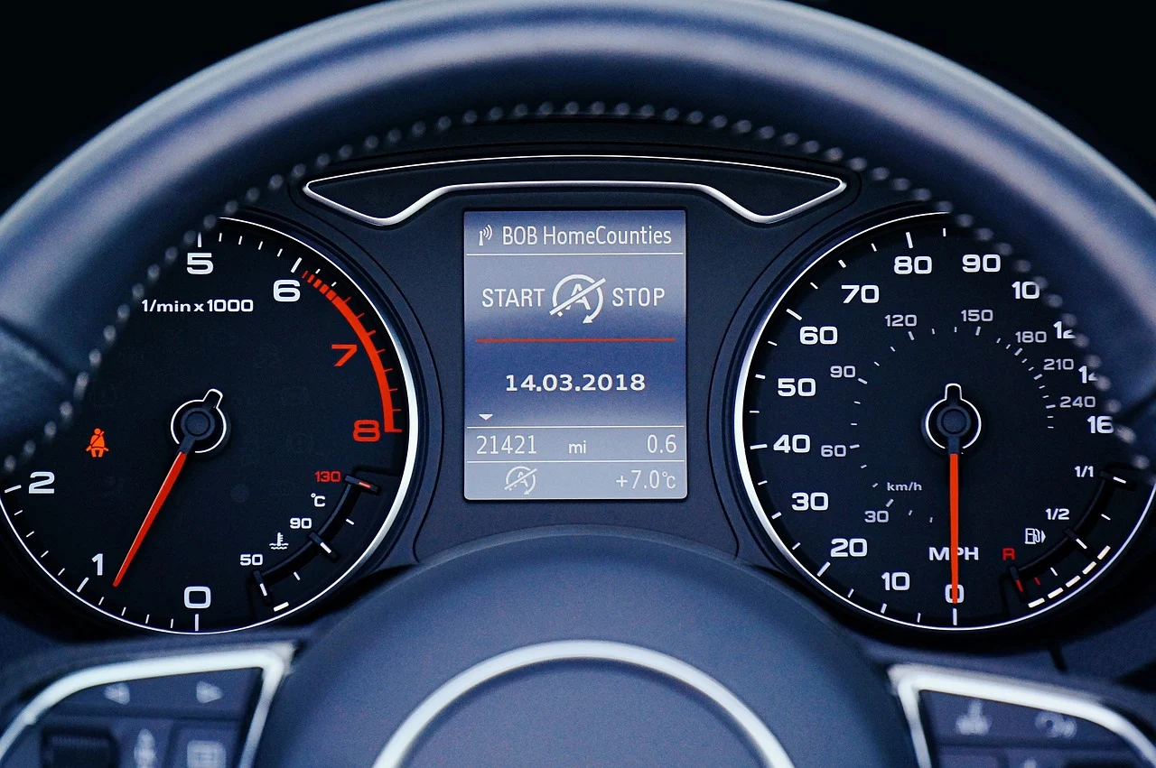
Ensure Discrimination
Similarity causes confusion.
Delete unnecessary similar features and highlight dissimilar ones to create distinctiveness
Mental Model Principles
When a user sees a display, they usually interpret the display based on their expectations of the system being displayed. These expectations come from past experiences which have formed a mental model of the system and how it works. It is important to design displays that are consistent with the mental models of the user.

Slide 31
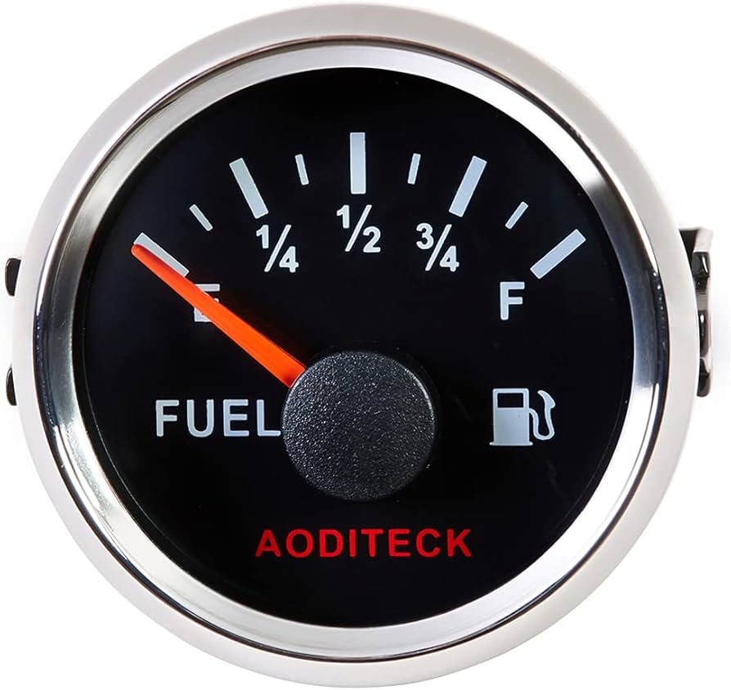
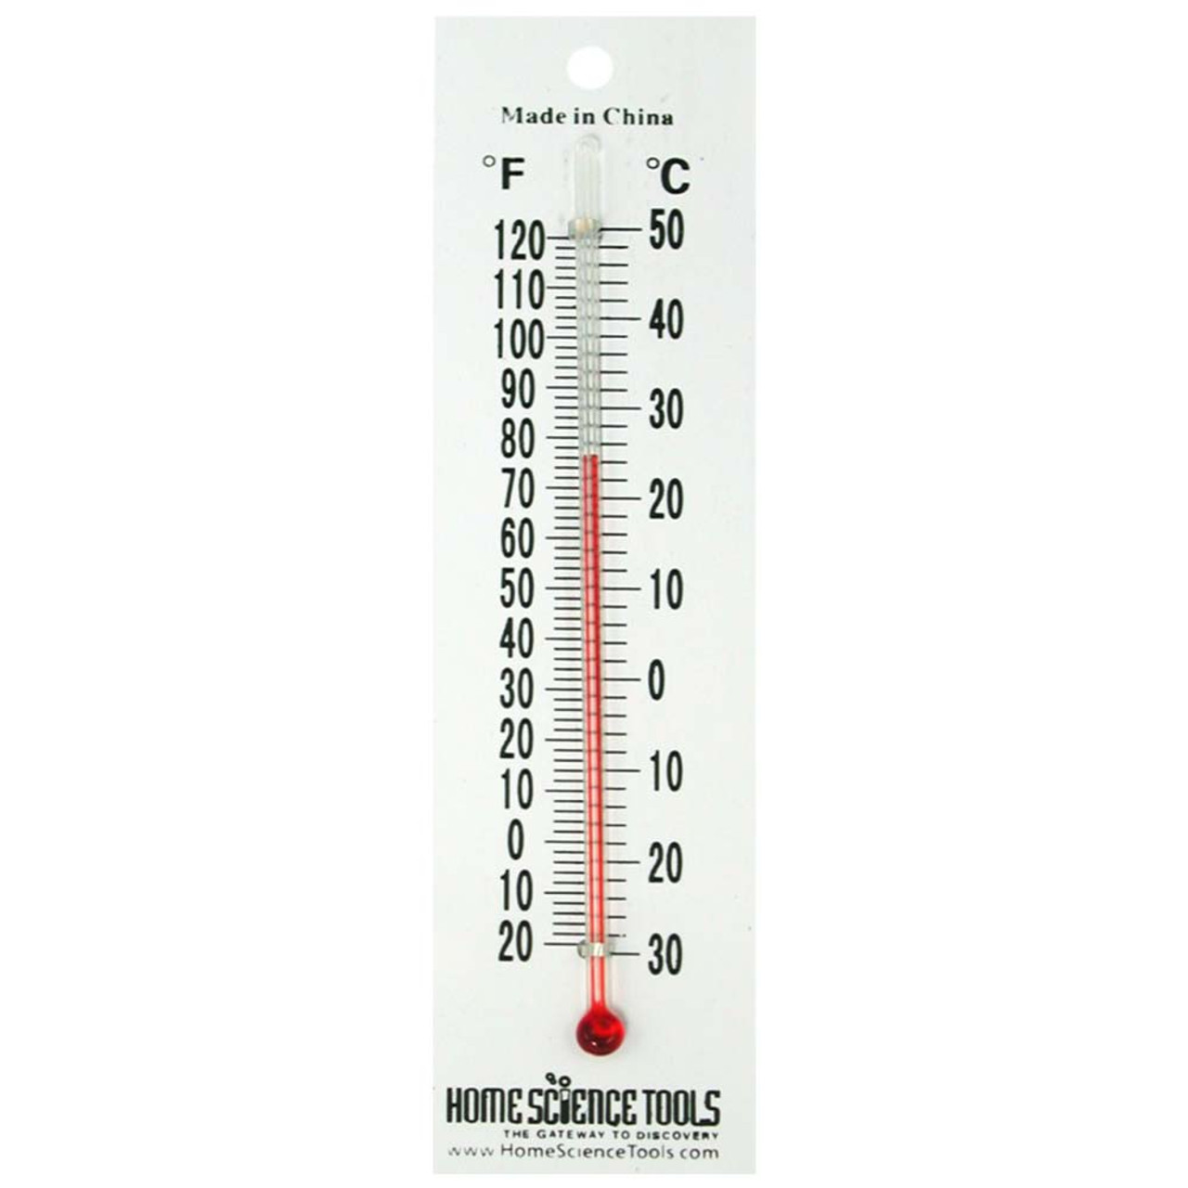
Principle of Pictorial Realism
Displayed quantities should correspond to a person’s internal model of these quantities.
Example: A thermometer measures temps from high to low, so it should me displayed vertically.
Principle of the Moving Part
The direction of moving parts of an indicator should change in accordance with the internal model a person has of the change.
Ex. Thermometer mercury rises as temperature rises
Some cases could have different perspectives of the same change, and it is important to account for these
Ex. When a plane banks a direction, the pilot sees the horizon moving while from an outside perspective, it is the plane that is moving. How would you show the change on a display.
Answer: fast turns are displayed using outside perspective, gradual ones are displayed with pilot’s perspective

Slide 32
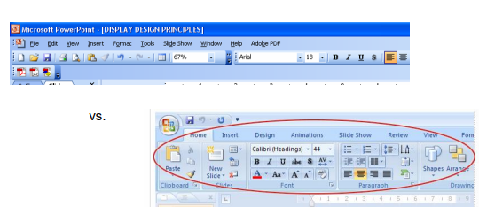
Principles based on Attention
These are based on the person operating being able to keep attention easily by reducing clutter and using simplicity. Cluttered displays can make people lose focus and cause confusion.
Minimizing information access cost
Selective attention: the idea people should pay more attention to the most relevant information rather than all information.
Minimize the cost in time and effort of moving selective attention from one display location to another by keeping frequently accessed information sources close together so that the cost of “traveling” between them is small.

Slide 33
Proximity compatibility principle
Gestalt - human tendency to perceive complex configurations as complete entries
Mental proximity: When two or more sources of info are related to the same task and must be mentally integrated to complete the task
When sources have a close mental proximity, provide users with close display proximity by having them close together. This lowers the information access cost.
However too many close displays proximity could be bad, especially if one source requires more attention than others.
Principle of Multiple Resources
Processing large amounts of info can be facilitated by dividing that info across resources. This can be done by presenting with both auditory and visual info rather than just one or the other.
Input modes, response devices, and tasks should be combined such that they are dissimilar in terms of processing stages, input modularity, and processing codes.
Ex. Texting and Driving

Slide 34
Memory Principles
These principles have to do with a person’s own memory and how that affects their ability to complete tasks quickly.
Principle of predictive aiding
Prediction is hard for a person to do and is even harder if they are already doing another cognitive task. Displays that can explicitly predict what will (or what is most likely going to) happen will be more effective.

Slide 35
Principle of Knowledge in the World vs Knowledge in Head
Penny Test: You know what all is on a penny, but do you know where they go on that penny.
Placing explicit reminders or statements of what is to be done at the time and place that will trigger the appropriate action
This can lead to clutter; good design must find a balance
Principle of Consistency
Consistency leads to a positive transfer between different displays.
This means you should have consistency between displays of the same system (Red colored objects all mean the same thing) and should be consistent with a user’s mental model of how something should work (Red means hot, stop, bad, etc)

Slide 36
Why does prototyping matter?
Prototypes are the visual representation of your plan for your final project. They help with visualizing concepts, gathering feedback, and testing functionality. This allows you to show off your project without needing a finished product.
Types of Prototypes
There are many types of prototypes but for HCI/UX there are four main ones. These types are:
Paper
Low-Fidelity
Mid-Fidelity
High-Fidelity

Slide 37
Paper Prototypes
These are the most basic and involve using hand drawn sketches and layouts of an interface on paper.
Pros: Easy to make, little to no cost, easy to modify during creation and brainstorming
Cons: no interactivity, limited design testing
Low-Fidelity Digital Prototypes
These are digital representations made with basic design software. They are more functional but lack great amounts of detail
Pros: Functionality and testing can be done
Cons: Little detain and doesn’t convey the intended feel of app

Slide 38
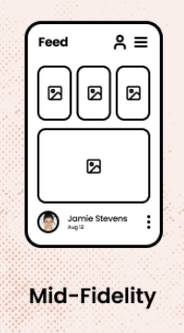
Mid-Fidelity Prototype
These is midpoint between low and high fidelity. This adds more features that will be in the final project but is still unfinished enough that things can be easily changed. This allows you to focus on refining the user experience and test more specific functions.
High Fidelity Prototypes
This is the most detailed and closest to final design prototype. This uses intricate design elements and functionality.
Pros: Most realistic representation, very valuable for user testing and showing to clients
Cons: Most time consuming and focus may be put too much on the looks and not the actual design.

Slide 39
HCI/UX
Needs
Design
Evaluation
Agile
Responsive

Slide 40
Evaluating
a Design
Users and Tasks
Measurements and Testing
Iterating the Design

Slide 41
Evaluating a design for HCI/UX
Why do we evaluate HCI / UX? (AIA = Andy Is Angry)
Assess the system’s functionality
Identify specific problems with the interface
Assess users’ experience with the interface
Assess the system’s functionality
System evaluation should ensure:
Provision of sufficient functionality for users to perform tasks efficiently.
Assessment on how effectively users interact with the system.
Source: https://www.educative.io/answers/what-are-the-evaluation-and-goals-in-hci

Slide 42
Identify specific problems with the interface
Related to system functionality and usability of interface design.
Inspecting interface components which generate unexpected outputs and confuse users.
Assess users’ experience with the interface
Evaluate user’s experience with interaction
Evaluated through learnability, usability, and user satisfaction
Examine pain points and avoid them
Source: https://www.educative.io/answers/what-are-the-evaluation-and-goals-in-hci

Slide 43
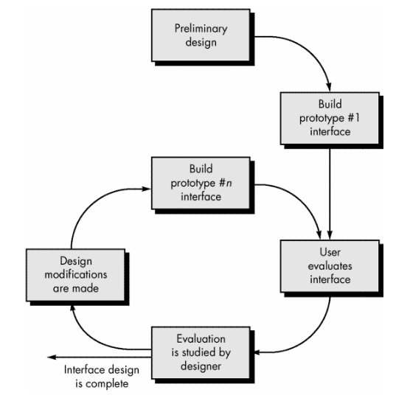
Users and Tasks
In evaluating a HCI/UX design, we need to recognize the importance of understanding users and the tasks they wish to achieve.
Users:
In understanding the users, we utilize personas. Personas are fictional characters which are created based on research. They are used to:
Identify different user groups
Understand their goals and needs
Address potential frustrations
Source: https://www.interaction-design.org/literature/article/personas-why-and-how-you-should-use-them

Slide 44
Types of Personas (GEFR = Great Elephants Fear Rain)
Goal-directed Personas
The main goal is to analyze how the user would like to achieve their goals while utilizing the product.
Engaging Personas
Engaging personas are used to help designers become more engaged with them, so that they are considered during process design.
Fictional Personas
These personas come from the UX design team, to make assumptions on how users look like. These assumptions are based on past interactions.
Role-based Personas
Role-based personas focus on the user’s role in the organization . The role we play helps determine how our designs are created to meet these needs.
Source: https://www.interaction-design.org/literature/article/personas-why-and-how-you-should-use-them

Slide 45
Tasks (TDBRA= The Dragon Breathes Red Air)
Understanding required tasks are another important part of HCI/UX design, as it helps in evaluating as well as designing the system. Five types of data for analyzing tasks are:
Trigger - What initiates the task for the user?
Desired Outcome - How will the user know they have successfully completed the task?
Base Knowledge - What will the users be expected to know when starting the task?
Required Knowledge - What do users already know before starting the task?
Artifacts - What resource or tools will users require during task?
Source: https://www.interaction-design.org/literature/article/task-analysis-a-ux-designer-s-best-friend

Slide 46
Measurement and Testing
UI/UX metrics provide insights into user behaviors, attitudes, and preferences. This helps analyze and facilitate a seamless and pleasant user experience. There are four categories of UI/UX measurement metrics:
Quantitative: Numerical data that provide insights into user behavior and interactions with product
Qualitative: Capture users’ feelings and experiences towards the product
Behavioral: Tracking users’ actions and engagement with product
Attitudinal: Capturing how users feel about the product
Source: https://medium.com/kubo/10-crucial-ui-ux-metrics-every-start-up-should-be-tracking-ee6f87af693a

Slide 47
Based on the four categories mentioned in the previous slide, we have ten UI/UX metrics:
User satisfaction: Helps measure happiness quotient of users
Task Success: Analyze if users achieve what they set out to do
Engagement: How often do users interact with your product
Usability: How easy is it for users to use your product
Conversion Rate: Percentage of users who completed a desired action
Retention Rate: Percentage of returning users after initial visit
Error Rate: Number of errors encountered while using product
Loading Time: Keep track of loading times for optimization of user experience
Navigation: Measure how user-friendly the product navigation is
Accessibility: Ability to be used by people of all abilities
Source: https://medium.com/kubo/10-crucial-ui-ux-metrics-every-start-up-should-be-tracking-ee6f87af693a

Slide 48
Testing:
Testing is done by combining information from user responses to prototypes, as well as experiences from earlier product iterations.
7 types of product testing methods are:
Concept validation: Asking real and potential users to respond to early product design and hypotheses.
Usability task analysis: Checking whether users can complete key tasks on the product without hitches.
First-click testing: Teams observe users to see where they click first on an interface to complete certain tasks.
Card sorting: Tests the design, usability, and information architecture of the product page.
Tree testing: Ask participants to do specific tasks on a pared-down product map, to analyze product experience.
User feedback: Open-ended research method for direct feedback about overall user experience.
Split testing: Performing multivariate tests on controlled groups to try different design combinations, and analyze to which designs users respond best
Source: https://www.hotjar.com/product-design/testing-methods/

Slide 49
Usability Testing
Usability Testing is the practice of testing how easy a design is to use with a group of representative users. Chief objectives are:
Determine whether testers can complete tasks successfully and independently.
Assess their performance and mental state as they try to complete tasks, to see how well your design works.
See how much users enjoy using it.
Identify problems and their severity.
Find solutions.
Source: https://www.interaction-design.org/literature/topics/usability-testing

Slide 50
How to make a usability testing work best:
Plan
Define what you want to test : Have a clear aspect of design to test
Decide how to conduct your test: Determine scope of test, methods of testing, and stick to it
Set user tasks
a. Prioritize most important tasks to meet objectives
b. Clearly define tasks with realistic goals
c. Create scenarios where users can try to use design naturally
Recruit testers which are part of your target group
Facilitate testing in a suitable environment, observe and interview users, and notice issues
Source: https://www.interaction-design.org/literature/topics/usability-testing

Slide 51
Iterative Design
Iterating a design helps refine a product, by including user feedback and testing into consideration. Design, testing, analysis, and redesign are conducted iteratively to help the product evolve into a better version of itself.
There are five key steps in iterative design:
Prototype creation: Creation of simple representation of product to test main functionalities
User testing and feedback: Prototype is tested by users, and feedback is recorded
Analysis of results: Feedbacks from users are analyzed
Redesign: Design is refined from these feedbacks to improve user experience
Repeat testing and feedback: After redesign, the product is tested again with users. The cycle continues
Source: https://www.thedesignership.com/blog/a-complete-guide-to-primary-and-secondary-research-in-ux

Slide 52
HCI/UX
Needs
Design
Evaluation
Agile
Responsive

Slide 53
Agile and UX
Integration / Adapting HCI / UX process to the agile framework

Slide 54
Nature of Agile:
In agile, development occurs in short sprints. It focuses on incremental improvements. UX can be adapted into the agile development. This will be done so by adjusting the UX design process to shorter sprint cycles. There are four key adjustments needed for adaption of UX design for Agile:
Condensing User Research Efforts: Shorten research phases, and focus only on key insights
Rapid Prototyping: Utilize quick, iterative prototyping to validate ideas
Prioritize User Testing: Conduct user testing within shorter time frames
Incremental Design Improvements: Emphasize small, continuous improvements and maintain user-centric design
Source: https://www.seamgen.com/blog/agile-ux-design-process#:~:text=ADAPTING%20UX%20DESIGN%20for%20Agile%20vs.&text=Key%20adjustments%20include%3A,deep%20understanding%20of%20users'%20needs.

Slide 55
There are a list of strategies which can be applied to achieve agility for UX design process:
Design Sprints
User Story Mapping
Persona Development
Journey Mapping
Wireframing
Prototyping
Usability Testing
A/B Testing
Continuous User Feedback
Cross-Functional Workshops
Kanban Boards
Pair Design
Heuristic Evaluation
Design Systems
Source: https://www.seamgen.com/blog/agile-ux-design-process#:~:text=ADAPTING%20UX%20DESIGN%20for%20Agile%20vs.&text=Key%20adjustments%20include%3A,deep%20understanding%20of%20users'%20needs.

Slide 56
HCI/UX
Needs
Design
Evaluation
Agile
Responsive

Slide 57
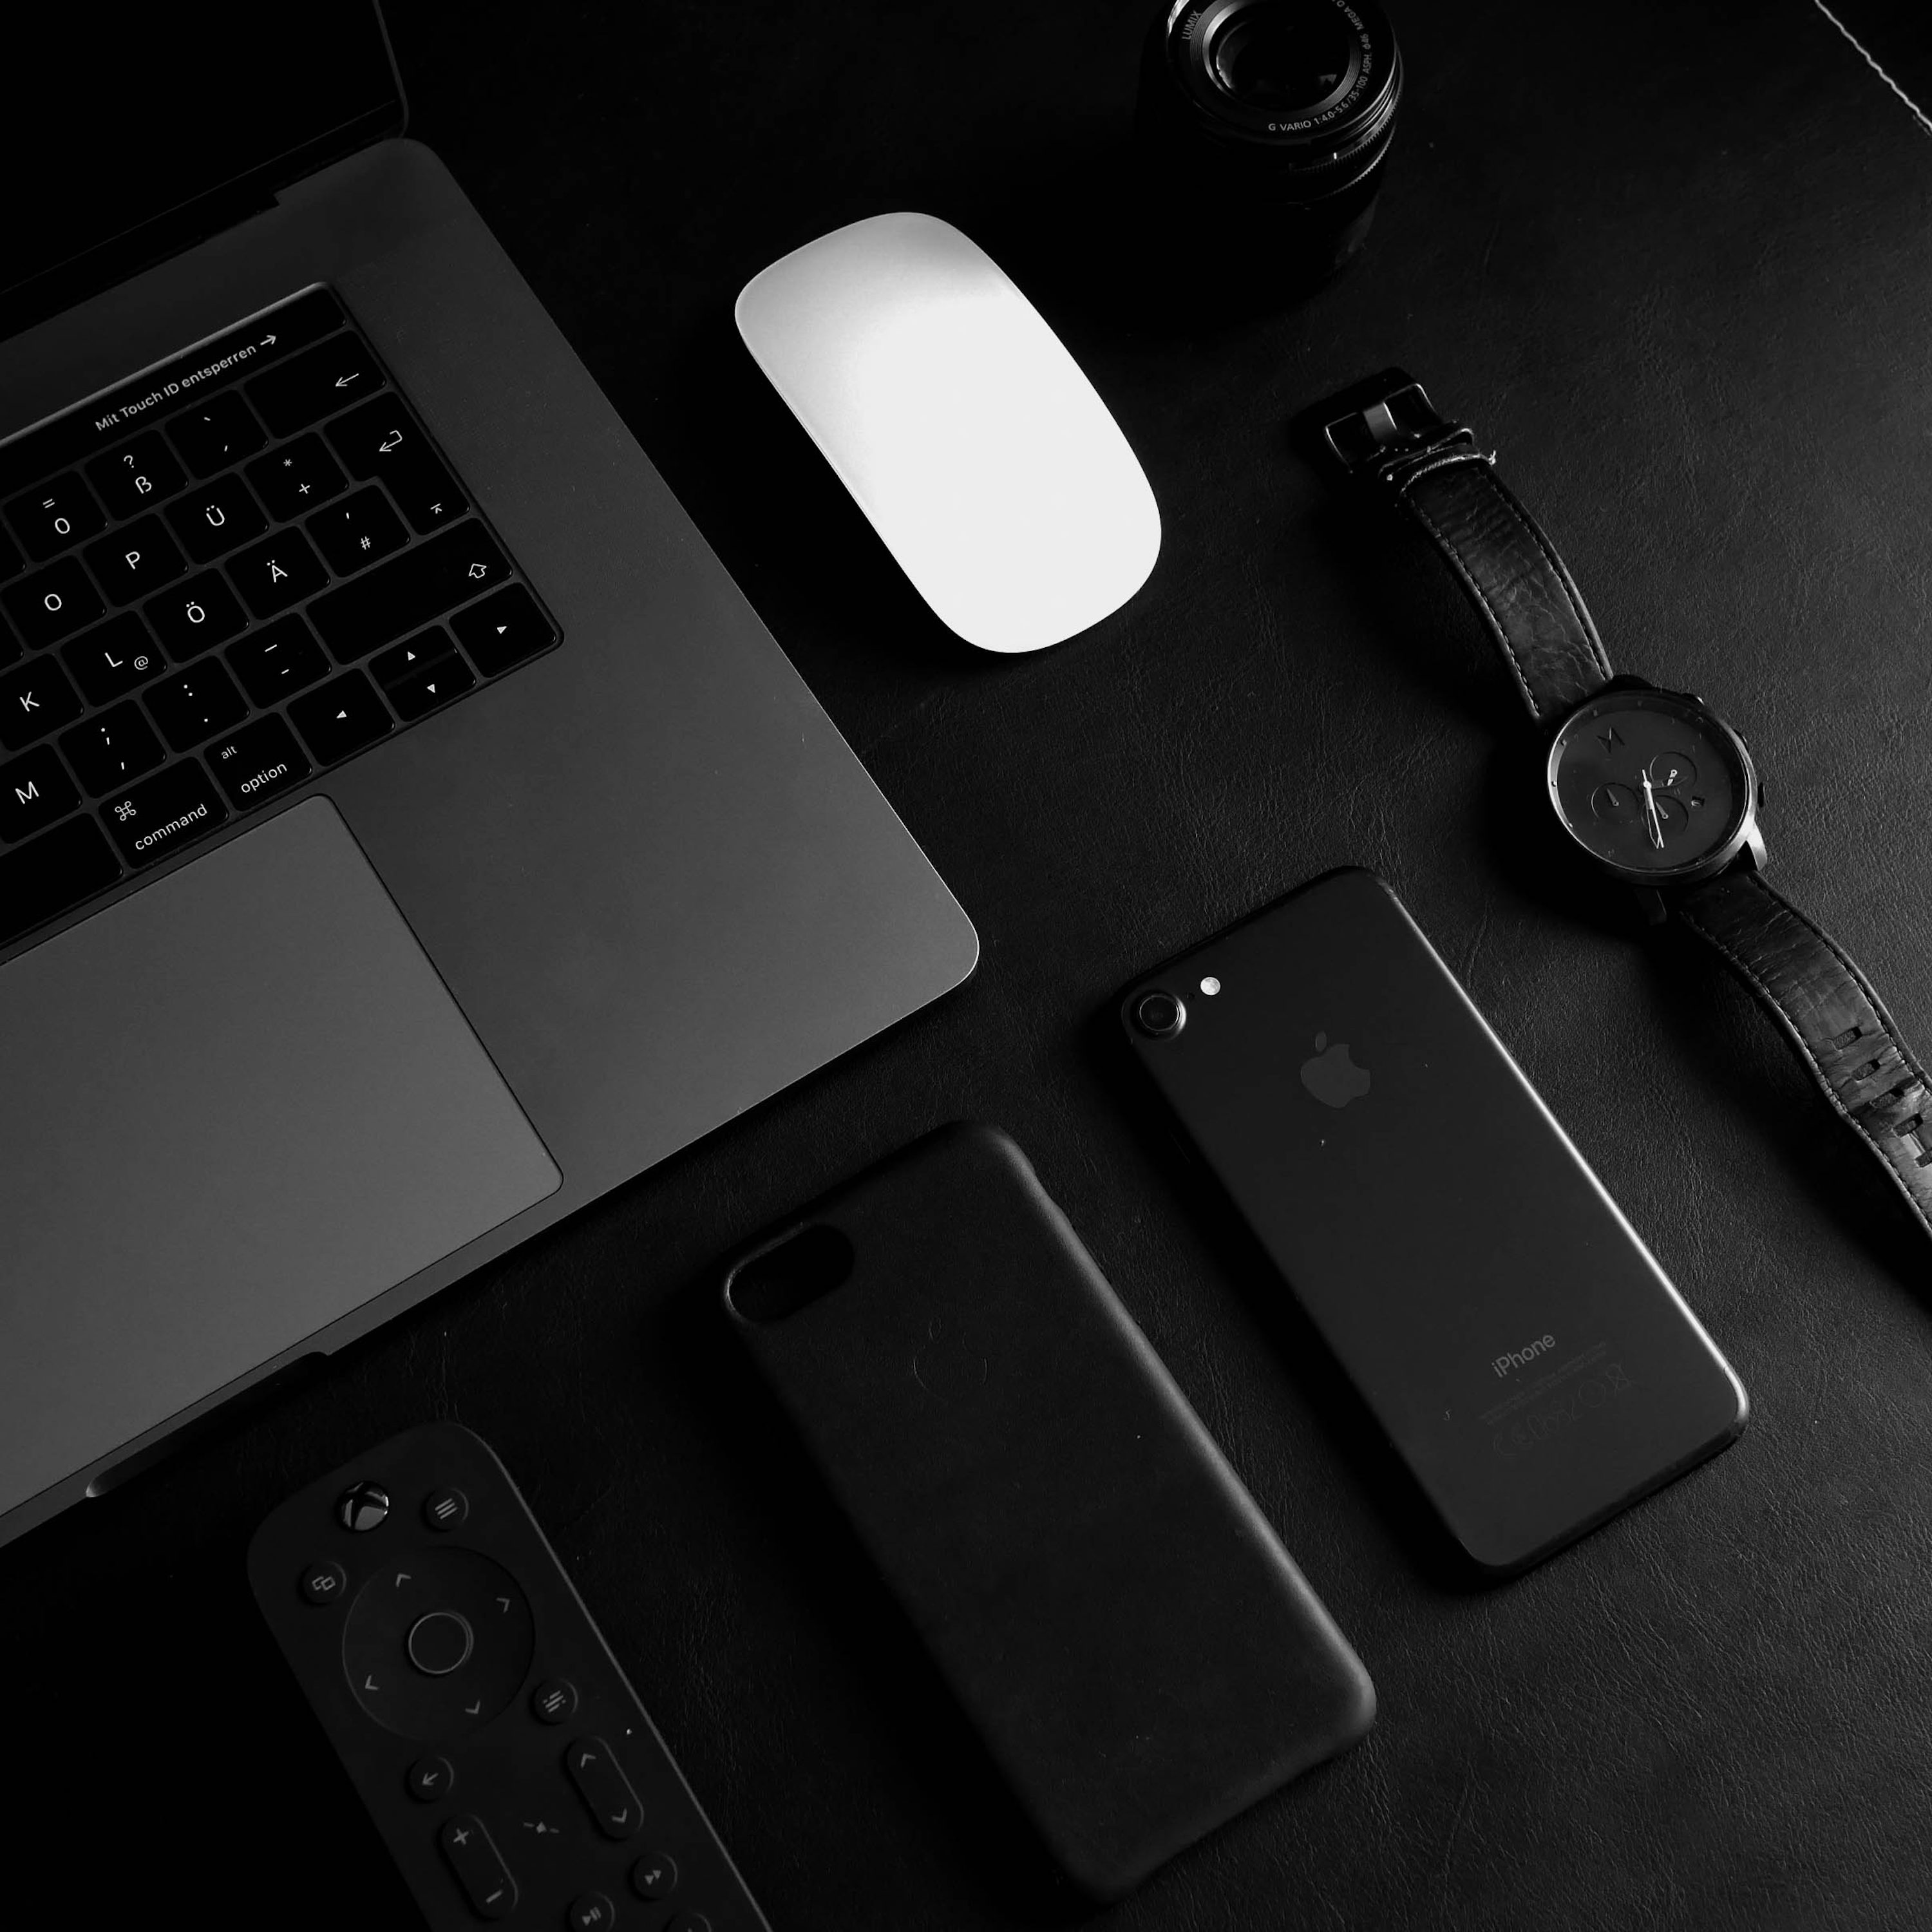
Responsive Web Design

Slide 58
What is responsive web design?
Responsive web design essentially makes a web page look good on all devices. Web pages do not leave out information to fit smaller devices but adapt its content to fit any device. There are three key features:
Site must be built with a flexible grid foundation
Images that are incorporated into the design must be flexible themselves
Different views must be enabled in different contexts via media queries
Source:https://www.webfx.com/blog/web-design/understanding-the-elements-of-responsive-web-design/

Slide 59
Responsive Web Design
Flexible Grid
Most existing grid systems restrictively use CSS classes to define size, space and alignment. The truly important aspect of a flexible grid system is in the mechanics of your layout sizes and spacing. We also must abandon pixels and replace them with web layouts that use percentages and em’s, which are relative units of measurement.
Flexible Image
The CSS overflow property (e.g.overflow: hidden) gives us the ability to crop images dynamically as the containers around them shift to fit new display environments. We can also have multiple versions of the image on the server, and then dynamically serve the appropriately sized version depending on the user agent using server-side or client-side feature detection in tandem with DOM manipulation. We also have the option to hide images altogether if we really want to put focus on the non-image content
Source: https://www.webfx.com/blog/web-design/understanding-the-elements-of-responsive-web-design/

Slide 60
Media Queries
Media queries allow designers to build multiple layouts using the same HTML documents by selectively serving stylesheets based on the user agent’s features, such as the browser window’s size. Other parameters are orientation (landscape or portrait), screen resolution, color (i.e. how much color the screen can render), and so on.
Media queries are not specifically a mobile solution or a tablet solution. Instead, media queries and responsive design allow us to think outside of the constraints of a screen size or resolution and start building websites that flexibly adapts to (theoretically) all the different mediums.
Source: https://www.webfx.com/blog/web-design/understanding-the-elements-of-responsive-web-design/

Slide 61
HCI/UX
Needs
Design
Evaluation
Agile
Responsive

Slide 62
THE END

Slide 63
Sources
https://www.geeksforgeeks.org/introduction-to-human-computer-interface-hci/
https://www.productplan.com/glossary/user-experience/
https://careerfoundry.com/en/blog/ux-design/what-is-user-experience-ux-design-everything-you-need-to-know-to-get-started/
https://faculty.mercer.edu/moody_le/documents/412lesson809-displaydesign.pdf
https://userexperienceexperience.blogspot.com/2009/11/design-heuristics-by-wicken-gordon-liu.html
https://www.thedesignership.com/blog/different-ux-research-methods
https://htmlburger.com/blog/prototype-design/
https://storiesonboard.com/blog/user-stories-vs-requirements#:~:text=User%20stories%20vs%20requirements%20are%20two%20different%20approaches%20to%20capturing,typically%20in%20a%20narrative%20format
https://www.educative.io/answers/what-are-the-evaluation-and-goals-in-hci
https://www.interaction-design.org/literature/article/personas-why-and-how-you-should-use-them
https://www.interaction-design.org/literature/article/task-analysis-a-ux-designer-s-best-friend
https://medium.com/kubo/10-crucial-ui-ux-metrics-every-start-up-should-be-tracking-ee6f87af693a
https://www.hotjar.com/product-design/testing-methods/
https://www.interaction-design.org/literature/topics/usability-testing
https://www.thedesignership.com/blog/a-complete-guide-to-primary-and-secondary-research-in-ux
https://www.seamgen.com/blog/agile-ux-design-process#:~:text=ADAPTING%20UX%20DESIGN%20for%20Agile%20vs.&text=Key%20adjustments%20include%3A,deep%20understanding%20of%20users'%20needs
https://www.webfx.com/blog/web-design/understanding-the-elements-of-responsive-web-design/

Slide 64
Sources
https://faculty.mercer.edu/moody_le/documents/412lesson809-displaydesign.pdf
https://userexperienceexperience.blogspot.com/2009/11/design-heuristics-by-wicken-gordon-liu.
html https://www.thedesignership.com/blog/different-ux-research-methods
https://htmlburger.com/blog/prototype-design/
https://storiesonboard.com/blog/user-stories-vs-requirements#:~:text=User%20stories%20vs%20requirements%20are%20two%20different%20approaches%20to%20capturing,typically%20in%20a%20narrative%20format

