Slide 1
STL and Boost
Thomas Bendall, Adam Kendrick, Samanvay Gupta

Slide 2
Standard Template Library (STL)

Slide 3
What is STL?
It was originally designed by Alexander Stepanov. It eventually became accepted as part of the C++ standard in C++ 98.
It is a C++ library that contains a set of template classes and functions that provide the implementation of common data structures and algorithms such as lists, stacks, arrays, sorting, searching, etc. It also provides the iterators and functors which makes it easier to work with algorithms and containers.

Slide 4
Why use STL?
Efficiency
Reusable
Flexible
Big part of modern C++ programming.
Allows programmers to not have to constantly re-create these things (vector, lists, etc.) themselves, and instead provides a common standard for all programmers to use which improves readability and writability of one’s program

Slide 5
Iterators

Slide 6
What is an iterator?
Types of Iterators
Iterators are Pointer-like objects used to point to the memory addresses of STL containers
Input
Output
Forward
Bidirectional
Random-Access

Slide 7
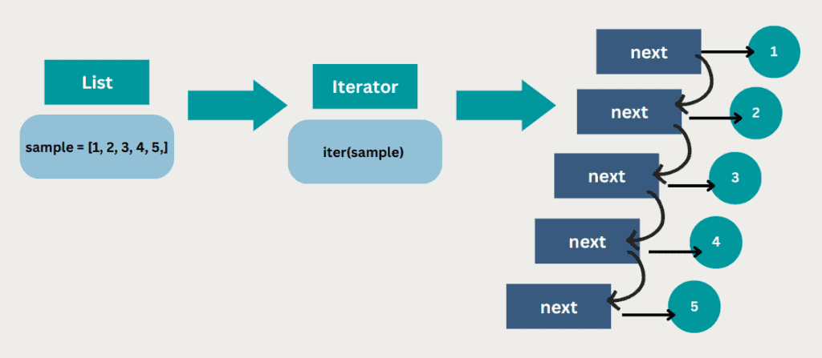
Input
Used to read values from a sequence once
The weakest and simplest among the STL iterators
Only moves forward

Slide 8
Prominent Features
Usability- can only be used with single pass algorithms where we can go to all location in the range.
Dereferencing- can obtain a value stored at the position being pointed to using ‘->’
Incrementable- can be incremented using ‘++’ to refer to the next element in the sequence.

Slide 9
Limitations
Input iterators are only able to access a value, it can never be used to assign a value
Can’t be decremented, can only move forward
No addition, subtraction, multiplication, division, <,>,<=,>= can be used

Slide 10
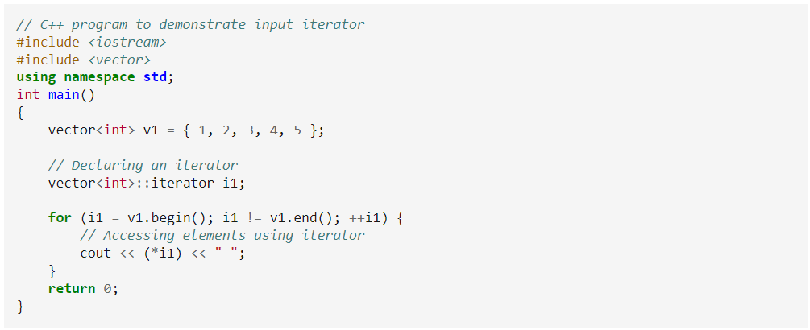
Example

Slide 11
Output
Opposite of input
Used to write values in a sequence only once, and move forward

Slide 12
Prominent Features
Usability - can only be used with single pass algorithms where we can go to all location in the range.
Dereferencing- can obtain a value stored at the position being pointed to using ‘->’
Incrementable- can be incremented using ‘++’ to refer to the next element in the sequence.

Slide 13
Limitations
Out iterators are only able to assign a value, it can never be used to access a value.
Can’t be decremented,
Can’t be used in multi-pass algorithms where we need to process the container multiple times.

Slide 14
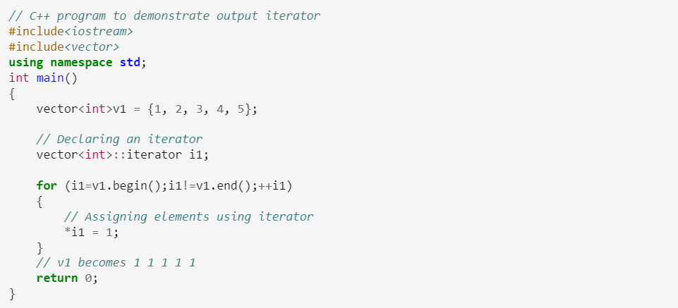
Example

Slide 15
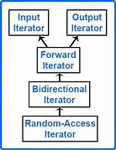
Forward
A combination of input and output iterators

Slide 16
Prominent Features
Can be used in multi-pass algorithms
Can be compared(==,!=)
Can be dereferenced like input and output, but can be dereferenced to show a value or assign a value

Slide 17
Limitations
Like the others, it can’t be decremented and only moves forward (hence the name)

Slide 18
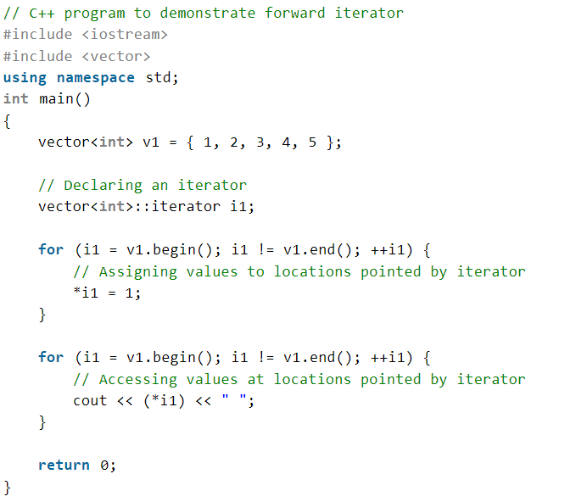
Example

Slide 19
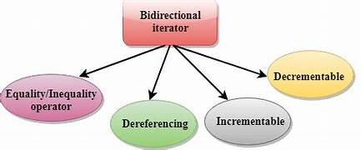
Bidirectional
Does everything a forward iterator can do, but can also move backwards

Slide 20
Prominent Features
Usability- can be used in multi-pass algorithms
Can be dereferenced just like forward iterators to both access and assign
Incrementable
Decermentable

Slide 21
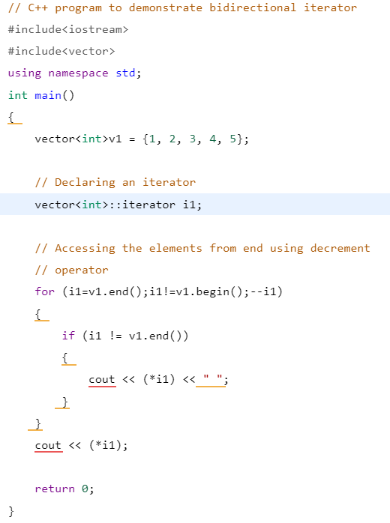
Example

Slide 22
Random-Access
Supports all operations of bidirectional iterator, and provides efficient random access to elements

Slide 23
Prominent Feature
Everything all the other iterators can do
Can use relational and arithmetic operators
Can use the ‘[]’ offset dereference operator

Slide 24
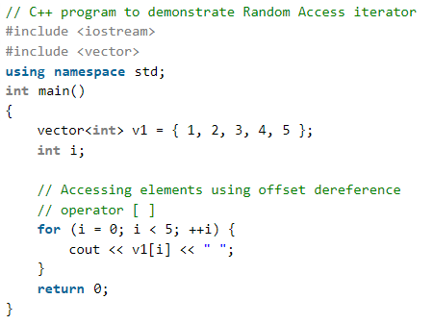
Example

Slide 25
Algorithm

Slide 26
What is an Algorithm?
A process or set of result to be followed by a set of ‘instructions’
A sequence of rigorous instructions used to solve a specific problem or to perform a computation.

Slide 27
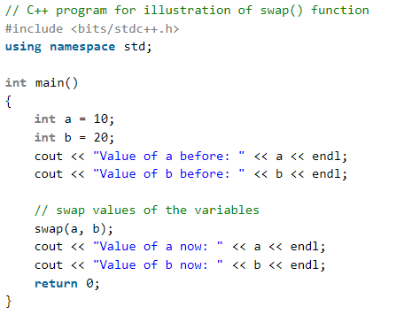
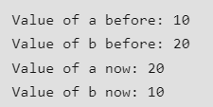
Swap
Exchanges the values of two variables
Takes two parameters(simple version)

Slide 28
Sort
Default sorts elements in ascending order
Takes two-three parameters
The first parameter is which point of the container will be in the sort first
The second parameter is where container end(or its desired end for the sort)
The third is optional, but can be used to sort the elements in a different way

Slide 29
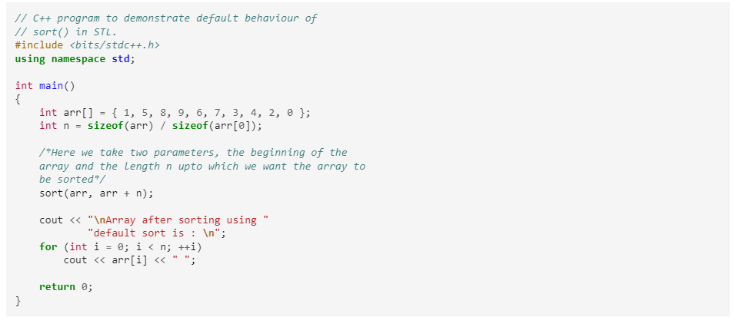
Example(Ascending)

Slide 30
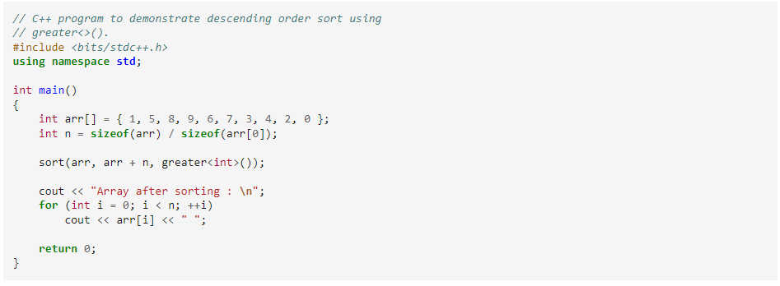
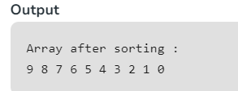
Example(descending)

Slide 31
Accumulate
Find the sum of the elements within the given range
Takes 3-4 parameters
First parameter is the first element of the range to be added
Second parameter is the last element of the range to be added
The third parameter is an initial value of the sum
The fourth parameter(optional) is a user defined function

Slide 32
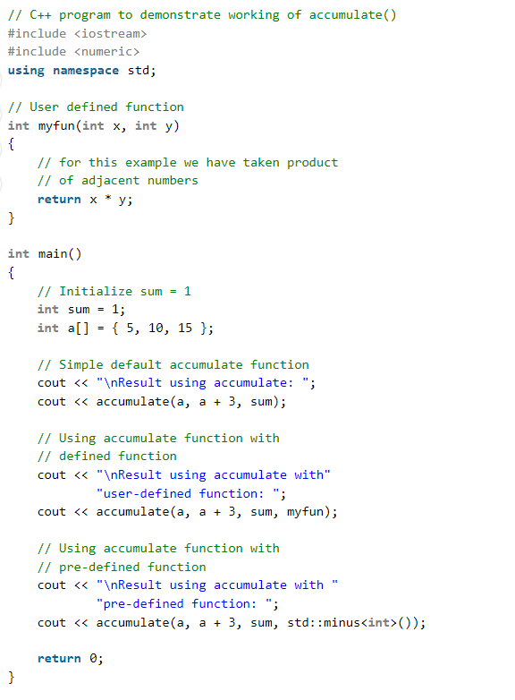
Example

Slide 33
Merge
This functions merges two containers together
Takes 4 parameters
First the beginning of the first container
Second the end of the first container
Third the beginning of the second container
Fourth the end of the second container

Slide 34
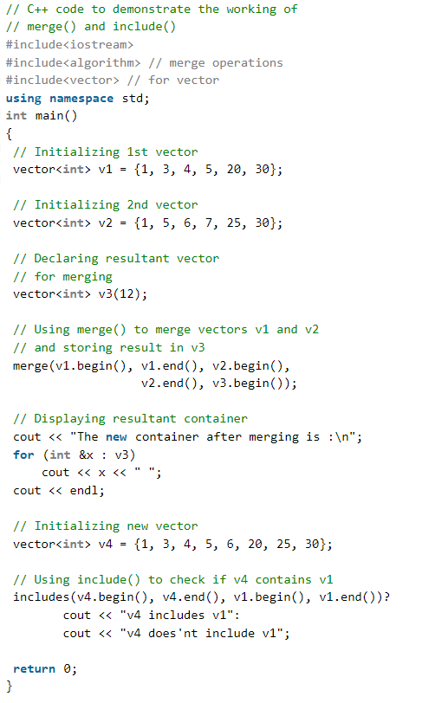
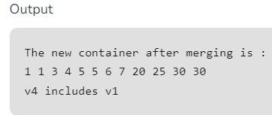
Example

Slide 35
make_heap
Transforms a container/sequence into a heap, which is a data structure that points to its highest(or lowest) element to make its access time O(1)
Takes 2 parameters
First beginning of the container
Second the end of the container

Slide 36
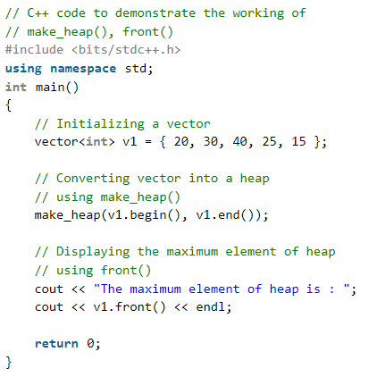
Example

Slide 37
Search
Searches the given sequence for an occurrence of the second given sequence
Takes 4 parameters
First beginning of the first sequence
Second end of the first sequence
Third beginning of the second sequence
Fourth end of the second sequence
Returns an iterator of the first occurrence of the second sequence within the first

Slide 38
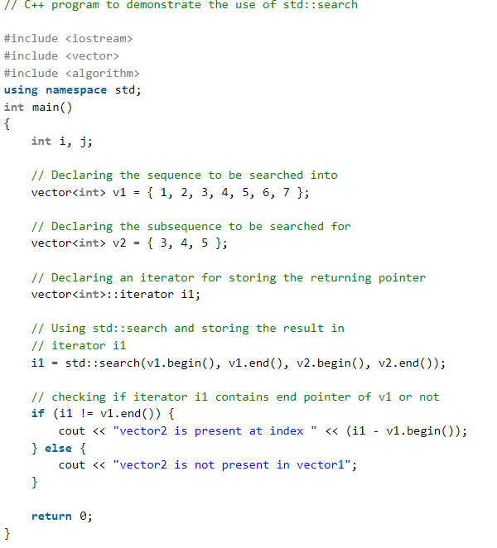
Example

Slide 39
Equal
Compares elements of a sequence within a range to another sequence
Takes 3 parameters
First parameter is the first position of the first sequence
Second parameter is the last position of the first sequence
Third parameter is the first position of the second sequence
Returns a boolean value

Slide 40
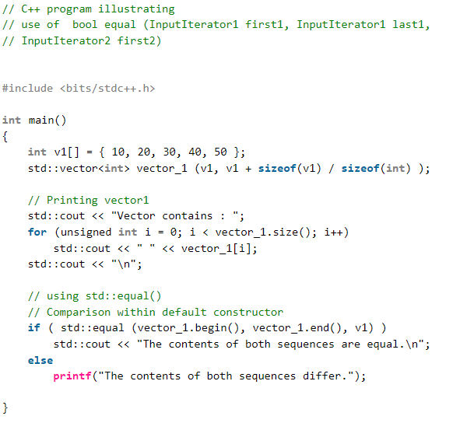
Example

Slide 41
Find
Searches for a given element within a specific range
Takes 3 parameters
First parameter: starting position of the sequence
Second parameter: final position of the sequence
Third parameter: the value that we are trying to find

Slide 42
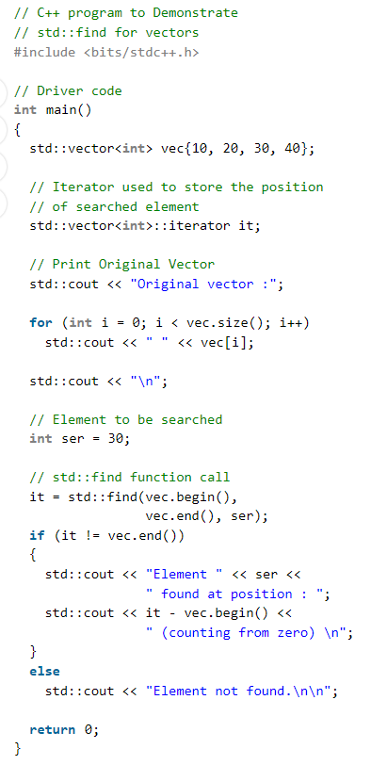
Example

Slide 43
for_each
Accepts a function and iterates through each instance of the given sequence and applies the function to each element
Takes 3 parameters
First parameter: beginning of the sequence
Second parameter: end of the sequence
Third parameter: the given functions that gets applied to each element

Slide 44
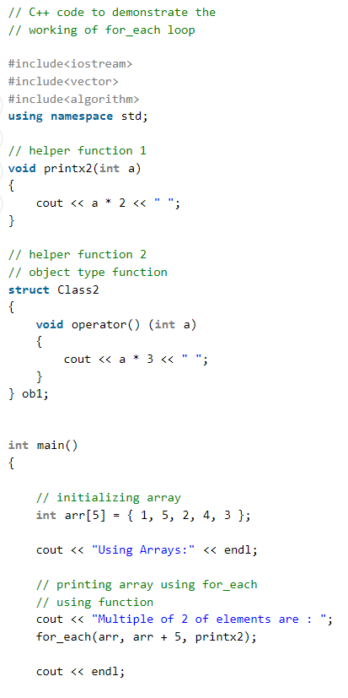
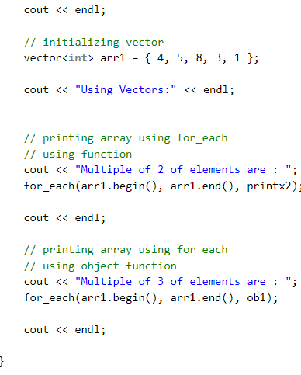
Example

Slide 45
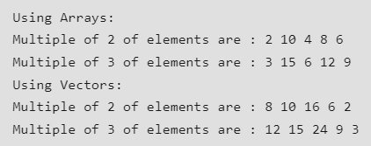
OutPut

Slide 46
all_of
Checks for a given property of every element within the given range
Takes 3 parameter
First parameter: beginning of the sequence
Second parameter: end of the sequence
Third parameter: A unary predicate function that accepts an element and returns a bool

Slide 47
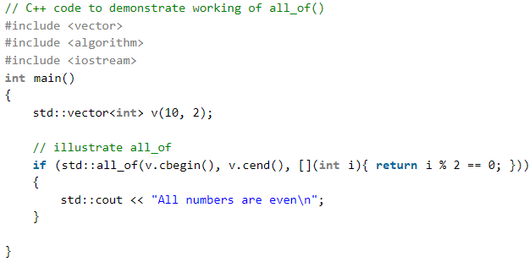
Example

Slide 48
Containers

Slide 49
What is a Container?
STL Containers
An object that stores a collection of other objects
vector
array
list
forward_list
deque
stack
queue
priority_queue
set and unordered_set
multiset and unordered_multiset
map and unordered_map

Slide 50
vector
Key Characteristics
An array with the ability to resize itself automatically when an element is inserted or deleted, with its storage being handled automatically by the container.
Data is commonly inserted at the end, which will be faster. If insertion anywhere else is needed, it will be a bit slower.
Can be made multidimensional.
Dynamic Sizing:
Automatically resizes when inserting and deleting
Efficient Access:
Elements are stored in contiguous memory locations, so access is in constant time
Insertion and Deletion:
as mentioned, inserting and deleting elements at the end is much faster than inserting and deleting anywhere else.

Slide 51
Commonly Used Member-Functions
begin() - returns an iterator to the first element
end() - returns an iterator to the non-existing element following the last element
push_back() - used to insert an item at the back of the vector
pop_back() - used to delete an item at the back of the vector
insert() - used to insert at a specific index
erase() - erases the elements specified within a range or specific location
clear() - erases every element
‘[ ]’ operator - used to access an element of the vector, used just like a normal c++ array.

Slide 52
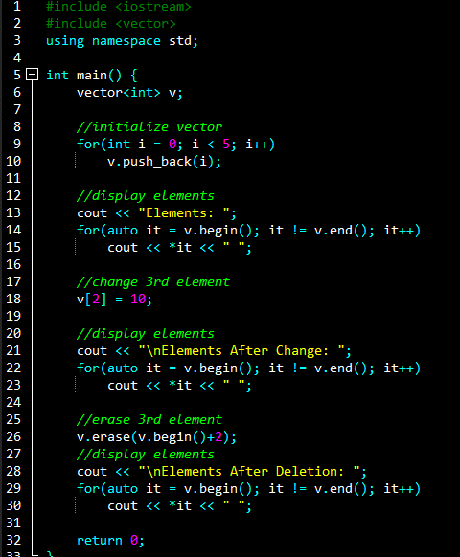
The code initializes the vector, changes its third element, and then deletes its third element. It displays the results throughout
Output
Code Example

Slide 53
array
Advantages Over C-Style Array
A collection of objects of the same type.
Static size.
Very similar to a C-Style Array
Unlike the normal C-Style array, the array provided by STL gives member functions: front(), back(), swap(), empty(), etc. These member functions allow us to do more than what we normally could with a C-Style Array.

Slide 54
Commonly Used Member-Functions
front()/back() - used to access the first/last element of the array.
swap() - swaps the content of two arrays.
empty() - checks whether the array is empty or not
fill() - used to fill all indices with the same value
size() - returns the size of the array

Slide 55
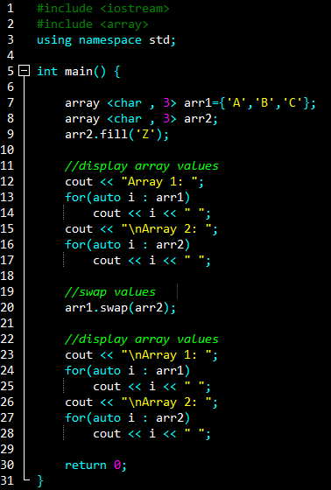
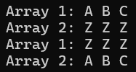
The code initializes the two arrays, and swaps their values. It displays the results throughout.
Output
Code Example

Slide 56
list
Key Characteristics
A sequence container that allows non-contiguous memory allocation.
The list takes longer to traverse opposed to the vector, but is faster with insertion and deletion.
Dynamic Sizing:
Automatically resizes when inserting and deleting
Sequential Access:
Any middle element cannot be randomly accessed.
Insertion and Deletion:
Insertion and deletion is faster with a list than it would be with a vector.

Slide 57
Commonly Used Member-Functions
front()/back() – Returns the value of the first/last element in the list.
push_front/back() – Adds a new element at the beginning/end of the list.
pop_front/back() – Removes the first/last element of the list, and reduces the size of the list by 1.
insert() – Inserts new elements in the list before the element at a specified position.
size() – Returns the number of elements in the list.
begin() – returns an iterator pointing to the first element of the list.
end() – returns an iterator pointing to the theoretical last element which follows the last element.

Slide 58
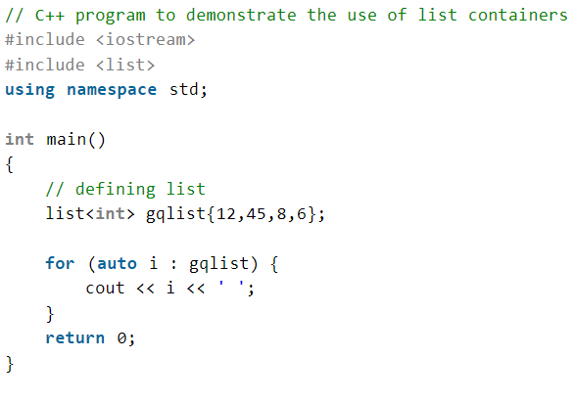
code explaination
Output
Code Example

Slide 59
forward_list
Key Characteristics
A singly-linked list.
Useful for insertion, removal, and any other moving operations (like sort).
Unlike the list, the forward_list only keeps track of the next element, whereas the list keeps track of the next and previous element.
Dynamic Sizing:
Automatically resizes when inserting and deleting
Sequential Access:
Any middle element cannot be randomly accessed. It cannot be iterated backwards.
Insertion and Deletion:
Insertion and deletion is faster with a list than it would be with a vector.

Slide 60
Commonly Used Member-Functions
assign() - used to assign values to the forward list.
push_front() - This function is used to insert the element at the first position.
pop_front() - removes the element at the first position.
insert_after() - gives the choice to insert elements at any position in the list.
erase_after() - gives the ability to erase elements at any position.

Slide 61
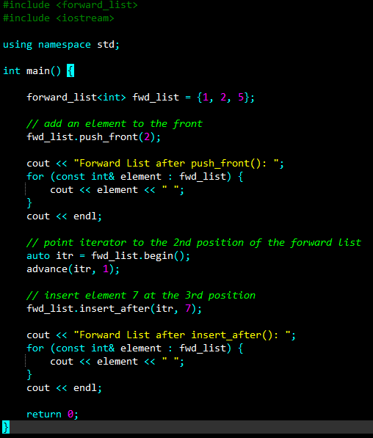
the code displays different ways to insert into the forward_list
Output
Code Example

Slide 62
deque
Key Characteristics
Double-Ended-Queue
Similar to vectors, but are better for insertion and deletion.
Doesn’t have guaranteed contiguous storage allocation (unlike vectors)
Dynamic Sizing:
Has the ability to expand and contract on both ends.
Access:
Accessing elements is done in constant time.
Insertion and Deletion:
Inserting and deleting from the back or front can be done in constant time, anywhere else is linear time.

Slide 63
Commonly Used Member-Functions
insert() - inserts an element at specified location.
push_front/back() - pushes an element to the front/back of the deque.
front()/back() - returns the first/last element of the deque.
[ ] operator - elements can be accessed using the ‘[]’ operator.

Slide 64
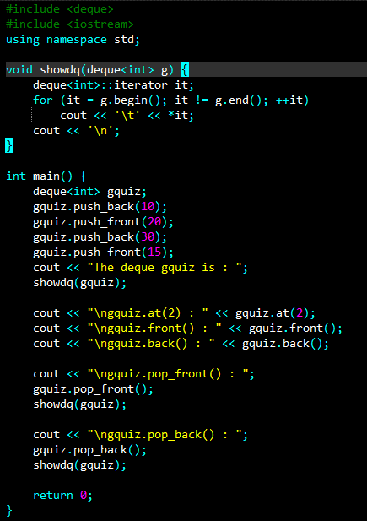
The code shows how to insert/delete items from the front and back of the deque.
Output
Code Example

Slide 65
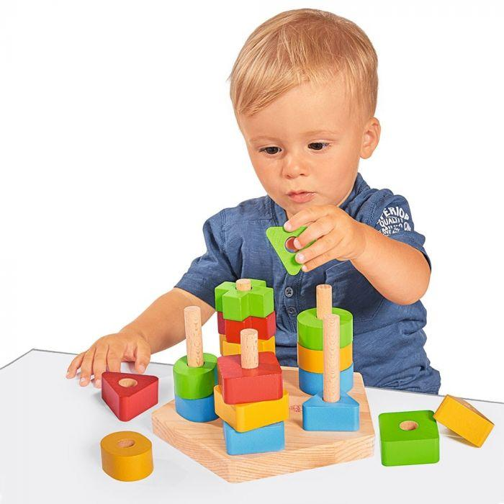
stack
Stacks have a LIFO(Last In First Out) type of working, where a new element is added at one end (top) and an element is removed from that end only.
It uses an encapsulated object of either vector or deque (by default) or list (sequential container class) as its underlying container.

Slide 66
Member-Functions
empty() – Returns whether the stack is empty
size() – Returns the size of the stack
top() – Returns a reference to the top most element of the stack
push() – Adds the passed element at the top of the stack
pop() – Deletes the most recent entered element of the stack

Slide 67
the code pushes items to the stack, removes some, and outputs what is left in the stack.
Output
Code Example

Slide 68
queue
Queues have a FIFO (First In First Out) type of arrangement. Elements are inserted at the back (end) and are deleted from the front.
They use an encapsulated object of deque or list (sequential container class) as its underlying container.

Slide 69
Member-Functions
empty() - checks if queue is empty
size() - Returns the size of the queue.
swap() - swaps contents of two queues (must be same data type)
emplace() - Insert a new element into the queue container, the new element is added to the end of the queue.
front()/back() - returns the first/last element of the queue
push() - adds the given element at the end of the queue
pop() - deletes the first element of the queue

Slide 70
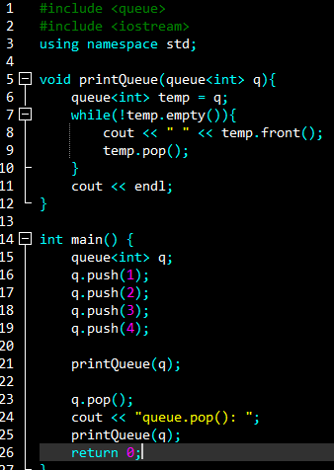
the code pushes multiple items to the queue, pops one item, and displays the result.
Output
Code Example

Slide 71
priority_queue
A type of queue designed so that the first element of the queue is either the greatest or the smallest of all elements in the queue, and elements are in non-increasing or non-decreasing order.
In C++ STL, the top element is always the greatest by default.
Priority queues are built on the top of the max heap and use an array or vector as an internal structure.

Slide 72
Member-Functions
empty() - checks if queue is empty
size() - Returns the size of the queue.
swap() - swaps contents of two queues (must be same data type)
emplace() - Insert a new element into the queue container
push() - adds the given element at the end of the queue
pop() - deletes the first element of the queue
top() - returns the topmost element of the queue

Slide 73
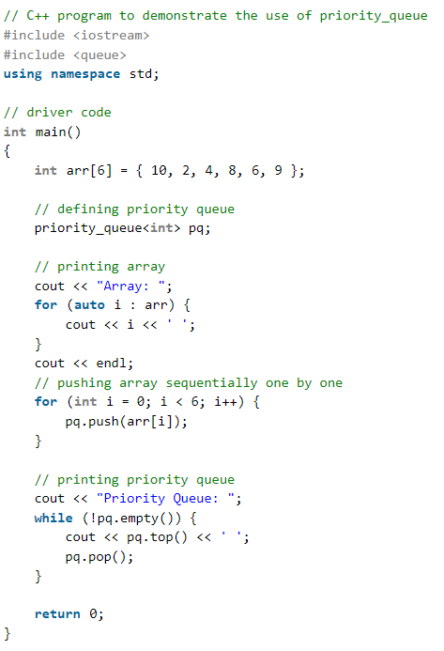
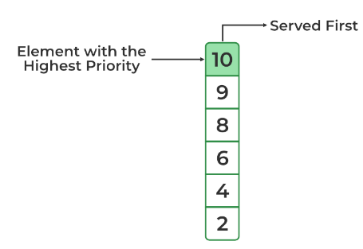
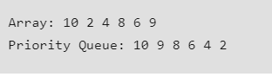
Output
Code Example

Slide 74
set
Properties
Sorted Order:
The set stores the elements in sorted order.
Values Characteristics:
All the elements in a set have unique values.
Values Nature:
The value of the element cannot be modified once it is added to the set.
Search Technique:
Sets follow the Binary search tree implementation.
Arranging order:
The values in a set are unindexed.
Sets are a type of associative container where each element has to be unique because the value of the element identifies it.
The values are stored in a specific sorted order.

Slide 75
Commonly Used Member-Functions
begin() – Returns an iterator to the first element in the set.
end() – Returns an iterator to the theoretical element that follows the last element in the set.
size() – Returns the number of elements in the set.
max_size() – Returns the maximum number of elements that the set can hold.
empty() – Returns whether the set is empty.

Slide 76
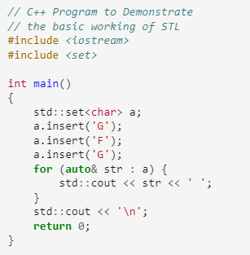
The code inserts three characters, two of the elements being equal value, and displays the result.
Output
Code Example

Slide 77
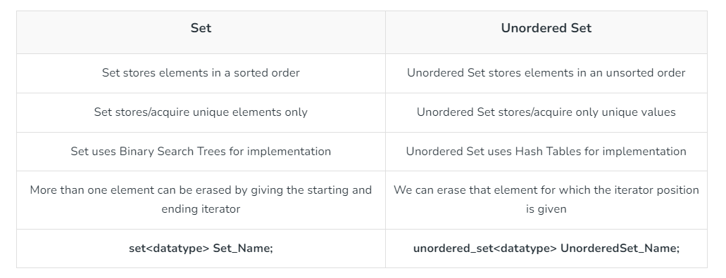
unordered_set

Slide 78
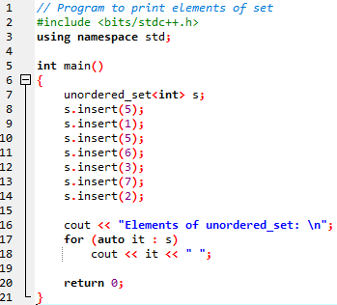
The code inserts multiple values (some being of equal value), and displays the results.
Output
Code Example

Slide 79
multiset
Commonly Used Member-Functions
Similar to sets, except multiple elements can have the same value.
begin() – Returns an iterator to the first element in the multiset
end() – Returns an iterator to the theoretical element that follows the last element in the multiset
size() – Returns the number of elements in the multiset
max_size() – Returns the maximum number of elements that the multiset can hold
empty() – Returns whether the multiset is empty
insert () – Inserts a given element in the multiset
clear () – Removes all the elements from the multiset
erase() – Removes all the occurrences of a specified element

Slide 80
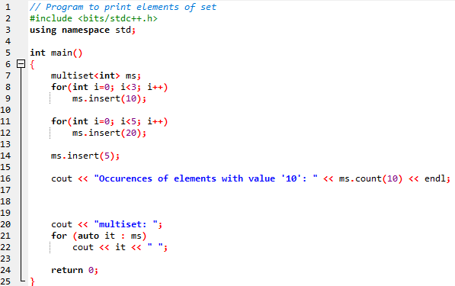
The code inserts multiple values, and checks for the number of occurrences of a specified value. It displays the results.
Output
Code Example

Slide 81
unordered_multiset
Just like how the multiset is similar to the set, the unordered_multiset is similar to the unordered_set except we can have multiple elements with the same value

Slide 82
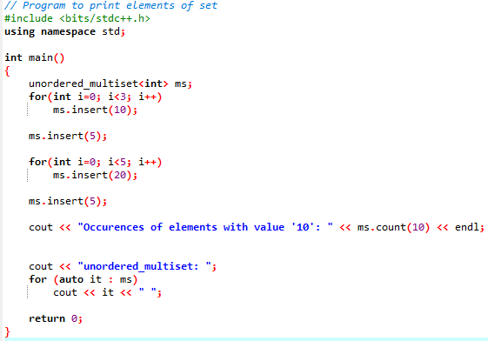
The code resembles the same code from multiset
Output
Code Example

Slide 83
map
Basic Member-Functions
A container where each element have a key value and a mapped value.
No two mapped values can have the same key values.
Stores elements in order based on its key.
begin() – Returns an iterator to the first element in the map.
end() – Returns an iterator to the theoretical element that follows the last element in the map.
size() – Returns the number of elements in the map.
empty() – Returns whether the map is empty.
insert() – Adds a new element to the map (based on a given pair of a ‘key’ and value).
erase()– Removes the given key-value (or given iterator) from the map.
clear() – Removes all the elements from the map.

Slide 84
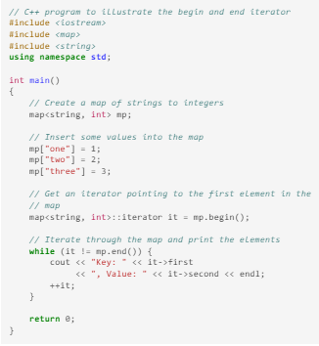
The code inserts three values and assigns them a key. It displays the results.
Output
Code Example

Slide 85
unordered_map

Slide 86
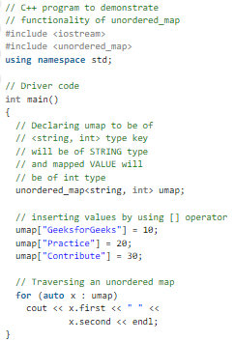
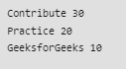
The code inserts multiple values with specified keys, and displays the contents of the unordered_map.
Output
Code Example

Slide 87
Functors

Slide 88
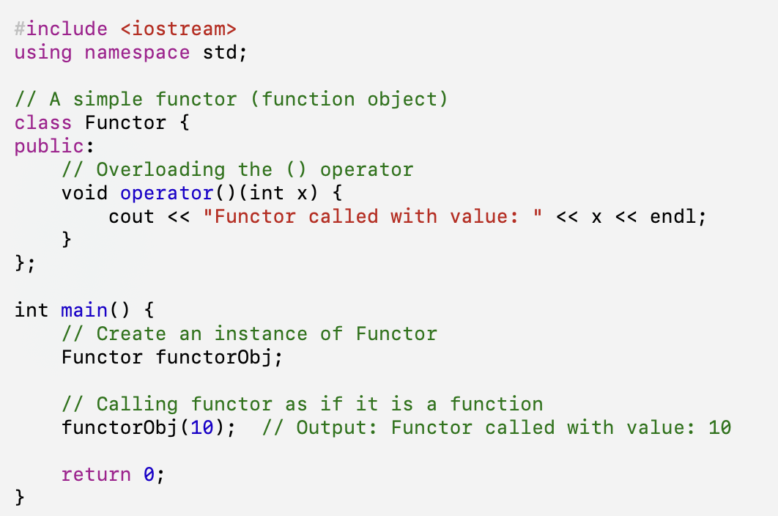
Fundamentals of Functors in C++
A functor, also known as a function object, is any object in C++ that can be treated as if it is a function.
Functors are often used in scenarios where functions are passed as arguments to other functions (like std::sort or std::for_each). The advantage of using functors over function pointers is that they can maintain state, meaning they can store data and keep track of it between calls.

Slide 89
Types of Functors
Functors in C++ can be classified into two main types:
Unary Functor
Binary Functor
A unary functor is a class or struct that overloads the function call operator () to take a single argument. Unary functors are commonly used for operations that apply to a single value, such as negation, increment, or a custom transformation.
A binary functor is a class or struct that overloads the function call operator () to take two arguments. Binary functors are used for operations that involve two values, such as arithmetic operations, comparisons, or logical operations.

Slide 90
Arithmetic Functors
Arithmetic functors perform basic mathematical operations like addition, subtraction, multiplication, and division. For example, the following functor adds a constant value to its argument:
Plus3 Functor
struct Plus3 { int operator()(int x) { return x + 3; } };
Comparison Functors
Comparison functors allow you to define custom ordering or comparison logic. This is useful for sorting or searching containers. Here's an example of a functor that compares two integers in descending order:
GreaterThan Functor
struct GreaterThan { bool operator()(int x, int y) { return x > y; } };
Logical Functors
Logical functors perform boolean operations like AND, OR, and NOT. This can be used to create more complex conditions. For instance, the following functor checks if a number is both positive and even:
PositiveEven Functor
struct PositiveEven { bool operator()(int x) { return x > 0 && x % 2 == 0; } };
Bitwise Functors
Bitwise functors operate on the individual bits of their arguments. They can be used for bit manipulation, flags, and other low-level operations. Here's an example of a functor that checks if the least significant bit of a number is set:
IsOdd Functor
struct IsOdd { bool operator()(int x) { return x & 1; } };

Slide 91
What is Boost?
Boost is a collection of peer-reviewed, free, portable C++ source libraries. It's a widely-used and trusted library designed to help developers write high-quality, robust, and efficient code.

Slide 92
Why use the Boost library?
1
Code Efficiency
2
Increased Productivity
3
Cross-Platform Compatibility
Boost provides well-tested and optimized components, reducing the time and effort required to develop software solutions.
Boost eliminates the need to reinvent the wheel by offering ready-to-use components for common tasks.
Boost libraries are designed to work across different operating systems and compilers, making it easier to port code.
4
Community Support
A large and active community of developers contributes to Boost, ensuring a wealth of knowledge and assistance is readily available.

Slide 93
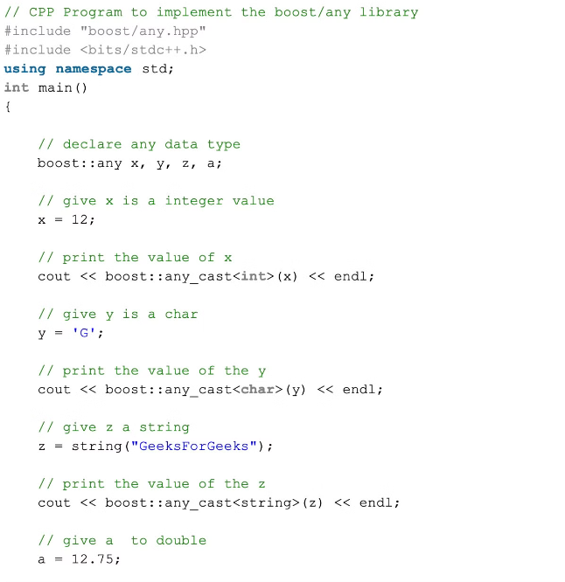
Boost Any
Type Erasure
Flexibility and Genericity
Boost Any allows you to work with values of different types without knowing their specific type at compile time. It uses type erasure to abstract away the underlying type.
Any is particularly useful in situations where you need to store or manipulate data of unknown types, enhancing code flexibility and adaptability.
Dynamic Type Handling
Boost Any enables dynamic type handling by storing the actual type and value at runtime, making it ideal for scenarios with polymorphic data.

Slide 94
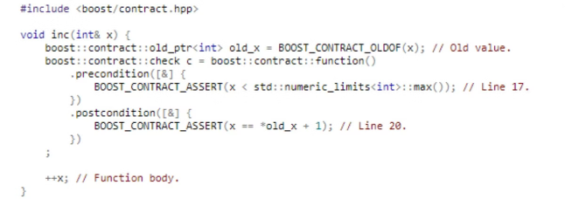
Boost Contract
Code Verification
Code Clarity
Early Error Detection
Boost Contract helps you enforce preconditions, postconditions, and invariants in your code, ensuring that functions behave as expected.
Contracts act as documentation, clearly outlining the expected behavior of functions and improving code readability and maintainability.
Boost Contract aids in detecting errors at runtime, allowing for prompt identification and resolution of issues.

Slide 95
Boost Functional/Factory
Boost Function
Boost Factory
The Function class provides a type-safe way to store and invoke callable entities such as functions, function objects, and lambdas.
Boost Factory provides a mechanism for dynamically creating objects based on their type, enabling flexible and extensible object creation.
1
2
3
Boost Bind
Boost Bind allows you to create new callable objects by binding arguments to functions or function objects, facilitating flexible function composition.

Slide 96
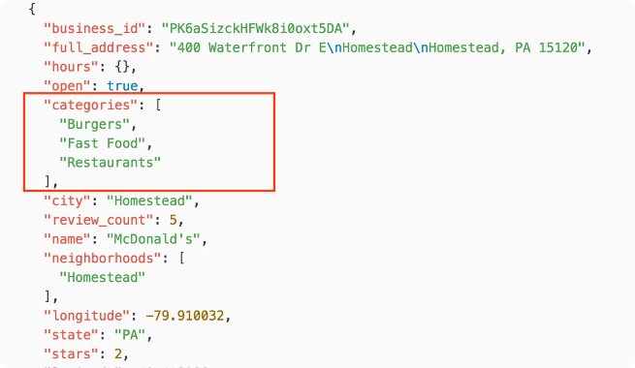
Boost JSON
Feature
Description
JSON Parsing
Boost JSON provides robust and efficient parsers for JSON data, enabling you to read and process JSON documents.
JSON Serialization
It offers facilities for serializing C++ objects to JSON format, allowing for data exchange and storage.
Type Safety
Boost JSON ensures type safety by validating data against the specified JSON schema, preventing errors and inconsistencies.
Extensibility
Boost JSON is extensible, allowing you to customize behavior and adapt to specific JSON requirements.

Slide 97
Boost Locale
Localization
Boost Locale supports language-specific formatting and presentation of data, including dates, times, numbers, and currency.
Internationalization
It enables you to adapt your software to different cultures and regions, ensuring a localized user experience.
Text Encoding
Boost Locale provides support for various character encodings, allowing you to handle text in different languages and scripts.
Number Formatting
It offers functions for formatting numbers according to different locales, ensuring correct representation of numeric values.

Slide 98
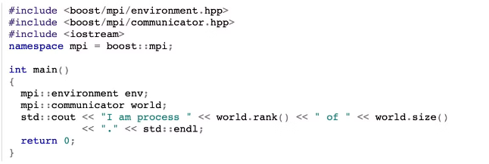
Boost MPI
Parallel Processing
Message Passing
Scientific Computing
Boost MPI enables you to write parallel programs that leverage multiple processors or computers to perform computations.
It provides a high-level abstraction for message passing, allowing processes to communicate and share data.
Boost MPI is widely used in scientific computing applications, facilitating complex simulations and data analysis.

Slide 99
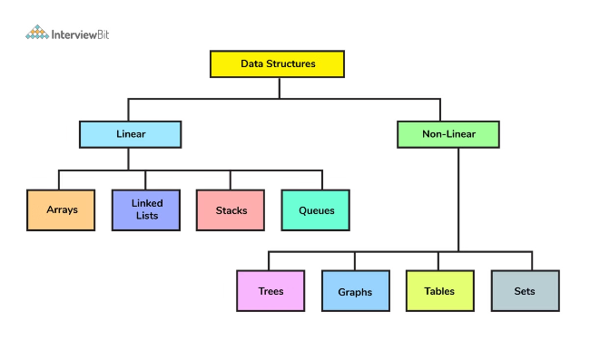
Property Tree
Hierarchical Data
File I/O
Boost Property Tree provides a flexible and efficient way to represent hierarchical data in a tree-like structure.
It supports various file formats, including XML, JSON, INI, and plain text, facilitating data serialization and deserialization.
Data Access
Configuration Management
Boost Property Tree allows easy access and manipulation of data elements through intuitive interfaces.
It is often used for configuration management, allowing applications to load and manage settings from external files.

Slide 100
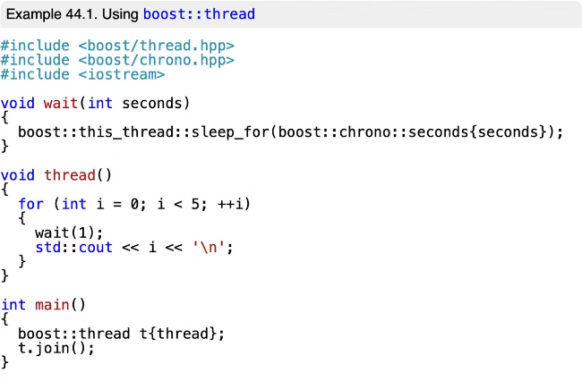
Boost Thread
1
Thread Management
2
Concurrency
It helps you take advantage of multi-core processors, improving performance by parallelizing tasks.
Boost Thread provides a portable and efficient way to create, manage, and synchronize threads in your applications.
3
Synchronization Primitives
4
Thread Pool
It includes a thread pool implementation, allowing you to efficiently manage and reuse threads for optimal resource utilization.
Boost Thread offers synchronization primitives such as mutexes, condition variables, and semaphores to manage access to shared resources.

Slide 101
Sources
https://www.geeksforgeeks.org/the-c-standard-template-library-stl/ (and sub-pages)
https://www.programiz.com/cpp-programming/forward-list (forward-list code example)

