Slide 1
Introduction to UML
By: Navraj Singh, Garrett Brewer, Miguel Gutierrez

Slide 2
What is UML?
It stands for “Unified Modeling Language”
It is an industry-standard graphical language for specifying, constructing and documenting the artifacts of software system
It is different from the other programming languages like Java, C++
It can be used to generate code in various languages using UML diagrams
Simplifies the complex process of software design

Slide 3
Brief History of UML
Grady Booch, Ivar Jacobson and James Rumbaugh, known as “Three Amigos”
Booch: OOAD, very complex but good at low level design
Rumbaugh: OMT, simple modeling language, Good at middle ground
Jacobson: OOSE, good at high level of design.

Slide 4
Brief History of UML
In 1994, all of them decided to build a notation language by merging all three languages and the product of that was UML.
Adopted as a standard by Object Management Group (OMG) in 1997
Standardized by the International Organization for Standardization (ISO) in 2005
Since then, they have been making improvements in UML

Slide 5
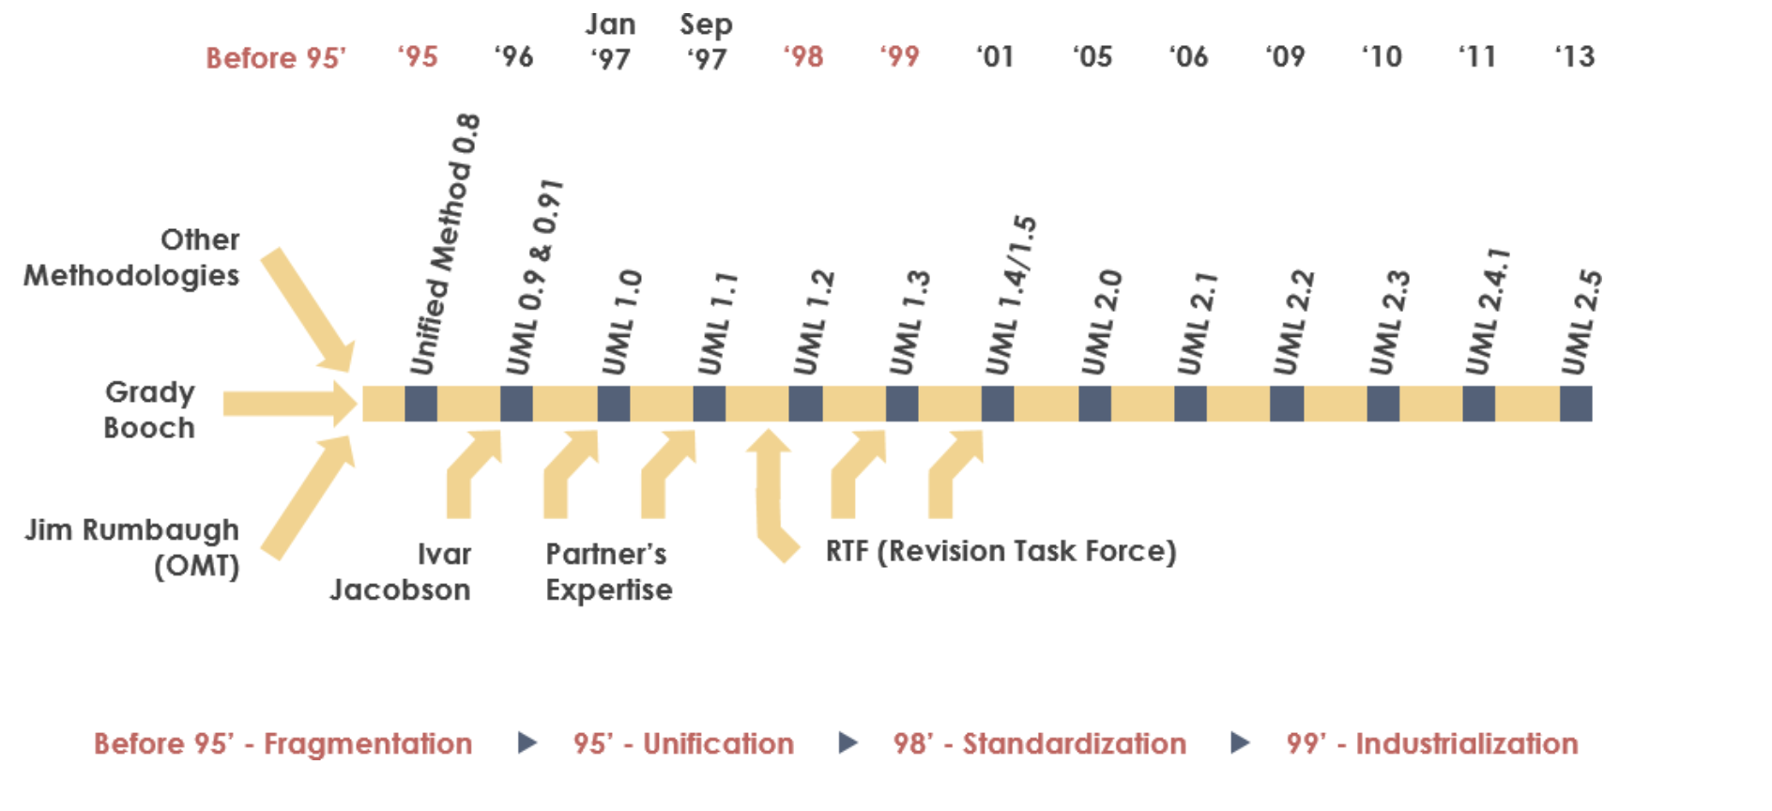
History of UML

Slide 6
What problems does UML modeling solve?
Complexity Management : Simplifies complex systems into manageable components
Communication: Standardized visual language enhances stakeholder and team collaboration
Documentation: Provides consistent and clear documentation for system architecture and behavior
Design Validation: Identifies potential issues early, reducing costly errors.

Slide 7
Common structure of UML diagrams
Class Diagrams
Use case Diagrams
Sequence Diagrams
Deployment Diagrams
Component Diagrams

Slide 8
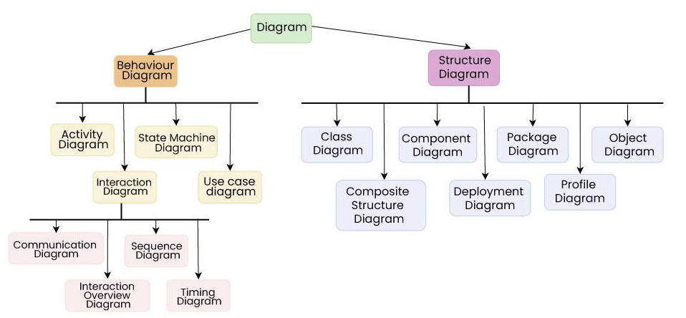
Types of UML Diagrams

Slide 9
Types of UML Diagrams
Structural Diagrams :
Include abstract, real-world, and implementation concepts
Shows how different systems parts are interconnected
Help visualize the elements within a system
Example: In a vehicle reservation system, elements like car, Reservation, Driver's License, and Credit Card are connected to show their relationships.
Behavior Diagrams:
Focus on the system’s time-dependent behavior
Shows how the objects change over time
Essential for understanding the system’s dynamic processes
Example: In an online shopping system, a Sequence Diagram might show the process of a user placing an order, interacting with elements like Shopping Cart, Payment Gateway, and order Confirmation.

Slide 10
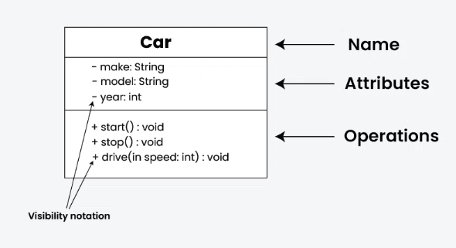
Subparts of Structural Diagrams:
Class Diagram:
Fundamental to object-oriented design
It represents set of objects having similar responsibilities
This provides a clear and organized view of the system’s architecture.

Slide 11
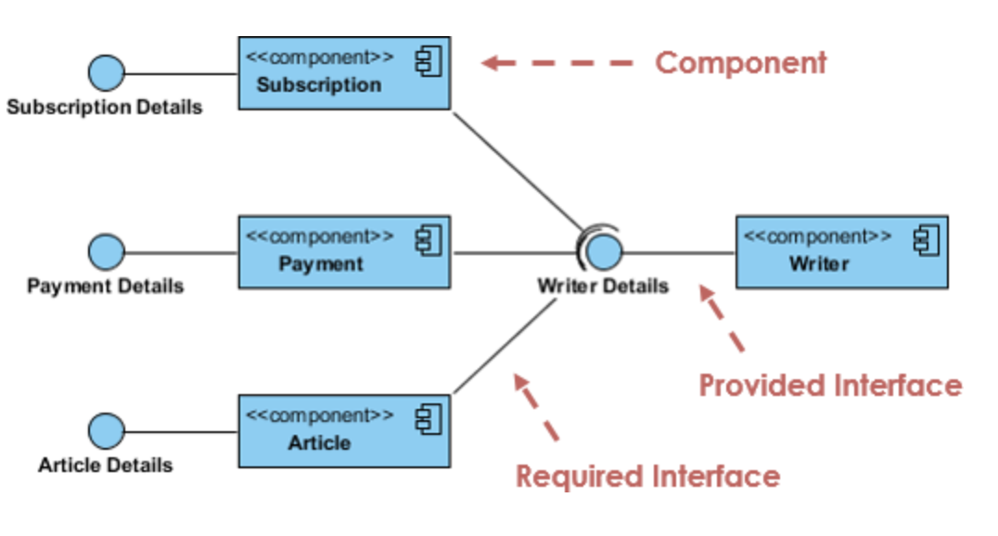
Subparts of Structural Diagrams:
Component Diagram:
Describe physical part of a system
Useful in complex systems with many interacting parts
Highlight the organization and modularity of the system

Slide 12
Subparts of Structural Diagrams:
Object Diagram:
Object diagrams may be considered a special case of class diagram
Shows actual object relationships, similar to class diagrams
Represent real-world scenarios with concrete examples
Composite structure:
Represent the internal strucutre of a class
Shows how parts are organized and collaborate within a class or system
Useful for detailing the internal workings of complex systems

Slide 13
Subparts of Structural Diagrams:
Deployment Diagram:
Shows the physical deployment of a software on hardware
Useful for visualizing deployments across different machines
Include elements like nodes, components, and connections to depict communication paths
Package Diagram:
Organize and group related elements of a system into packages
Shows the dependencies and relationships between different packages
Useful for organizing and managing large systems

Slide 14
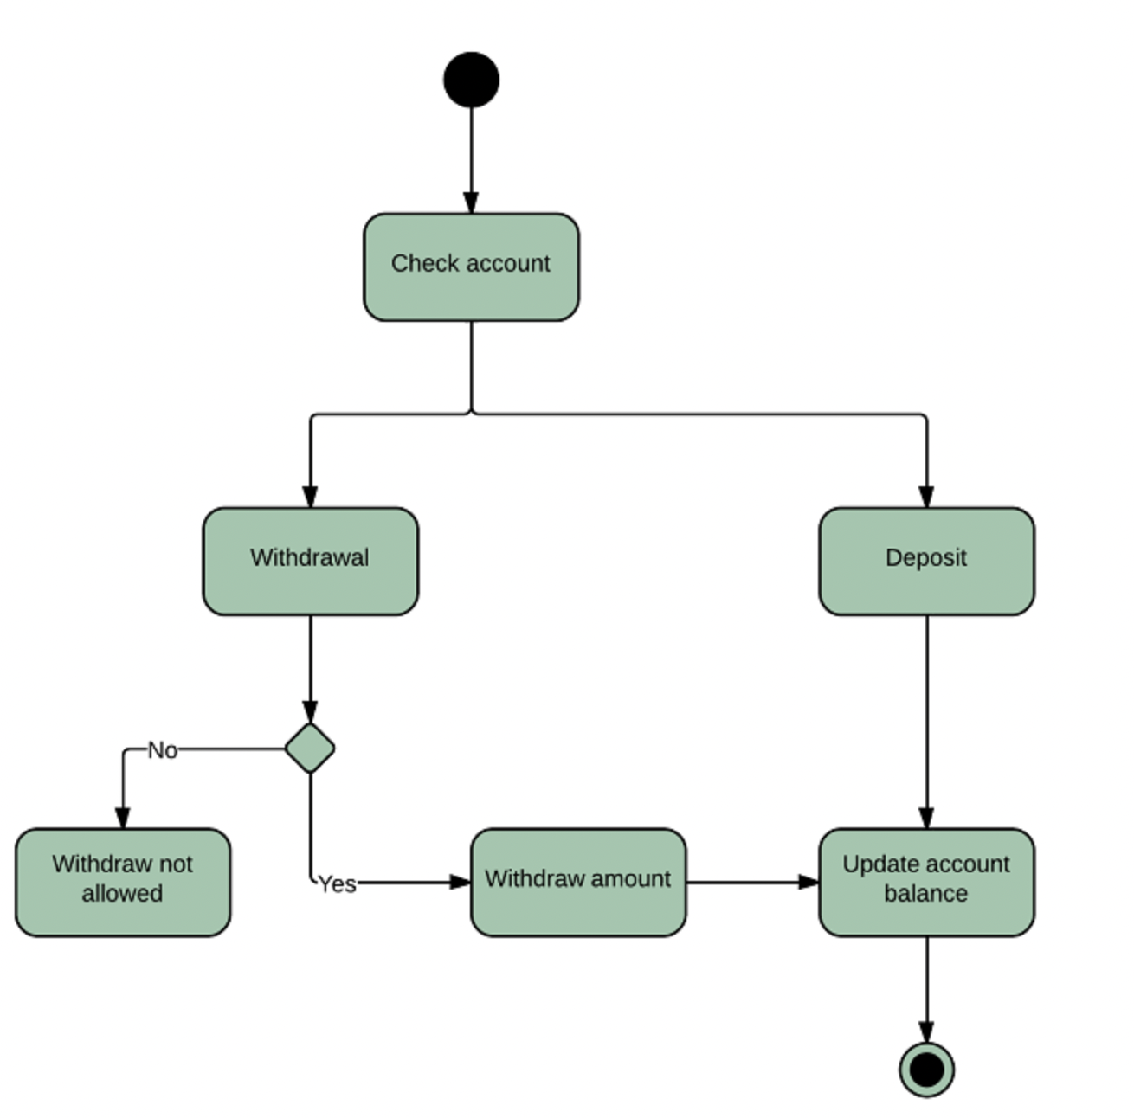
Subparts of Behavior Diagrams:
Activity Diagram:
Represent the workflow of activities in a system
Show the flow of control from one activity to another
Include elements like actions, decision points, start/end nodes and transitions
Useful for modeling process with a system
https://www.lucidchart.com/pages/uml-activity-diagram

Slide 15
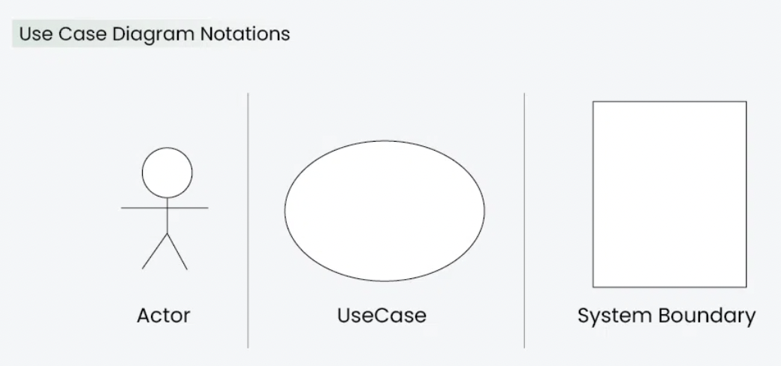
Subparts of Behavior Diagrams:
Use case Diagram:
Shows the functional requirements of a system
Shows the interactions between users (actors) and the system
Include elements like actors, use cases, and relationships
https://www.geeksforgeeks.org/use-case-diagram/

Slide 16
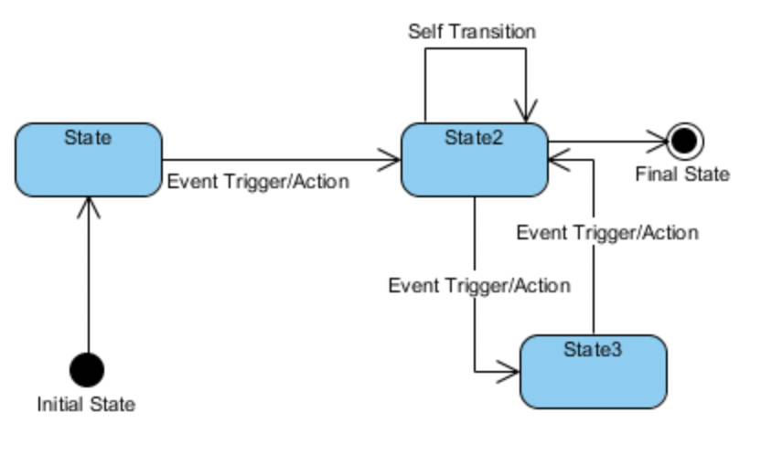
Subparts of Behavior Diagrams:
State Machine Diagram:
Shows how objects behave differently depending on their state.
Useful for modeling the lifecycle of an object within a system
Include elements like states, transtions, events, and actions.
https://www.visual-paradigm.com/tutorials/how-to-draw-state-machine-diagram-in-uml/

Slide 17
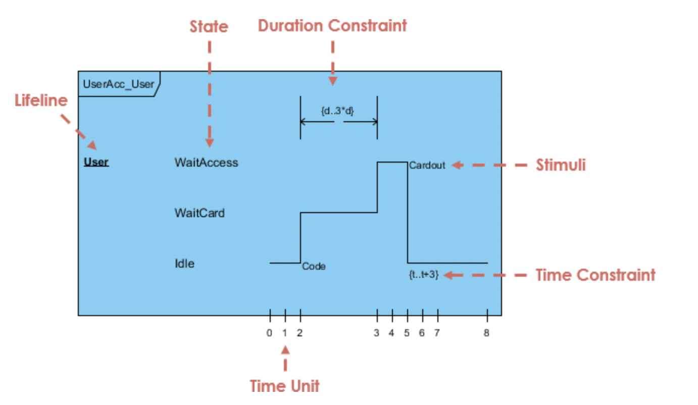
Subparts of Behavior Diagrams:
Timing Diagram
Shows the changes in state or value of one or more objects over time
Focus on the timing of interactions and events within a system
Useful for analyzing real-time systems where precise timing is critical
https://www.visual-paradigm.com/tutorials/how-to-draw-state-machine-diagram-in-uml/

Slide 18
Subparts of Behavior Diagrams:
Interaction Diagram:
Represent the flow of message between objects to achieve a specific task
Useful for visualizing the communication between objects in a sequence
Include Sequence Diagrams and Communication Diagrams as the main types
Sequence Diagram:
Shows the flow of interactions between objects over time
Useful for modeling how objects collaborate to complete a particular task
Include elements like objects, messages, and activations

Slide 19
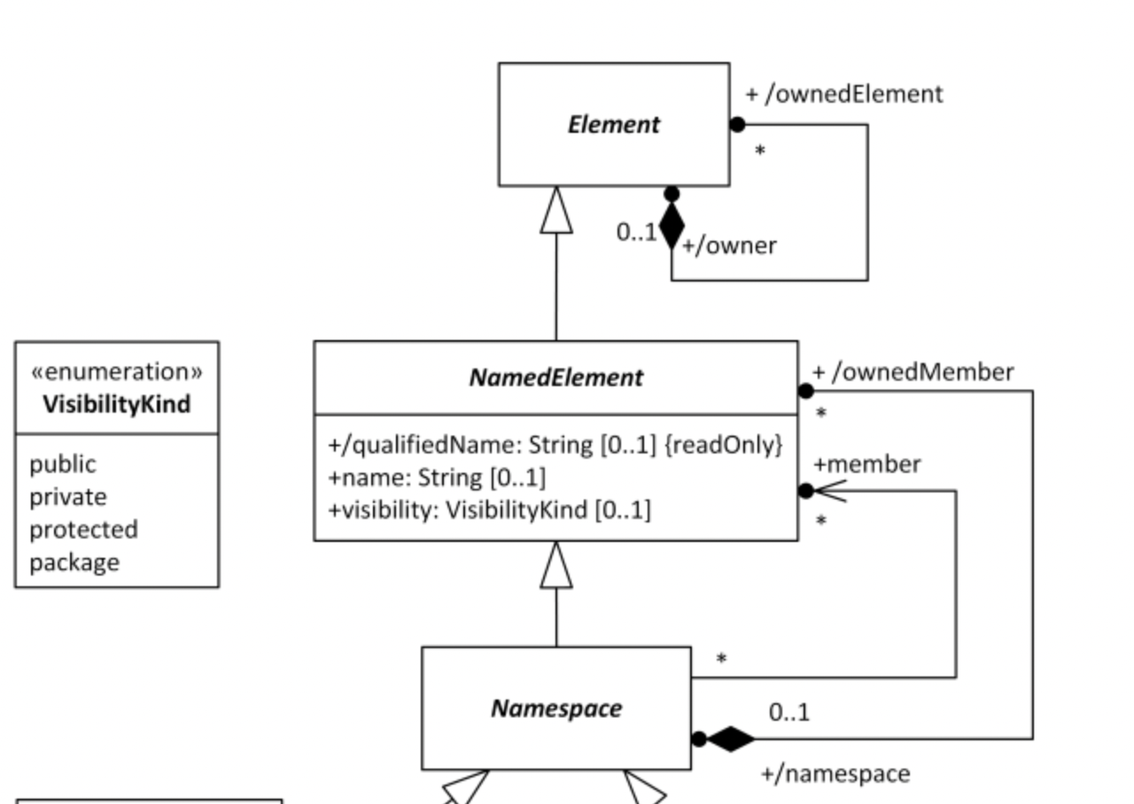
Namespace
Organizes and groups model elements like classes and packages
Helps to avoid name conflicts by requiring names within the same namespace
Different namespaces can have elements with the same name.

Slide 20
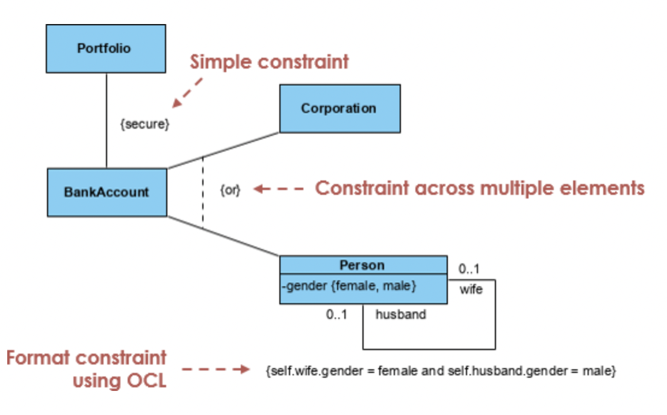
Constraints
Constraints are conditions or rules that must be met for a model to be valid
Commonly used to enforce business rules, design decisions
Represented using curly braces ' { } '
https://www.visual-paradigm.com/guide/uml-unified-modeling-language/how-to-model-constraints-in-uml/

Slide 21
Dependencies
Represent a relationship where one element relies on another
Indicated by a dashed arrow from the dependent to the supplier element
Help in understand coupling between system parts

Slide 22
Templates
Define generic models that can be reused with different data types or classes
Commonly used in class diagrams to define generic classes
Help in reducing redundancy and enhancing the scalability of the models

Slide 23
Introduction to Structural Diagrams
Garrett Brewer

Slide 24
Structural Diagrams
"Structural UML diagrams illustrate the organization of a system by depicting its components, such as classes, objects, and packages. They represent the elements that make up the system and the relationships between them." - geeks for geeks
Class
Component
Object
Composite structure
Deployment
Package

Slide 25
Structural Diagrams
Structural UML diagrams are like visual maps that show how different parts of a computer program or system are connected.
They help the people designing the software see how different pieces will work together.
Structural diagrams make it easy to explain how a computer program works and share ideas with the team.
These diagrams help organize the different parts of a computer program.
It keeps everything in order, making it easier to understand and update.
Before building something big, like a bridge, engineers use drawings to catch any problems early. Structural diagrams do the same for computer programs.
They help find and fix issues before spending lots of time writing the actual code.

Slide 26
Class
Class diagrams are the main building blocks of every object-oriented method.
The class diagram can be used to show the classes, relationships, interface, association, and collaboration. UML is standardized in class diagrams.

Slide 27
Class
+ for public (visible to all classes)
- for private (visible only within the class)
# for protected (visible to subclasses)
~ for package or default visibility (visible to classes in the same package)

Slide 28
Class

Slide 29
Component
Component
Modular parts of the system that encapsulate functionalities
Interfaces
Set of operations that a component offers or requires
Relationships
Connections and dependencies between components
Ports
Specific interaction points on the boundary of a component
Artifacts
Physical files or data that are deployed on nodes
Nodes
Physical or virtual execution enviroments
Component diagrams are used to represent how the physical components in a system have been organized. We use them for modelling implementation details.
Component Diagrams depict the structural relationship between software system elements and help us in understanding if functional requirements have been covered by planned development.
Component Diagrams become essential to use when we design and build complex systems.
Interfaces are used by components of the system to communicate with each other.

Slide 30
Component

Slide 31
Object
An Object Diagram can be referred to as a screenshot of the instances in a system and the relationship that exists between them.
Since object diagrams depict behaviour when objects have been instantiated, we are able to study the behavior of the system at a particular instant.
Object diagrams are vital to portray and understand functional requirements of a system. In other words, “An object diagram in the Unified Modeling Language (UML), is a diagram that shows a complete or partial view of the structure of a modelled system at a specific time.

Slide 32
Object
Detailed insight into relationships
They offer a detailed view of relationships and collaborations between instances of classes. This helps in understanding the specific interactions and dependencies among objects.
Implementation guidance
During the system implementation phase, object diagrams assist developers in building and testing the actual instances of classes. They provide guidance on how to represent objects in code.
Integration testing assitance
They are valuable for integration testing, allowing testers to evaluate how different objects collaborate and exchange information. This ensures that integrated components of the system work seamlessly.
Validation of code implementation
Developers can use object diagrams to validate that the actual code aligns with the intended relationships and interactions specified in the design. This helps maintain consistency between the design and the implementation.
They offer a detailed view of how objects interact with each other in specific scenarios.
Proper design and analysis of applications can be faster and efficient.
Object diagrams are beneficial during the implementation phase of software development.
Promoting a shared understanding of specific instances and their relationships, facilitating collaboration among team members.

Slide 33
Composite Structure
A composite structure diagram represents relationship between parts and their configuration which determine how the classifier (class, a component, or a deployment node) behaves.
They represent internal structure of a structured classifier making the use of parts, ports, and connectors.
They are similar to class diagrams except they represent individual parts in detail as compared to the entire class.

Slide 34
Deployment
Deployment Diagrams are used to represent system hardware and its software.It tells us what hardware components exist and what software components run on them.
We illustrate system architecture as distribution of software artifacts over distributed targets.
They are primarily used when a software is being used, distributed or deployed over multiple machines with different configurations.

Slide 35
Deployment
System Planning: Deployment diagrams help plan how software systems will be set up on different devices. They show where each part of the system will go.
Infrastructure Design: They help design the hardware needed to support the software. By showing which software parts go where, they help decide what devices and networks are needed.
Resource Allocation: Deployment diagrams make sure each part of the software has enough resources, like memory or processing power, to run well.
Dependency Analysis: They show how different parts of the software depend on each other and on the hardware. This helps understand how changes might affect the whole system.
Performance Optimization: By seeing how everything is set up, teams can find ways to make the software run faster and smoother.
Security Planning: Deployment diagrams help plan how to keep the system safe from hackers or other threats by showing where security measures are needed.
Documentation: They provide a visual guide to how the system is set up, making it easier to understand and manage.

Slide 36
Package
A package diagram is a type of Unified Modeling Language (UML) diagram mainly used to represent the organization and the structure of a system in the form of packages.
A package is used as a container to organize the elements present in the system into a more manageable unit.
It is very useful to represent the system’s architecture and design as a cohesive unit and concise manner.

Slide 37
Package
Package – collection of diagrams
Namespace – name of package
Package merge – arrow that shows combination of packages
Dependency – represents connection between packages
Element – the units within a package
Constraint – requirement of a package

Slide 38
Package
System Structure Visualization: Package Diagram is helpful to represent the system’s structure in a diagrammatic format. It also helps in organizing the elements into smaller and compact packages. This type of visualization help in understanding the structure of the system in a more concise manner.
Module and Component Management: Package Diagram is useful to organize and manage modules or components within a system. Package acts as a container for items which are related to each other. It helps in grouping and categorizing parts of the system.
Dependency Management: Developers use Package Diagram to represent dependency between the different packages, this is useful to represent the system’s architecture neatly and show the potential impact of the changes.
System Decomposition: System Architects tend to break down a complex problem into a group of smaller and easily manageable problem at the initial stage of the System Design. This helps in designing the components easier and easier implementation.
Versioning and Release Planning: Project Managers often use Package Diagram to plan release of the product, ensuring that all the newly added components and changes are well understood and coordinated.

Slide 39
Introduction to Behavioral UML Diagrams
Miguel Gutierrez

Slide 40
Behavior Diagrams
Instead of the static nature of structure diagrams, behavioral UML diagrams visualize the more dynamic nature of a system.
There are many different types of behavioral UML diagrams
Activity
Use Case
State machine
Interaction
Sequence
Communication
Timing

Slide 41
Activity Diagram
Shows the flow of interaction/control within a system
Workflow, business procedures, dynamic decisions

Slide 42
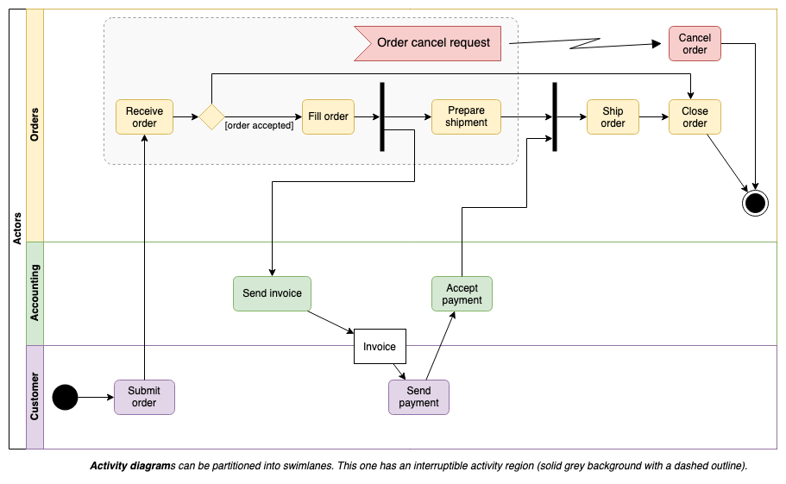
Activity Diagram

Slide 43
Use Case Diagram
Shows how a system is used
Actors/Users are depicted outside of system boundaries as stickmen
Majority of symbols used for use case are basic UML symbols
Squares, boxes, arrows, etc.

Slide 44
State Machine Diagram
Shows the changes in the state of a class/object
Shows what triggers these changes and their possible results/outcomes

Slide 45
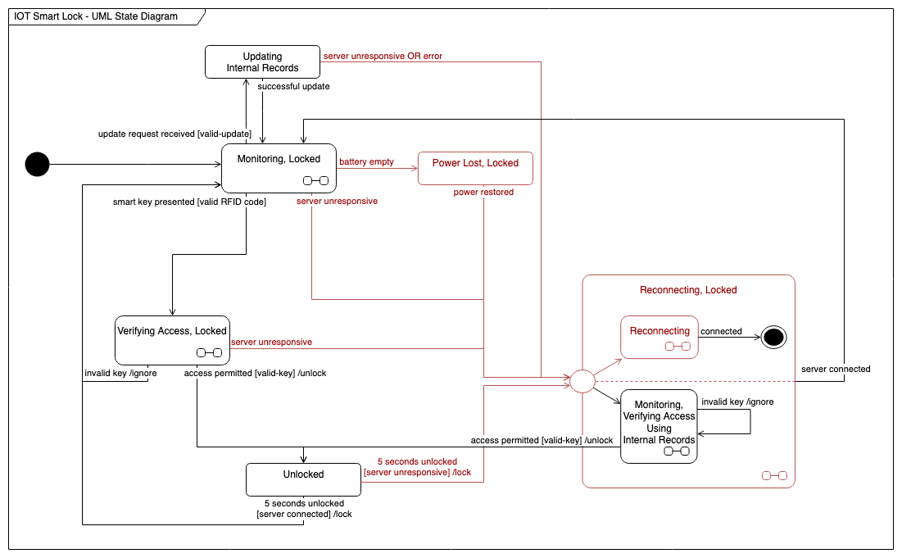
State Machine Diagram

Slide 46
Interaction Diagrams
A subsection of Behavioral diagrams
Still dynamic in nature like other Behavior diagrams
Includes the aspect of time to dictate the flow of the diagram
Types of this kind of diagram
Sequence diagrams
Communication diagrams
Timing diagrams

Slide 47
Sequence Diagram
More in depth version of an activity diagram and class diagram
Activity diagram shows the flow of your program
Sequence shows when and in what order the information flows

Slide 48
Communication Diagram
Simpler version of a sequence diagram
Doesn’t go into as much detail as a sequence diagram
Shows the data that goes between objects/software

Slide 49
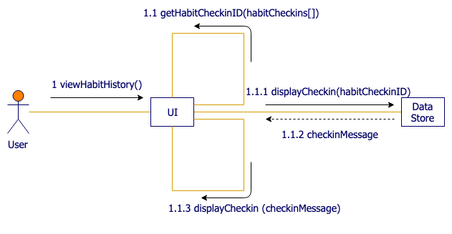
Communication Diagram

Slide 50
Timing Diagram
Shows the change in state and how different objects interact over some time
There are different versions of timing diagrams

Slide 51
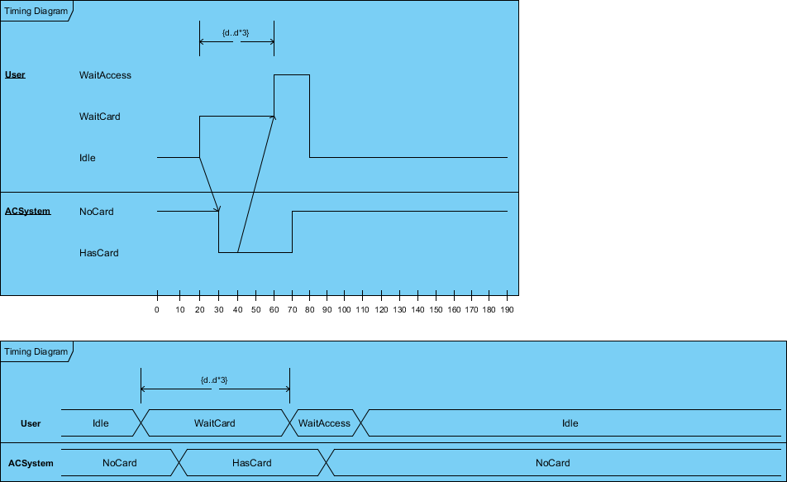
Timing Diagram

Slide 52
UML software
Creation
draw.io
Lucidchart
Visual Paradigm
Diagram -> code
UML Lab

Slide 53
Works cited
https://www.visual-paradigm.com/guide/uml-unified-modeling-language/what-is-uml/
https://www.geeksforgeeks.org/structural-diagrams-unified-modeling-languageuml/
https://www.visual-paradigm.com/guide/uml-unified-modeling-language/what-is-timing-diagram/
https://drawio-app.com/blog/create-uml-sequence-diagrams-in-draw-io/
https://drawio-app.com/blog/uml-communication-diagrams/
https://www.drawio.com/blog/uml-state-diagrams
https://drawio-app.com/blog/uml-use-case-diagrams-with-draw-io/
https://www.drawio.com/blog/uml-activity-diagrams
https://www.uml-diagrams.org/dependency.html​
https://www.lucidchart.com/pages/how-to-draw-component-diagram-in-UML
https://www.geeksforgeeks.org/use-case-diagram/

