Slide 1
CI/CD
Kelson Moore and Emilio Huerta 2nd

Slide 2
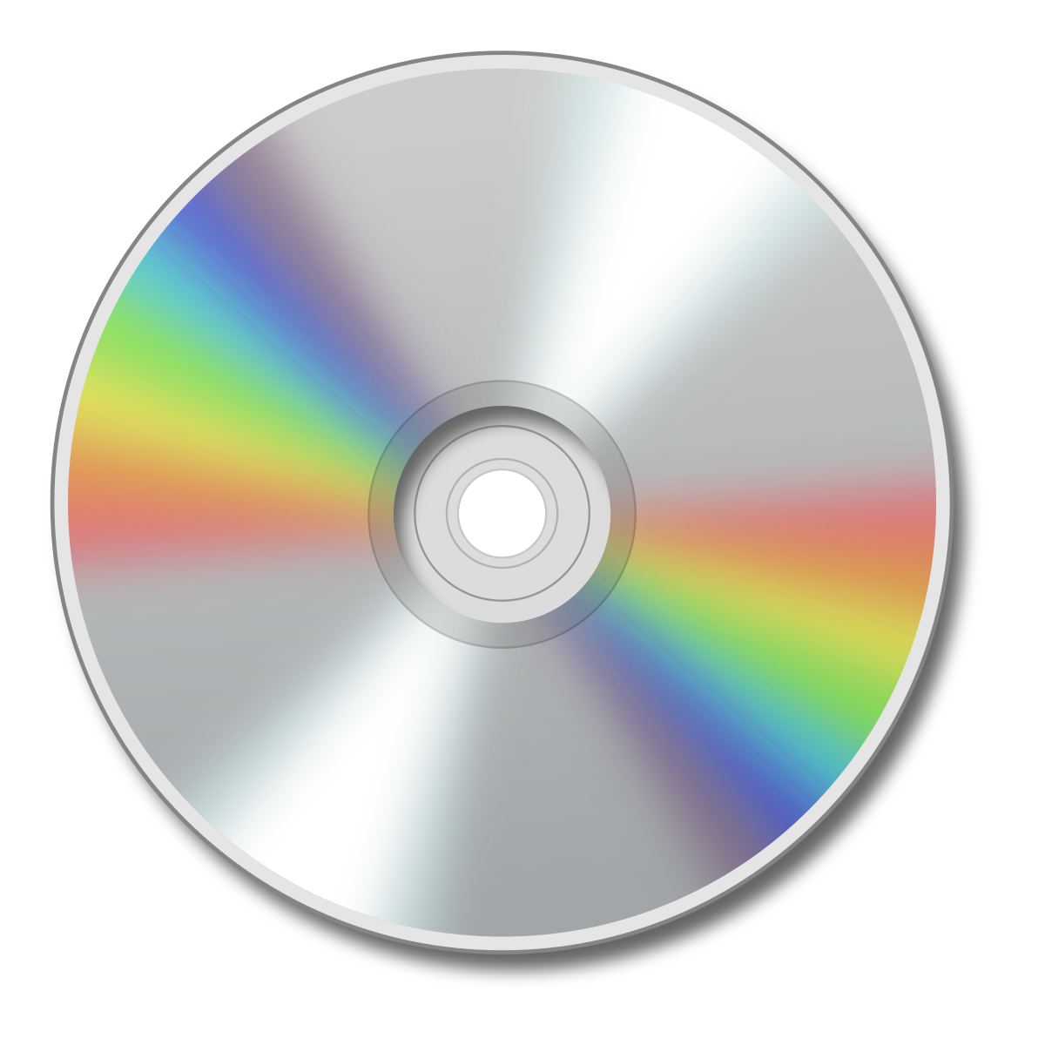
What is it?
CI - continuous integration
CD = Continuous Delivery/Deployment
Not to be confused with CIA / CD

Slide 3
Continuous Integration
Is the practice of automating the integration of code changes from multiple contributors into a single software project.
Why is it important? It helps prevent merge conflict and entering the realm of merge hell
When multiple people are working on the same code base and start making changes over a long period and then submit their work, they could end up messing up another individual work completely and vice versa

Slide 4
The inner mechanism
How does this work in practice? Well, you could manually enter your code and then pull it, but there is an issue with this: You could have code that doesn’t work.
What you do is get it to get code and perform a build test automatically and if anything fails it will email the team and let them know that the code broke and by whom.
What this adds is that now you can always have a build that works and automatically checks itself if it fails to test. That way if something happens you always have a backup.

Slide 5
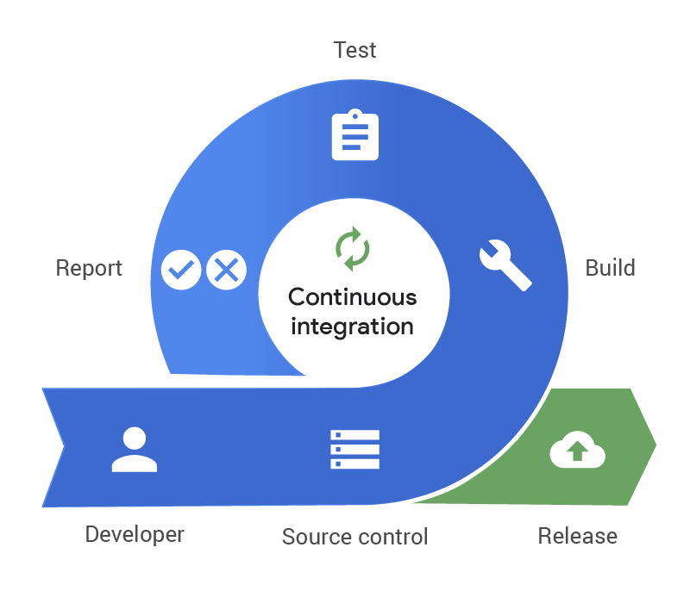
Action
Source control - a mechanism for keeping multiple versions of your files, so that when you modify a file you can still access the previous revisions.

Slide 6
What is CD
Continuous delivery - a software development practice that uses automation to speed the release of new code.
Continuous Deployment – a software development strategy where code changes to an application are released automatically into the production environment.

Slide 7
Continuous Delivery vs Continuous Deployment
Continuous Delivery is trying to get code into production the fastest after being tested automatically and verified before hitting production.
Continuous Deployment encompasses everything as Delivery except for one thing there is no human verification before hitting production. The tests are set up to be as close to production as possible so that as long as it passes all the test it will shoot to production automatically

Slide 9
Continuous Testing
The Practice of running automated tests as part of the software delivery pipeline.
Types of Tests
Unit Test: Tests individual pieces of code, like functions or classes
Integration Test: Assesses the interactions between modules to check if they work together
End-to-End Test: Simulates the user's journey from start to end of the application
Benefits
Reduces risks by catching bugs early
Faster development by giving constant and consistent feedback
Improved reliability since you are testing before publishing

Slide 10
CI/CD Pipeline
What is it?
The CI/CD Pipeline is an automated sequence of steps that moves code from development to production.
Benefits:
Saves time through automation
Ensures consistency through enforcing a standardized process
Phases of the Pipeline:
Source Control: Code changes are pushed to a repository (GIT)
Build: Code is compiled, packaged, and dependencies are managed
Test: Runs automated tests to verify code's functionality and quality
Deploy: Moves the code to a staging or production environment
Monitor: Tracks the application and collects data on performance, errors, and usage.
Through monitoring, the next CI/CD cycle is started

Slide 11
CI/CD Tools
Jenkins – A widely used, open-source automation server that supports continuous integration and continuous deployment. Known for its extensive plugin ecosystem, allowing integration with almost any language
GIT – Has built in CI/CD tools that allow for easy integration. Known for its ease of use.
GitHub Actions
GitLab CI/CD
CircleCI – Known for its speed and efficient resource use; it’s often preferred for modern cloud-native environments.
TravisCI - Primarily used in open-source projects, it integrates easily with GitHub repositories and provides a cloud-based CI/CD service.

Slide 12
Jenkins Example
Basic Workflow
Job Configuration – Define steps such as compiling, testing, and deploying code
Pipeline as Code - Jenkins uses a file called Jenkinsfile to define CI/CD stages, enabling version control for the pipeline.
Plugins - Jenkins has a robust plugin ecosystem, enabling it to integrate with tools like Git, Docker, and AWS.
JenkinsFile typically includes:
Checkout – Checks out the latest code from the repository to ensure the pipeline is working with up-to-date files.
Build – Creates a build directory to organize the compiled files and runs "make"
Test – Automatically runs tests on the files to ensure no compilation failures exists
Post-build notifications – Sends a success or failure message depending on the tests
Deploy – Rolling out the new files, this is when the new files are merged with the main branch

Slide 13
GitHub Actions Example
Overview
GitHub Actions provides GitHub repositories with a fully integrated CI/CD tool, enabling developers to automate, customize, and run CI/CD workflows directly from GitHub.
Features of GitHub Actions
Workflow Files - Define workflows using YAML files within the GitHub repository, which improves readability and maintainability.
Reuseable Actions - Allows for building reusable pieces of automation available in the GitHub Marketplace.
CI/CD - Enables easy setup for both CI and CD directly within GitHub.

Slide 14
GitHub Actions Example Workflow
Actions/checkout
Checks the repository code, giving the workflow access the the source files
Pulling from upstream
Actions/cache
Caches dependencies to speed up future workflow runs
Actions/make
Runs commands to configure and build the project
Test
Automatically runs tests on the made files

Slide 15
Work Cited
https://www.atlassian.com/continuous-delivery/continuous-integration
https://www.youtube.com/watch?v=1er2cjUq1UI
https://www.pagerduty.com/resources/learn/what-is-continuous-integration/
https://www.tutorialspoint.com/continuous_integration/continuous_integration_version_control.htm#:~:text=Previous,still%20access%20the%20previous%20revisions.
https://www.geeksforgeeks.org/what-is-ci-cd/
https://www.istockphoto.com/photos/tools
https://www.techtarget.com/searchitoperations/definition/continuous-delivery-CD#:~:text=Continuous%20delivery%20(CD)%20is%20an,cycles%20to%20improve%20software%20quality.
https://www.ibm.com/topics/continuous-deployment#:~:text=Continuous%20deployment%20is%20a%20strategy,directly%20to%20the%20software's%20users.
https://www.datamation.com/data-center/continuous-delivery-vs-deployment/

