Slide 1
Cloud
Technologies
by Parminder, Paul, Hannah, and Kent

Slide 2
History of Cloud Computing
Client Server Architecture:
Before cloud computing came to exist, client-server architecture was used. In this, both data and the control of the client-side were hosted on the server. In that, if a user wanted to access data, first he needed to connect to the server and get the appropriate access, which took longer and had many disadvantages.
Distributed Computing:
In this type of computing all the computers were connected to each other through LAN (Local Area Network). Through this, computers could share information, which is helpful for organizational work. However, this had several problems like overheating, startup cost, etc.
Cloud Computing
In 1961 John McCarthy said ”Computing can be sold as a utility, like water and electricity.” during his speech at MIT. Later on, a boom in cloud computing was seen when Amazon released its AWS services in 2006.

Slide 3
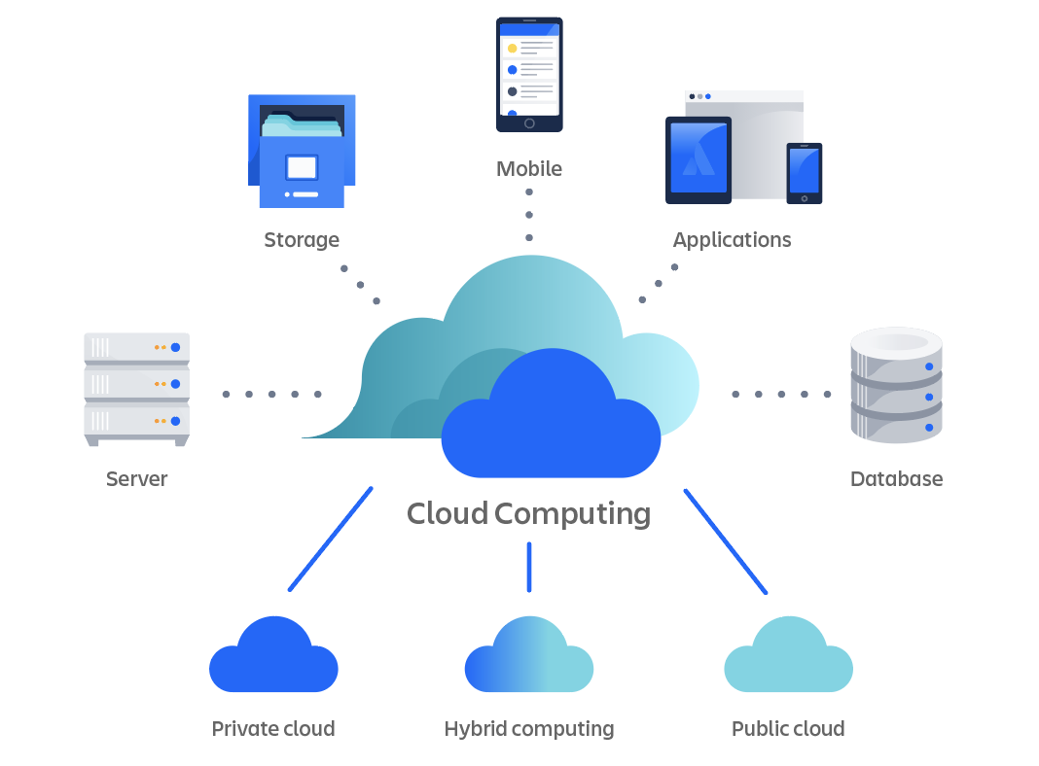
What is Cloud Computing ?
According to Google, "cloud computing is the on-demand availability of computing resources (such as storage and infrastructure), as services over the internet. It eliminates the need for individuals and businesses to self-manage physical resources themselves, and only pay for what they use.”
Example : Startup
Leading Cloud Providers : Microsoft Azure ,
Amazon Web Services , Google Cloud platform
Pillars of cloud computing
IaaS – Infrastructure as a Service
SaaS – Software as a Service
PaaS – Platform as a Service
From - www.atlassian.com

Slide 4
Cloud Computing Infrastructure: IaaS
Infrastructure as a Service
Infrastructure as a service (IaaS) is the on-demand availability of highly scalable computing resources as services over the internet. It eliminates the need for enterprises to procure, configure, or manage infrastructure themselves, and they only pay for what they use.
Eliminates extra expenses for example: servers, investing in physical spaces, air conditioning, an IT team for managing the servers, etc.

Slide 5
Cloud Computing Infrastructure: PaaS
Platform as a Service
In the Platform-as-a-Service (PaaS) model, developers essentially rent everything they need to build an application, relying on a cloud provider for development tools, infrastructure, and operating systems.
For example, users have the capability to execute Node.js or Java applications using the PaaS. This platform provides the necessary runtime environment for working with these tools, while also allowing users to install applications of their choice.

Slide 6
Cloud Computing Infrastructure: SaaS
Software as a Service
Software-as-a-Service (SaaS) refers to cloud-based applications purchased on a subscription basis from external service providers. In contrast to traditional software, which is installed on and run from a local computer or server, SaaS apps live in the cloud. Users access the app over the internet, typically with a web browser.
In a SaaS business model, the software provider owns and maintains the software. The customer does not need to install any software on their own computer. Needless to mention, the SaaS business model is quite different from a managed service model. For a recurring fee or subscription, the end user does not need to worry about the provisioning, management, and maintenance of the infrastructure, platform, and application. This is usually done through a central cloud-based system.

Slide 7
Advantages of SaaS
1. Cost Effective
No upfront cost
2. Scalability & Accessibility
Increasing size of team
Can be accessed from anywhere
3. Update & Maintenance
SaaS companies handle the updates and maintenance from their end.
Pay-as-you-go model

Slide 8
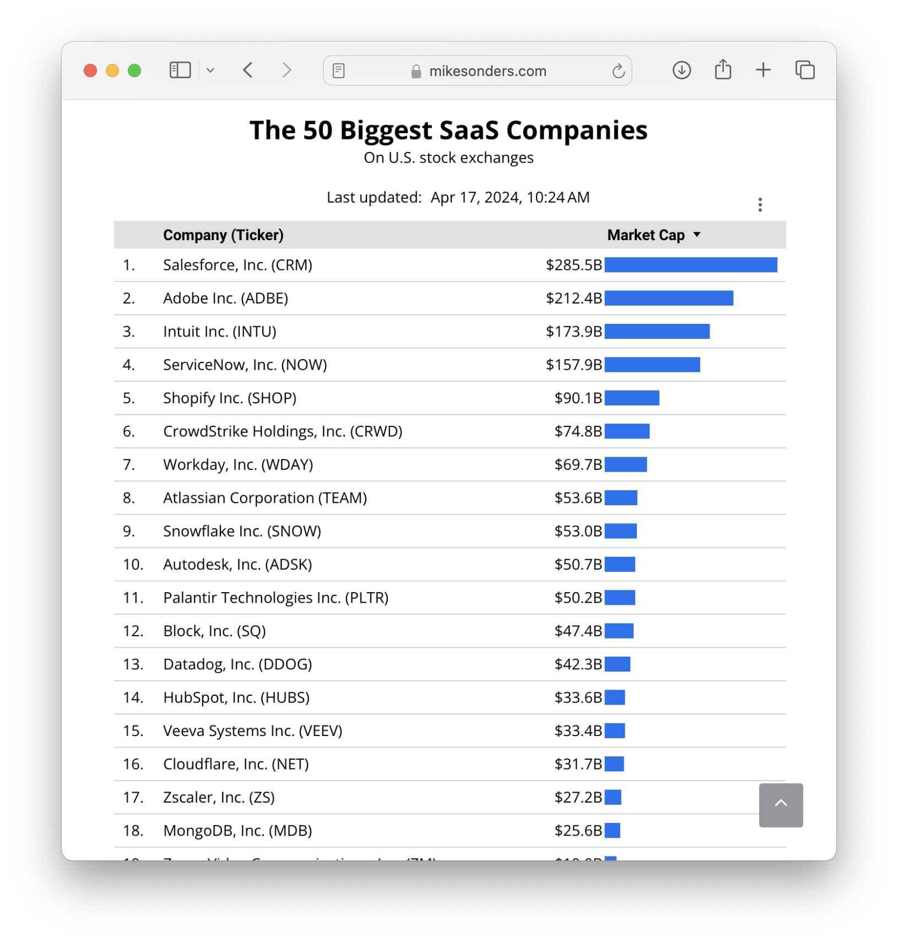
From – www.mikesconders.com

Slide 9
Cloud Computing & Cloud Security
Cloud security, also known as cloud computing security, encompasses a collection of security measures, guidelines, policies, and procedures designed to protect cloud-based infrastructure, applications, and data.
Measures cloud providers use:
Encryption - is being used by the service providers for both in transit and at rest to keep data secure.
Access Controls – access to cloud resources is granted based on the user's role or privilege, ensuring that data remains inaccessible to unauthorized users.
Network Security – network security measures like firewalls, intrusion detection and prevention systems are used by the cloud providers.

Slide 10
1
Public Cloud
Private Cloud
Bare metal
Virtual Machine
Types of Cloud Computing
2
3
4

Slide 11
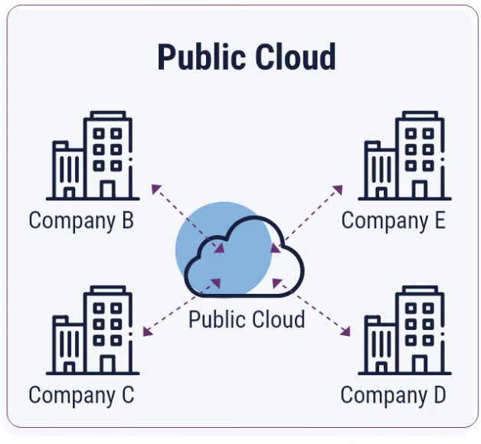
Public Cloud
This is the most widely used type of cloud by both organizations and individuals.
A public cloud is a type of computing service offered by a third-party provider over the internet. In a public cloud, the provider owns and maintains the infrastructure, including hardware, software, and networking.
Users can access these services on a pay-as-you-go model, meaning they only pay for the resources they use.
This allows businesses and individual developers to offload the responsibility of managing and maintaining their own IT infrastructure, and instead, they can rely on the public cloud provider to handle these tasks.
The public cloud is often used for tasks provided by companies AWS, GCP such as data storage, application hosting, and web services.

Slide 12
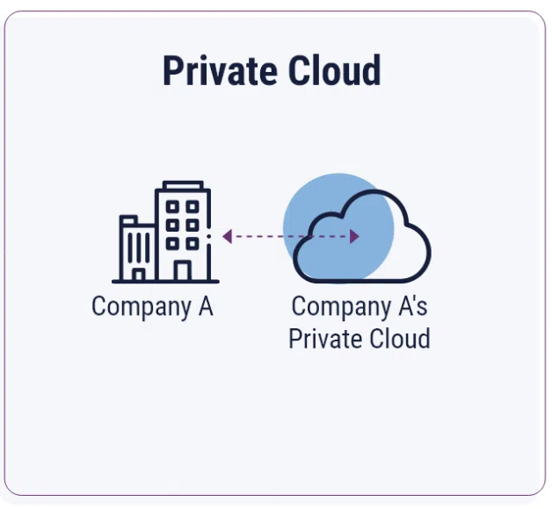
Private Cloud
A private cloud refers to a cloud computing environment that is dedicated solely to a single organization. This type of cloud a particular business or software organization to have complete control over their data and resources.
In a private cloud, the organization has the option to manage the cloud environment themselves or have a third-party service provider manage it exclusively for them.
For example, a company may set up its own private cloud infrastructure within its data centers, allowing them to utilize the computing resources like data storage or virtual machines.
This provides the organization with the flexibility and scalability of cloud computing while maintaining a higher level of control and security over its data and resources.

Slide 13
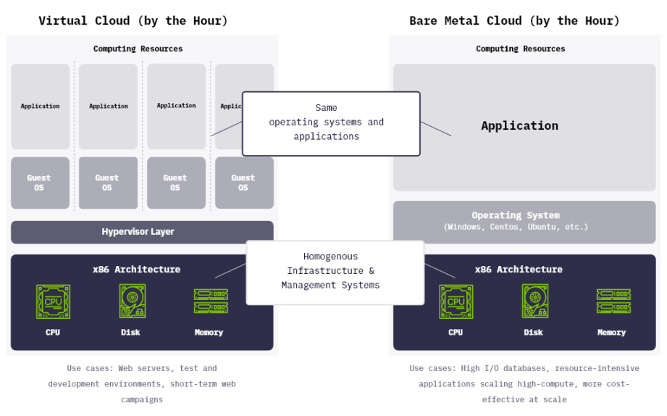
Bare Metal Cloud
Bare metal cloud, also known as dedicated cloud, is a form of cloud service where the user rents the physical server from the service provider which is not shared with another tenants.
The key thing about this type of cloud is that it provides you with the raw performance. Because you have access to the physical hardware which boosts the performance.
The bare metal cloud provides you with a high degree of security because your resources like server are not shared with anybody which makes the bare metal a better option for the intensive computer environments.
Understanding with real world example:
Bare metal is like having your own independent apartment. You don’t need to deal with noisy neighbors.
Providers: IBM and Cloud

Slide 14
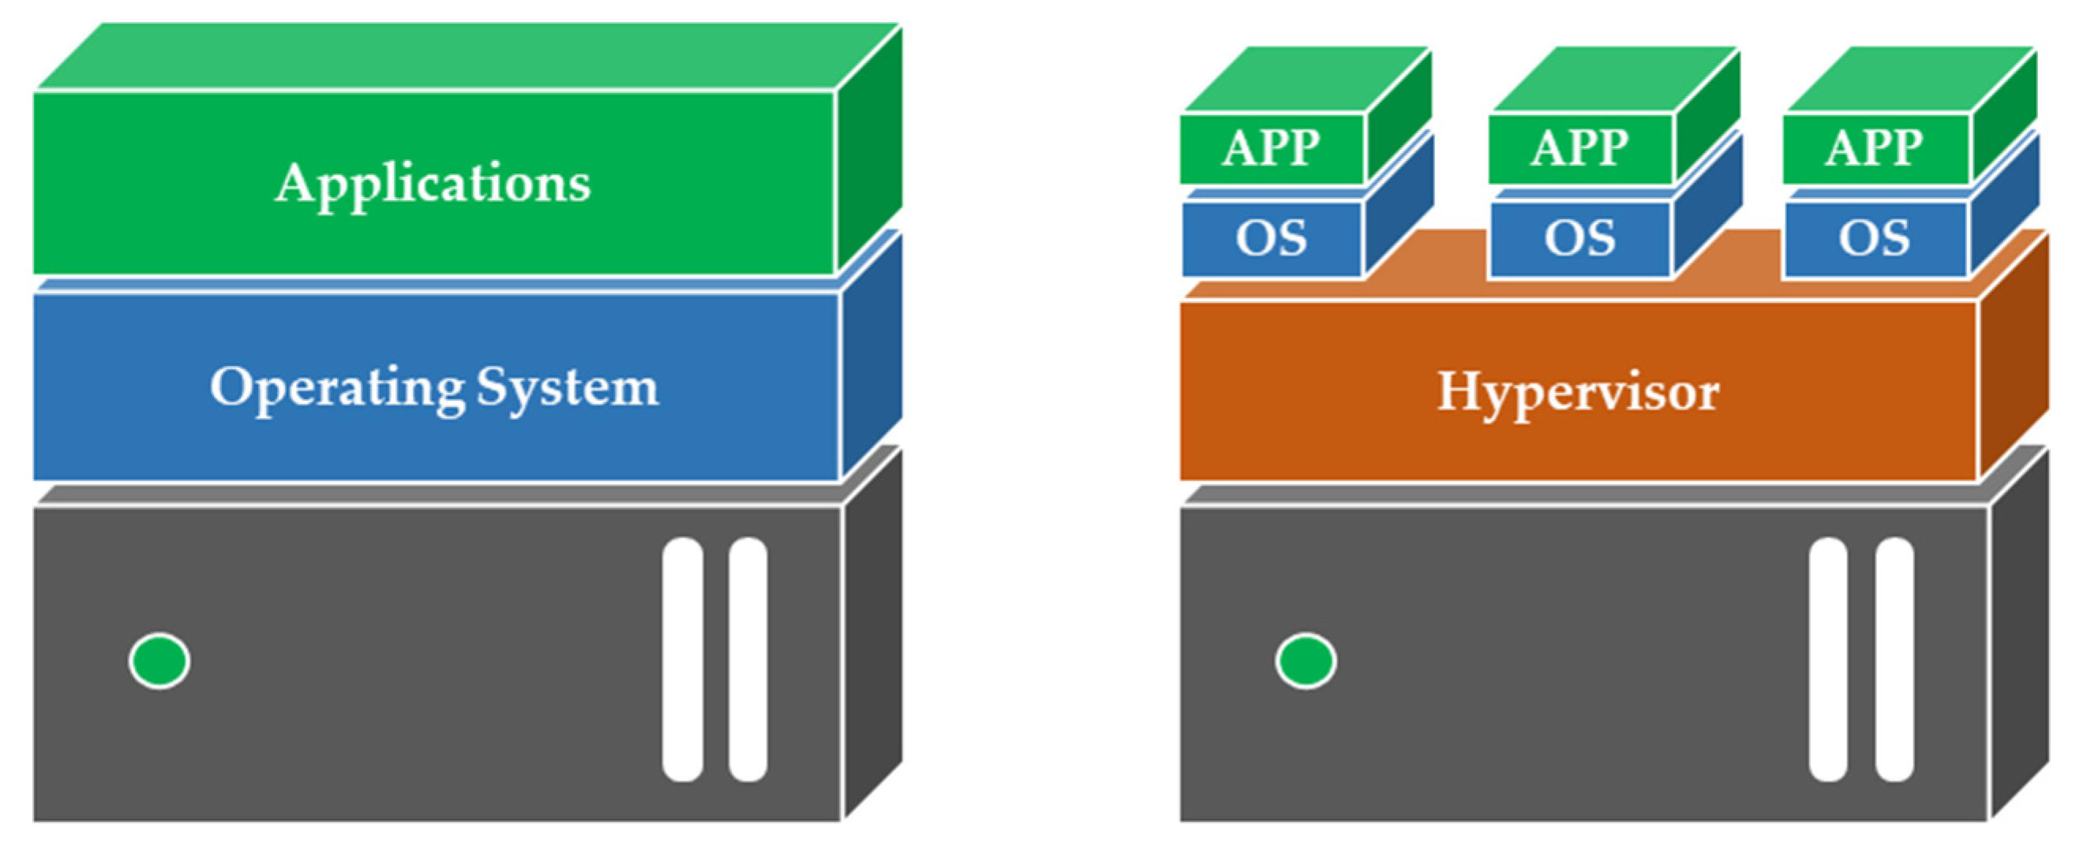
Virtual Machine Cloud
Virtual machine in cloud is the digital version of your physical computer. These machines are created and exist within cloud environment and allow users to run multiple operating system.
In virtual machines hypervisor plays a crucial role, also known as a virtual machine monitor. It is a firmware that creates the virtual machines. Key role of the hypervisor is that it allows multiple virtual machines to run independently with isolation.
On cloud, it enables providers to offer the virtual machine instance as a service, allow users to deploy and manage their virtual machines on a shared physical environment.

Slide 15
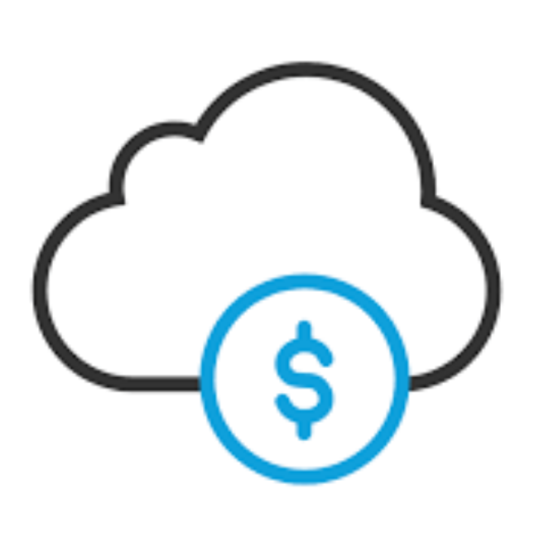
Advantages of the Cloud - 1
Cost Savings:
Cloud computing services offer cost-saving benefits compared to maintaining an on-premises data center.
Many cloud providers implement pay-as-you-go policies for resources, allowing businesses to pay only for the services and resources they use.
Cloud computing solutions contribute to reduced maintenance and employee costs, as the infrastructure and management responsibilities are often handled by the cloud provider.
Companies utilizing cloud services benefit from the absence of update costs, as updates and maintenance are typically included as part of the service.

Slide 16
Advantages of the Cloud - 2
Advanced Security:
Cloud providers and data center operators place a huge emphasis on security in all the services and solutions they offer. Their security measures will be significantly more advanced and robust than a typical in-house system a business might traditionally use.
Cloud data security protects data that is stored (at rest) or moving in and out of the cloud (in motion) from security threats, unauthorized access, theft, and corruption. It relies on physical security, technology tools, access management and controls, and organizational policies.
Cloud data security best practices follow the same principles as that of data security and governance: Data confidentiality, integrity, and availability. This is also known as the CIA triad.

Slide 17
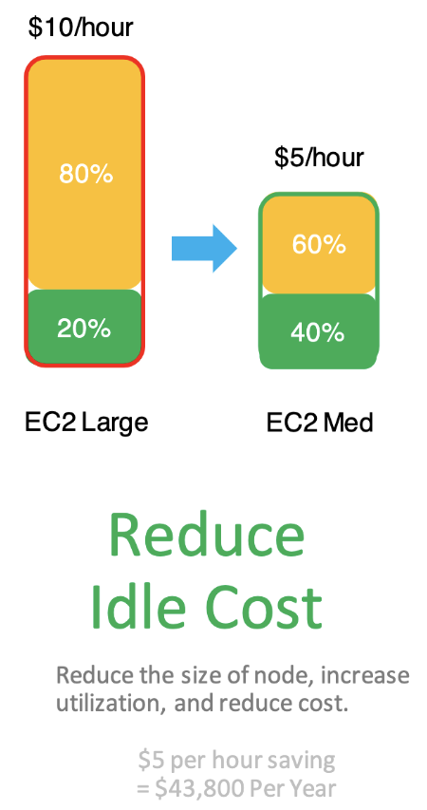
Advantages of the Cloud - 3
Scalability & Flexibility:
During periods of peak demand, the allocation of resources can be increased in order to align with the heightened demand, thereby mitigating potential performance issues.
During periods of reduced activity, resources can be downscaled to minimize expenditure and optimize cost efficiency.
Therefore, Cloud helps businesses easily handle fluctuating workloads, leading to optimization of computing resources and costs.
With quicker turnaround times, businesses gain a competitive edge.

Slide 18
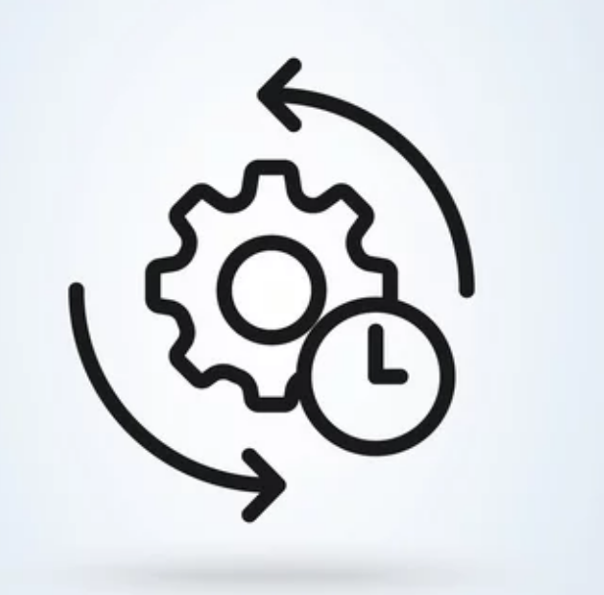
Advantages of the Cloud - 4
Agility:
Agile Development and Deployment: Cloud platforms provide tools and services that support agile software development practices, such as continuous integration, continuous delivery (CI/CD), and DevOps automation. Development teams can iterate on software quickly, deploy updates frequently, and respond rapidly to feedback from customers and stakeholders.
Rapid Provisioning of Resources: Cloud services allow companies to quickly provision computing resources such as servers, storage, and databases within minutes, compared to the weeks or months it might take to acquire and set up physical infrastructure. Therefore, they can begin development faster.
On demand scalability, collaboration and integration.

Slide 19
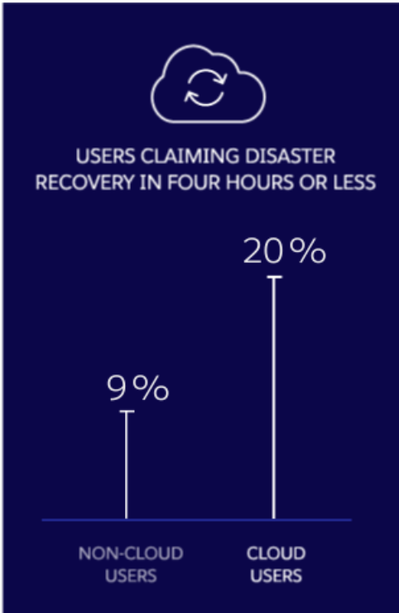
Advantages of the Cloud - 5
Disaster Recovery & Loss prevention:
Cloud environments can deploy across several data center locations. If one server suffers downtime, services continue uninterrupted across other resources. Meanwhile, extensive cloud data storage options allow business continuity in the case of natural disasters.
When organizations don't use cloud solutions, if their local hardware experiences an issue, there's a chance all their data might be completely lost or corrupted. A cloud solution offers easy rollback of versions and backup recovery in such a case.

Slide 20
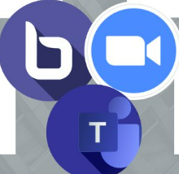
Advantages of the Cloud - 6
Collaboration:
Cloud services enable straightforward collaboration between people across the business, wherever they are located. Having every document, file and application available on-demand in the cloud environment removes traditional barriers such as having to have everybody working together in one centralized location.
Team members can view and share information easily and securely across a cloud-based platform.

Slide 21
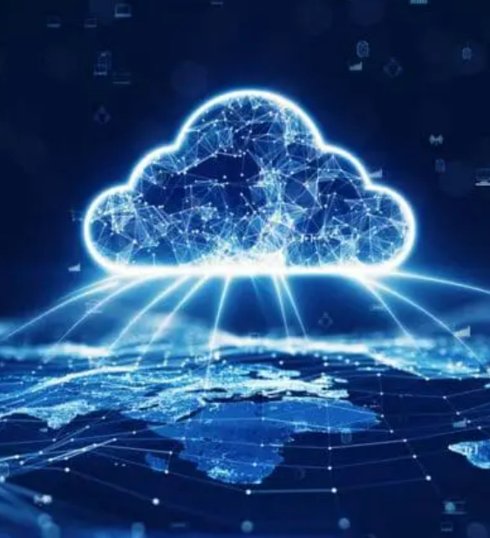
Advantages of the Cloud - 7
Other Advantages:
Mobility: Instant access to data and applications through an internet connection
Accessibility: Fast deployment Reduce the lead time of securing and deploying new resources such as servers, storage and applications
Quality: consistent delivery of reliable, secure, and high-performance services to meet user expectations and business requirements.

Slide 22
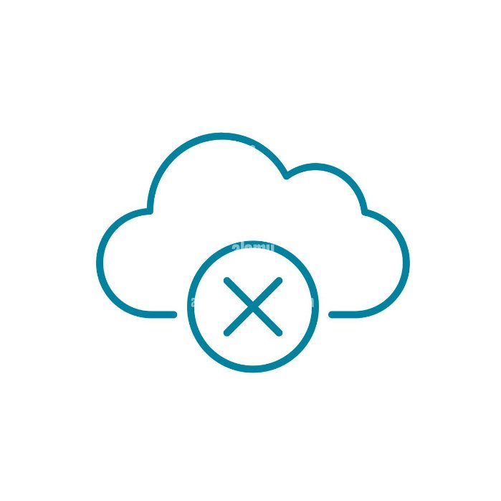
Disadvantages of the Cloud - 1
Downtime:
This is possibly the biggest disadvantage of Cloud Services.
As cloud services are heavily reliant on the internet, an outage can affect access to data and applications and hence disrupt business.
No organization is immune to these problems, and on average outages can cost organizations losses upwards of $100K per hour.
How to reduce it?
Consider provider’s infrastructure, downtime history, and SLA (service-level agreement) guarantees.
Consider multi-region deployments to provide the highest level of business continuity.
Have a backup system with minimal downtime.

Slide 23
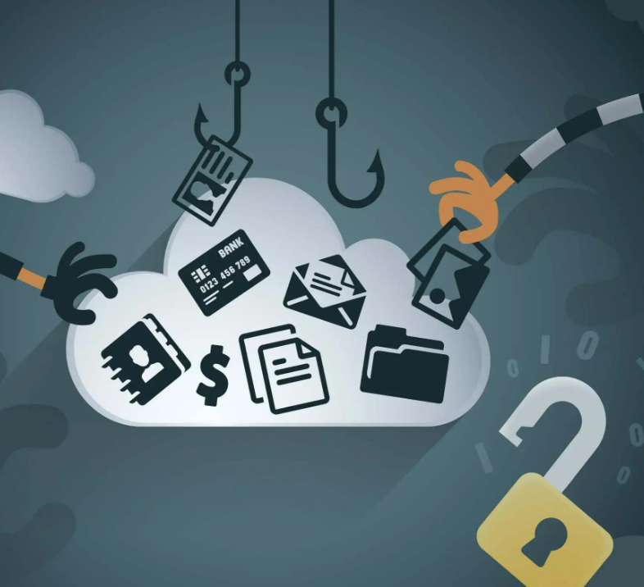
Disadvantages of the Cloud - 2
Security:
When sensitive information is stored online, it is vulnerable to attacks. These attacks are quite common as 98% of cloud users reported at least 1 data breach between 2020 and 2022.
Cloud Providers are expected to provide security of infrastructure and hardware, but the organization is liable for user access management and weighing risk scenarios.
How to ensure it?
Analyse security certifications, measures, history of security breaches.
Implement access control to limit access to data.
Understand your shared responsibility model.

Slide 24
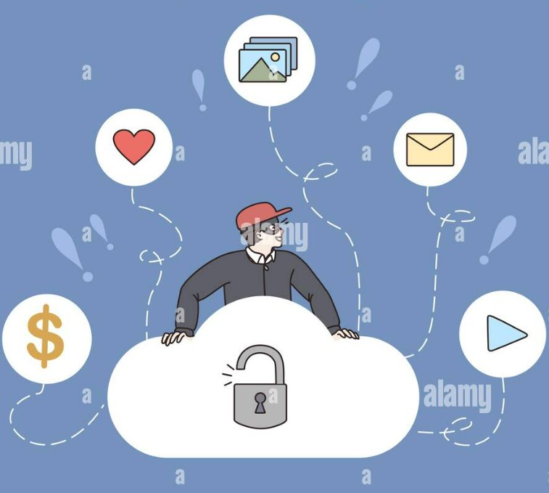
Disadvantages of the Cloud - 3
Vulnerability to attacks:
As every component in Cloud computing is online, they're exposed to potential vulnerabilities.
Many businesses prefer using public cloud for cost reasons, that opens them up for these attacks.
Attacks Include: Data breaches, Hackings, Malware attacks etc.
How to reduce it?
Security should be a core principle for all IT operations in the company.
Keep ALL teams up do date with cloud security best practices.
Review and reset credentials often, apply access control.
Review and update security policies often.

Slide 25
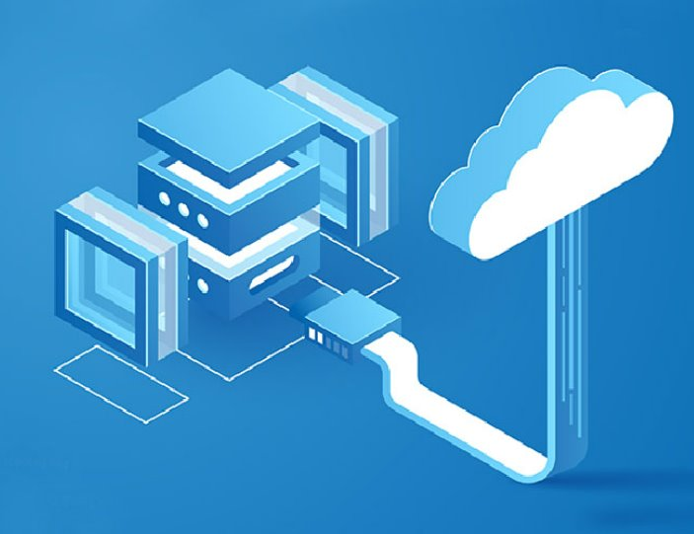
Disadvantages of the Cloud - 4
Limited Control and flexibility:
Since the cloud infrastructure is owned, managed and monitored by the cloud service provider, the customers are often left wanting more control over the Backend infrastructure.
End-user license agreement and management policies impose limits on what the customer can do with their deployments.
How to increase it?
Opt for a CSP that gives more control and customization possibilities for moving data in and out of the system.
Make sure to understand the CSP's basic level of support .
Enlist the help of a cloud partner to help implement, run and support cloud services.

Slide 26
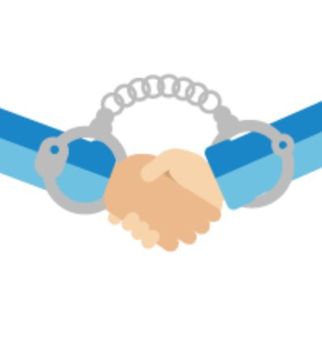
Disadvantages of the Cloud - 5
Vendor lock-in:
Organizations usually have a hard time switching between cloud service providers as differences in the platforms create difficulties when migrating from one cloud platform to another.
Migrating from a complex platform can lead to configuration complexity leading to gaps which expose data to vulnerabilities.
How to avoid it?
Employ multi-cloud strategies to avoid vendor lock-ins. This might add deployment and operational complexity to deployment.
Properly understand what their vendor is selling to avoid such a situation.
Use a backup and recovery system for their data to ensure that they have a copy that can be retrieved in a case like this.

Slide 27
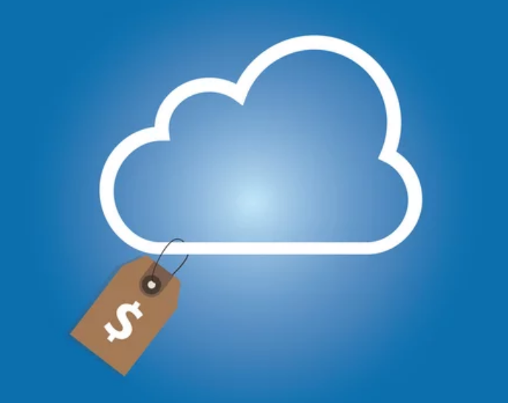
Disadvantages of the Cloud - 6
Cost concerns:
Cloud enables small scale businesses to access high quality services without spending much money.
However, in case their usage spikes or their provider changes prices, their costs can increase.
How to reduce it?
Choose a cost-effective CSP that offers affordable and flexible billing options.
Utilize various storage types, such as block or object storage, depending on your unique requirements and workloads.

Slide 28
Cloud Billing Models
Pay-as-you-go
Subscription Based Model
Reserved Instances
Spot Instances
Resource Based Billing
Hybrid Models

Slide 29
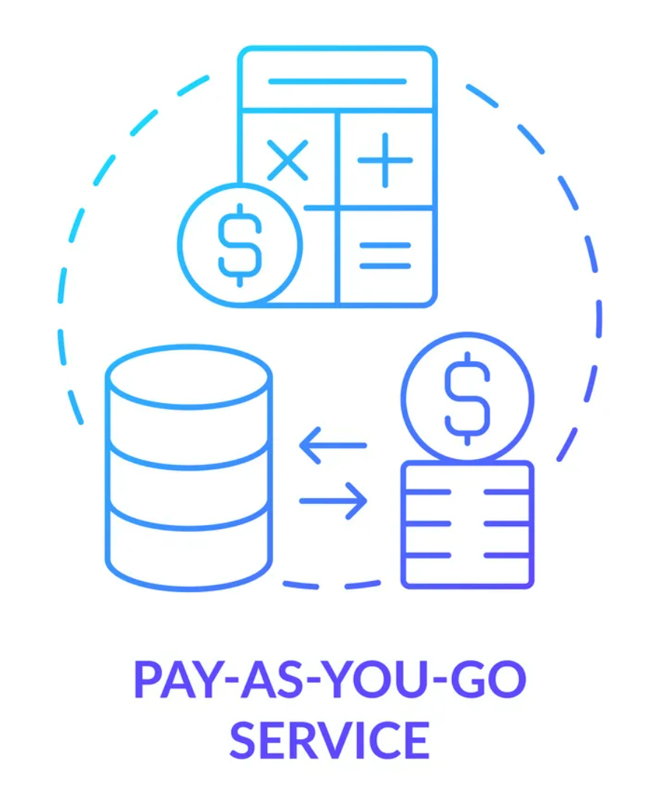
Pay-as-You-Go
Flexible Scaling
Cost Optimization
PAYG allows organizations to scale resources up or down as needed, without long-term commitments, making it suitable for variable workloads.
Users only pay for the resources they consume, enabling them to optimize costs and avoid overprovisioning.
Budgeting Challenges
The lack of predictability in costs can make budgeting more complex for organizations, especially those with steady workloads.

Slide 30
Subscription Based Modeling
Predictable Costs
Discounts for Commitment
Inflexibility
Subscription-based models offer a fixed monthly or yearly fee, making it easier for organizations to budget and plan.
Longer-term commitments often come with discounts, resulting in cost savings for stable workloads.
Subscriptions may lead to unused resources if organizations overestimate their needs, and they can lack the flexibility to quickly scale resources.

Slide 31
Reserved Instances
1
Cost Savings
2
Capacity Assurance
3
Upfront Commitment
Reserved Instances offer substantial discounts compared to on-demand pricing, making them ideal for predictable workloads.
Reserved Instances provide guaranteed access to resources, ensuring availability when needed.
The required upfront payment and fixed term length can be a barrier for some organizations.

Slide 32
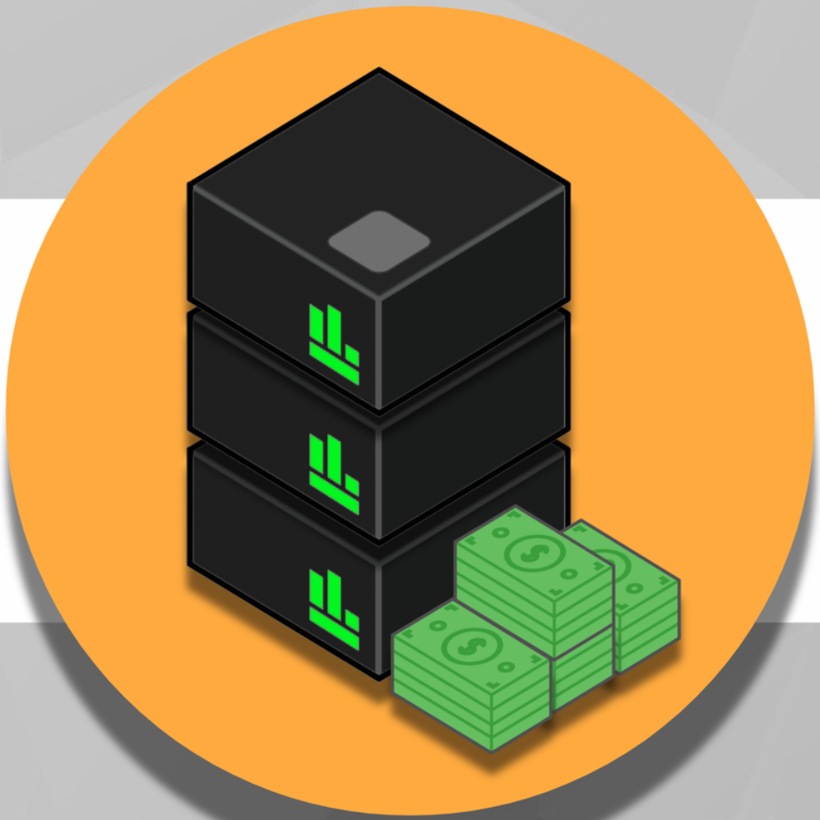
Spot Instances
Cost Optimization
Intermittent Availability
Suitable workloads
Spot Instances offer significant cost savings, often at a fraction of the cost of on-demand instances.
Spot Instances are subject to interruptions when the spot price exceeds the bid price or when capacity is needed by other users.
Spot Instances are best suited for non-critical, fault-tolerant workloads that can handle interruptions.

Slide 33
Resource-Based Billing
Cost Transparency
Precise Cost Control
Resource-based billing provides detailed insights into usage, enabling organizations to identify and eliminate wasteful spending.
Users only pay for the resources they consume, allowing for more granular cost optimization.
Complexity
Resource-based billing can be challenging to understand and manage, especially in environments with diverse resource types and usage patterns.

Slide 34
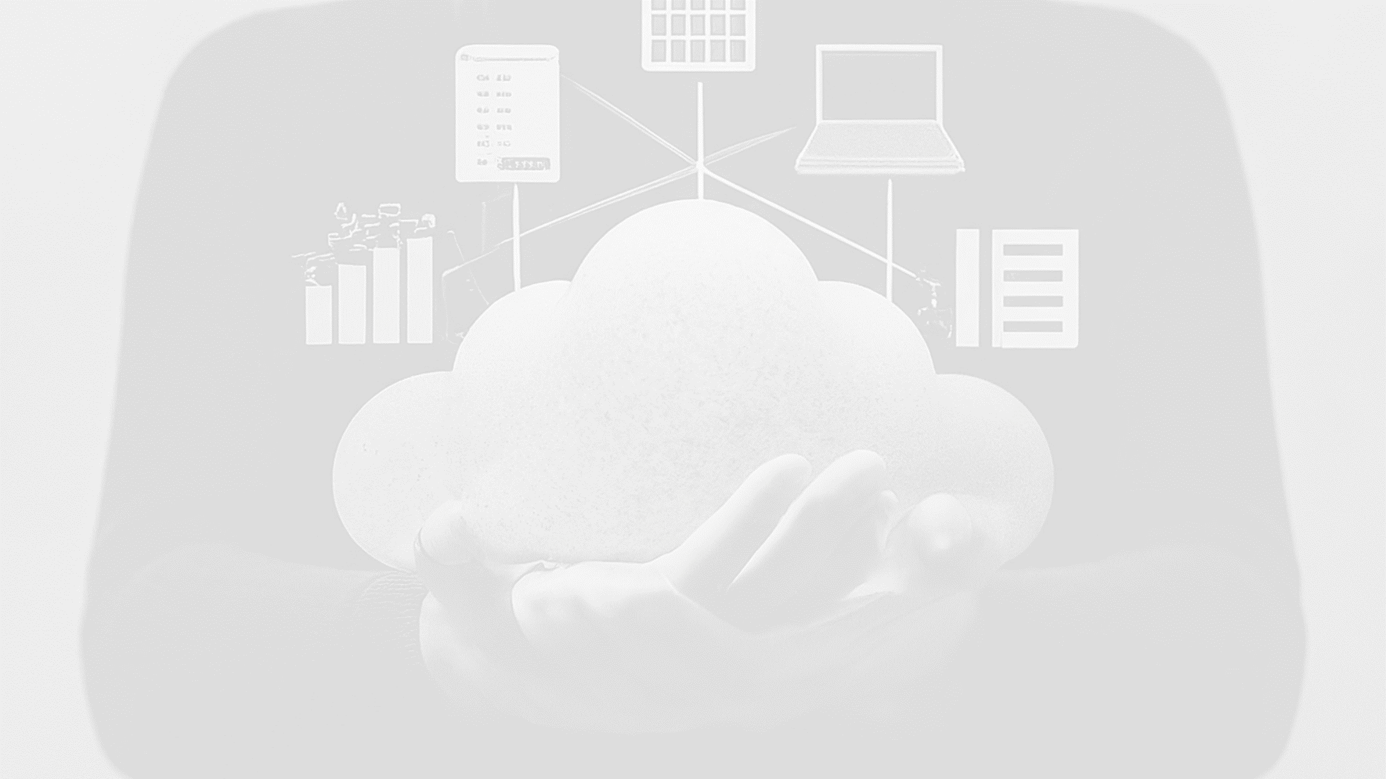

Slide 35
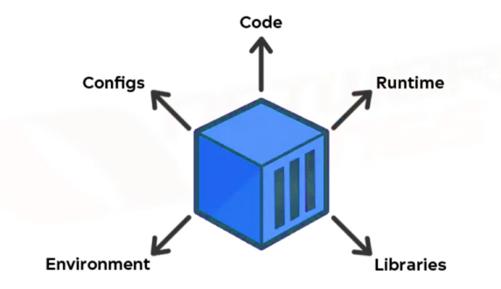
What Is a Container?
Containers are software packages (application code) containing all of the necessary elements (e.g. libraries) to run in any environment.
Containers are basically a virtualized operating system and can run from anywhere. For example:
From a private data center
The public cloud
On a developer's personal laptop
Google applications, like Gmail, are all containerized and run on Google's cloud server.
From – www.nwkings.com

Slide 36
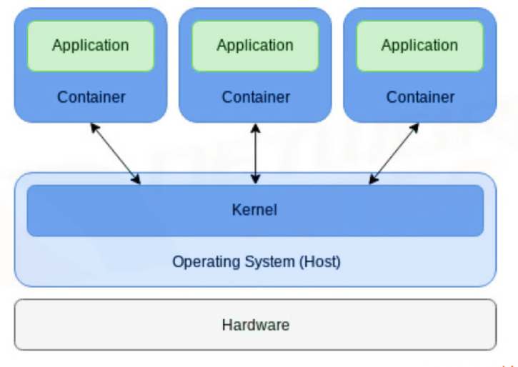
What Do Cloud Containers Do?
Virtualization of a singular app that is hosted on the cloud
Each container = one application
Various features can be adjusted by developers without the entire application being affected
From – www.nwkings.com

Slide 37
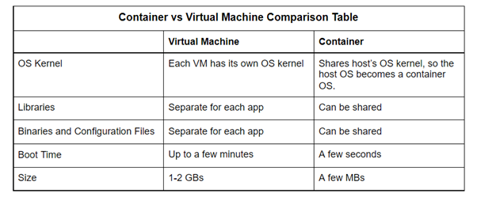
Cloud Containers vs Virtual Machines
From - www.ridge.co

Slide 38
What Are Containers Used for?
Continuous Integration
and Deployment (CI/CD)
Applications that can be deployed, scaled, and integrated without interruption become simple for DevOps to build. Deployment is continuous therefore development and testing processes are more efficient.
Batch Processes
Due to the sharing of OS, libraries, and other dependencies among alike applications, containers are perfect for deploying and executing batch processes.
Microservices
Containers are great for the development of apps that employ microservices architecture. This architecture uses several containers to deploy a single app, which creates a container cluster.
Distributed Cloud
In distributed cloud architecture, containers solve the issues of portability and exchanging of information. This allows for easy data and app relocation and resource sharing between clouds.

Slide 39
Benefits of Containers
Responsibility Distribution
Workload Portability
Application Isolation
Developers can focus on dependencies, application logic and other details such as configurations and software versions. IT teams can spend their time focusing on deploying and managing applications.
Due to containers having the capability to run basically anywhere, development and deployment are alleviated on:
Developer machines
Data centers
Public cloud
Virtual machines
Physical servers
Linux, Windows, and Mac OS
Developers are provided with a view of the OS logically isolated from other apps due to containers virtualizing CPU, memory, storage, and network resources all at the OS level.

Slide 40
Container Security
There are four levels of security available
within containers to prevent vulnerabilities
1
Application/Code Level
2
Container Level
Validations can be added by developers so that their code is up to security standards.
A secure container service, such as Kubernetes, can be utilized by developers.
3
Cluster Level
4
Cloud Level
Restrictions can be implemented by network administrators to restrict unauthorized traffic.
Using a container platform that is reliable will provide excellent security (e.g. Amazon EKS (Elastic Kubernetes Service)).

Slide 41
What Is Docker?
Docker is an open source platform that enables developers to build, deploy, run, update and manage containers. (ref #7)
Docker is an operating system for containers. Applications can be quickly deployed and scaled into any environment with assurance that the code will run.

Slide 42
What is a Dockerfile?
Text file containing instructions for creating a custom docker image, which is a read-only file containing lots of instructions. A new layer is created in the image with each instruction.
Dockerfile structure
Based on set of instructions:
"RUN", "COPY", "ENV", "FROM", etc.
New layer is added to the image with each instruction
Instructions specified in previous layer are included in each new layer
Result of all instructions specified throughout the Dockerfile make up the final image
Instructions:
Installing dependencies
Copying files
Setting environment variables
Configs for the container
Dockerfiles can be created/edited with any text editor. The docker build command will build an image once a Dockerfile has been created. Then, the docker run command can be used to run the image as a container.

Slide 43
Important Docker Commands
FROM <image>
WORKDIR <directory>
CMD ["executable", "param1", "param2",…]
FROM is used to specify the base image that the container is going to be built on top of.
WORKDIR is used to establish the working directory for all following commands
CMD sets the command that will be executed when a container is run from the image
COPY <src-path> <destination-path>
COPY ..
RUN <command_name>
RUN is used to execute commands that will run during image building
COPY is used to copy local files from the host machine to the current working directory
COPY can also be used to copy all files from the current directory to the containers current directory
From: https://medium.com
Reference #9

Slide 44
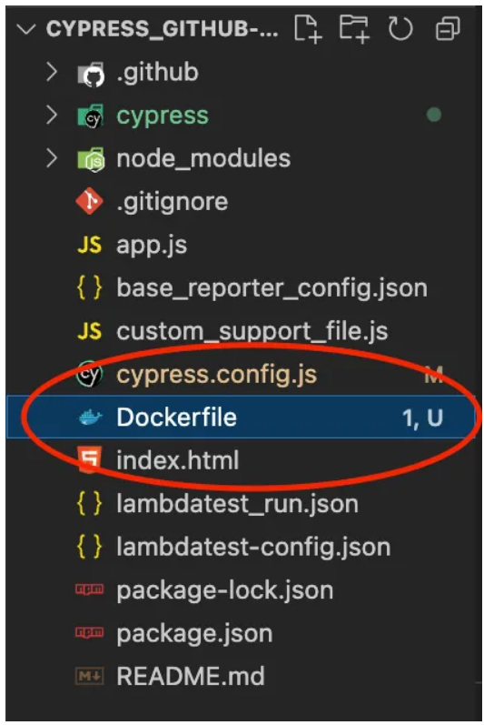
Creating a Dockerfile - 1
Install Docker on your system
Open preferred IDE (e.g. VS Code)
3. Create new file in project directory (root level), name is Dockerfile (no extension)
Example from: https://medium.com
Reference #9

Slide 45
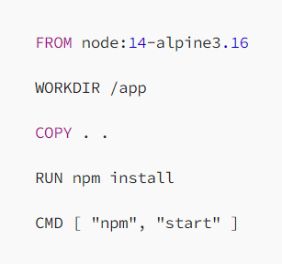
Creating a Dockerfile - 2
4. Create your Docker file
Example from: https://medium.com
Reference #9

Slide 46
Running a Dockerfile - 1
Example from: https://medium.com
Reference #9
Login
Build the image
docker login
docker build –t testing:v1
Building Process
Successful build - FINISHED

Slide 47
Verify Docker Image
Check if the image you built got created using this command:
docker images
Example from: https://medium.com
Reference #9

Slide 48
Push Docker Image
Push the docker image using this command:
docker push testing:v1
Example from: https://medium.com
Reference #9

Slide 49
Run Docker Image
Run the docker image to ensure that the image built is working correctly using this command:
Docker run testing:v1
Example from: https://medium.com
Reference #9

Slide 50
Benefits of Dockerfiles
Use less memory than VM
Deployment of apps is faster and more efficient.
Can be utilized in automation testing to build and run test environments for all different apps and services.
Dockerfiles can be integrated effortlessly with a CI/CD pipeline.

Slide 51
What is Kubernetes?
Container orchestrator.
Helps manage containerized workloads on distributed systems.
Facilitates automation.
Allows for scaling.

Slide 52
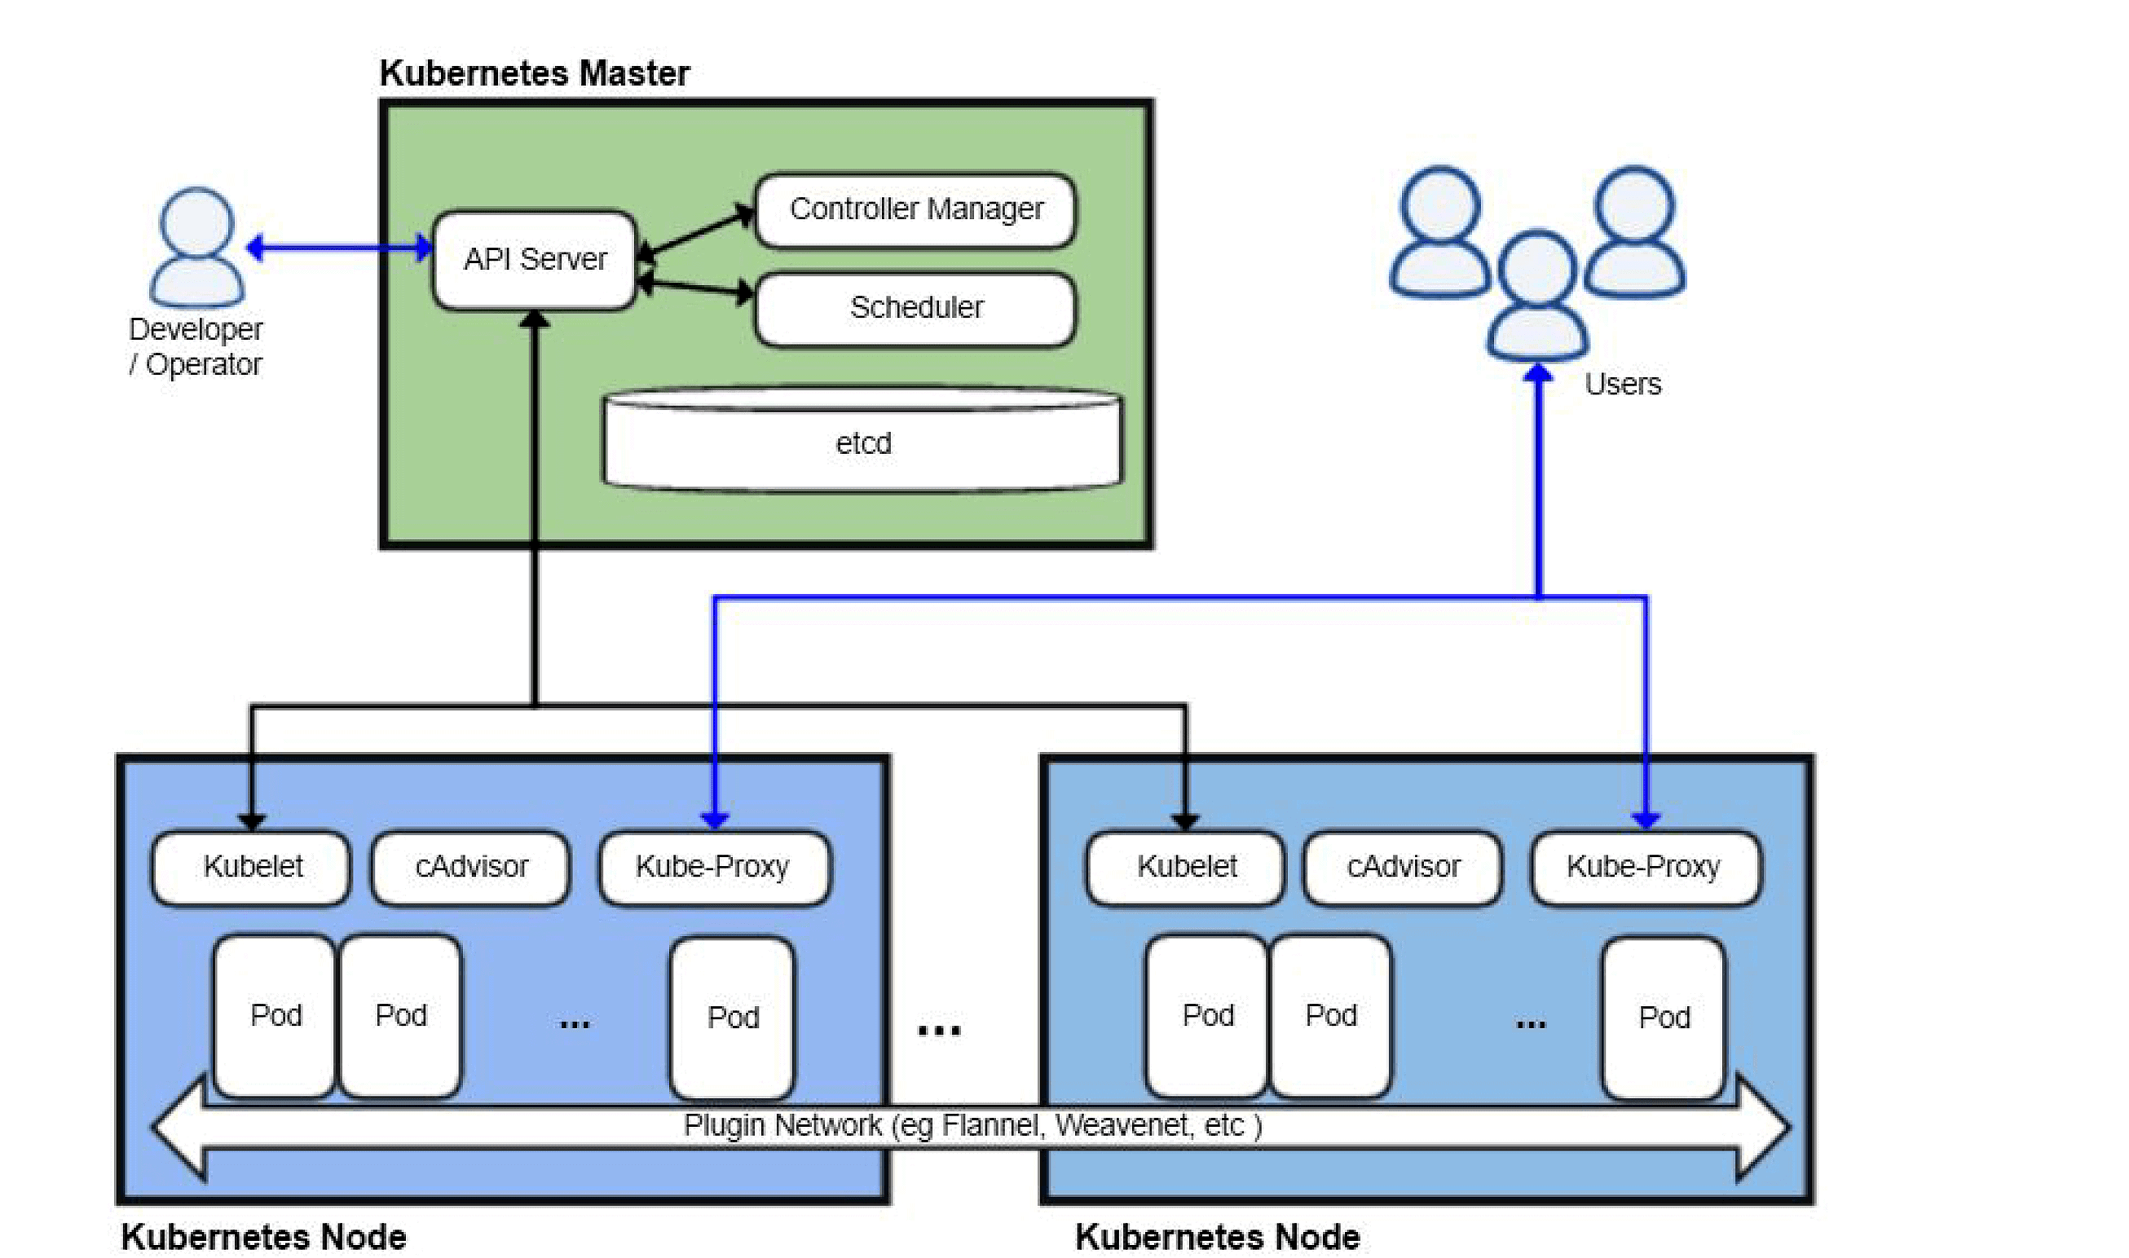
Kubernetes components
Notes:
The Master node / control plane : manages worker nodes and the pods in the cluster.
The API server : is the front end of the system.
The controller manager : watches the cluster and makes periodic changes to try to reach the desired state.
Etcd : stores key-values for critical information in the cluster.
Node: basically a virtual or physical
Pods: usually holds one container but may hold
Scheduler : matches pods to nodes
Kubelet : monitors the health of the pods running in a node
cAdvisor: monitors resource usage and analyzes performance
Kube-Proxy – handles requests and responses

Slide 53
Deployment configuration file
Notes:
Config files are YAML files
For each component there is an apiversion
Yaml is strict about indentation
Three parts for deployment and service config files.
Metadata
Specification attributes of spec are different for each kind of config file
Status automattically generated by kubernetes.

Slide 54
service configuration file
Notes:
Config files are YAML files
Three parts for deployment and service config files.
Metadata
Specification
status

Slide 55
What is Kubectl?
A command line tool for Kubernetes
Communicates with the Api server

Slide 56
A selection of Kubectl commands
Kubectl apply –f <filename.yaml> : applys configuration files
Kubectl get X : lists resources of the particular type, can type get all for all.
Kubectl delete –f <filename.yaml>: deletes the resources specified in the file.
Kubectl edit X <name> : lets you edit the specified resource directly.
Kubectl logs <pod name> : prints the logs for the container in the pod.

Slide 57
References
https://www.nwkings.com/containers-in-cloud-computing
https://www.ridge.co/blog/what-are-containers/
https://cloud.google.com/learn/what-are-containers
https://www.hpe.com/us/en/what-is/cloud-containers.html
https://www.xcubelabs.com/blog/the-advantages-and-disadvantages-of-containers/
https://www.ridge.co/blog/what-are-containers/:
https://www.ibm.com/topics/docker
https://aws.amazon.com/docker/#:~:text=Docker%20is%20a%20software%20platform,tools%2C%20code%2C%20and%20runtime
https://medium.com/@anshita.bhasin/a-step-by-step-guide-to-create-dockerfile-9e3744d38d11
https://cloud.google.com/docs
https://www.ibm.com/topics/virtual-machines
https://www.cloudflare.com/en-gb/learning/cloud/what-is-iaas/
https://www.infoworld.com/article/3310941/why-you-should-use-docker-and-containers.html
https://www.youtube.com/watch?v=s_o8dwzRlu4&t=2170s
https://kubernetes.io/
https://www.okteto.com/blog/kubernetes-cheat-sheet-must-know-commands-and-examples/
https://www.quora.com/What-security-features-should-cloud-computing-have#:~:text=Cloud%20security%2C%20also%20known%20as%20cloud%20security%2C,as%20speed%20and%20efficiency%20through%20dynamic%20scaling.
https://www.geeksforgeeks.org/bare-metal-servers-networks-in-system-design/
https://www.geeksforgeeks.org/software-as-a-service-saas/
https://www.geeksforgeeks.org/platform-as-a-service-paas-and-its-types/

Slide 58
References Continued
21. https://www.salesforce.com/products/platform/best-practices/benefits-of-cloud-computing/
22. https://www.digitalrealty.com/resources/articles/what-are-the-advantages-of-cloud-computing
23. https://www.redswitches.com/blog/disadvantages-of-cloud-computing/
24. https://cloudacademy.com/blog/disadvantages-of-cloud-computing/
25. https://spot.io/resources/cloud-cost/cloud-cost-models-management-strategies/

