Slide 1
DevOps
Building bridges between teams, tools, and success."
MEMBER-1
Shivam Sharma
MEMBER-2
Gaganjot Malhotra
MEMBER-4
Daivik Singla
MEMBER-3
Rajveer Singh

Slide 2
DevOps
Building bridges between teams, tools, and success."
MEMBER-1
Shivam Sharma
MEMBER-2
Gaganjot Malhotra
MEMBER-3
Rajveer Singh
MEMBER-4
Daivik Singla

Slide 3
Brief History
The limitations of Agile methodology, such as conflicts between development and operations teams, maintenance challenges, and information sharing difficulties, underscored the need for a more integrated approach in software development. While Agile emphasized continuous improvement within development teams, it failed to address the disconnect between development and operations, causing inefficiencies and delays in software delivery. Recognizing this gap, DevOps emerged as a holistic solution to bridge the divide, streamline the software delivery process, and facilitate seamless collaboration between teams. By promoting automation, collaboration, and continuous feedback, DevOps enables organizations to deliver high-quality software rapidly and reliably, meeting the demands of today's fast-paced digital landscape and enhancing overall customer satisfaction.

Slide 4
What Is DevOps ?
Formal Definition:
DevOps, short for Development and Operations, is a set of practices, principles, and cultural philosophies that aim to improve collaboration, communication, and integration between software development (Dev) and IT operations (Ops) teams. It emphasizes automation, continuous delivery, and the rapid iteration of software development and deployment processes to enable organizations to deliver high-quality software more efficiently and reliably.

Slide 5
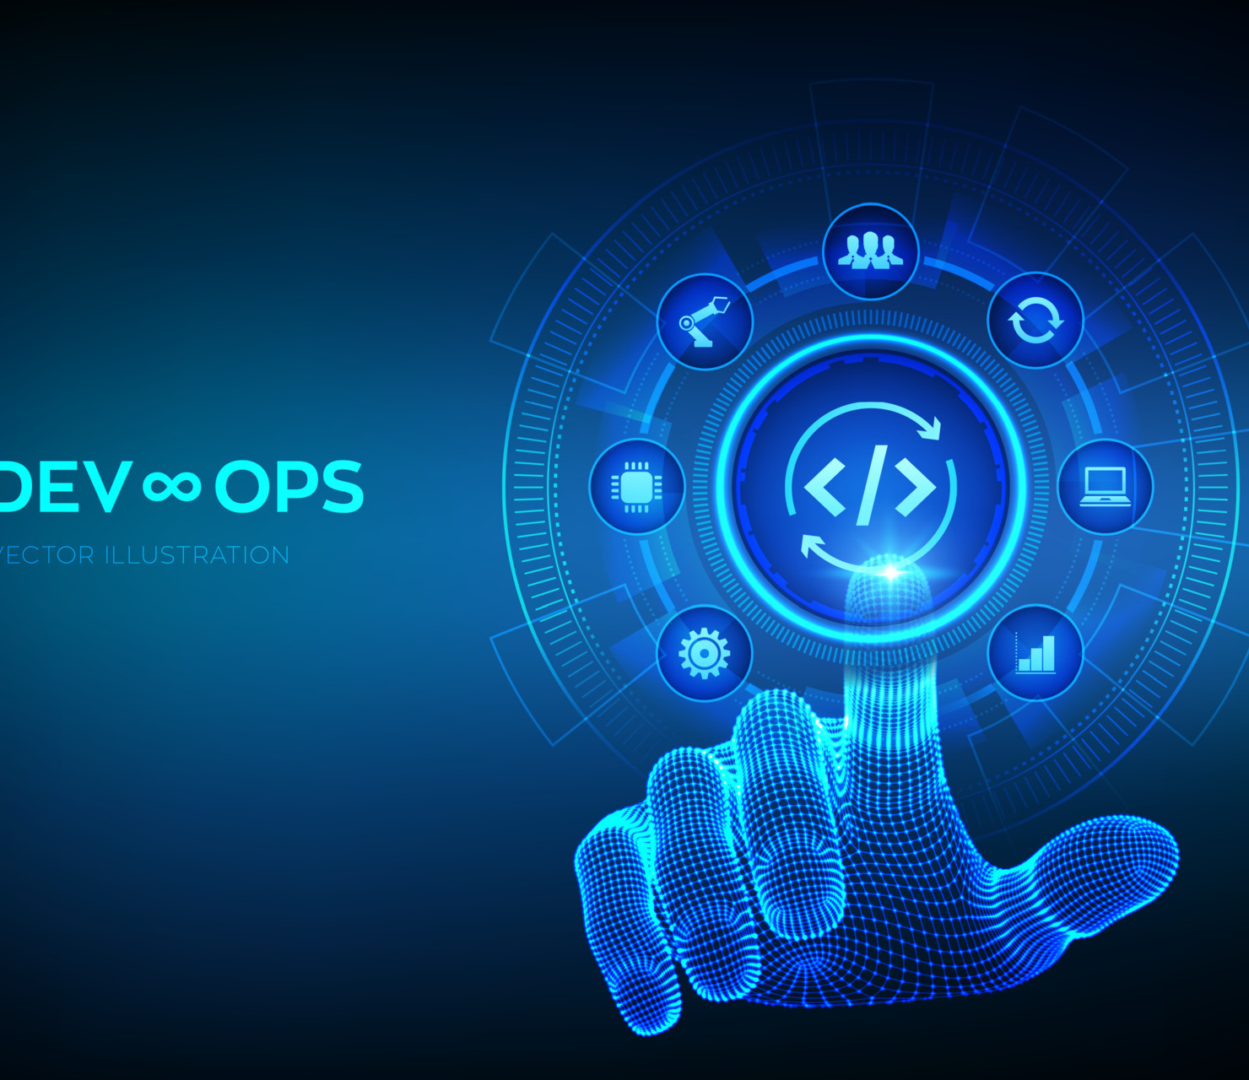
What Is DevOps ?
Informal Definition:
DevOps is like the glue that holds together the entire software development and deployment process. It's all about breaking down barriers between development and operations teams, so they can work together smoothly and get things done faster. With DevOps, teams use cool tools, share responsibilities, and focus on delivering top-notch software to users without all the headaches and delays that used to come with traditional methods.

Slide 6
DevOps Practices

Slide 7
01
Practice 01
Continuous Integration (CI): Involves integrating code changes into a shared repository frequently, often several times a day. This practice ensures that code changes are tested and validated continuously, reducing integration issues and improving code quality.
02
Practice 02
Continuous Delivery/Continuous Deployment (CD): Enables the automated deployment of code changes to production environments, allowing teams to release updates swiftly and reliably.
03
Practice 03
Infrastructure as Code (IaC): Treats infrastructure configurations as code, allowing teams to define and manage infrastructure resources programmatically. This approach enhances consistency, repeatability, and scalability, as infrastructure changes can be version-controlled and automated.
04
Practice 04
Automated Testing: Automates the execution of tests throughout the software development lifecycle, including unit tests, integration tests, and end-to-end tests. Automated testing helps identify defects early, ensures software quality, and accelerates feedback loops.

Slide 8
02
01
03
04
1
Kubernetes
Jenkins
Docker
Ansible, Chef, Puppet:
2
A containerization platform that allows applications to be packaged with their dependencies and run consistently across different environments.
Tools
An open-source container orchestration platform that automates the deployment, scaling, and management of containerized applications.
Configuration management tools used for automating the provisioning and configuration of infrastructure resources.
An open-source automation server used for doing CI/CD pipelines, automating build, test, and deployment processes.
3
4

Slide 9
02
04
01
03
1
Kubernetes
Jenkins
Docker
Ansible, Chef, Puppet:
2
A containerization platform that allows applications to be packaged with their dependencies and run consistently across different environments.
An open-source automation server used for doing CI/CD pipelines, automating build, test, and deployment processes.
An open-source container orchestration platform that automates the deployment, scaling, and management of containerized applications.
Configuration management tools used for automating the provisioning and configuration of infrastructure resources.
Tools
3
4

Slide 10
02
04
01
03
1
Kubernetes
Jenkins
Docker
Ansible, Chef, Puppet:
2
A containerization platform that allows applications to be packaged with their dependencies and run consistently across different environments.
An open-source container orchestration platform that automates the deployment, scaling, and management of containerized applications.
An open-source automation server used for doing CI/CD pipelines, automating build, test, and deployment processes.
Configuration management tools used for automating the provisioning and configuration of infrastructure resources.
Tools
3
4

Slide 11
02
04
01
03
1
Kubernetes
Jenkins
Docker
Ansible, Chef, Puppet:
2
A containerization platform that allows applications to be packaged with their dependencies and run consistently across different environments.
Tools
An open-source container orchestration platform that automates the deployment, scaling, and management of containerized applications.
Configuration management tools used for automating the provisioning and configuration of infrastructure resources.
An open-source automation server used for doing CI/CD pipelines, automating build, test, and deployment processes.
3
4

Slide 12
02
01
04
03
1
Kubernetes
Jenkins
Docker
Ansible, Chef, Puppet:
2
A containerization platform that allows applications to be packaged with their dependencies and run consistently across different environments.
Tools
An open-source container orchestration platform that automates the deployment, scaling, and management of containerized applications.
Configuration management tools used for automating the provisioning and configuration of infrastructure resources.
An open-source automation server used for doing CI/CD pipelines, automating build, test, and deployment processes.
3
4

Slide 13
CULTURAL PHILOSOPHY

Slide 15
COLLABORATION
One hallmark of a healthy DevOps culture is collaboration between teams, which starts with visibility.
Different teams such as development and IT operations must share their DevOps processes, priorities, and concerns with each other.
These teams must also plan to work together and align on goals and measures of success as they relate to the business.
C

Slide 16
RESPONSIBILITY
As teams align, they take ownership and become involved in additional lifecycle phases—not just the ones central to their roles.
Developers become accountable not only to the innovation and quality established in the develop phase, but also to the performance and stability their changes bring in the operate phase.
At the same time, IT operations staff should include governance, security, and compliance in the plan and develop phase.
R

Slide 17
R
RELEASE CYCLES
DevOps teams remain agile by releasing software in short cycles.
Shorter release cycles make planning and risk management easier since progress is incremental, which also reduces the impact on system stability.
Shortening the release cycle also allows organizations to adapt and react to evolving customer needs and competitive pressure.

Slide 18
L
LEARNINGS
High-performing DevOps teams establish a growth mindset.
They fail fast and incorporate learnings into their processes, continually improving, increasing customer satisfaction, and accelerating innovation and market adaptability.
DevOps is a journey, so there is always room to grow.

Slide 19
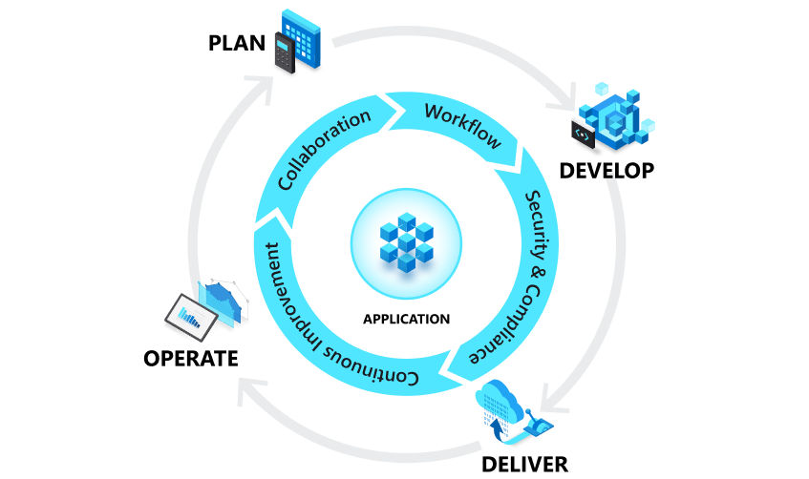
DevOps LIFECYCLE
01 PLAN
In the plan phase, DevOps teams ideate, define, and describe features and capabilities of the applications and systems they are building. They track progress at low and high levels of granularity—from single-product tasks to tasks that span portfolios of multiple products.
02 DEVELOP
The develop phase includes all aspects of coding—writing, testing, reviewing, and the integration of code by team members as well as building that code into build artifacts that can be deployed into various environments. DevOps teams seek to innovate rapidly without sacrificing quality, stability, and productivity.
03 DELIVER
Delivery is the process of deploying applications into production environments in a consistent and reliable way. The deliver phase also includes deploying and configuring the fully governed foundational infrastructure that makes up those environments.
04 OPERATE
The operate phase involves maintaining, monitoring, and troubleshooting applications in production environments. In adopting DevOps practices, teams work to ensure system reliability, high availability, and aim for zero downtime while reinforcing security and governance

Slide 20
DevOps LIFECYCLE
01 PLAN
In the plan phase, DevOps teams ideate, define, and describe features and capabilities of the applications and systems they are building. They track progress at low and high levels of granularity—from single-product tasks to tasks that span portfolios of multiple products.
02 DEVELOP
The develop phase includes all aspects of coding—writing, testing, reviewing, and the integration of code by team members as well as building that code into build artifacts that can be deployed into various environments. DevOps teams seek to innovate rapidly without sacrificing quality, stability, and productivity.
03 DELIVER
Delivery is the process of deploying applications into production environments in a consistent and reliable way. The deliver phase also includes deploying and configuring the fully governed foundational infrastructure that makes up those environments.
04 OPERATE
The operate phase involves maintaining, monitoring, and troubleshooting applications in production environments. In adopting DevOps practices, teams work to ensure system reliability, high availability, and aim for zero downtime while reinforcing security and governance

Slide 21
DevOps LIFECYCLE
01 PLAN
In the plan phase, DevOps teams ideate, define, and describe features and capabilities of the applications and systems they are building. They track progress at low and high levels of granularity—from single-product tasks to tasks that span portfolios of multiple products.
02 DEVELOP
The develop phase includes all aspects of coding—writing, testing, reviewing, and the integration of code by team members as well as building that code into build artifacts that can be deployed into various environments. DevOps teams seek to innovate rapidly without sacrificing quality, stability, and productivity.
03 DELIVER
Delivery is the process of deploying applications into production environments in a consistent and reliable way. The deliver phase also includes deploying and configuring the fully governed foundational infrastructure that makes up those environments.
04 OPERATE
The operate phase involves maintaining, monitoring, and troubleshooting applications in production environments. In adopting DevOps practices, teams work to ensure system reliability, high availability, and aim for zero downtime while reinforcing security and governance

Slide 22
DevOps LIFECYCLE
01 PLAN
In the plan phase, DevOps teams ideate, define, and describe features and capabilities of the applications and systems they are building. They track progress at low and high levels of granularity—from single-product tasks to tasks that span portfolios of multiple products.
02 DEVELOP
The develop phase includes all aspects of coding—writing, testing, reviewing, and the integration of code by team members as well as building that code into build artifacts that can be deployed into various environments. DevOps teams seek to innovate rapidly without sacrificing quality, stability, and productivity.
03 DELIVER
Delivery is the process of deploying applications into production environments in a consistent and reliable way. The deliver phase also includes deploying and configuring the fully governed foundational infrastructure that makes up those environments.
04 OPERATE
The operate phase involves maintaining, monitoring, and troubleshooting applications in production environments. In adopting DevOps practices, teams work to ensure system reliability, high availability, and aim for zero downtime while reinforcing security and governance

Slide 23
IMPORTANCE
Accelerates Time-to-Market:
DevOps enables organizations to deliver software faster, reducing time-to-market and gaining a competitive edge in the market.
Enhances Collaboration:
DevOps breaks down traditional silos between development and operations teams, fostering collaboration, communication, and shared responsibility.
Improves Quality:
Automation, continuous testing, and monitoring practices in DevOps lead to higher quality software with fewer defects.
01
02
03

Slide 24
IMPORTANCE
Accelerates Time-to-Market:
DevOps enables organizations to deliver software faster, reducing time-to-market and gaining a competitive edge in the market.
Enhances Collaboration:
DevOps breaks down traditional silos between development and operations teams, fostering collaboration, communication, and shared responsibility.
Improves Quality:
Automation, continuous testing, and monitoring practices in DevOps lead to higher quality software with fewer defects.
01
02
03

Slide 25
IMPORTANCE
Enhances Collaboration:
DevOps breaks down traditional silos between development and operations teams, fostering collaboration, communication, and shared responsibility.
Accelerates Time-to-Market:
DevOps enables organizations to deliver software faster, reducing time-to-market and gaining a competitive edge in the market.
Improves Quality:
Automation, continuous testing, and monitoring practices in DevOps lead to higher quality software with fewer defects.
01
02
03

Slide 26
IMPORTANCE
Improves Quality:
Automation, continuous testing, and monitoring practices in DevOps lead to higher quality software with fewer defects.
Accelerates Time-to-Market:
DevOps enables organizations to deliver software faster, reducing time-to-market and gaining a competitive edge in the market.
Enhances Collaboration:
DevOps breaks down traditional silos between development and operations teams, fostering collaboration, communication, and shared responsibility.
01
02
03

Slide 27
BENEFITS
01
02
03
By delivering high-quality software quickly and reliably, DevOps enhances customer satisfaction and loyalty. By responding quickly to customer feedback and market changes, organizations
By automating manual tasks, streamlining processes, and promoting collaboration, DevOps enhances efficiency and productivity across development and operations teams.
Automation, continuous testing, and monitoring practices in DevOps lead to higher quality software with fewer defects.
Improved customer satisfaction and loyalty:
Higher quality software with fewer defects:
Increased efficiency and productivity:

Slide 28
BENEFITS
01
02
03
By automating manual tasks, streamlining processes, and promoting collaboration, DevOps enhances efficiency and productivity across development and operations teams.
Automation, continuous testing, and monitoring practices in DevOps lead to higher quality software with fewer defects.
Improved customer satisfaction and loyalty:
Higher quality software with fewer defects:
Increased efficiency and productivity:
By delivering high-quality software quickly and reliably, DevOps enhances customer satisfaction and loyalty. By responding quickly to customer feedback and market changes, organizations

Slide 29
BENEFITS
01
02
03
By delivering high-quality software quickly and reliably, DevOps enhances customer satisfaction and loyalty. By responding quickly to customer feedback and market changes, organizations
By automating manual tasks, streamlining processes, and promoting collaboration, DevOps enhances efficiency and productivity across development and operations teams.
Improved customer satisfaction and loyalty:
Higher quality software with fewer defects:
Increased efficiency and productivity:
Automation, continuous testing, and monitoring practices in DevOps lead to higher quality software with fewer defects.

Slide 30
BENEFITS
01
02
03
By delivering high-quality software quickly and reliably, DevOps enhances customer satisfaction and loyalty. By responding quickly to customer feedback and market changes, organizations
Automation, continuous testing, and monitoring practices in DevOps lead to higher quality software with fewer defects.
Improved customer satisfaction and loyalty:
Higher quality software with fewer defects:
Increased efficiency and productivity:
By automating manual tasks, streamlining processes, and promoting collaboration, DevOps enhances efficiency and productivity across development and operations teams.

Slide 31
CHALLENGES

Slide 32
01
Challenge 01-
Cultural Resistance and Organizational Inertia:
Implementing DevOps requires a cultural shift, which can be met with resistance from traditional structures and processes within organizations.
02
Challenge 02
Complexity of Integration:
Integrating different tools and processes across the software development lifecycle can be complex and require careful planning and coordination.
03
Challenge 03
Security Concerns:
Rapid deployments and automation can introduce security risks if not managed properly, requiring organizations to implement robust security practices and controls.
04
Challenge 04
Skill Gaps and Training Needs:
Adopting DevOps practices may require upskilling existing teams or hiring new talent with expertise in automation, cloud computing, and DevOps tools and practices.

Slide 33
UNDErstanding devops and ci/cd

Slide 34
What is CI/CD
CI/CD, which stands for continuous integration and continuous delivery/deployment, aims to streamline and accelerate the software development lifecycle.
Continuous integration (CI) refers to the practice of automatically and frequently integrating code changes into a shared source code repository. Continuous delivery or deployment (CD) is a "2 part" process that refers to the integration, testing, and delivery of code changes. Continuous delivery stops short of automatic production deployment, while continuous deployment automatically releases the updates into the production environment.

Slide 35
Why is it important?
CI/CD helps organizations avoid bugs and code failures while maintaining a continuous cycle of software development and updates. As apps grow larger, features of CI/CD can help decrease complexity, increase efficiency, and streamline workflows.
Because CI/CD automates the manual human intervention traditionally needed to get new code from a commit into production, downtime is minimized and code releases happen faster. And with the ability to more quickly integrate updates and changes to code, user feedback can be incorporated more frequently and effectively, meaning positive outcomes for users and more satisfied customers overall.

Slide 36
What is "ci" in ci/cd?
The "CI" in CI/CD always refers to continuous integration, an automation process for developers that facilitates more frequent merging of code changes back to a shared branch, or “trunk.” As these updates are made, automated testing steps are triggered to ensure the reliability of merged code changes. In modern application development, the goal is to have multiple developers working simultaneously on different features of the same app. However, if an organization is set up to merge all branching source code together on one day (known as “merge day”), the resulting work can be tedious, manual, and time-intensive. That’s because when a developer working in isolation makes a change to an application, there’s a chance it will conflict with different changes being simultaneously made by other developers. This problem can be further compounded if each developer has customized their own local integrated development environment (IDE), rather than the team agreeing on one cloud-based IDE. CI can be thought of as a solution to the problem of having too many branches of an app in development at once that might conflict with each other.

Slide 37
Successful ci building and testing
Successful CI means that once a developer’s changes to an application are merged, those changes are validated by automatically building the application and running different levels of automated testing, typically unit and integration tests, to ensure the changes haven’t broken the app. This means testing everything from classes and function to the different modules that comprise the entire app. If automated testing discovers a conflict between new and existing code, CI makes it easier to fix those bugs quickly and often.

Slide 38
What is "cd" in ci/cd?
The "CD" in CI/CD refers to continuous delivery and/or continuous deployment, which are related concepts that sometimes get used interchangeably. Both are about automating further stages of the pipeline, but they’re sometimes used separately to illustrate just how much automation is happening. The choice between continuous delivery and continuous deployment depends on the risk tolerance and specific needs of the development teams and operations teams.

Slide 39
What is continuous delivery?
Continuous delivery automates the release of validated code to a repository following the automation of builds and unit and integration testing in CI. So, in order to have an effective continuous delivery process, it’s important that CI is already built into your development pipeline.
In continuous delivery, every stage—from the merger of code changes to the delivery of production-ready builds—involves test automation and code release automation. At the end of that process, the operations team is able to swiftly deploy an app to production.
Continuous delivery usually means a developer’s changes to an application are automatically bug tested and uploaded to a repository (like GitHub or a container registry), where they can then be deployed to a live production environment by the operations team. It’s an answer to the problem of poor visibility and communication between dev and business teams. To that end, the purpose of continuous delivery is to have a codebase that is always ready for deployment to a production environment, and ensure that it takes minimal effort to deploy new code.

Slide 40
Ci/cd vs devops
CI/CD is an essential part of DevOps methodology, which aims to foster collaboration between development and operations teams. Both CI/CD and DevOps focus on automating processes of code integration, thereby speeding up the processes by which an idea (like a new feature, a request for enhancement, or a bug fix) goes from development to deployment in a production environment where it can provide value to the user. In the collaborative framework of DevOps, security is a shared responsibility integrated from end to end. It’s a mindset that is so important, it led some to coin the term "DevSecOps" to emphasize the need to build a security foundation into DevOps initiatives. DevSecOps (development, security, and operations) is an approach to culture, automation, and platform design that integrates security as a shared responsibility throughout the entire IT lifecycle. A key component of DevSecOps is the introduction of a secure CI/CD pipeline.

Slide 41
An ci/cd example
Netflix is known for updating its software very quickly and smoothly, all thanks to CI/CD. This is what they do:
Continuous Integration (CI): Netflix's developers make small changes to the software often and check if everything still works well together. This helps keep their software ready to go live at any time.
Continuous Deployment (CD): When the software passes all tests, it's automatically sent live for users. Netflix made a tool called Spinnaker to do this without needing a person to push the button.
What it Means for Netflix: Thanks to CI/CD, Netflix can add new features, fix problems, and respond to what users want very fast without breaking things. This helps them stay ahead of the game and keep their viewers happy.

Slide 42
A devops example
Netflix is not just about fancy tech tools; it's also about how people work together. They have a cool work culture where everyone helps out:
Freedom and Responsibility: Every developer can decide how to build their part of Netflix but must ensure it works well.
Making Choices: Teams can make their own decisions quickly, which helps them try new things and be creative.
Learning from Mistakes: At Netflix, it's okay to make mistakes as long as you learn from them. This helps everyone do better over time.
What it Means for Netflix: This way of working helps Netflix make its service better and faster. It shows that having a good team spirit and letting people take charge of their work can lead to great things.

Slide 43
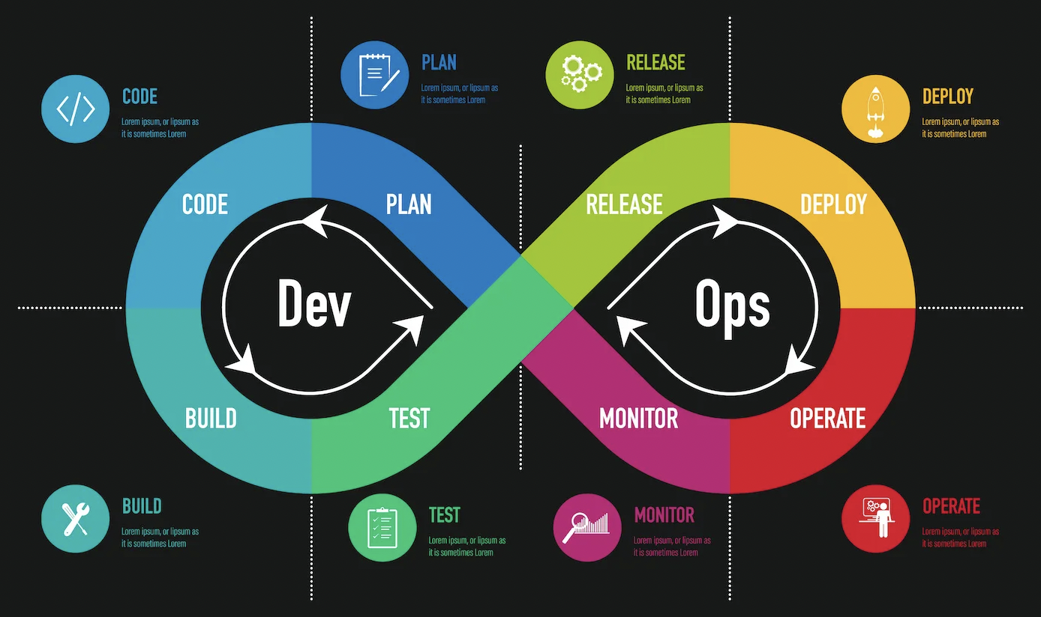
Devops core Principles

Slide 44
Devops collaboration
The most basic definition or explanation of DevOps is that it integrates software development (Dev) and IT operations (Ops) teams. In other words, collaboration is critical to DevOps and sits at the methodology’s core. Through collaboration, the development team can optimize the software’s configuration for the operations stages. The operations team, meanwhile, can start testing software earlier to make sure it passes all requirements.
For collaboration to work well, development and operations teams must share information effectively. Any issue found when software is deployed should be logged. This can ensure that the development team fixes the issue in future versions. Through the open communication and collaboration that DevOps promotes, teams can generate a shared sense of ownership and responsibility for the entire software development lifecycle (SDLC).
Information is not the only thing that should be shared between teams for DevOps to function as intended, as feedback is also essential. Positive feedback can motivate teams and remind them of the importance of their work and how essential their roles are to overall success. And negative feedback is essential and even more valuable since it helps teams make continuous improvements to the software they deliver. Feedback should be gathered during all stages of development and deployment via continuous monitoring and performance metrics. And teams should also get customer feedback to improve products and provide satisfaction to end-users.

Slide 45
Make decisions based on data
Making decisions based on data is another DevOps principle. This means using facts and information to influence your choices. When you need to pick the proper technology or DevOps tool to optimize your work process, gather data around each option. Look at how well the tool performed in the past. Does it align with your team’s metrics and goals? If so, it is probably the right choice for your team’s needs, and you can proceed.
For example, a common performance metric for many teams is how long it takes to fix an issue. The longer the issue lingers, the more trouble it can cause. By knowing the average time it takes to fix an issue, you can make data-based decisions when implementing new procedures or tools to your pipeline. Compare the results of the procedure/tool versus your benchmark average, and you can figure out if it will be harmful or beneficial.

Slide 46
Keep customers in mind
While making data-based decisions is a DevOps principle, so is making customer-based decisions, as the methodology stresses delivering value to users. Making decisions and taking actions that benefit the customer, fulfill their needs, and improve satisfaction should be a top priority in DevOps.
When making a decision, a team should question whether or not that choice will help the customer. Getting customer feedback on the current product is essential in optimizing it for the future.
Live monitoring of application performance helps DevOps teams fix issues before they negatively impact customers. Special tools help monitor real-time user interaction to help spot any problem areas. Thanks to the speed and efficiency of the DevOps lifecycle, teams can quickly issue updates to fix those problems and ensure customers enjoy the smoothest experience possible.

Slide 47
Devops automation
DevOps allows for faster software delivery, patches, updates, etc. When properly practiced, the methodology offers this added speed through automation, as DevOps teams aim to automate as much of the SDLC as they can.
Automation not only accelerates everything, but it also handles tedious, manual tasks. This gives team members more time to write code, research new features, be creative, and complete other essential tasks, and it also increases job satisfaction. Those are not the only benefits DevOps automations provide, though, as it also boosts productivity and reduces human error.
How can project managers and developers automate their infrastructure, testing, deployment, monitoring, and other processes? Through the wide variety of DevOps automation tools, such as Ansible, Jenkins, Bamboo, Chef, GitLab CI/CD, and more.

Slide 48
Continuous improvement
Continuous improvement is another DevOps focus and principle. It states that teams should constantly focus on making their products better through upgrades and new features. It also follows the Agile methodology’s use of incremental releases.
In the past, software development teams aimed to release the perfect product right from the start. While that may sound great, the goal of perfect releases resulted in long delays as teams worked to fix issues. With incremental releases, teams shift their goals and aim to deliver the most basic version of the software or minimal viable product (MVP) as quickly as possible.
The MVP has sufficient functionality to meet core customer needs. Once delivered, teams work to perfect the product by gradually adding new, valuable features until the ideal software is finally achieved. By using this incremental method, the customer gets to use and benefit from the product in its essential form without having to wait. They also get accustomed to its new features as they are released and become comfortable with the product over time, versus having to learn it all at once via the old method.

Slide 49
End to end responsibility
The development team codes and builds an application in the traditional way of developing software. Once finished, they pass it on to the operations team for testing, deployment, and delivery to the customer. What happens to the bugs found during that second stage? The operations team is responsible for them, versus the development team who actually wrote the code.
DevOps takes a different approach that leans heavier on logic and stresses responsibility throughout the entire product lifecycle. Instead of the development team being responsible for the product in one stage and the operations team having responsibility in another, both teams share responsibility from beginning to end. During the entire lifecycle, DevOps has development and operations teams collaborate to fix issues and release updates.
The developers most familiar with the source code will be tasked with fixing issues and adding improvements and new features. This emphasizes the production of high-quality code, plus finding and fixing bugs as they appear, which results in a better product for the customer.

Slide 50
Embrace failure
DevOps makes software development flexible. As the software being produced improves on a continuous basis, so do the processes used to create it. A key to achieving such flexibility is to encourage risk-taking and embrace failure and view it as an opportunity for learning and improvement.
Risks can result in failure or success. Even if an experiment fails and no success is achieved, it offers a learning experience. It tells you what works and what does not, and this knowledge can be used for data-based decision-making when planning future strategies.
While embracing failure is a DevOps principle, there is a way to fail, gain that desired learning experience, and ensure it does not negatively impact the customer. That way is through early testing, as it lets you spot and fix issues prior to deployment.

Slide 51
Simplification and optimization
DevOps encourages the simplification and optimization of processes, tools, and products. This means continuously looking for ways to remove unnecessary complexity, streamline workflows, and optimize resource use. This principle helps in reducing waste, accelerating delivery times, and improving the overall efficiency of the development and deployment process.
Incorporating these principles into your DevOps practices can significantly enhance your team's ability to deliver high-quality software quickly and efficiently, while also responding to changes and challenges with agility and resilience.

Slide 52
DevOps Architecture/Infrastructure
DevOps Architecture refers to the underlying setup designed to support DevOps practices. It's a blueprint that guides organizations in implementing and managing their DevOps practices efficiently. The architecture usually includes a combination of tools, technologies, methodologies, and cultural philosophies aimed at bridging the gap between development (Dev) and operations (Ops), facilitating seamless software development, delivery, and operation.

Slide 53
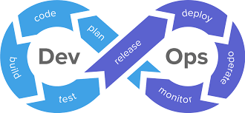
Key Components of DevOps Architecture

Slide 54
Microservices
An architectural style that structures an application as a collection of loosely coupled services, improving modularity and making the application easier to understand, develop, and test.
Benefits: Improved modularity makes applications easier to understand, develop, test, and maintain. It also enables technology diversity, allowing different services to be written in different languages best suited to their functionality.
Challenges: Microservices require careful management of network communication and data consistency. Service discovery mechanisms and API gateways are often used to manage these interactions effectively.

Slide 55
Containers and Container Orchestration:
Containers package and run applications with their dependencies. Orchestration tools like Kubernetes manage these containers' deployment, scaling, and networking.
Benefits: Containers support DevOps by enabling continuous integration and continuous deployment (CI/CD), allowing for scalable and efficient application deployments across different environments.
Challenges: Orchestration complexity increases with the scale of deployment. Ensuring security within containerized environments also requires additional considerations.

Slide 56
Infrastructure as Code (IaC)
This involves managing and provisioning computing infrastructure through machine-readable definition files, rather than physical hardware configuration or interactive configuration tools.
Benefits: IaC ensures consistent and repeatable environment setups, reducing discrepancies between development, testing, and production environments. It also enhances speed and efficiency in infrastructure provisioning and scaling.
Tools: Popular IaC tools include Terraform, Ansible, AWS CloudFormation, and Azure Resource Manager.

Slide 57
Continuous Integration/Continuous Deployment (CI/CD) Pipelines:
Automation pipelines that allow for the frequent and reliable deployment of code changes. They include automatic building, testing, and deployment processes.
Benefits: CI/CD minimizes manual errors, improves developer productivity, and accelerates the feedback loop, allowing for faster iterations.
Implementation Challenges: Establishing a CI/CD pipeline requires careful planning to choose the right set of tools and to integrate them into the development process seamlessly.

Slide 58
Monitoring and Logging
Tools and practices that provide visibility into the application's performance and operational health. This feedback is crucial for ongoing improvement and troubleshooting.
Benefits: They enable proactive issue resolution and performance optimization, crucial for maintaining service reliability and quality user experience.
Tools: Examples include Prometheus for monitoring, ELK Stack (Elasticsearch, Logstash, Kibana) for logging, and Grafana for visualization.

Slide 59
Collaboration and Communication Tools
Platforms that facilitate collaboration and communication among development and operations teams, such as Slack, Microsoft Teams, or JIRA.
Benefits: These tools facilitate a culture of transparency and shared responsibility, essential for the DevOps model. They help break down silos between teams, allowing for more efficient problem-solving and innovation.
Implementation: Integrating these tools into daily workflows and ensuring they are used effectively can be challenging but is key to fostering a collaborative environment.

Slide 60
Relationship to Other Software Industry Practices

Slide 61
Agile
Agile methodologies focus on iterative development, customer feedback, and small, rapid releases. DevOps complements Agile by extending these principles to include the operations team, thus supporting the entire software lifecycle from development to deployment and operations.
Both Agile and DevOps emphasize collaboration, flexibility, and the lean use of resources.

Slide 62
CI/CD
CI/CD is a critical element of DevOps. Continuous Integration (CI) refers to the practice of frequently integrating code changes into a shared repository, which are then automatically tested. Continuous Deployment (CD) extends this by automatically deploying all code changes to a testing or production environment after the build stage.
CI/CD bridges the gap between development and operations by ensuring that code changes are automatically tested and deployed, facilitating a rapid, reliable software release cycle.

Slide 63
Continuous Improvement
Continuous Improvement in DevOps is rooted in the idea of constantly seeking ways to improve software development and deployment processes. This is achieved through ongoing feedback, performance metrics, and the use of practices like monitoring and logging to identify areas for enhancement.
This principle aligns with the Kaizen model of continuous improvement, which is also foundational to Agile methodologies. It focuses on small, incremental changes rather than large-scale transformations, fostering a culture of continuous learning and adaptation.

Slide 64
Dev ops and cloud technologies : tools and practices

Slide 65
Quick Recap on DevOps
Definition
DevOps is a set of practices that combines software development (Dev) and IT operations (Ops) aimed at shortening the system development life cycle and providing continuous delivery with high software quality.
Core Focus
It emphasizes collaboration, automation, continuous integration, and continuous delivery, with the goal of making the build, test, and release process faster and more reliable.
Connection to Cloud
Enabling Agility
Scalability and Flexibility
Integrated Tooling and Services
Objective
Understanding the synergy
Tool exploration

Slide 66
The Synergy Between DevOps and Cloud Computing
Synergy Explained
Cloud computing provides an on-demand, scalable, and flexible environment that is ideal for implementing DevOps practices. It allows for the automation of traditional manual processes, supports a wide range of automation tools, and offers scalable resources on-demand, aligning perfectly with the needs of a DevOps-driven development lifecycle.
Cloud as a Catalyst
The cloud acts as a catalyst for DevOps, offering the technological and operational flexibility necessary for rapid development, testing, and deployment cycles. It enables DevOps teams to utilize resources more efficiently, experiment more freely, and implement changes more quickly.
Benefits
Increased Deployment speed
Enhanced collaboration
Improved resource management
Enhanced automation
Reliability and Availability

Slide 67
Importance of Cloud in DevOps
Scalability
Auto-Scaling Features: Cloud services offer auto-scaling capabilities, allowing resources to automatically scale up or down based on demand. This ensures that applications can handle sudden spikes in traffic without manual intervention.
Cost-Efficiency: Auto-scaling helps optimize resource usage, ensuring that organizations only pay for the resources they use. This aligns with DevOps principles of efficiency and cost-effectiveness.
Collaboration
Enhanced Team Collaboration: Cloud environments provide centralized platforms and collaboration tools that enable seamless communication and collaboration among distributed teams.
Real-Time Collaboration: Features like real-time document editing, instant messaging, and video conferencing foster effective collaboration, breaking down geographical barriers and promoting teamwork.
Version Control: Cloud-based version control systems ensure that team members always have access to the latest version of code, facilitating smoother collaboration and reducing errors.

Slide 68
Importance of Cloud in DevOps
Tool Integration
Seamless Integration: Cloud platforms offer APIs and integrations that make it easy to connect and integrate various DevOps tools into the development and deployment pipelines.
Unified Environment: By hosting DevOps tools in the cloud, organizations can create a unified environment where development, testing, deployment, and monitoring tools work together seamlessly.
Flexibility: Cloud-based DevOps tools can be accessed from anywhere with an internet connection, providing developers and operations teams with the flexibility to work remotely without compromising productivity.
Cost-Effectiveness
Pay-as-You-Go Model: Cloud services typically operate on a pay-as-you-go model, where organizations only pay for the resources they use, avoiding the need for large upfront investments in infrastructure.
Resource Optimization: Cloud platforms offer tools for monitoring resource usage and optimizing costs, allowing organizations to allocate resources more efficiently and reduce unnecessary spending.
Scalable Pricing: Cloud providers often offer scalable pricing plans, allowing organizations to adjust their resources and costs according to their needs, making it easier to scale operations up or down as required.

Slide 69
Cloud Technologies Enabling DevOps
Infrastructure as Code (IAC)
Definition: Infrastructure as Code (IAC) is the practice of managing and provisioning computing infrastructure through machine-readable definition files, rather than physical hardware configuration or interactive configuration tools.
Benefits: IAC enables automation, consistency, and scalability in infrastructure management, allowing DevOps teams to treat infrastructure as code and apply software engineering practices such as version control and testing.
Example Tools: Terraform, AWS CloudFormation, Azure Resource Manager (ARM).
Containers and Orchestration
Definition: Containers are lightweight, standalone, executable software packages that include everything needed to run a piece of software, including code, runtime, libraries, and dependencies. Orchestration tools manage the deployment, scaling, and operation of containers.
Benefits: Containers provide consistency across environments, faster deployment times, and efficient resource utilization. Orchestration simplifies container management, automates scaling, and ensures high availability.
Example Tools: Docker for containerization, Kubernetes for container orchestration, Docker Swarm, Amazon ECS.

Slide 70
Cloud Technologies Enabling DevOps
Microservices
Definition: Microservices is an architectural style that structures an application as a collection of loosely coupled, independently deployable services. Each service is responsible for a specific business capability and can be developed, deployed, and scaled independently.
Benefits: Microservices promote agility, scalability, and resilience by enabling teams to work on small, decoupled components. They facilitate rapid iteration, easier maintenance, and better fault isolation.
Example Implementations: Netflix, Amazon, Spotify have successfully adopted microservices architectures to achieve high scalability and flexibility.
Serverless Computing
Definition: Serverless computing allows developers to build and run applications and services without managing servers. It abstracts away server management tasks, allowing developers to focus on writing code and delivering value.
Benefits: Serverless computing offers scalability, cost-effectiveness, and reduced operational overhead. It enables automatic scaling, pay-per-use pricing, and faster time-to-market for applications.
Example Services: AWS Lambda, Azure Functions, Google Cloud Functions.

Slide 71
Common dev ops tools

Slide 72
DevOps Tools Overview
Objective
To introduce the variety of tools used in DevOps practices, highlighting how each category facilitates different aspects of the DevOps lifecycle.
Version Control:
Description: Version control systems track and manage changes to code, allowing multiple developers to work on the same project without conflicts.
Examples: Git, GitHub, Bitbucket.
Continuous Integration/Continuous Deployment (CI/CD):
Description: CI/CD tools automate the software release process, from code commit to production deployment.
Examples: Jenkins, GitLab CI, Circle CI, Travis CI.

Slide 73
DevOps Tools Overview
Configuration Management:
Description: These tools help in automating the provisioning and management of software and servers, ensuring consistency across environments.
Examples: Ansible, Chef, Puppet.
Monitoring and Logging:
Description: Monitoring and logging tools provide insights into application performance and system health, enabling proactive maintenance and troubleshooting.
Examples: Prometheus, Grafana, ELK Stack (Elasticsearch, Logstash, Kibana), Splunk.
Containerization and Orchestration:
Description: Containerization tools package applications and their dependencies into containers, while orchestration tools manage these containers' deployment and scaling.
Examples: Docker, Kubernetes, Docker Swarm.

Slide 74
DevOps Tools Overview
Infrastructure as Code (IAC):
Description: IAC tools allow for the automated management and provisioning of infrastructure through code.
Examples: Terraform, AWS CloudFormation.
Collaboration and Communication:
Description: These tools facilitate collaboration among team members, improving efficiency and integration across the development and operations teams.
Examples: Slack, Microsoft Teams, Jira.
Security:
Description: DevSecOps tools integrate security practices into the DevOps process, ensuring continuous security assessment and compliance.
Examples: SonarQube, Aqua Security, Snyk.

Slide 75
Challenges in integrating dev ops
Security
Complexity
Cost Management
Automation

Slide 76
Challenges in integrating with cloud Technologies
Security:
Shared Responsibility Model: Emphasize the shared responsibility between cloud providers and customers for security. While cloud providers secure the infrastructure, customers are responsible for securing their applications, data, and access controls.
Challenge: Ensuring that security practices are integrated throughout the DevOps pipeline and that security controls are consistently applied across cloud environments.
Complexity:
Managing Complex Deployments and Configurations: The dynamic and scalable nature of cloud environments can lead to increased complexity in managing deployments and configurations.
Challenge: Dealing with diverse technologies, multiple environments, and intricate dependencies, which can make it challenging to maintain consistency and reliability across deployments.

Slide 77
Challenges in integrating with cloud Technologies
Cost Management:
Tracking Cloud Resource Usage: Cloud services operate on a pay-as-you-go model, making it essential to monitor resource usage to avoid unexpected costs.
Challenge: Keeping track of resource utilization, optimizing resource allocation, and implementing cost-control measures to ensure that cloud spending remains within budgetary constraints.
Automation:
Implementing Effective Automation: While automation is a cornerstone of DevOps, achieving effective automation in complex cloud environments can be challenging.
Challenge: Addressing the need for automation tools that can handle the dynamic nature of cloud infrastructure, as well as ensuring proper testing and validation of automated processes to minimize errors and risks.

Slide 78
Summary
Interrelation of DevOps and Cloud Technologies: Throughout this presentation, we've explored how DevOps practices and cloud technologies are closely intertwined. DevOps leverages the scalability, flexibility, and automation capabilities of cloud environments to streamline software development and deployment processes.
Importance of Various Tools: We've discussed a variety of tools and technologies that play essential roles in DevOps practices, ranging from version control and CI/CD to containerization and infrastructure as code. These tools enable automation, collaboration, and efficiency across the DevOps lifecycle.
Outlook
Emerging Trends: Looking ahead, we anticipate further evolution and adoption of emerging trends in the DevOps landscape. One such trend is serverless computing, which offers even greater scalability and cost-efficiency by abstracting away server management. Additionally, the integration of artificial intelligence (AI) and machine learning (ML) technologies into DevOps processes holds promise for enhancing automation, predictive analytics, and decision-making.

Slide 79
References:
1. https://aws.amazon.com/devops/what-is-devops/
2. https://itrevolution.com/the-three-ways-principles-underpinning-devops/
3. https://www.atlassian.com/devops/devops-culture
4. https://www.redhat.com/en/topics/devops/what-is-ci-cd
5. https://www.redhat.com/en/topics/devops/what-is-devops-tools
6. https://www.docker.com/get-started
7. https://kubernetes.io/docs/tutorials/kubernetes-basics/
8. https://docs.ansible.com/ansible/latest/index.html
9. https://www.jenkins.io/doc/
10. https://learn.hashicorp.com/collections/terraform/aws-get-started
11. https://git-scm.com/doc
12. https://www.redhat.com/en/topics/automation/what-is-infrastructure-as-code
13. https://aws.amazon.com/devops/best-practices/
14. https://landing.google.com/sre/books/
15. https://itrevolution.com/book/the-devops-handbook/

