Slide 1
Secure Coding Practices
Drew Clark
Andrew Pierson
Austin Davis

Slide 2
What are secure coding practices?
Definition
Four Pillars of Software Security
Why are Secure Coding Practices Important?
Risks of Not Using Secure Coding Practices

Slide 3
definition
The principle of designing code that adheres to code security best practices, safeguards and protects published code from unknown and unanticipated vulnerabilities.
Vulnerabilities including but not limited to the exploitation of shared keys, business data, and personally identifiable information (PII).

Slide 4
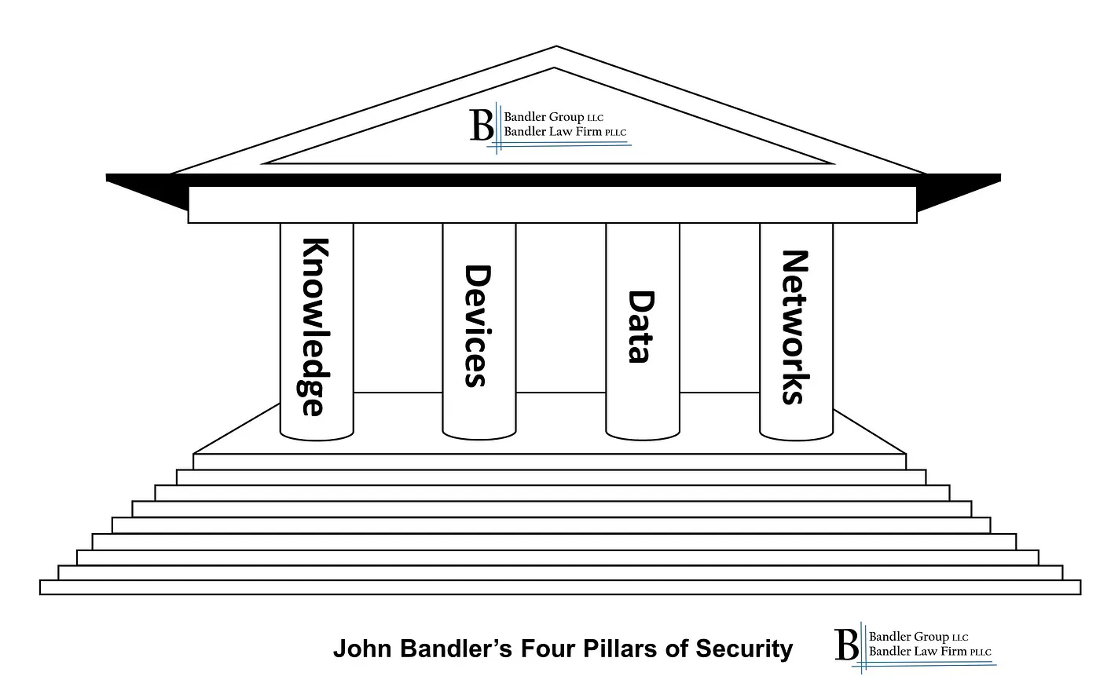
Four pillars of software security
1 – Knowledge and Awareness
2 – Protection of Computing Devices
3 – Protection of Data
4 – Protection of Networks

Slide 5
Four pillars of software security
Every employee needs a degree of knowledge and awareness to make good decisions. Imagine trying to secure a system without the know-how. The results would be disastrous, and even might result in a devastating cybercrime.
It is important to know how to secure a system as well as anticipate obvious potential threats.
Know and be aware of:
How computers work
Privacy Threats
Basic Information security principles
How networks and the internet work
Etc.
Knowledge and Awareness

Slide 6
Four pillars of software security
Devices, in use or not, must be secured
Inventory of Devices
Updating of Devices
Ensure physical security/control over devices
Proper configurations
Access Control
Intrusion protection
Malware Protection
Protection of Computing Devices

Slide 7
Four pillars of software security
Data needs to be protected from potential breaches
Control access to data
Secure data at a level commensurate to its confidentiality
Encrypt data where warranted
Regularly back up data
Certain data breaches may trigger certain report requirements
Protection of Data

Slide 8
Four pillars of software security
Data constantly flows through and between devices
Minimize use of public networks
Encrypt data in transit whenever possible
Be conscious of the route data takes
Routers and switches are security configured, including Unique passwords. Kept updated. Unneeded features should be disabled.
Protection of Networks

Slide 9
Why are secure coding practices important?
By incorporating secure coding practices throughout the planning and development of your product, you can avoid costly security breaches and the resulting damage to your reputation.
Secure coding demonstrates a changing shift in responsibility by literally naming the developer as responsible for code security rather than a security team.
Secure coding adds a protective layer that checks both the current code and any new code when it’s added to a code storage. It helps enforce best practices that prevent human error.

Slide 10
Risks of not using secure coding practices
Serious security gaps in the application development lifecycle.
Developers might not be adequately trained or aware of how to write code that minimizes security risks.
Software vulnerabilities that attackers can exploit, potentially leading to data breaches or other security incidents.
Broken Access Control
Cryptographic Failure
Vulnerable and/or Outdated components
Data Integrity Failures
Injection Attacks

Slide 11
Software Assurance
What is (SwA)?
Example – OWASP SAMM
(SwA)

Slide 12
What is
Software Assurance (SwA) is defined as the level of confidence that software functions as intended and is free of vulnerabilities. Either intentionally or unintentionally designed or inserted as part of the software throughout the lifecycle.
2 main Functions of SwA
Ensuring that software functions as intended
Ensuring that software is free of vulnerabilities
3 main Challenges of SwA
Incorporated Code
Code Volume
Tool Effectiveness
(SwA)?

Slide 13
OWASP SAMM
O.pen W.orldwide A.pplication S.ecurity P.roject
S.oftware A.ssurance M.aturity M.odel
Governance
Design
Implementation
Verification
Operations

Slide 14
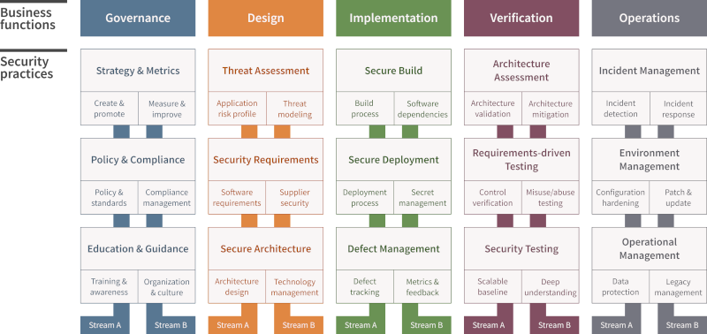
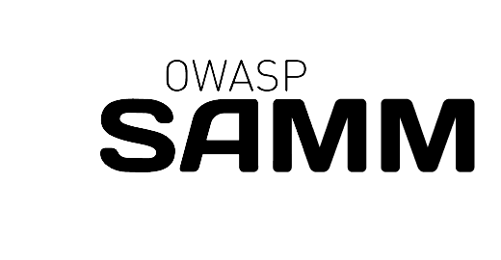
OWASP SAMM
SAMM v2 Model

Slide 15
OWASP SAMM
What does SAMM do?
Provides an evaluation of an organization's current software security posture.
Provides effective methods to improve an organization's software security posture on a risk driven basis.
It helps with improvements to an organization's software security posture throughout the software lifecyle

Slide 16
Secure SLDC
What is the Secure SDLC?
Example – Microsoft SDL

Slide 17
What is Secure SDLC?
Secure SDLC or Secure S.oftware D.evelopment L.ife C.ycle
A Secure SDLC aims to create secure software from the outset.
A Secure SDLC is a framework that integrates security practices into every phase of the software development process.
Requirements
Developing
Testing
Example – Microsoft SDL

Slide 18
Microsoft sDL
The Microsoft SDL aims to help integrate security into each stage of the development process.
"Embedding comprehensive security requirements, technology-specific tooling, and mandatory processes into the development and operation of all software products."
-Microsoft

Slide 19
Microsoft sDL Practices #1 Security Requirements
Security and privacy requirements must be collected alongside the functional and nonfunctional requirements.
These can be defined based on the functional/nonfunctional requirements
They are the foundation of secure applications
Consider data types/structures
Consider known threats
Clear documentation and tracking

Slide 20
Microsoft sDL Practices #2 Compliance
Define minimum acceptable levels acceptable levels of security quality and hold engineering teams accountable to meet that criteria from the outset.
Setting a meaningful threshold for the severity of security vulnerabilities
Critical vulnerabilities must be fixed within a specified time frame
Track key performance indicators (KPIs)
Clear labels for security defects/work items
Severity markings for each defect/work item

Slide 21
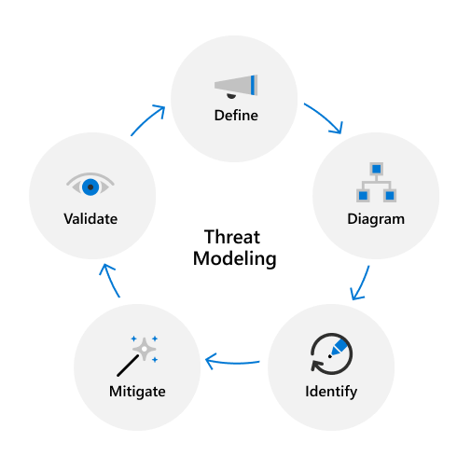
Microsoft sDL Practices #3 Design
Threat Modeling
Definition
Data Flow
Identification
Prioritization
Mitigation of unacceptable risks
Mitigation validation

Slide 22
Microsoft sDL Practices #4 Design Requirements
Consistent application
Communicate about the design of security systems
Analyze security design for potential security issues using a proven methodology
Suggest and manage mitigation for security issues

Slide 23
Microsoft sDL Practices #5 Define & use cryptography standards
Encrypt data in transit and at rest
In transit: strong transport layer security (TLS)
At rest: offline vs online protections
Cryptographic agility
Implementing changes to mechanisms, algorithms, and libraries as new threats arise
Encryption key and certificate management/rotation
Protect and rotate encryption keys/certificates
Lifecyle management

Slide 24
Microsoft sDL Practices #6 Verification and Testing
Static Application Security Testing (SAST)
What is does: Analyzes source code, byte code, or binary code to find security vulnerabilities.
When it's used: During the early stages of software development lifecycle (SDLC).
How it works: Scams the application before the code is complied
Benefits: Improves the security posture of software applications
A.K.A. : Inside-out or White box testing

Slide 25
Microsoft sDL Practices #6 Verification and Testing
Dynamic Application Security Testing (DAST)
What it does: Analyzes running applications for vulnerabilities by simulating attacks from a hacker's perspective
When it's used: In a run-time environment to simulate user interactions with application and common attack vectors
How it works: DAST tools often send requests to the application to mimic a user or attacker. DAST can detect vulnerabilities that other tools and methods, like SAST, cannot.
Benefits: DAST tools can detect vulnerabilities query strings, headers, fragments, verbs, etc.
A.K.A : Outside-in or Black Box testing

Slide 26
Microsoft sDL Practices #7 Standard incident Response Process
Product Security Incident Response Team (PSIRT)
Incident response plan
Emergency Contacts
Emergency Protocols
Security Servicing
Inherited code
Third Party Code
Incident response plan testing
Prior testing

Slide 27
Microsoft sDL Practices #8 Training
Developers and Engineers must remain informed on security basics and trends in secure development
All employees must be aware of what vulnerabilities bad actors may exploit and how to protect said vulnerabilities.

Slide 28
Secure Coding Review
A Secure Coding Review is the systematic process of examining an application’s source code to identify security flaws & vulnerabilities.
Code reviews specifically look for logic errors, implementation errors, and checks style guideline compliance, among other task.
Examples of secure coding review methods/tools are:
Static & Dynamic Analysis Tools
Penetration Testing
Code Review Checklists
Manual Code Reviews
Fuzz Testing

Slide 29
Why do we do Secure Code Reviews?
To improve the security and quality of an application’s source code.
To identify security risk early in the Software development life cycle (SDLC).
It is Cost-Effective Security that reduces technical debt by dealing with security before deployment.
To emphasize secure coding practices and educate development teams.
They are often mandated by industries, such as finance, healthcare, and e-commerce.

Slide 30
Task in a Secure Coding Review:
Planning- identify & set goals for the code that needs to be reviewed
Review Preparation- make sure code is well-documented for readability and in compliance with coding standards
Review Execution- automated or manual process of code review
Issue Identification- document security issues to fix
Issue Remediation- fix the documented issues
Verification- verify the issues are fixed
Documentation- document the whole review process for future reference

Slide 31
Secure Coding Reviews: MITRE EXAMPLE
What is MITRE?
MITRE is a non-profit organization founded in 1958 to support the U.S. Air Force's development of the Semi-Automatic Ground Environment (SAGE) air defense system during the cold war.
The MITRE Corporation has restructured the company to focus on publishing federally funded research and development centers (FFRDC).
MITRE has developed several frameworks that document researched vulnerabilities or attack methods for software, such as MITRE ATT&CK.

Slide 32
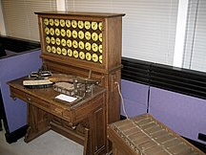
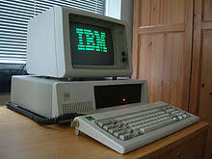
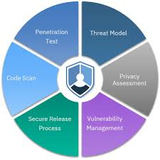
Secure Coding Reviews: IBM SPbD@IBM Example
What is IBM?
The Computing Tabulating Company (CTR), later known as International Business machines (IBM) was founded in 1911 to provide global computer solutions for business needs,
Business needs such as the punch-card tabulating system and the IBM Personal Computer.
What is SPbD@IBM?
It stands for Security and Privacy by Design at IBM.
SPbD is aligned with the United States National Institute of Standards and Technology (NIST’s) Secure Software Development Framework (SSDF).
An agile set of focused security and privacy practices:

Slide 33
The Seven Pernicious Kingdoms
What is it?
It is a taxonomy of common cyber-attacks published by MITRE and written by Katrina Tsipenyuk, Brian Chess, and Gary McGraw.
Input Validation and Representation
API Abuse
Security Features
Time and State
Errors
Code Quality
Encapsulation
Note: Each Kingdom has individual coding errors called phylum.

Slide 34
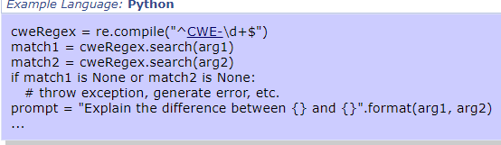
The Seven Pernicious Kingdoms
These issues are caused by metacharacters, alternate encodings, and numeric representations when an input is trusted.
Issues of this nature can be avoided if inputs are sanitized and validated properly.
Examples of issues:
Buffer Overflows
SQL injections
Integer overflows
Cross-Site Scripting
1. Input Validation and Representation

Slide 35
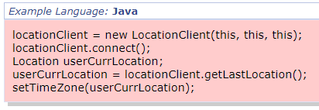
The Seven Pernicious Kingdoms
API stands for Application Programming Interface
An API has a Caller and Callee who operate based on the API’s Contract.
API abuse typically happens when the Caller violates the contract between the callee.
An example of a contact violation can be, if a program fails to call chdir() after calling chroot().
This is called ‘escaping the chroot jail’.
Consequences of violation could allow the callee to conduct a data breach of the API.
2. API Abuse

Slide 36
The Seven Pernicious Kingdoms
The Security Features kingdom is concerned with topics such as authentication, access control, confidentiality, cryptography, and privilege management.
Examples of issues:
Passwords Hard Coded into source code such as SSH keys
Insecure Randomness allows an adversary to reverse engineer the randomness algorithm (weak cryptography)
Least Privilege Violation– elevating OS Kernal privileges
3. Security Features

Slide 37
The Seven Pernicious Kingdoms
The Time and State kingdom refers to how a modern systems handle distributed computation.
A modern computer maximizes the computers computational timing by switching processes extremely quickly and keeping track of their process state.
Timing and State vulnerabilities arise when unexpected interactions between processes happen.
These interactions happen through shared state: semaphores, variables, the file system, and basically anything that can store information.
An example of this is having a Time-of-check Time-of-use (TOCTOU) Race Condition
This means the program checks the state of a resource before using that resource, but the resource's state can change between the check and the use in a way that invalidates the results of the check. This causes the product to perform invalid actions when the resource is in an unexpected state.
4. Time and State

Slide 38
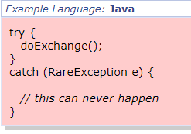
The Seven Pernicious Kingdoms
Errors with dealing with errors get their own kingdom due to how common these errors are.
There are two ways to handle errors improperly:
handling errors poorly or if at all (most common)
errors that give out too much information
When an error is handled poorly it typically results in the program crashing.
This can be an issue when trying to fix the problem later.
5. Errors

Slide 39
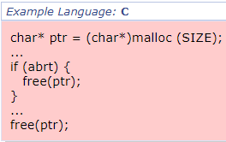
The Seven Pernicious Kingdoms
Poor Code Quality can lead to unexpected and undesirable behavior from the User’s perspective.
Poor Code Quality from the attacker’s perspective is an opportunity to stress the system in unexpected ways.
Examples of Poor Code Quality:
Memory Leaks
Null Dereferencing
An Uninitialized Variable
Double free()
6. Code Quality

Slide 40
The Seven Pernicious Kingdoms
Encapsulation refers to the differentiation between sensitive data from other data.
Encapsulation involves separating validated data and unvalidated data, or one user's data to another’s.
Vulnerabilities arise from weak access permissions or improper handling of classes.
Examples of encapsulation issues:
A Private Data Structure Returned From A Public Method
Comparison of Classes by Name
Exposure of Data Elements to the Wrong Session
7. Encapsulation

Slide 41
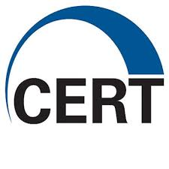
SEI CERT
What is SEI?
The Software Engineering Institute (SEI) is a Federally Funded Research and Development Center (FFRDC) at Carnegie Mellon University.
They conducts research in areas like software engineering, systems engineering, and cybersecurity, focusing on introducing private-sector innovations into government use, particularly for the U.S. Department of Defense (DOD).
What is SEI CERT?
The SEI Computer Emergency Response Team (CERT) is a SEI division that is partnered with government, industry, law enforcement, and academia to develop best practices for common coding languages.
The standards are updated and available on the web for C, C++, Java, Perl, Android OS.
https://wiki.sei.cmu.edu/confluence/display/seccode

Slide 42
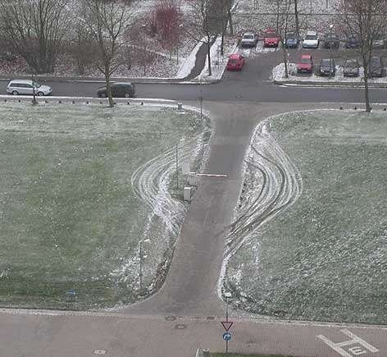
SEI CERT Top 10 practices:
https://wiki.sei.cmu.edu/confluence/display/seccode
Validate input
Heed compiler warnings
Architect and design for security policies
Keep it simple
Default deny
Adhere to the principle of least privilege
Sanitize data sent to other systems
Practice defense in depth
Use effective quality assurance techniques
Adopt a secure coding standard

Slide 43
SEI CERT Top 10 practices:
Validate input:
Validate input from all untrusted data sources, where the user uploads user-controlled files and the context is unknown.
Untrusted data sources include Command line interfaces and network interfaces.
Proper input validation, such as checking uploaded files , can eliminate most of these issues & vulnerabilities.
1

Slide 44
SEI CERT Top 10 practices:
Heed compiler warnings:
Compile code using the highest warning level & options available
eliminate warnings by modifying the code
Use static and dynamic analysis tools to detect and eliminate additional security flaws.
Example:
2

Slide 45
SEI CERT Top 10 practices:
Architect and design for security policies:
Create a software architecture and design your software to implement and enforce security policies.
For example, if your system requires different privileges at different times, consider dividing the system into distinct intercommunicating subsystems, each with an appropriate privilege set.
3

Slide 46
SEI CERT Top 10 practices:
Keep it simple:
Keep the design as simple and small as possible
Complex designs increase the likelihood that errors will be made in their implementation, configuration, and use.
A simple design encompasses cohesive class definitions and avoiding practices like complex coupling.
4

Slide 47
SEI CERT Top 10 practices:
Default deny:
By default, access should be denied.
The protection scheme identifies conditions under which access is permitted.
This practice can be applied to file access permission in a file system by default denying anyone but the admin user.
5

Slide 48
SEI CERT Top 10 practices:
Adhere to the principle of least privilege:
Every process should execute with the least set of privileges necessary to complete the job.
Any elevated permission should only be accessed for the least amount of time required to complete the privileged task.
This practice can be applied to an instance of accessing a database for something like a Shared Password Manager.
6

Slide 49
SEI CERT Top 10 practices:
Sanitize data sent to other systems:
Sanitize all data passed to complex subsystems such as command shells, relational databases, and commercial off-the-shelf (COTS) components.
Attackers inject malicious SQL commands, or other injection attacks into these attack vectors.
This is not to be confused an input validation problem because this complex subsystem knows the context of the input.
7

Slide 50
8. Practice defense in depth
Practice defense in depth:
Manage risk with multiple defensive strategies, so that if one layer of defense turns out to be inadequate, another layer of defense can prevent a security flaw from becoming an exploitable vulnerability and/or limit the consequences of a successful exploit.
For example, combining secure programming techniques with secure runtime environments should reduce the likelihood that vulnerabilities remaining in the code at deployment time can be exploited in the operational environment.
8

Slide 51
SEI CERT Top 10 practices:
Use effective quality assurance techniques:
Fuzz testing, penetration testing, and source code audits should all be used as part of an effective quality assurance program.
Incorporating code reviewers & external reviewers bring great perspective for security reviews
Effective quality assurance techniques add an extra layer of assurance before deployment of the product.
9

Slide 52
SEI CERT Top 10 practices:
Adopt a secure coding standard:
Develop and apply a secure coding standard for your target development language and platform:
C, C++, Java, Perl, Android OS
C++ coding standard:
https://wiki.sei.cmu.edu/confluence/display/cplusplus
You should use the C++ coding standard in C++ software projects to implement best coding practices per the SEI.
10

Slide 53
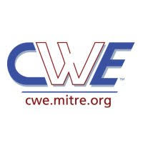
MITRE CWE
What is MITRE? (review)
A non-profit company that creates publicly available frameworks for software security.
What is MITRE CWE?
It is a MITRE framework that stands for Common Weakness Enumeration.
The framework provides a list known issues in software for preventing security vulnerabilities by helping identify missing security requirements.

Slide 54
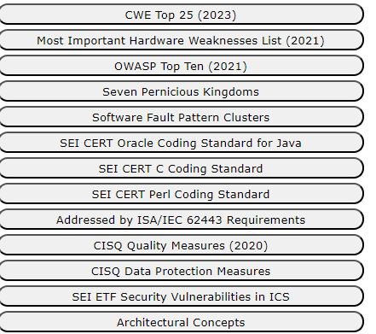
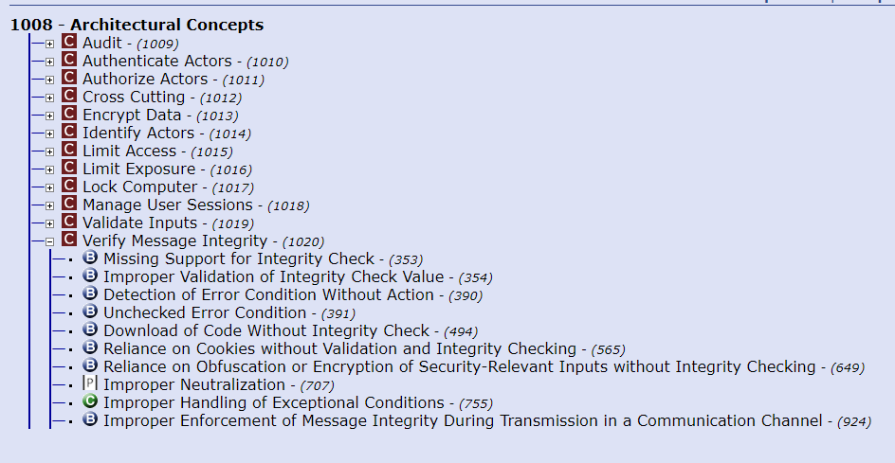
MITRE CWE
How is it used in practice?
Individuals and Organizations use the CWE as a common language for discussing how to eliminate or mitigate software security weaknesses in architecture, design, code, and implementation.
https://cwe.mitre.org/index.html

Slide 55
CWE top 25
It is a list of the most dangerous software weaknesses that are often found in software applications and products
It emphasizes common issues related to improper validation, weak authentication, and insufficient error handling
The list is created and updated by analyzing the frequency and severity of known vulnerabilities and provides guidance to developers, testers, and security professionals

Slide 56
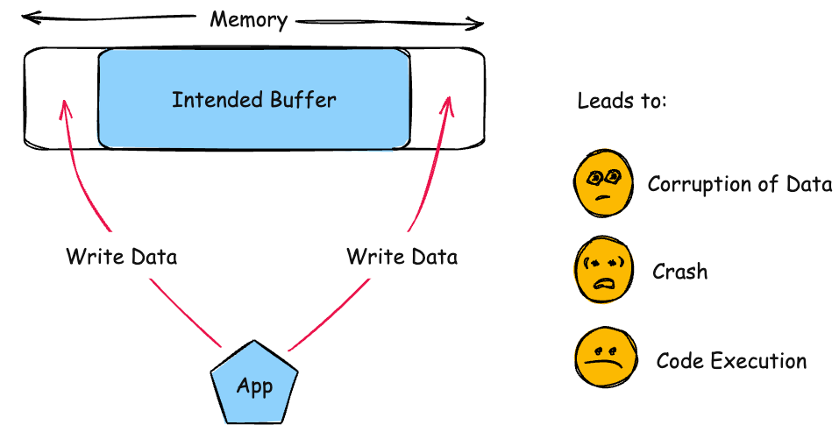
1. Out-of-Bounds Write
results
Consequences:
Write operations could cause memory corruption.
Attempting to access out-of-range or unauthorized memory can cause crashes
Subsequent write operations can produce unexpected results
The product writes data past the end, or before the beginning, of the intended buffer
Prevention:
Use a language that does not allow this to occur
Use a vetted library or framework that does not allow this weakness
Use automatic buffer overflow detection

Slide 57
2. Cross-site scripting (XSS)
results
The product does not neutralize or incorrectly neutralizes user-controllable input before it is placed in output that is used as a web page that is served to other users
Consequences:
Access to user information through cookies
Possible for arbitrary code execution on a victim’s computer
Prevention:
Use a vetted library or framework that does not allow this weakness
Understand the context of how your data will be used and the encoding that will be expected
For security checks on the client side, ensure these checks are duplicated on the server side

Slide 58
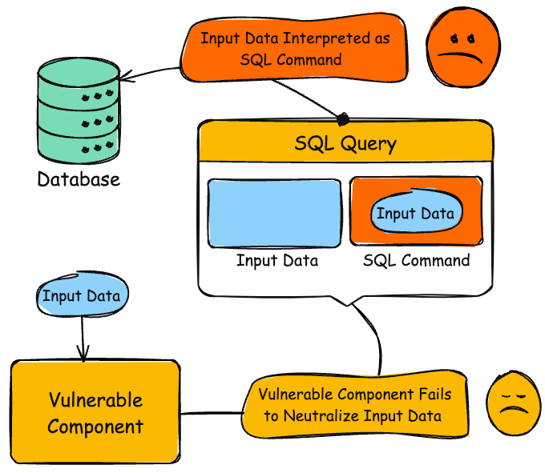
3. SQL injection
results
Consequences:
Loss of confidentiality
Possible to connect to product as a user with no password
Delete or modify data within database
The product constructs an SQL command using external input without adequate sanitization, allowing attackers to modify the command
Prevention:
Use a vetted library or framework that does not allow this weakness
Use structured mechanism that automatically enforce the separation between data and code
Run code using the lowest privileges that are required to accomplish the necessary tasks

Slide 59
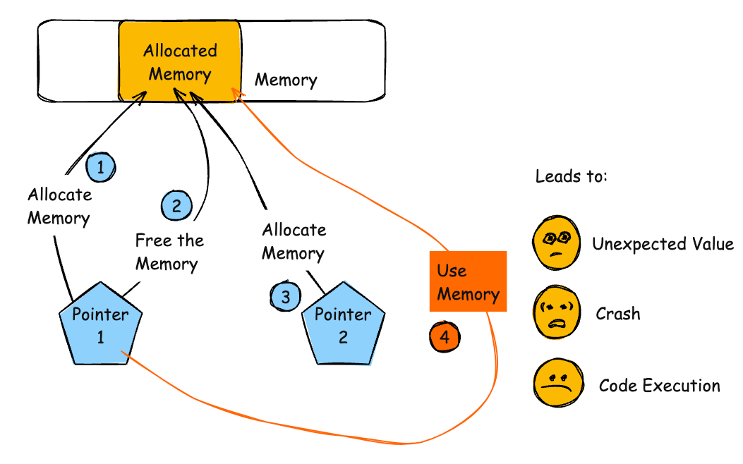
4. Use after free
results
Consequences:
Use of previously freed memory may corrupt data
Process may crash when invalid data is used as information
Arbitrary code execution could be achieved by overwriting the pointer with an address to shellcode
The product accesses memory after it has been freed, which can cause unexpected behavior. The memory may be reallocated, leading the original pointer to reference invalid data
Prevention:
Choose a language that provides automatic memory management
When freeing pointers, be sure to set them to NULL once they are freed

Slide 60
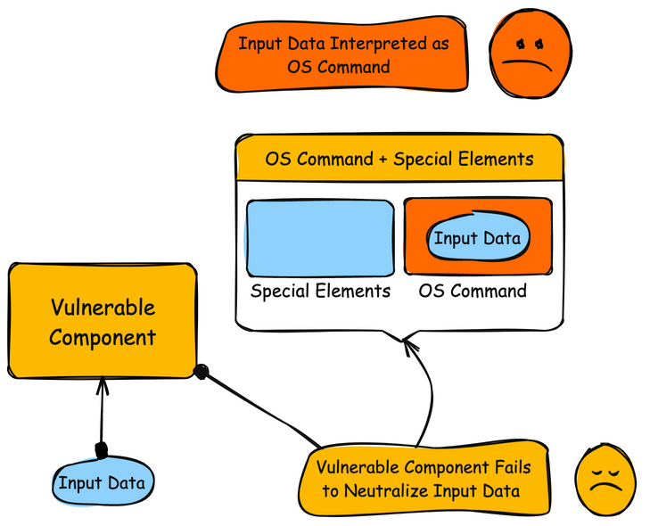
5. OS command injection
results
Consequences:
Attacker could execute unauthorized operating system commands, disable the product, and read and modify data without permissions
The product constructs an OS command using external input without properly sanitizing it, allowing special elements to modify the command’s intended behavior
Prevention:
If possible, use library calls rather than external processes to recreated the desired functionality
Run the code in a sandbox environment that enforces strict boundaries between the process and OS

Slide 61
6. Improper input validation
results
The product receives input or data, but it does not validate or incorrectly validates that the input has the properties that are required to process the data safely and correctly
Consequences:
An attacker could provide unexpected values and cause a program crash or consumption of resources
An attacker could read confidential data
An attacker could modify data and do arbitrary command execution
Prevention:
Use a vetted library or framework that does not allow this weakness
Understand the context of how your data will be used and the encoding that will be expected
For security checks on the client side, ensure these checks are duplicated on the server side

Slide 62
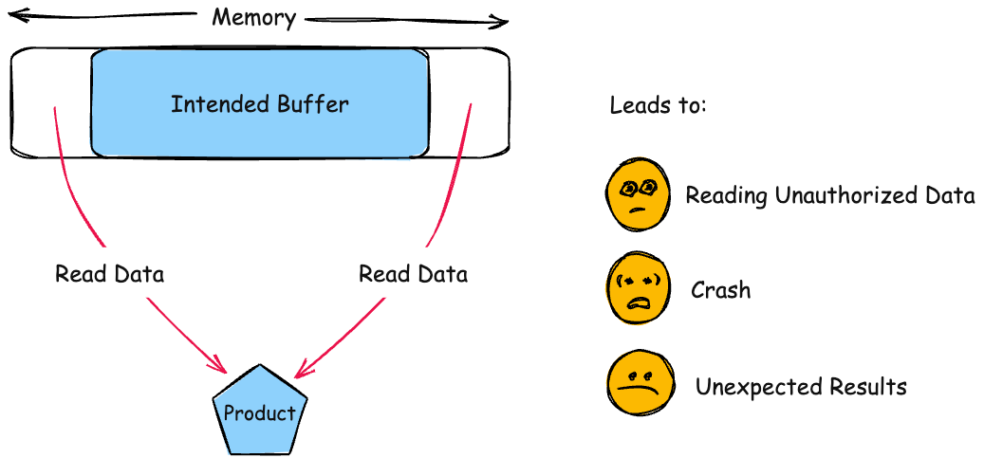
7. out-of-bounds read
results
Consequences:
An attacker could get secret values like keys, memory addresses
Out-of-Bounds memory could contain other information used to bypass ASLR or other protection
Can cause a segmentation fault or crash
The product reads data past the end, or before the beginning, of the intended buffer
Prevention:
Use an “accept known good” input validation strategy
Use a language that provides appropriate memory abstractions

Slide 63
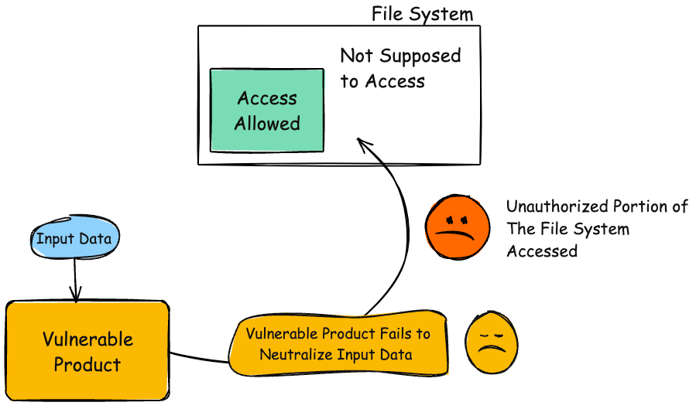
8. Path traversal
results
Consequences:
Attacker could create or overwrite critical files used to execute code
Attacker could bypass security mechanism
Read contents of unexpected files and expose sensitive data
Change or delete existing critical files
The product constructs a file path using external input without properly sanitizing it, allowing attackers to bypass directory restrictions and access unintended locations
Prevention:
Use an application firewall to detect attacks against this weakness
Use an “accept known good” input validation strategy

Slide 64
9. Cross-Site Request Forgery (CSRF)
results
The web application does not, or can not, sufficiently verify whether a well-formed, valid, consistent request was intentionally provided by the user who submitted the request
Consequences:
Obtaining complete control over web application
Deleting or stealing data
Only limited by the victim’s privileges
Prevention:
Send a separate confirmation request upon a user performing a dangerous operation
Use “double-submitted cookie” method

Slide 65
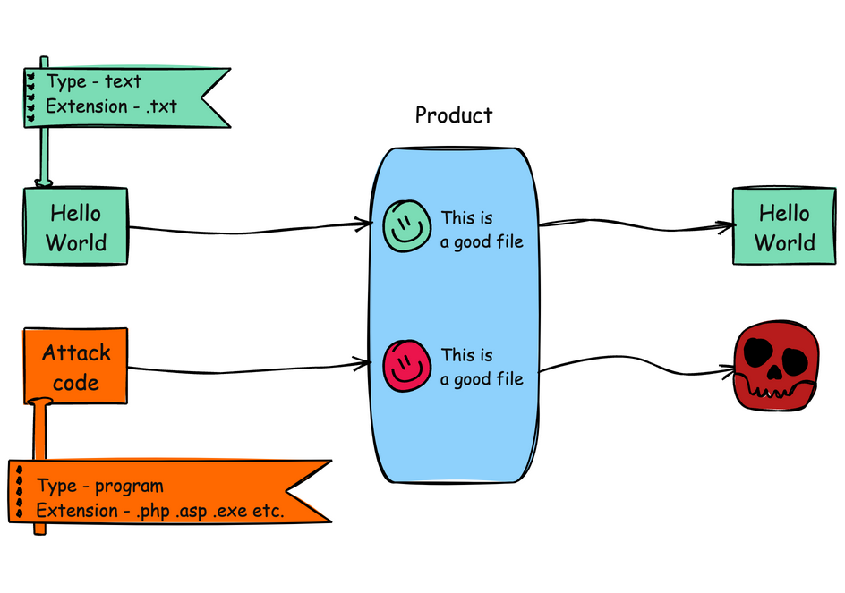
10. Unrestricted Upload of File with Dangerous Type
results
Consequences:
Arbitrary code execution is possible if an uploaded file is interpreted and executed as code by the recipient
Especially dangerous for web-server extensions such as .asp and .php
The product Allows the upload or transfer of dangerous file types that are automatically processed within its environment
Prevention:
Consider storing the uploaded files outside of the web document root entirely. Use other methods to deliver the files
Use an “accept known good” input validation
Generate a new, unique filename for an uploaded file instead of using the user-supplied filename

Slide 66
11. Missing Authorization
results
The Product does not perform an authorization check when an actor attempts to access a resource or perform an action
Consequences:
An attacker could read sensitive data
An attacker could modify, or delete data
An attacker could gain privileges by modifying critical data
Prevention:
Divide the product into anonymous, normal, privileged, and administrative areas
Ensure that access control checks are performed

Slide 67
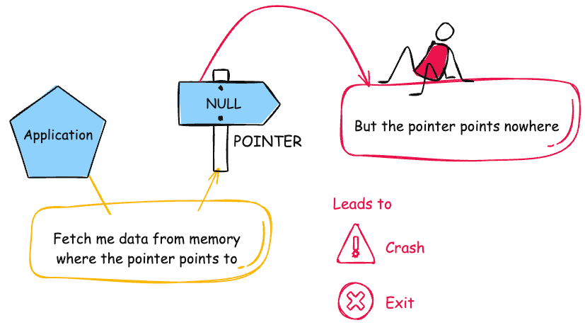
12. Null Pointer Dereference
results
Consequences:
NULL pointer dereferences usually result in the failure of the process without exception handling
In rare instances the NULL is equivalent to privileged code and therefore allows for access
The Product dereferences a pointer that it expects to be valid but is null
Prevention:
If all pointers that could have been modified are checked for NULL before use, nearly all NULL pointer dereferences can be prevented

Slide 68
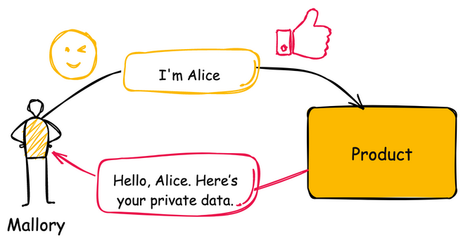
13. Improper authentication
results
Consequences:
Can lead to the exposure of resources or functionality to unintended actors
Possible to provide sensitive information or arbitrary code execution
When an actor claims to have given identity, the product does not prove or insufficiently proves that the claim is correct
Prevention:
Use an authentication framework or library

Slide 69
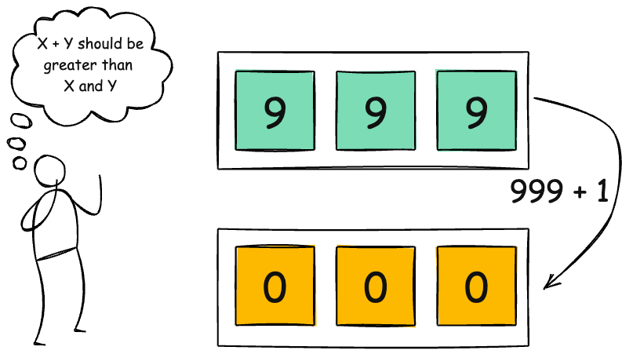
14. Integer overflow or wraparound
results
Consequences:
Can lead to undefined behavior and possible crashes
Data corruption
Can be used for buffer overflows and thus arbitrary code execution
The product performs a calculation that can cause an integer overflow, assuming the result will always be larger. When the value exceeds the storage limit, it wraps around potentially resulting in an unexpectedly small or negative number
Prevention:
Ensure that all protocols are strictly defined such that all out-of-bounds behavior can be identified
Use input validation to ensure numeric input is within expected range

Slide 70
15. Deserialization of untrusted data
results
The product deserializes untrusted data without sufficiently verifying that the resulting data will be valid
Consequences:
Attackers could modify unexpected objects or data
A function may never terminate
Prevention:
Use the signing/sealing features of a programming language when available
When deserializing data, populate a new object rather than just deserializing

Slide 71
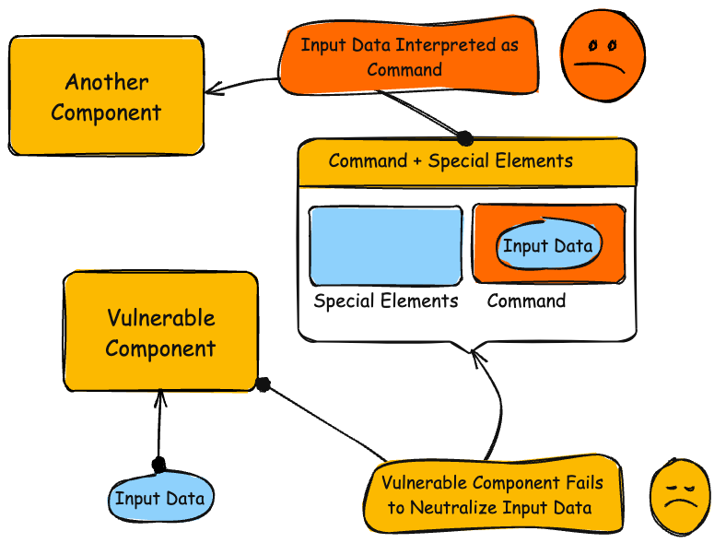
16. Command injection
results
Consequences:
If a malicious user injects a character that delimits the end of one command and the beginning of another, it could be possible to insert a new command
The product constructs a command using external input without properly sanitizing it, allowing special elements to modify the command’s intended behavior
Prevention:
If possible, use library calls rather than external process
If possible, ensure that all external commands called from the program are statically created
Use an “accept known good” input validation strategy

Slide 72
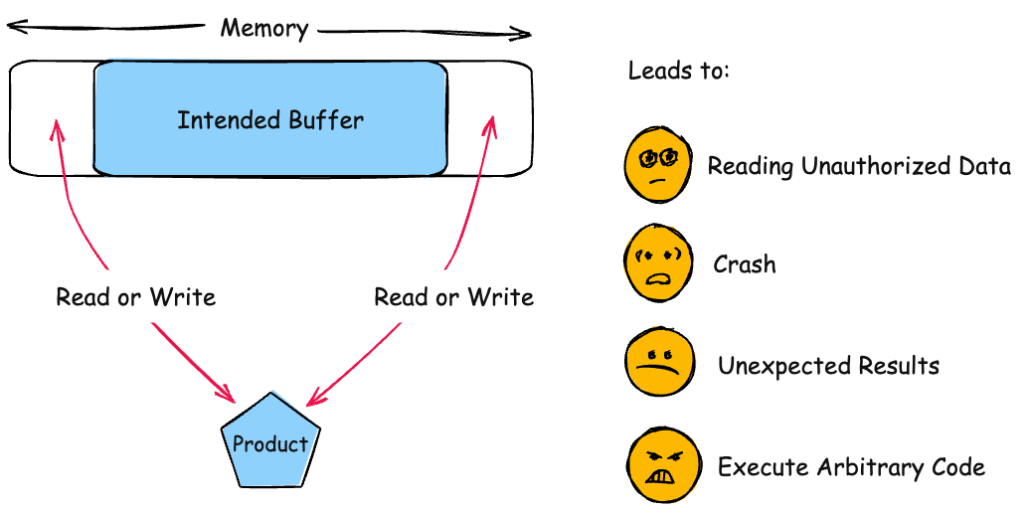
17. Buffer overflow
results
Consequences:
If the memory can be controlled, arbitrary code execution is possible
Result in corruption of relevant memory
Possible access to sensitive information
The product performs operations on a memory buffer but accesses memory outside the buffers bounds
Prevention:
Use automatic buffer overflow detection mechanisms offered by certain compilers or extensions
Use a vetted library or framework that does not allow this weakness to occur

Slide 73
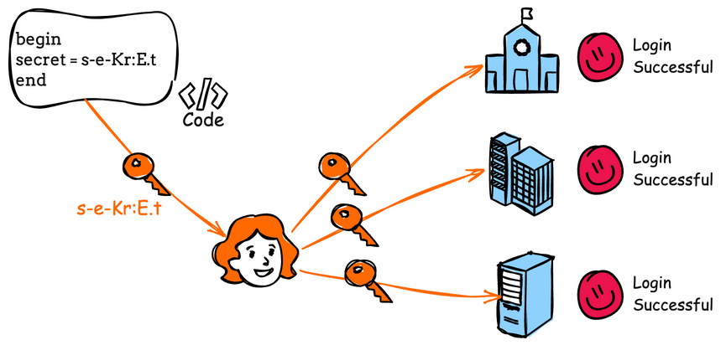
18. Use of hard-coded credentials
results
Consequences:
If hard-coded passwords are used, it is almost certain that malicious users will gain access
Can lead to exposure of resources or functionality to unintended actors
The product contains hard-coded credentials, such as a password or cryptographic key
Prevention:
For outbound store passwords, keys, and other credentials outside of the code in a strongly-protected, encrypted config file or database
For inbound utilize a “first login” mode that requires the user to enter a unique strong password or key

Slide 74
19. Server-side Request forgery (SSRF)
results
The web server receives a URL or similar request from an upstream component and retrieves the contents of this URL, but it does not sufficiently ensure that the request is being sent to the expected destination
Consequences:
Read application data
Execute unauthorized code or commands
Prevention:
Static Application Security Testing can sometimes detect instances of this weakness

Slide 75
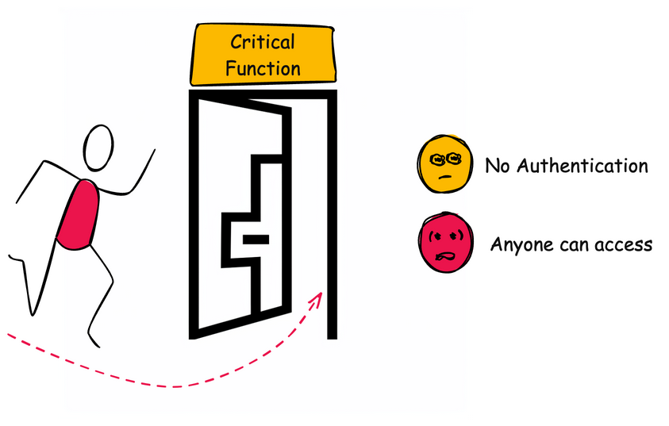
20. Missing authentication for critical function
results
Consequences:
Exposing critical functionality provides an attacker with the privilege level of that functionality
The product does not perform any authentication for functionality that requires a provable user identity or consumes a significant amount of resources
Prevention:
Divide the software into anonymous, normal, privileged, and administrative areas
For any security checks on the client side, ensure that these checks are duplicated on the server side

Slide 76
21. Race Condition
results
The product has concurrent code that needs temporary exclusive access to a shared resource, but a timing window allows another concurrent code sequence to modify the resource
Consequences:
A race condition may make it possible to bypass a resource cleanup routine, leading to resource exhaustion
A race condition could be combined with predictable resource names and loose permissions, allowing for access or overwriting of confidential data
Prevention:
In language that support it, use synchronization primitives
Use thread-safe capabilities
Minimize the usage of shared resources

Slide 77
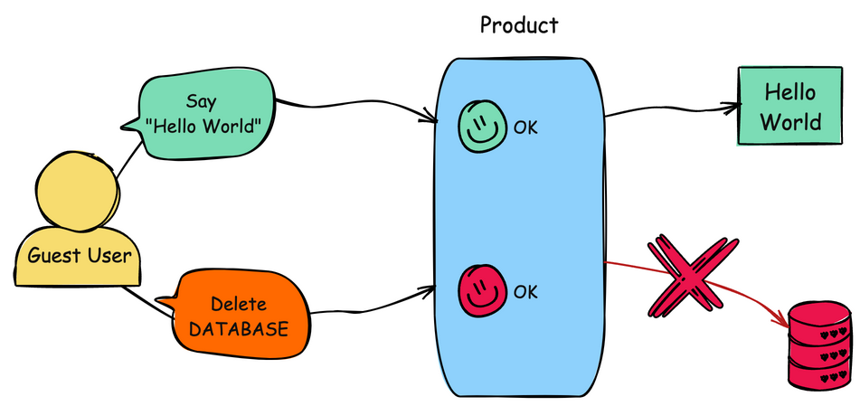
22. Improper privilege management
results
Consequences:
Gain privileges
Assume identity
The product does not properly assign, modify, track, or check privileges for an actor, creating an unintended sphere of control for that actor
Prevention:
Very carefully manage the setting, management, and handling of privileges
Follow the principle of least privilege when assigning access rights to entities in a software system
Consider following the principle of separation of privilege

Slide 78
23. Code injection
The product constructs all or part of a code segment using externally-influenced input from an upstream component, but it does not neutralize or incorrectly neutralizes special elements that could modify the syntax or behavior of the intended code segment
results
Consequences:
Injectable code can control authentication
Injected code can access resources that the attacker is directly prevented from accessing
Can lead to loss of data integrity
Prevention:
Refactor your program so that you do not have to dynamically generate code
Run your code in a sandbox environment that enforces strict boundaries
Use an “accept known good” input validation strategy

Slide 79
24. Incorrect authorization
results
The product performs an authorization check when an actor attempts to access a resource or perform an action, but it does not correctly perform the check
Consequences:
An attacker could read sensitive data
An attacker could modify sensitive data
An attacker could gain privileges by modifying or reading critical data
Prevention:
Divide the product into anonymous, normal, privileged, and administrative areas
Ensure that access control checks are performed related to the business logic

Slide 80
25. Incorrect default permissions
results
During installation, installed file permissions are set to allow anyone to modify those files
Consequences:
Attacker could read application data
Attacker could modify application data
Prevention:
The architecture needs allow access to modification attributes for files to only those that need it
Compartmentalize the system to have “safe” areas where trust boundaries can be unambiguously drawn

Slide 81
OWASP top 10
Open Web Application Security Project (OWASP) publishes this list to guide developers, testers, and security professionals
It is a list of the most critical security risks to web applications

Slide 82
OWASP top 10
Broken Access Control: Improper enforcement of access control restrictions
Cryptographic Failures: Issues related to weak or improper cryptographic protections
Injection: Flaws like SQL injection, command injection
Insecure Design: Design flaws that can lead to security issues
Security Misconfiguration: Default, incomplete, or ad-hoc security configurations

Slide 83
OWASP top 10
Vulnerable and Outdated Components: Using outdated or vulnerable libraries, frameworks, or software components
Identification and Authentication Failures: Issues like improper authentication or session management
Software and Data Integrity Failures: Problems with verifying software integrity
Security Logging and Monitoring Failures: Insufficient logging, detection, and monitoring of security events
Server-Side Request Forgery (SSRF): Vulnerabilities that allow an attacker to make unauthorized requests from the server

Slide 84
Sources
https://www.checkpoint.com/cyber-hub/cloud-security/what-is-secure-coding/
https://intellectualpoint.com/the-importance-of-secure-coding-in-software-development/
https://cqr.company/web-vulnerabilities/lack-of-secure-coding-practices/#:~:text=In%20essence%2C%20the%20lack%20of,breaches%20or%20other%20security%20incidents.
https://www.colsa.com/software-assurance-devsecops/#:~:text=Defining%20Software%20Assurance%20(SwA),throughout%20the%20lifecycle.%5B2%5D
https://owasp.org/www-project-samm/
https://www.hackerone.com/knowledge-center/what-ssdlc-secure-software-development-life-cycle#:~:text=The%20Secure%20Software%20Development%20Life,series%20of%20articles%20about%20DevSecOps.
https://www.microsoft.com/en-us/securityengineering/sdl
https://en.wikipedia.org/wiki/IBM#:~:text=IBM%20was%20founded%20in%201911,record%2Dkeeping%20and%20measuring%20systems.
https://en.wikipedia.org/wiki/IBM_Personal_Computer

Slide 85
Sources
https://www.synopsys.com/glossary/what-is-code-review.html#:~:text=Secure%20code%20review%20is%20a,style%20guidelines%2C%20among%20other%20activities.
https://www.linkedin.com/pulse/why-secure-code-review-matters-strengthening-software-bairagi-3j6df/
https://www.threatintelligence.com/blog/secure-code-reviews
https://www.galahcyber.com.au/cybersecurity/secure-code-review/
https://www.aquasec.com/cloud-native-academy/devsecops/secure-code-review/#:~:text=Secure%20Code%20Review%3F-,Secure%20code%20review%20is%20the%20systematic%20examination%20of%20software%20source,and%20security%20of%20the%20software.
https://en.wikipedia.org/wiki/Mitre_Corporation
https://www.linkedin.com/pulse/what-security-privacy-design-chris-pepin/
https://cwe.mitre.org/documents/sources/SevenPerniciousKingdoms.pdf
https://www.c-sharpcorner.com/article/the-seven-pernicious-kingdoms/#:~:text=In%20the%20same%20manner%2C%20the,Chess%2C%20McGraw%2C%202005%5D.
https://wiki.sei.cmu.edu/confluence/display/seccode/Top+10+Secure+Coding+Practices
https://en.wikipedia.org/wiki/CERT_Coordination_Center#:~:text=The%20CERT%20Coordination%20Center%20(CERT,funded%20research%20and%20development%20center.
https://www.linkedin.com/advice/0/how-do-you-use-fuzzing-penetration-testing
https://cwe.mitre.org/data/definitions/700.html
https://cycuity.com/cwe/#:~:text=MITRE's%20Common%20Weakness%20Enumeration%20is,complex%20systems%2C%20controls%20and%20processes.

Slide 86
Sources
https://cwe.mitre.org/top25/archive/2023/2023_top25_list.html
https://owasp.org/www-project-top-ten/

