Slide 1
UML
James Palmer, Rachel Honeycutt, and Cooper Vandiver

Slide 2
What is UML?
Unified Modeling Language
“A general-purpose visual modeling language that is used to specify, visualize, construct, and document the artifacts of a software system” - The Unified Modeling Language Reference Manual
UML in an integral part of the software engineering process
UML is NOT a programming language

Slide 3
Brief History of UML
Before UML, there was chaos
Object Modeling Technique - James Rumbaugh
The Booch method (not a joke) - Grady Booch
Object-Oriented Software Engineering - Ivar Jacobson
And many more
UML 1.0 was completed in January of 1997, overseen by the Object Management Group (OMG)
UML 2.5.1 released in December 2017

Slide 4
What Problems Does It Solve?
TLDR: all of ‘em, baby.
Nonproprietary
Standardization - readability & writability
Simple-ish: easy to learn, hard to master
Supports the vast majority of development processes
Integrate best practices into modeling

Slide 5
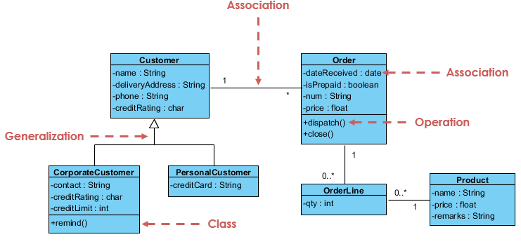
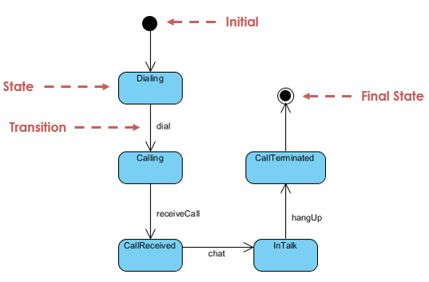
Structure of UML Diagrams
The general structure of a UML diagram consists of elements, details about those elements, and the relationships between elements.

Slide 6
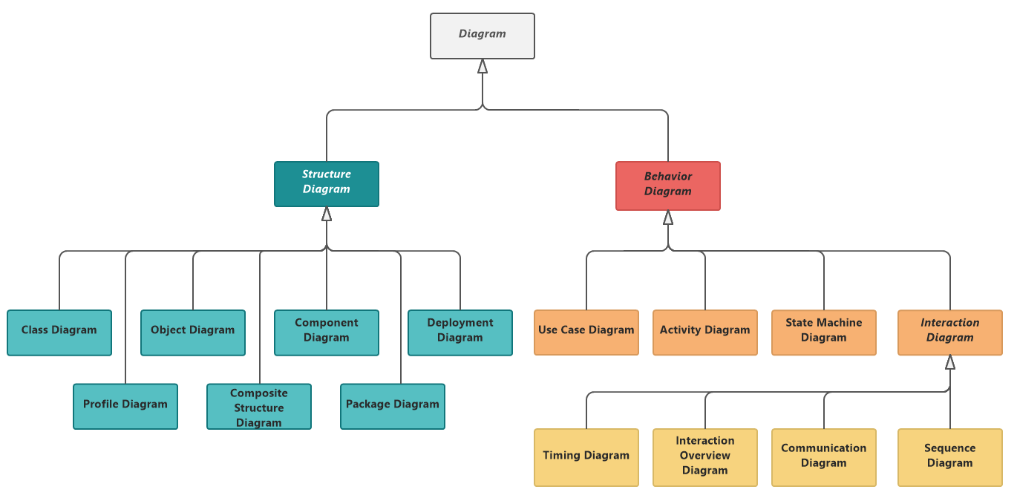
Types

Slide 7
Namespaces
As you may imagine, UML diagrams for very large systems may become complex and have numerous elements
Because of this, separate parts of a diagram may be split into different namespaces, which function similarly to how they do in C++
Namespaces themselves are not elements within a UML diagram, but rather are automatically invoked when certain structures are used including:
Classes
Associations
State machines

Slide 8
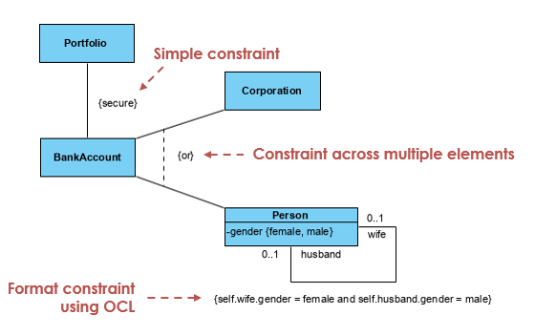
Constraints
A constraint is “a restriction on an element that limits the usage of that element.” - visual-paradigm.com
Some constraints are defined in UML, like XOR
Other constraints are user-defined and can be written in many ways
Object Constraint Language (OCL) developed by UML

Slide 9
Constraints Cont.
https://www.uml-diagrams.org/constraint.html

Slide 10
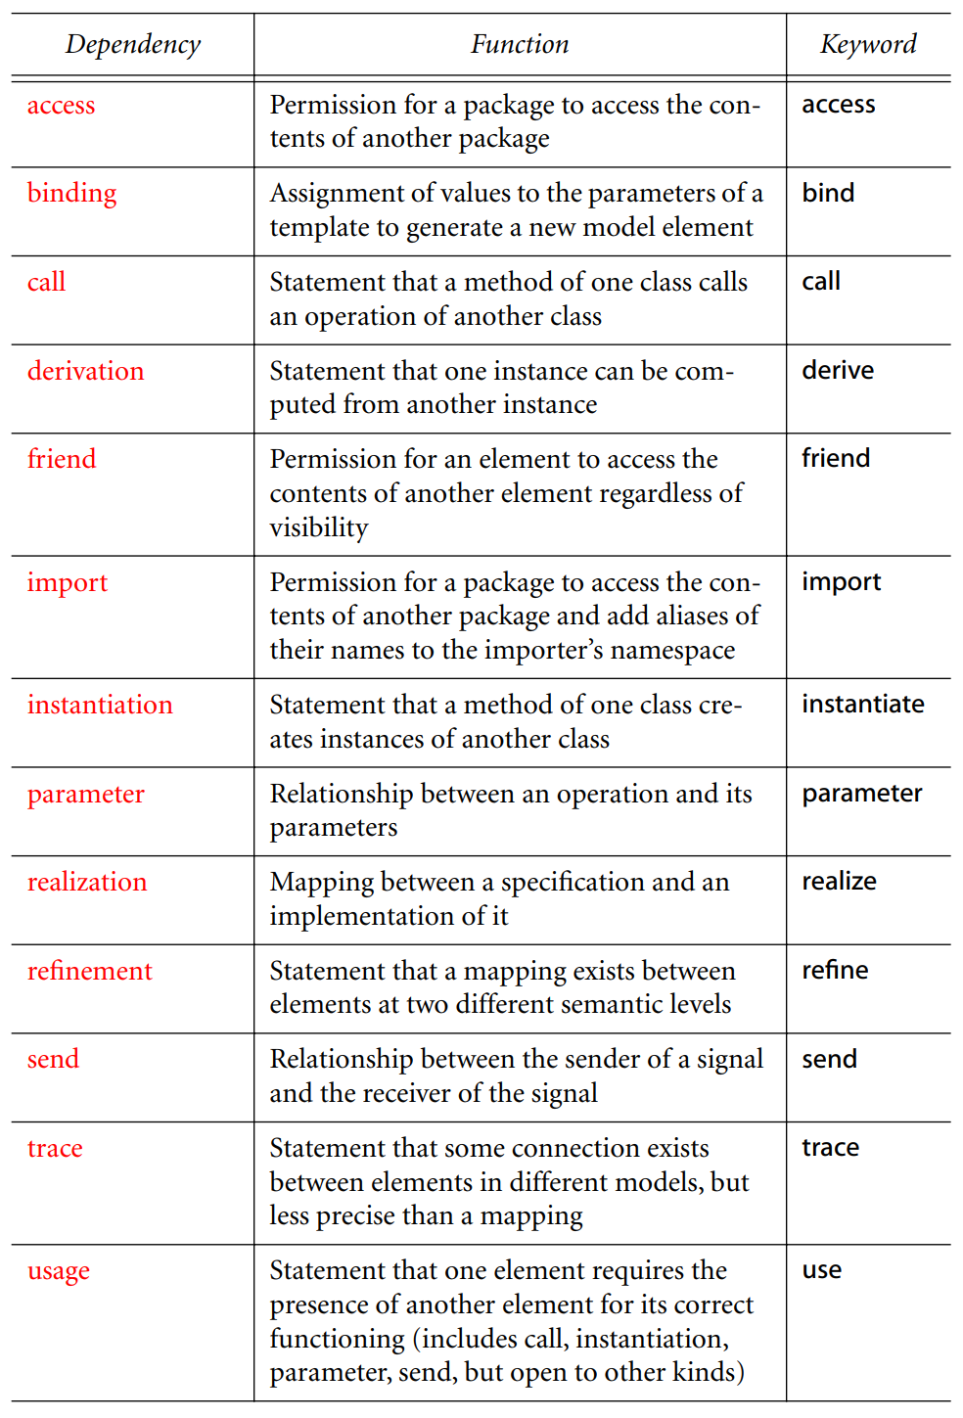
Dependencies

Slide 11
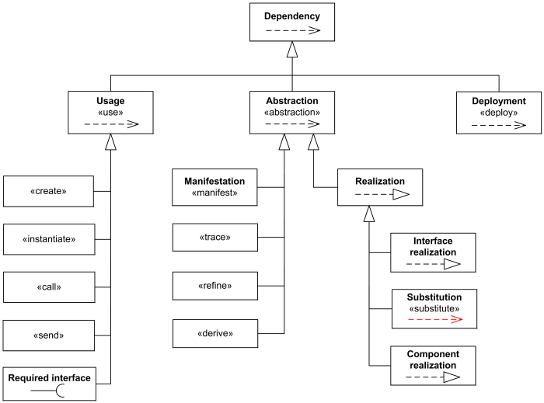
Dependencies Cont.

Slide 12
Dependencies Cont.
From The Unified Modeling Reference Manual

Slide 13
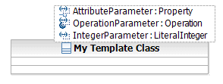
Templates
A parameterized model element that describes or identifies the pattern for a group of model elements of a particular type
Since templates represent types of elements you first have to instantiate the template by binding the parameters to actual values
A binding between a template and a model element generates a new model element based on the template
Templates can be used to design a single model element that works with different kinds of data

Slide 14
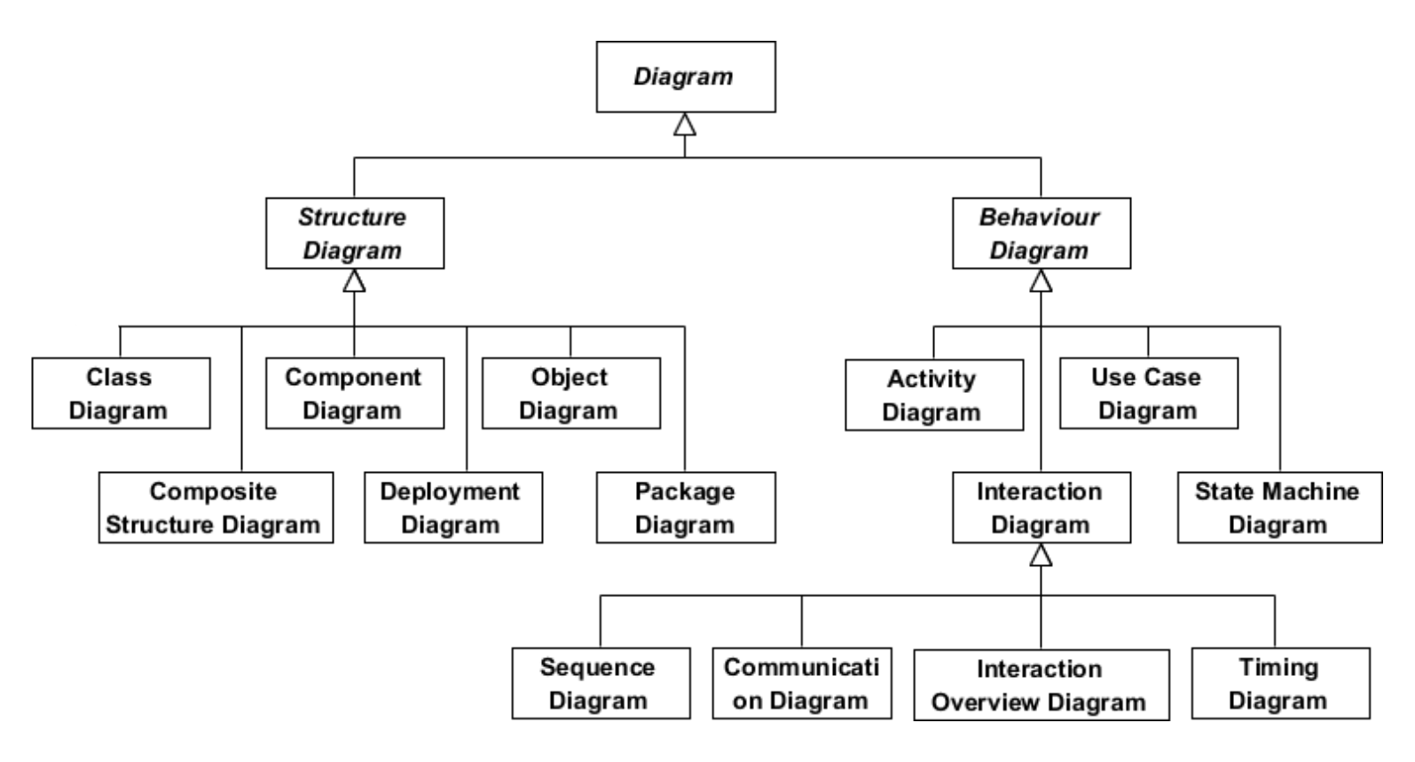
Diagrams Overview

Slide 15
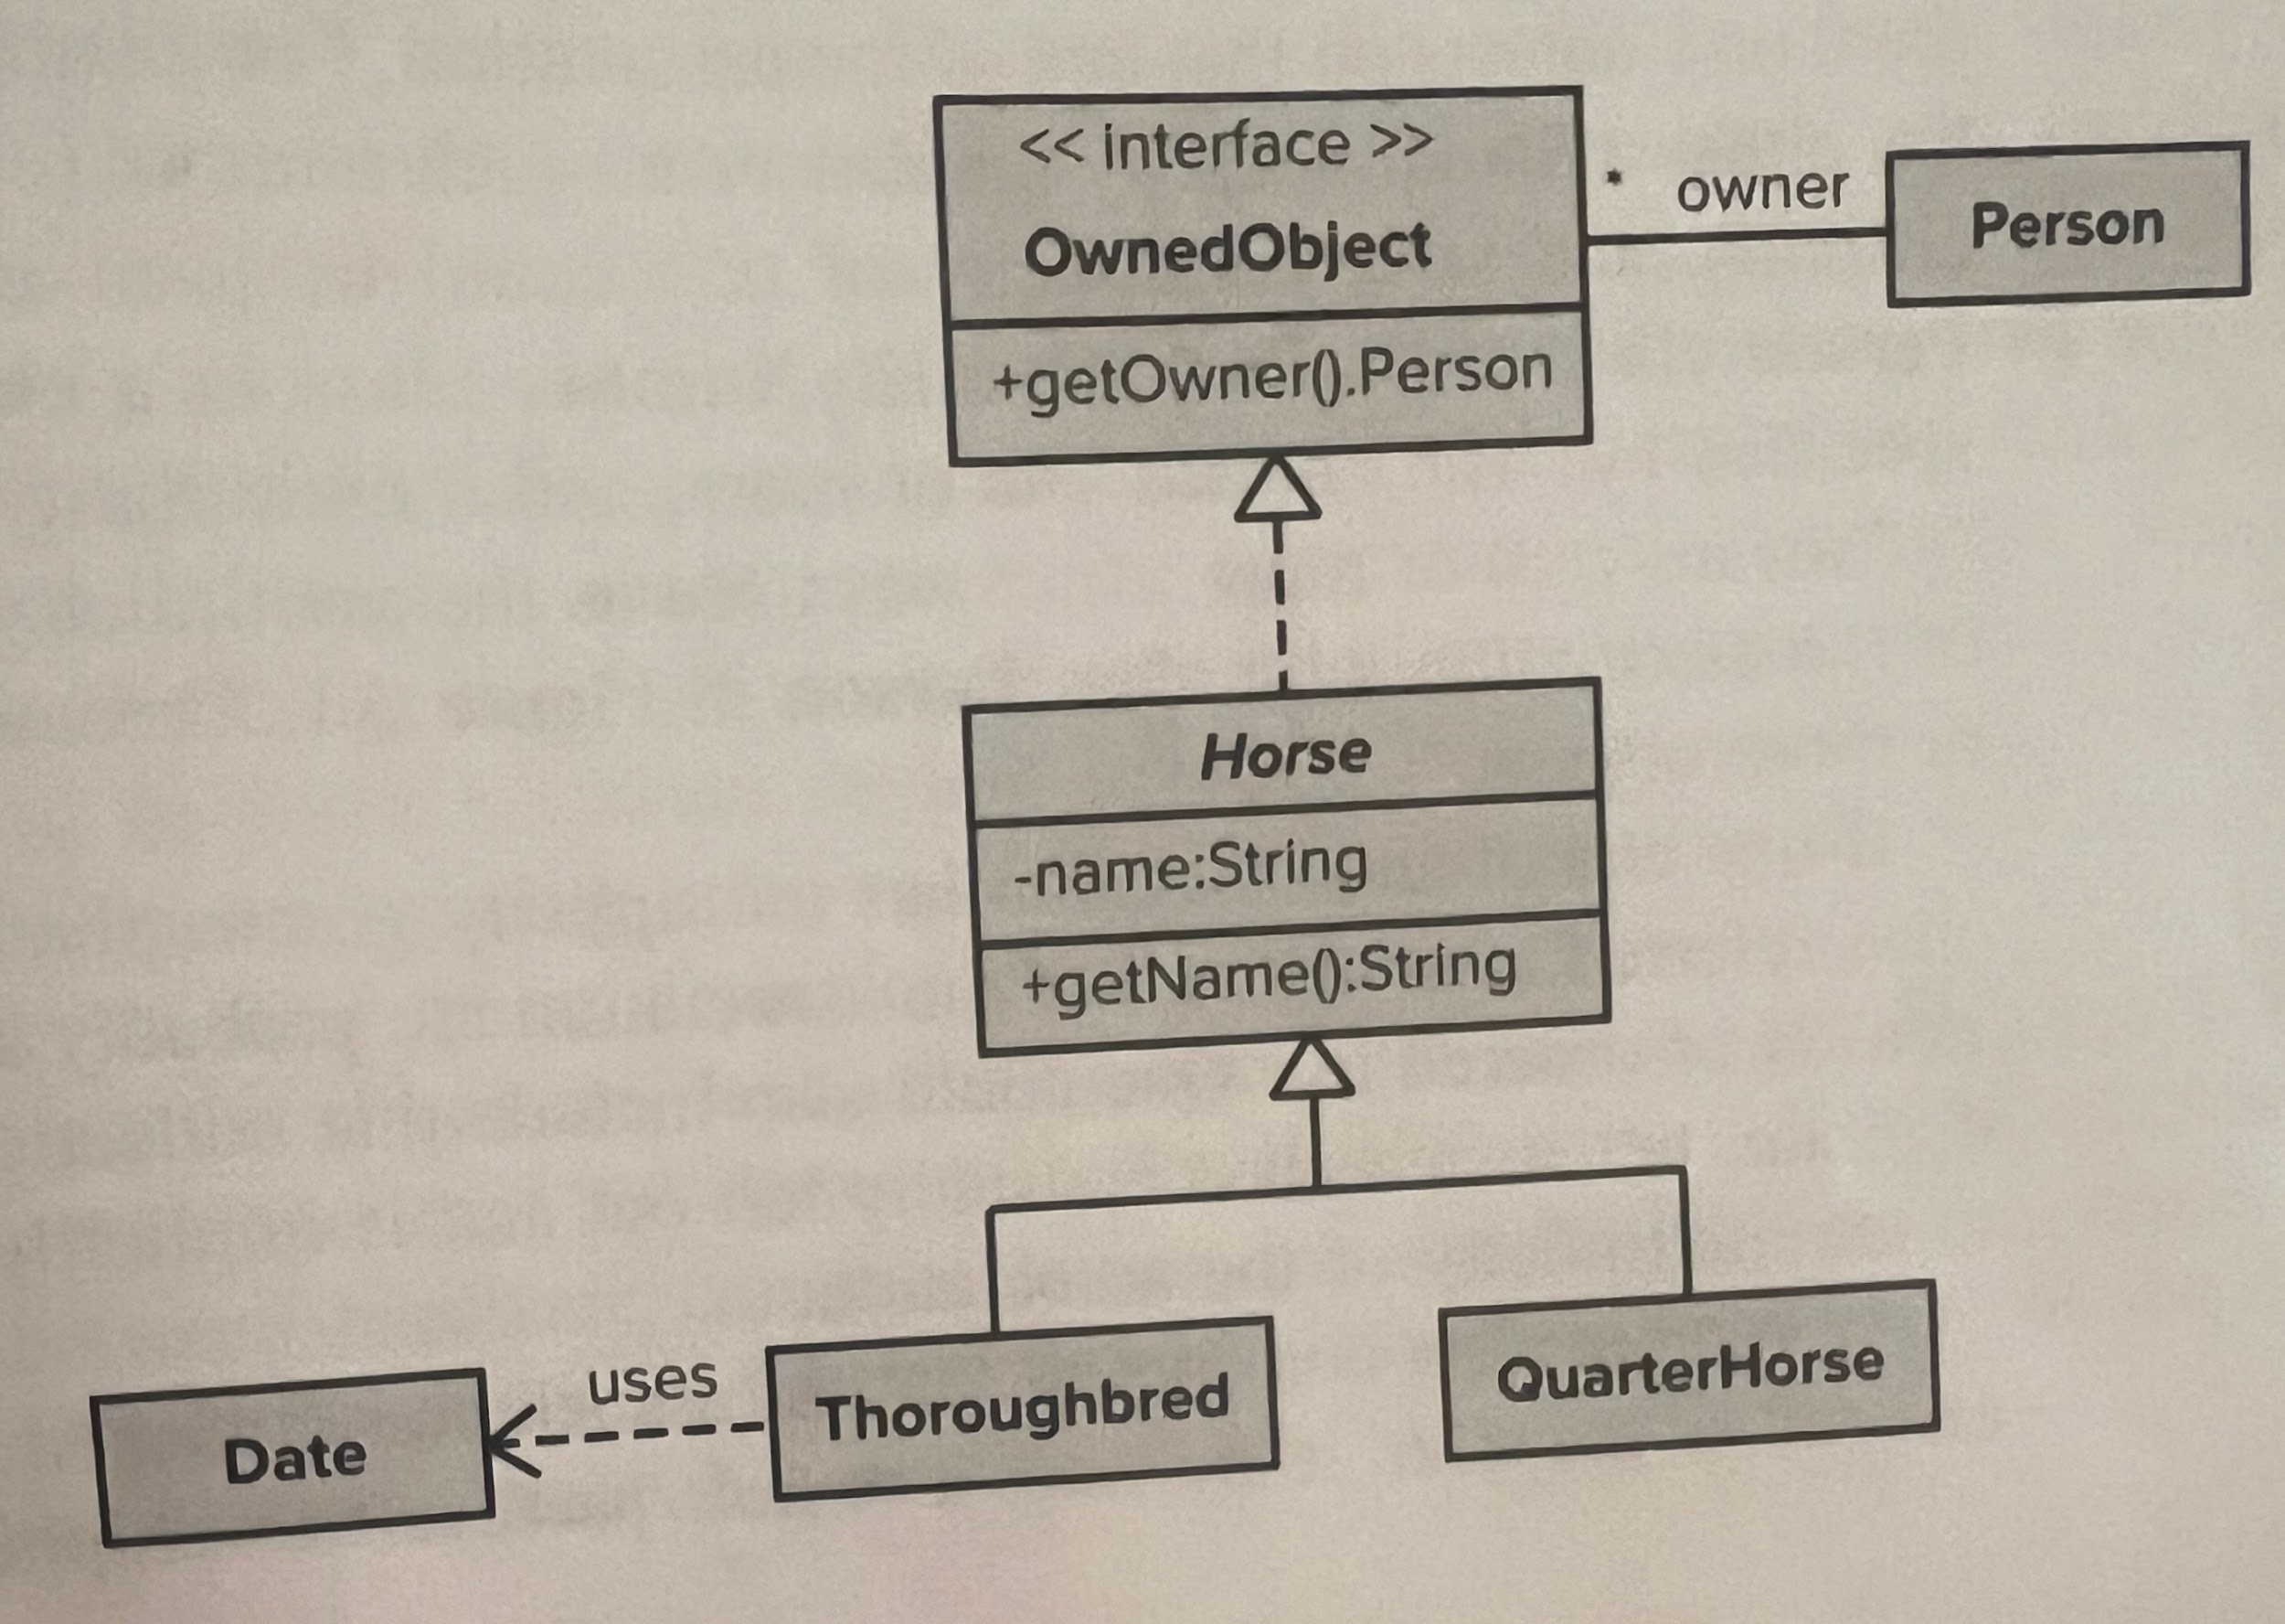
Class Diagram
Classes - a collection of things that have similar attributes and common behaviors
Boxes are used to represent classes and interfaces
Top: name
Middle: attributes
Bottom: operations/behaviors
Attributes: values that the class can get from its instance variables or from other objects of which it is composed
Operations refer to what objects of the class can do

Slide 16
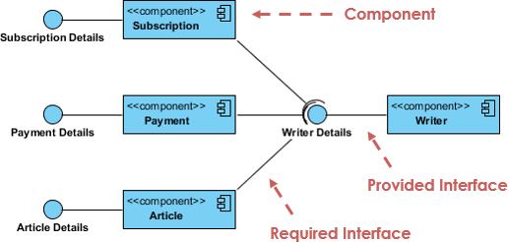
Component Diagram
Depicts how components are wired together to form larger components or software systems
It illustrates the architectures of the software components and the dependencies between them
Those software components including run-time components, executable components also the source code components.

Slide 17
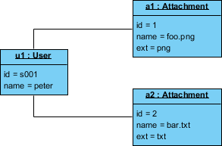
Object Diagram
A graph of instances, including objects and data values
An instance of a class diagram; it shows a snapshot of the detailed state of a system at a point in time
Represents specific instances of classes and relationships between them at a point of time
Representation of how classes are utilized at a particular state

Slide 18
Composite Structure Diagram
Represents relationship between parts and their configuration which determine how the classifier (class, a component, or a deployment node) behaves
They represent internal structure of a structured classifier making the use of parts, ports, and connectors
They are similar to class diagrams except they represent individual parts in detail as compared to the entire class

Slide 19
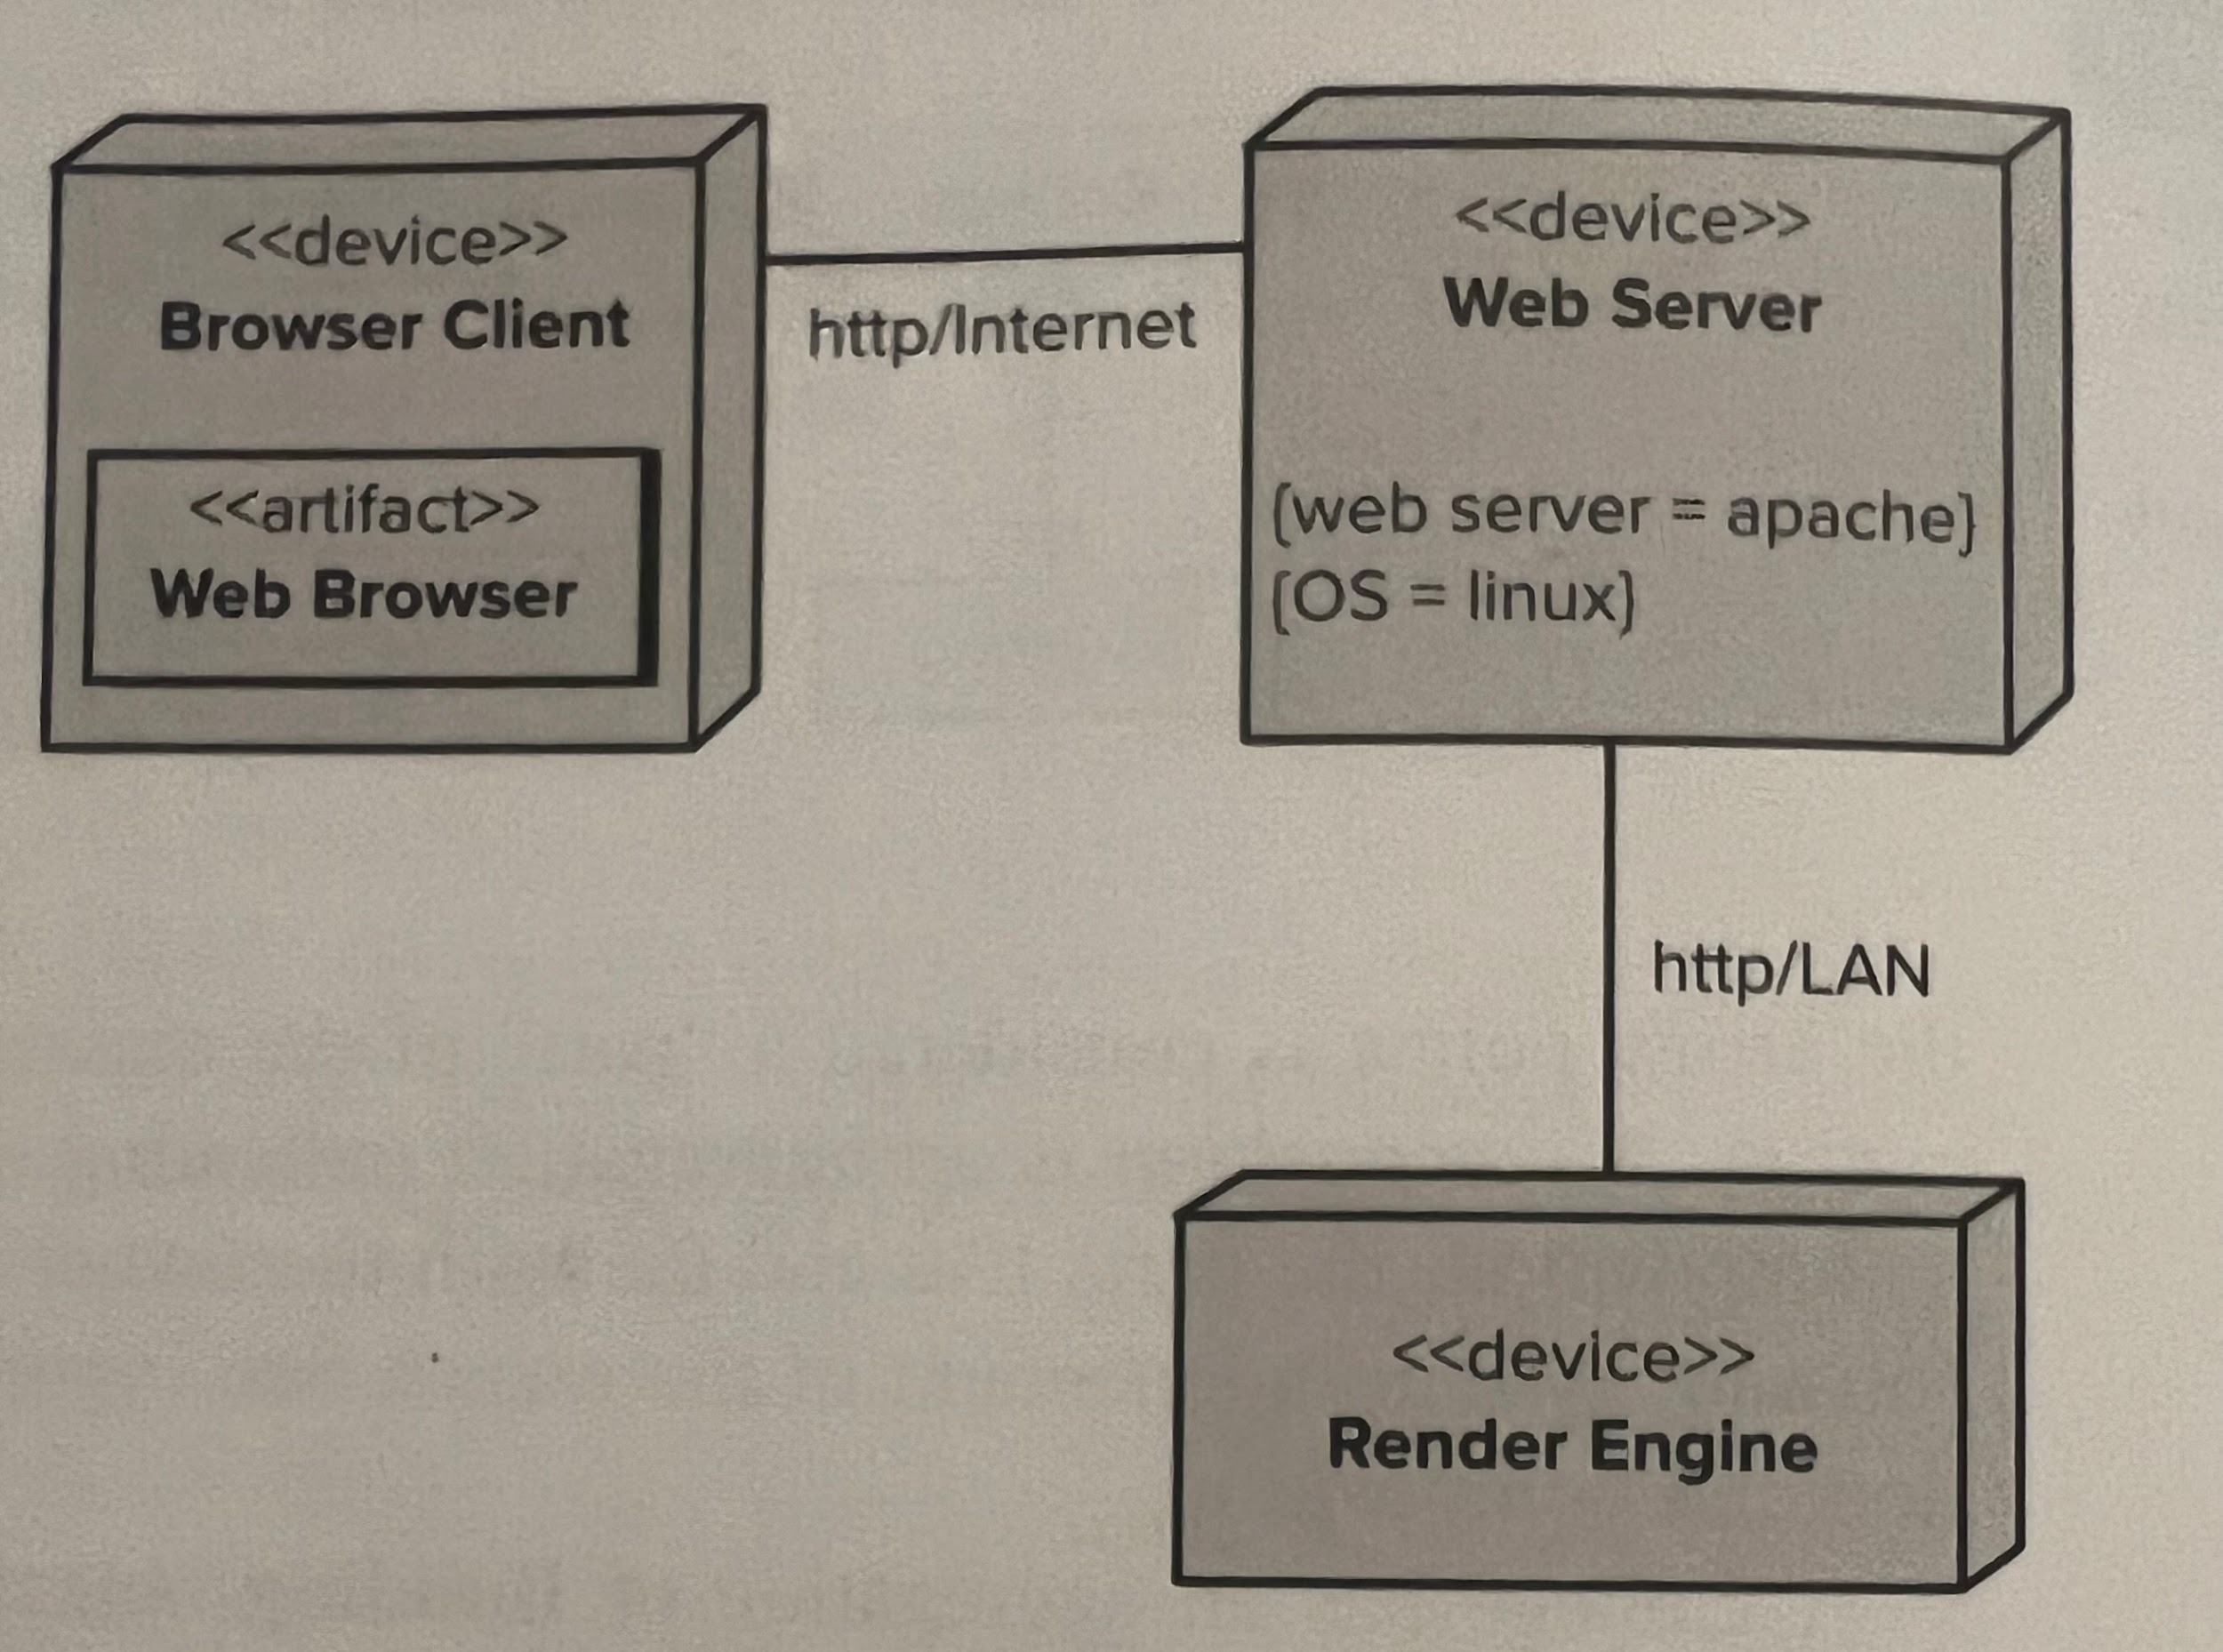
Deployment Diagram
Focuses on the structure of the software system and is useful for showing the physical distribution of a software system among hardware platforms and execution environments
<<device>> - hardware components
lines indication communication paths
artifact - a file containing software running on a device

Slide 20
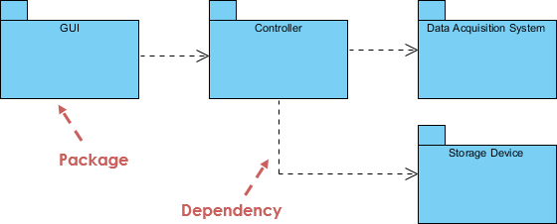
Package Diagram
Depict how packages and their elements have been organized
Help organise UML diagrams into meaningful groups and make the diagram easy to understand.
Primarily used to organise class and use case diagrams

Slide 21
Activity Diagram
Depicts the dynamic behavior of a system or part of a system through the flow of control between actions that the system performs
Consists of a collection of nodes connected by directed arrows that represent the control flow of the activity
Similar to a flowchart but allows for concurrent actions to take place
Swimlanes can be used to divide the chart into “lanes,” of which all activities within the lane are performed by the corresponding worker

Slide 22
Activity Diagram: Initial and Final Nodes
Initial
Represented by a solid black dot
Indicates the starting point of the activity
Final
Represented by a black dot surrounded by a black circle
Indicates the ending point of the activity

Slide 23
Activity Diagram: Action and Decision Nodes
Actions
Represented by a rounded rectangle
Corresponds to some task performed by the system
Decisions
Represented by a white diamond with one incoming arrow and two or more outgoing arrows
Each outgoing arrow is labeled with a guard, or some condition that must be true for the control flow to continue along that path

Slide 24
Activity Diagram: Fork and Join Nodes
Forks
Represented by a solid black rectangle with one incoming arrow and two or more outgoing arrows
Indicates the separation of an activity into two or more concurrent activities
Joins
Represented by a solid black rectangle with two or more incoming arrows and out outgoing arrow
Indicates the synchronization of two or more concurrent tasks back into one synchronous control flow
All incoming actions must wait for each other incoming action to complete before the outgoing flow can begin

Slide 25
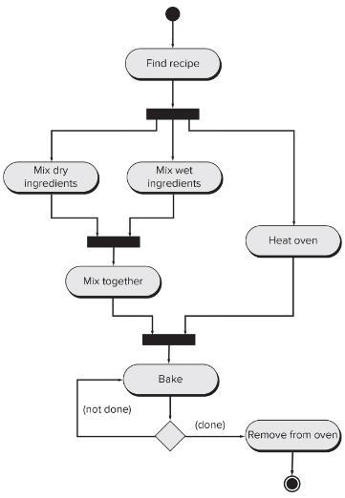
Activity Diagram Example
Activity diagram modeling the process of baking a cake
Beginning with selecting a recipe, the subsequent steps are laid out using the connecting lines
Certain tasks may be performed in parallel, such as mixing the dry ingredients and mixing the wet ingredients
No notion of allocation of actions to workers is shown

Slide 26
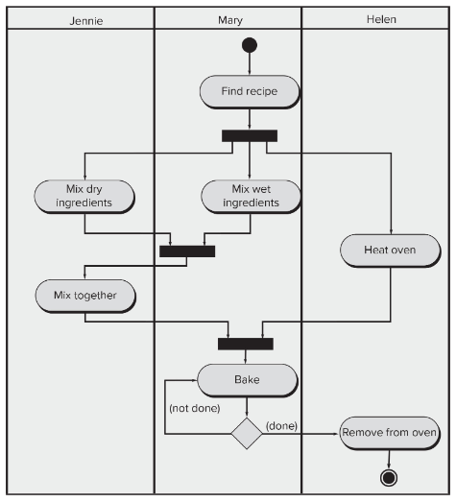
Activity Diagram Example with Swimlanes
This activity diagram once again models the process of baking a cake, but now three workers are available.
The swimlanes shown on the diagram determine who is responsible for which action
When a concurrent task occurs, such as mixing and heating the oven, Jennie and Helen can work concurrently

Slide 27
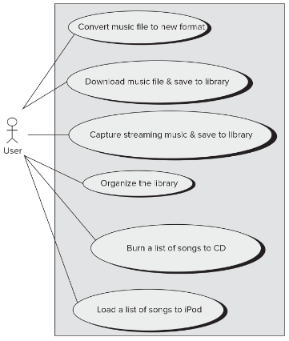
Use-Case Diagram
Aids in determining the functionality and features of a system from a user’s perspective
User is not limited to end-user, other individuals who interact with the system such as technicians and administrators are also able to be modeled
Overview of all of the use cases of a system and how they are related
Actors (users) are connected to ovals (use cases) based on which features are necessary for the category of actor

Slide 28
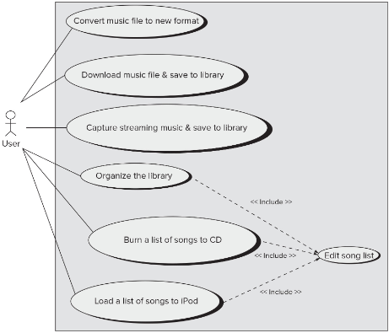
Use-Case Diagram: Including Use Cases
Some use cases in a system may involve other use cases. When this happens, it is often easier to create a new use case that includes the functionality of other use cases to prevent repeated use cases.
In the given example, the “<<include>>” directive is used to create the “Edit song list” feature. This feature utilizes the three included use cases as part of its functionality.

Slide 29
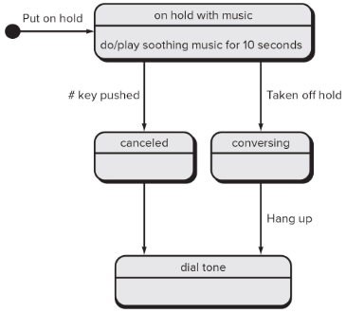
State Machine Diagram
Models an object’s state, the actions that are performed on those states, and the transitions between the states of the object
The initial state is represented by a black dot, and the final state is represented by a black dot surrounded by a circle
Transitions are denoted by arrows and are labeled to describe the transition
States are contained within rounded rectangles

Slide 30
Interaction Diagrams
Subset of behavior diagrams that model the interaction between objects in any given system
Sequence
Communication
Timing
Interaction Overview

Slide 31
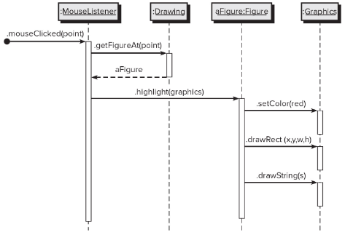
Sequence Diagram
Models the dynamic communications between objects during task execution over some sequence of time
Method calls from the caller to the callee are represented using horizontal arrows
Asynchronous messages are represented with dotted horizontal arrows

Slide 32
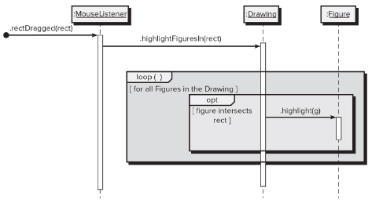
Sequence Diagram: Interaction Frames
Interaction frames can be used to model control flow in a sequence diagram
Sequence diagrams typically flow top-down as time goes on, but it can be helpful to have extra functionality for things such as conditionals and loops

Slide 33
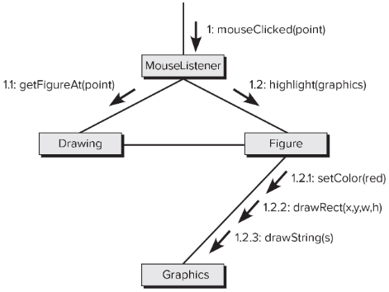
Communication Diagram
Models the relationships among objects and classes
Unlike a sequence diagram, time is not represented
Labeled arrows from one object to another represent method calls

Slide 34
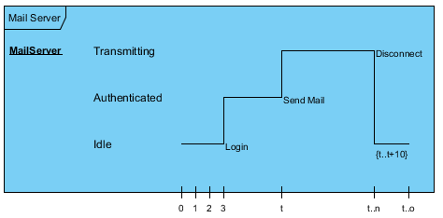
Timing Diagram
Models the behavior of a system over some period of time
Components
Lifeline - Represents the lifetime of a modeled object
States - Show the state of an object at a given time, represented as a value on the y-axis
Transitions - Arrows or lines that show the change in state of an object over time
Time Constraints - Models a specific timing requirement

Slide 35
Interaction Overview Diagram
Models control flow and transfer of data throughout a set of interaction diagram
Shares node types with activity diagrams, except for action nodes
Action nodes are replaced with interaction nodes
Two types of interaction nodes
“sd” - full interactions
“ref” - use of an interaction

Slide 36
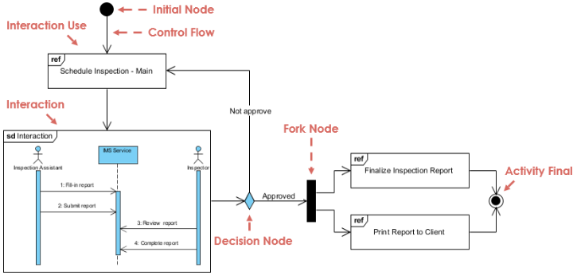
Interaction Overview Diagram Example

Slide 37
UML Software Demonstration
Problem: Florence Bank, inc. (FB) has hired you to design and build a system that can keep track of everyone involved with the business (customers and employees).
To keep track of who’s who, the data structure representing each individual must have the following fields:
Name
Birthdate
Social Security Number
What can we do to make management happy and make our lives much easier?
Use UML! (GenMyModel)

