Slide 1
Web Frameworks
Aidan Rouse, Bharat Verma, Joshua Townsend, Julia Woodruff

Slide 2
What is a Web Application?
Simply put, it is a program that is stored on a remote server and accessed through a browser interface.
What are they used for?
They are designed for interaction, allowing users to send and receive data between the browser and the web server.
What do examples of these interactions look like?
These interactions can be as simple as logging in to an account, or as complex as making a payment with your credit card.

Slide 3
Different Forms of Web Applications
Dynamic - Fetch data in real-time based on user requests.
Static - Built with HTML and CSS to display relevant content and data
don’t typically have user-server interaction.
Portal - Have different sections on the home page, such as forums, chats, user registration, and emails.
Single Page - Operate within a single web page, updating content dynamically instead of reloading the entire page.
Multiple Page - Consist of multiple pages, with each data change or server transfer rendering a new page.

Slide 4
What is a Progressive Web App (PWA)?
It is a web app that uses web technologies to provide a user experience similar to a native app.
What is a native app?
A native app is a software application specifically designed and developed to run on a particular platform or device. These apps are built using platform specific programming languages.
For example: Swift for iOS or Kotlin for Android OS.
How does a PWA function?
PWAs can run on multiple devices and platforms from a single codebase.
Designed to take advantage of native mobile device features:
Does not require users to visit an app store
Does not require a purchase to be made
Does not require a local software download

Slide 5
More Aspects of PWAs
Aspects:
Smooth animations
Responsive design
Intuitive gestures
Seamless integration w/ device features like:
notifications, offline capabilities, and access to hardware components.

Slide 6
What are the Benefits of a PWA?
User Benefits of PWAs include:
Push Notifications - Can increase engagement by up to four times by sending push notifications that appear on the user’s device.
App-like Appearance - Look about 95% identical to native apps, providing a superior user experience.
Offline Functionality - Can allow users to access the app without an internet connection.
Responsiveness - Work with many screen sizes and functions like native apps.

Slide 7
More Benefits. . .
Benefits in Development and for Stakeholders:
Affordable Development - Since PWAs are built with web tech like HTML and CSS; it may be quicker and cheaper to develop than traditional applications
Connectivity Independent - Allow users to access the app even with a low-quality internet connection
Discoverable - Can be found through search engines, which can improve their visibility and reach

Slide 8
What is the LAMP Stack?
The LAMP stack is a group of four separate software technologies that developers often use to construct website and web applications.
What does LAMP stand for?
Linux
Apache
MySQL
PHP

Slide 9
What is Each Component of Lamp Used For?
Linu
Is the Operating System
Apache
Is the web server
MySQL
Is the database server
PHP
Is the programming language

Slide 10
Why is a LAMP Stack Important?
The benefits of using these four specific technologies together includes:
Cost
The technologies are open source, which means they can be used without a licensing fee.
2. Efficiency
Setting up a new web development stack requires rigorous testing of different frameworks, modules, libraries, and tools.
3. Maintenance
Software experts from around the globe contribute to the development of LAMP stack technologies by changing, commenting, and reviewing the publicly available source codes.
4. Support
Popular open-source technologies such as this have the support of a large, global IT community.
5. Flexibility
LAMP stack gives both reliability and flexibility to web developers. Developers can replace software components for each layer as they see fit.

Slide 11
What is the LAMP Stack as a whole used for?
The LAMP stack is used for backend or server development.
Backend applications are software that runs in an environment that is hidden from the end users.
Consist of:
Data processing software
Database components
Business logic in code
API for communicating with other applications
Interaction with the frontend application (webpage) results in your browser communicating with the backend to retrieve the required information.

Slide 12
What is Ajax?
A group of web application technologies that make web applications more responsive to user interaction
The Five Components of AJAX include:
XHTML and CSS - for presenting data
Document Object Model (DOM) - for dynamically interacting with and displaying the presented information
XMLHttpRequest object - manipulate data asynchronously with the web server
XML, HTML, and XSLT - for data interchange and manipulation
JavaScript - for binding data requests and information display

Slide 13
Ajax Data exchange
AJAX uses a JavaScript function to create a XMLHttpRequest object on the browser.
The page information is compiled in XML format for which the XMLHttpRequest object sends to the web server.
The server processes and responds with the requested data
The browser is updated with the requested data only which does not require a refresh of the page

Slide 14
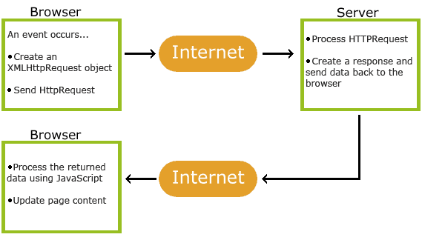

Slide 15
Benefits of AJAX
Fewer interruptions with the interaction of the web page
Reduced bandwidth usage
User-friendly
Instant Validation
Asynchronous processing
Improved response times
Reduced traffic

Slide 16
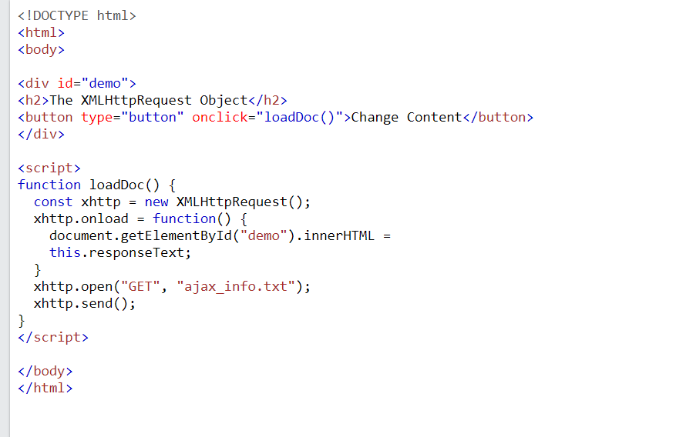
AJAX in code

Slide 17
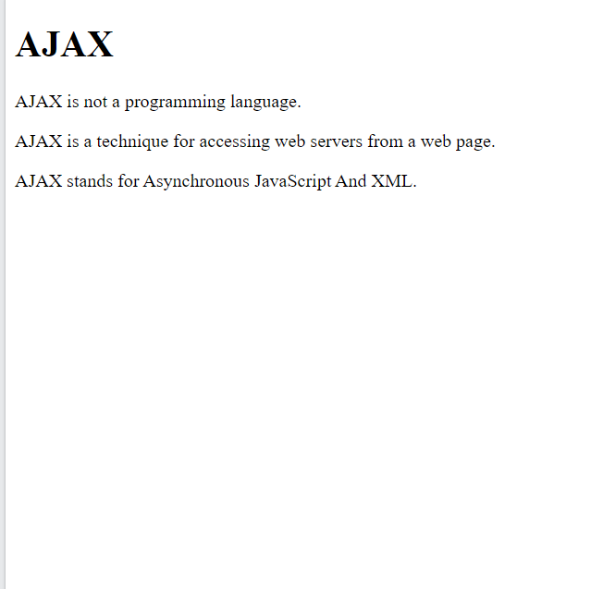

Slide 18
AJAX Limitations
Browser support - Not every browser supports JavaScript or the XMLHttpRequest object
Security and Privacy concerns - Not all concerns are considered
Accessibility - Because browser support is not for every browsers, some users may not have access to the application
Bookmark and navigation - Some of the page may not correspond to the newly loaded page. Browser history and bookmarks may not have the correct behavior.

Slide 19
Standards Impacting Web Development
There are three standards that are used to build any website
HTML - gives content meaning and structure
CSS - For styling
JavaScript - Makes Web Pages interactive
These languages are front-end languages meaning they are run by the browser.
Let’s Break down these web development building blocks

Slide 20
HTML
HyperText Markup Language or HTML is a language that defines the structure and meaning of the web content
Hypertext refers to the linking of web pages to one another.
HTML uses markup to annotate text, images, and other content for display within a select web browser.
HTML elements include but not limited to:
<head>, <title>, <body>, <section>, <p>, <img>, and many more tags
It is the most basic building block of web development

Slide 21
CSS
Cascading Style Sheets or CSS is a stylesheet language used to describe the presentation of a document written in HTML
CSS describes how elements should be rendered on the screen or on other media
For example if you want a color of a paragraph to be red, the syntax is:

Slide 22
Example continued…
This is the code that would implement the CSS style into your HTML document:

Slide 23
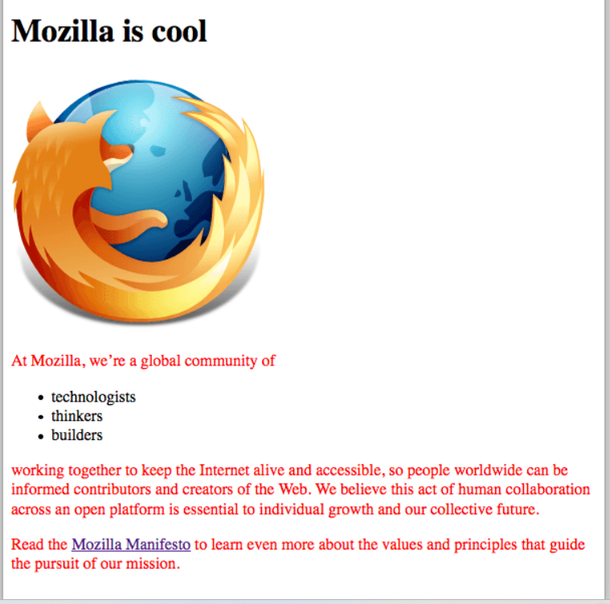

Slide 24
Javascript
JavaScript is a class-platform, object-oriented programming language
Primarily used in Web development to produce buttons, pop-up menus, and other animations on a web application.
Interpreted language - run-time compile
Loading Pages without reloading the whole page in a Web Application
Example: Google Maps
JavaScript enables a Web application to become interactive instead of static.

Slide 25
Constructing a House tie-ins (SSF)
House Analogy:
HTML is similar to the foundation of the house.
The walls and floors that provide structure to the house.
CSS is similar the aesthetic features of the house.
The paintings on the wall, the paint of the wall, the carpet , and wallpapers are used to give your house style.
JavaScript is similar to the appliances in a home.
These include the stove, the TV, and many more that gives your home some useful functionality.

Slide 26
What are validators (HTML / CSS)?
What Are Validators?
Validators are like quality check tools for your website's code. They scan your HTML and CSS to make sure everything is written correctly according to web standards.
Why Do We Need Validators?
These tools ensure that your code sticks to the official web rules laid out by organizations like (W3C). This is like making sure your car meets safety standards before you drive!
How Do Validators Help Us?
Catch Errors: Just as a spell-checker finds typos in your text, validators catch mistakes in your code that you might have missed.
Ensure Browser Compatibility: Validators make sure your website looks good and works right on all kinds of browsers, from Chrome to Firefox.
Boost Website Accessibility and SEO: They help improve your site’s accessibility, making it easier for people with disabilities to use your site. Plus, clean and correct code is better understood by search engines, helping your site rank higher.

Slide 27
(Benefits of using Validators)
Error Detection: Validators give you quick feedback on any mistakes in your code that you might not notice while you're working. This helps you fix problems right away.
Cross-Browser Compatibility: They ensure that your website works well and looks the same on all the major web browsers. This means everyone sees your website the way you intended, no matter what browser they use.
Accessibility Improvements: Validators help make your website more user-friendly for people with disabilities by ensuring your code follows certain guidelines. This makes your site more welcoming to everyone.
SEO Benefits: Using validators can help clean up your code, which search engines like. Cleaner code is easier for them to read and could boost your website's visibility in search results.

Slide 28
HTML Validators
•Definition: HTML validators are tools that check the markup of web documents, ensuring they meet the standards set by the World Wide Web Consortium (W3C).
•Example of Validation: Demonstration of an HTML validator identifying errors in markup, such as missing closing tags, improperly nested elements.

Slide 29
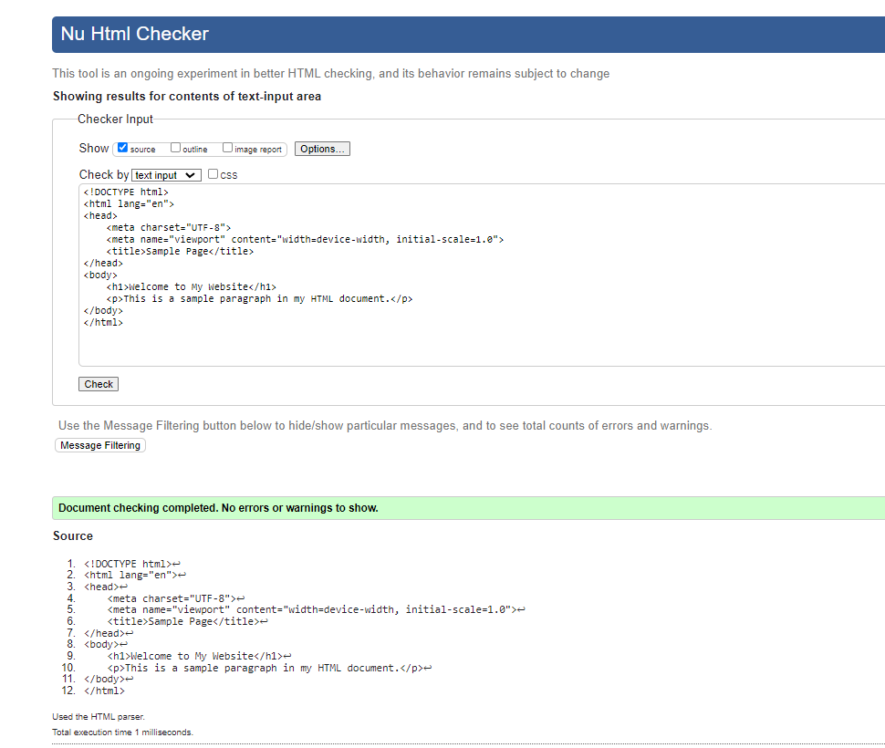
Example Validating HTML Code

Slide 30
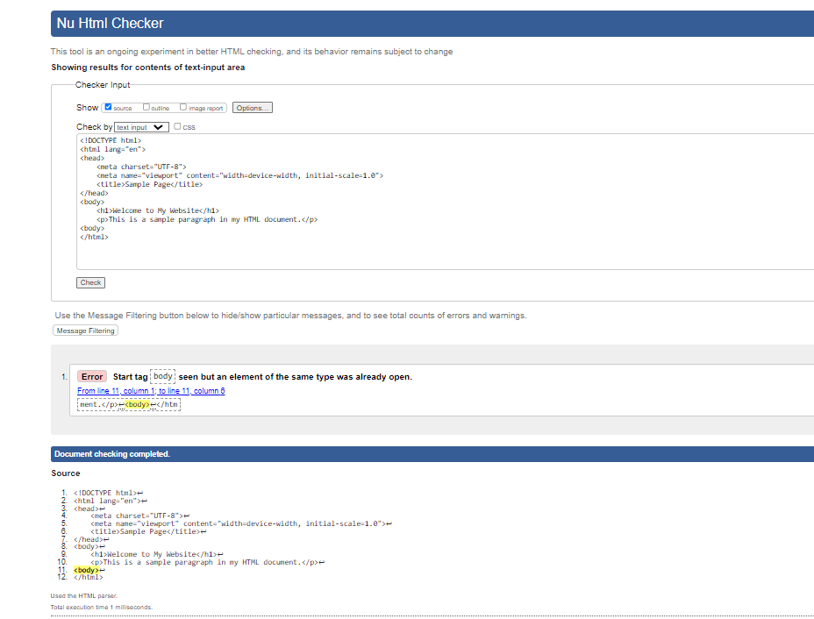
Validating Incorrect code

Slide 31
Example Validating CSS
body {
font-family: Arial, sans-serif;
line-height: 1.6;
color: #
}
h1 {
color: navy;
}

Slide 32
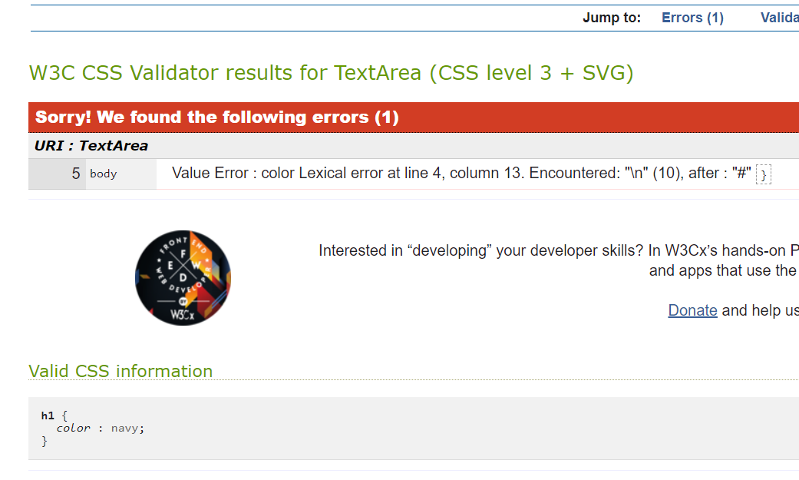
CSS Validator Error

Slide 33
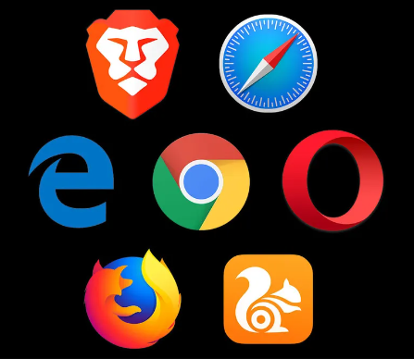
Web Developer Tools In Browsers
•Role of Developer Tools: Browser developer tools are essential for web developers to inspect, debug, and optimize their websites directly within the browser environment.
•Core Features: These tools provide functionalities such as DOM inspection, console logging, network activity monitoring, and performance assessment.
•Supported Browsers: Major browsers like Chrome, Firefox, and Edge each offer a suite of developer tools tailored to enhance web development efficiency.

Slide 34
Web Developer Tools in Browser (Chrome)
•Inspection and Editing: Allows developers to inspect HTML elements and CSS styles in real-time, make changes and see their effects immediately.
•JavaScript Console: Provides a powerful JavaScript console for testing scripts, viewing errors, and interacting with the web page's DOM.
•Network Monitoring: Enables tracking of network requests and responses, helping to diagnose loading issues and optimize resource delivery.
•Performance Profiling: Tools to analyze the performance of web pages, identify bottlenecks, and improve loading times and responsiveness.

Slide 35
Web Developer Tools in Browsers (Firefox)
•Element Inspection: Firefox DevTools offers comprehensive tools for inspecting and editing HTML and CSS, with a unique grid layout tool for CSS Grid systems.
•Console & Debugger: Features a full-featured JavaScript debugger and console that integrates with other tools to provide a seamless debugging experience.
•Network and Storage: Tracks all network activity, provides detailed information about headers, caching, and security settings, and offers tools to manage website data storage.
•Performance Tools: Includes detailed performance recording tools that help identify and rectify performance issues to enhance user experience.

Slide 36
Web Developer Tools in Browsers (Edge)
•Modern Interface: Edge DevTools offers a modern, user-friendly interface that integrates seamlessly with the browser, enhancing productivity and ease of use.
•Network Performance: Detailed insights into network performance, including timing, headers, and cookies, crucial for debugging and optimizing web applications.
•JavaScript Debugging: Advanced JavaScript debugging tools, similar to those in Chrome, thanks to shared Chromium base, with additional Microsoft-specific enhancements.
•Accessibility Testing: Includes built-in tools to test and improve the accessibility of web pages, ensuring compliance with web accessibility standards.

Slide 37
What are Web Frameworks?
Web frameworks are a piece of software that offers a way to create and run web applications.
They have a pre-built set of libraries, software tools, and best practices that support the overall development of web apps.

Slide 38
What do Web Frameworks do?
They make web app development more maintainable and efficient by handling multiple routine tasks at a time and providing a structured way to organize code.
They also provide a consistent development approach which helps guarantee that the final product is scalable, reliable, and maintainable.

Slide 39
Different Types of Web Frameworks
Frontend (client-side): mainly deals with the user interface (UI) and customer-side interactivity which further assists in front end testing
are responsible for managing user interactions, displaying content, and helping the overall user experience
crucial for generating dynamic, responsive, and visually alluring web apps.
examples: Angular, Vue.js, React, and Ember.js
Backend (server-side): primarily designed to focus on the logic of web apps
manage server operations, communicate with databases, and process requests from the user side
responsible for robust security, functionality, and data management of web apps
examples: ASP.NET., Ruby on Rails, express.js, django, and spring boot

Slide 40
Advantages
Rapid Development: they offer pre-built components which cuts down on development time
Consistency: they enforce good practices which results in consistent and maintainable code
Security: some of them come with built-in security traits which protect against potential vulnerabilities.
Community and Ecosystem: they have extensive libraries and active communities of developers
Scalability: they support scalability through scalable & modular architectures
Testing: they provide different tools to help simplify testing and debugging

Slide 41
Disadvantages
Learning Curve: developers have to take time to learn the practices and conventions of the framework
Flexibility: some may limit design choices or restrict customization
Performance Overhead: they have abstraction layers which can lead to performance overhead
Compatibility and Updates: it can be hard to keep up with their updates and to guarantee compatibility
Resource Consumption: some of them consume more server resources then customized coded solutions

Slide 42
Web Frameworks (Examples)
https://laravel-news.com/what-is-laravel
https://datascientest.com/en/django-all-about-the-python-web-development-framework
https://www.devopsschool.com/blog/what-is-jquery-and-how-it-works-an-overview-and-its-use-cases/
https://www.theadleaf.com/services/website-development-2/bootstrap

Slide 43
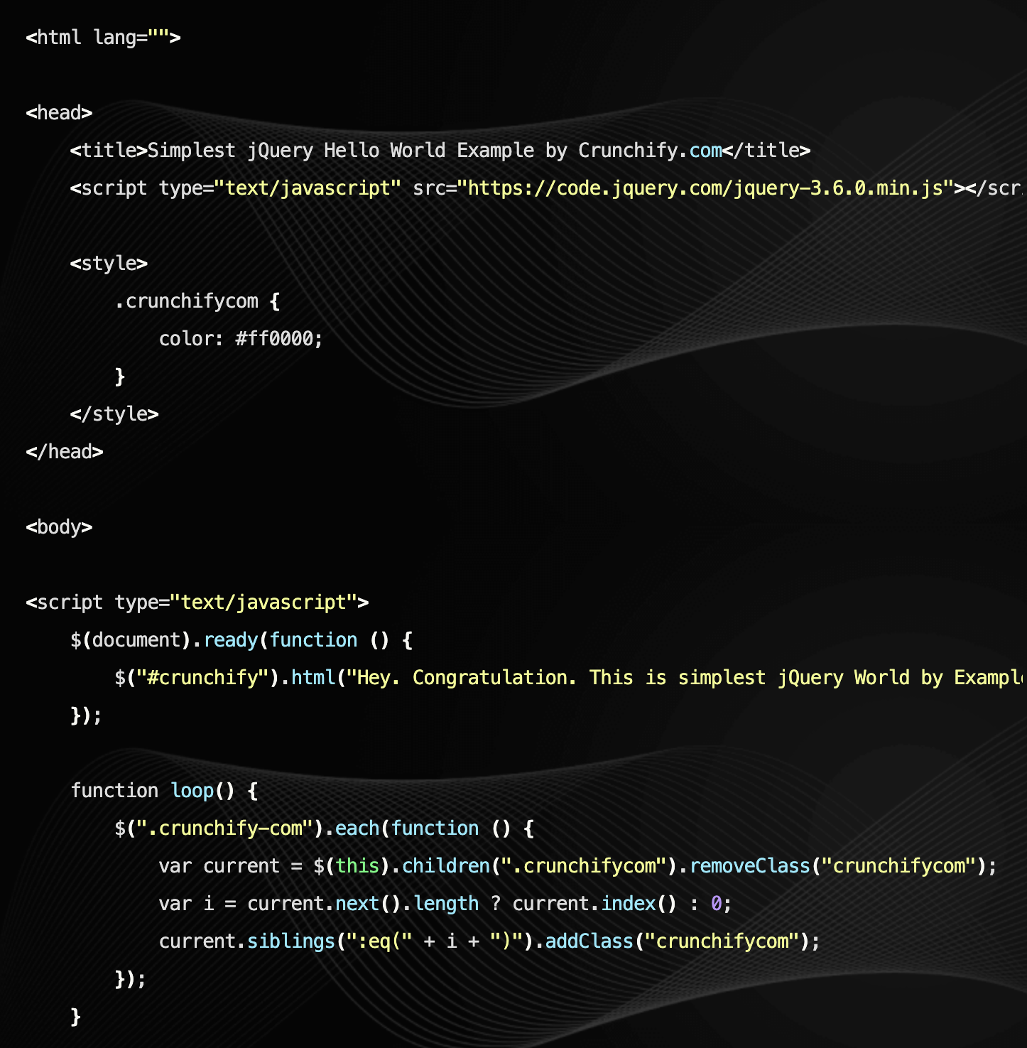
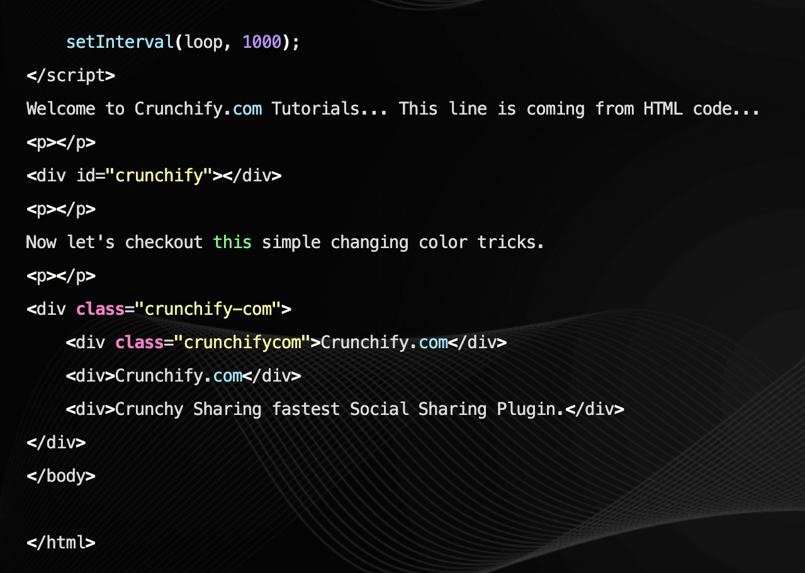
Web Framework Example w/ jQuery
jQuery is a small, fast, versatile, and feature-rich JavaScript library. It uses an API that works across a multitude of browsers which makes things like HTML document traversal & manipulation, event handling, animation, and Ajax much simpler.

Slide 44
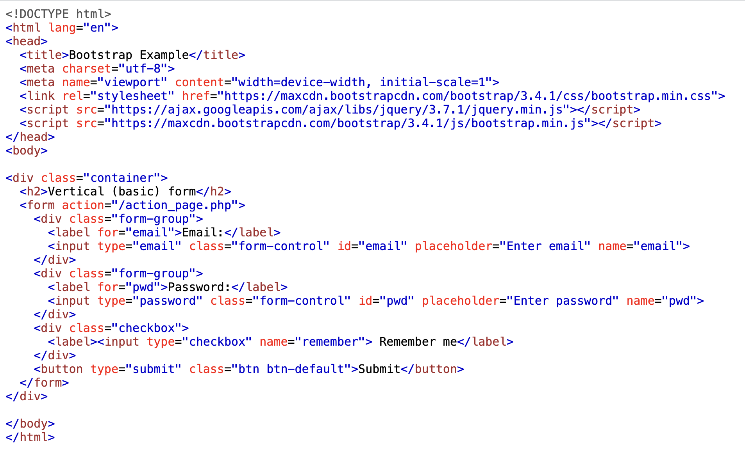
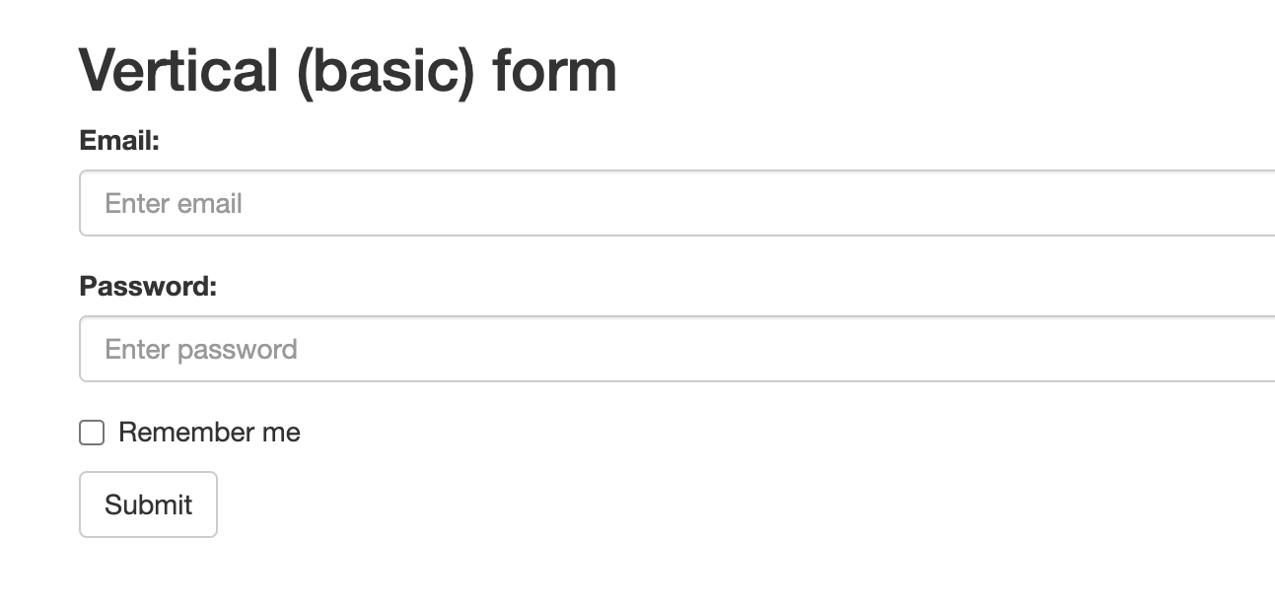
Web Framework Example w/ Bootstrap
Bootstrap is an open-source front-end framework. It provides HTML, CSS, and JavaScript components and tools which enables developers to easily build responsive websites.

Slide 45
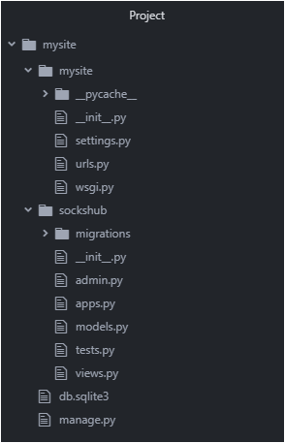
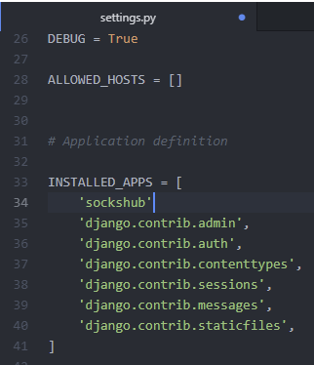
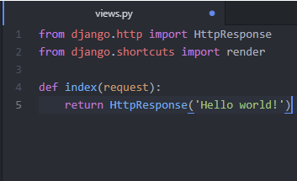
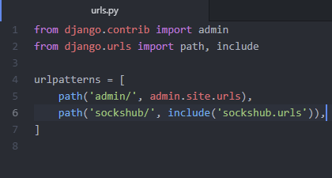
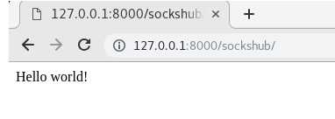
Web Framework Example w/ Django
Django is a high-level Python web framework built by experienced developers. It is free & open source and encourages rapid development and clean realistic design.
settings.py: configuration file
urls.py: links & templates
views.py: describe how to use or operate the model

Slide 46
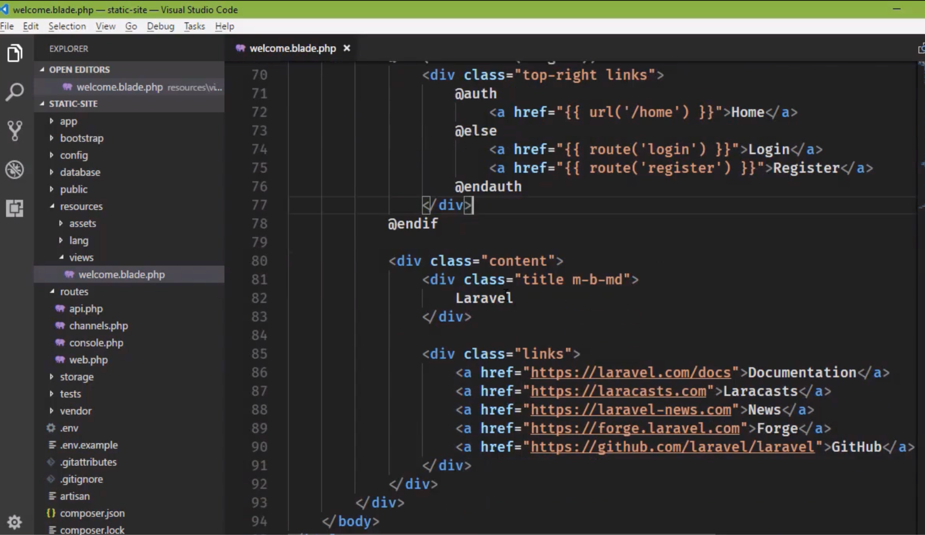
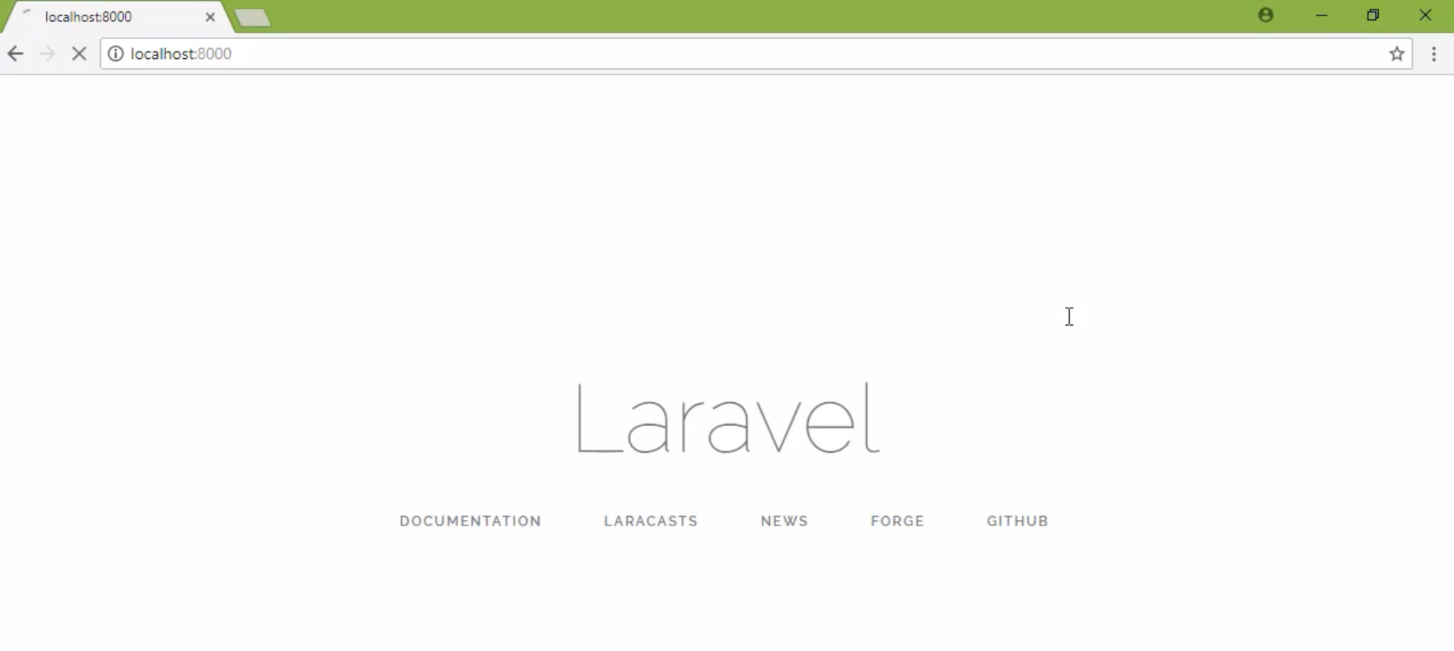
Web Framework Example w/ Laravel
Laravel is an open-source PHP framework with built-in features that help make developing apps easier and faster.
Some of these features include: automatic testing, a complete authentication system, a portable environment, object-relational mapping, a command-line interface, and more.

Slide 47
References:
https://www.techtarget.com/searchsoftwarequality/definition/Web-application-Web-app
https://www.codecademy.com/article/what-is-a-web-app
https://www.freecodecamp.org/news/what-are-progressive-web-apps/
https://jelvix.com/blog/pwa-vs-native-app-benefits-for-users-and-developers
https://developer.mozilla.org/en-US/docs/Web/Progressive_web_apps/Guides/Best_practices
https://onesignal.com/blog/what-is-a-pwa/
https://aws.amazon.com/what-is/lamp-stack/
https://www.ibm.com/docs/en/rational-soft-arch/9.6.1?topic=page-asynchronous-javascript-xml-ajax-overview
https://aws.amazon.com/what-is/ajax/#:~:text=Asynchronous%20JavaScript%20and%20XML%20
https://www.testgorilla.com/blog/ajax-web-development/
https://www.browserstack.com/guide/web-development-frameworks
https://jquery.com/
https://www.geeksforgeeks.org/bootstrap/
https://www.djangoproject.com/
https://dev.to/creativetim_official/what-is-laravel-explain-it-like-i-m-five-19eb
https://developer.mozilla.org/en-US/docs/Learn/Getting_started_with_the_web/The_web_and_web_standards
https://developer.mozilla.org/en-US/docs/Web/HTML#:~:text=HTML%20(HyperText%20Markup%20Language)%20is,functionality%2Fbehavior%20(JavaScript).
https://developer.mozilla.org/en-US/docs/Learn/CSS
https://developer.mozilla.org/en-US/docs/Web/JavaScript
https://www.simplilearn.com/applications-of-javascript-article
https://www.w3schools.com/js/js_ajax_examples.asp
https://steemit.com/utopian-io/@valium/2-or-hello-world-setting-views-py-and-urls-py-configuring-settings-py-django-tutorial
https://crunchify.com/simplest-jquery-hello-world-example/

